Slide 1
Sorting Techniques : Bubble, Insertion & Selection

Slide 2
Sorting
Sorting is a technique to rearrange the elements of a list in ascending or descending order, which can be numerical, or any user-defined order.
Sorting is a process through which the data is arranged in ascending or descending order.

Slide 3
Sorting
Sorting takes an unordered collection and makes it an ordered one.
1 2 3 4 5 6
77
42
35
12
101
5
1 2 3 4 5 6
5
12
35
42
77
101

Slide 4
Bubble Sort

Slide 5
Bubble Sort
It is very simple method that sorts the array elements by repeatedly moving the largest element to the highest index position of the array.
In bubble sorting consecutive adjacent pairs of the elements in the array are compared with each other. If the element at the lower index is greater than the element at the higher index the two elements are interchanged so that the smaller element is placed before bigger one.
In this technique, we compare each element with its neighbor to the right
If they are out of order, swap them
This puts the largest element at the very end
And repeat the procedure for rest of the array.

Slide 6
"Bubbling Up" the Largest Element
Traverse a collection of elements
Move from the front to the end
“Bubble” the largest value to the end using pair-wise comparisons and swapping
1 2 3 4 5 6
77
42
35
12
101
5

Slide 7
"Bubbling Up" the Largest Element
Traverse a collection of elements
Move from the front to the end
“Bubble” the largest value to the end using pair-wise comparisons and swapping
Swap
1 2 3 4 5 6
42
77
77
42
35
12
101
5

Slide 8
"Bubbling Up" the Largest Element
Traverse a collection of elements
Move from the front to the end
“Bubble” the largest value to the end using pair-wise comparisons and swapping
1 2 3 4 5 6
Swap
35
77
42
77
35
12
101
5

Slide 9
"Bubbling Up" the Largest Element
Traverse a collection of elements
Move from the front to the end
“Bubble” the largest value to the end using pair-wise comparisons and swapping
1 2 3 4 5 6
Swap
12
77
42
35
77
12
101
5

Slide 10
"Bubbling Up" the Largest Element
Traverse a collection of elements
Move from the front to the end
“Bubble” the largest value to the end using pair-wise comparisons and swapping
1 2 3 4 5 6
42
35
12
77
101
5
No need to swap

Slide 11
"Bubbling Up" the Largest Element
Traverse a collection of elements
Move from the front to the end
“Bubble” the largest value to the end using pair-wise comparisons and swapping
1 2 3 4 5 6
Swap
5
101
42
35
12
77
101
5

Slide 12
"Bubbling Up" the Largest Element
Traverse a collection of elements
Move from the front to the end
“Bubble” the largest value to the end using pair-wise comparisons and swapping
1 2 3 4 5 6
101
42
35
12
77
5
Largest value correctly placed

Slide 13
Items of Interest
Notice that only the largest value is correctly placed
All other values are still out of order
So we need to repeat this process
1 2 3 4 5 6
101
42
35
12
77
5
Largest value correctly placed

Slide 14
Repeat “Bubble Up” How Many Times?
If we have N elements…
And if each time we bubble an element, we place it in its correct location…
Then we repeat the “bubble up” process N – 1 times.
This guarantees we’ll correctly place all N elements.

Slide 15
Example of bubble sort
7
2
8
5
4
2
7
5
4
8
2
5
4
7
8
2
4
5
7
8
2
7
8
5
4
2
7
5
4
8
2
5
4
7
8
2
4
5
7
8
2
7
8
5
4
2
5
7
4
8
2
4
5
7
8
(done)
2
7
5
8
4
2
5
4
7
8
2
7
5
4
8
Pass 1.
Step1. If a[0]>a[1] then swap a[0] and a[1]
Step2. If a[1]>a[2] then swap a[1] and a[2]
Stepn-1. If a[n-2]>a[n-1] then swap a[n-2] and a[n-1]
Pass 2.
Step1. If a[0]>a[1] then swap a[0] and a[1]
Step2. If a[1]>a[2] then swap a[1] and a[2]
Stepn-2. If a[n-3]>a[n-2] then swap a[n-3] and a[n-2]
Pass k.
Step1. If a[0]>a[1] then swap a[0] and a[1]
Step2. If a[1]>a[2] then swap a[1] and a[2]
Step(n-k). If a[n-k+1]>a[n-k] then swap a[n-k+1] and a[n-k]

Slide 16
Algorithm analysis ( Bubble Sort)
After (n-1) passes the array will be sorted in ascending order.
As we have seen first pass requires (n-1) comparisons,
Second requires (n-2) passes and
kth requires (n-k) and
last requires only one comparisons

Slide 17
Code for bubble sort
void bubbleSort(int a[] , int n)
{ int k, inner,j;
for (k = 0; k < n-1; k++)
{ for ( j = 0; j < n-k ; j++)
{ if (a[j] > a[j + 1])
{ temp = a[j];
a[j] = a[j + 1]; a[j + 1] = temp; } } }}

Slide 18
Loop invariants
In this algorithm, the outer loop is for the total number passes which is n-1.
The inner loop will be executed for every pass. The frequency of inner loop will decrease with every pass because after every pass, one element will be in its correct position.
Therefore for every pass the inner loop will be executed (n-k) times, where n is the number of elements in the array and k is count of the pass.

Slide 19
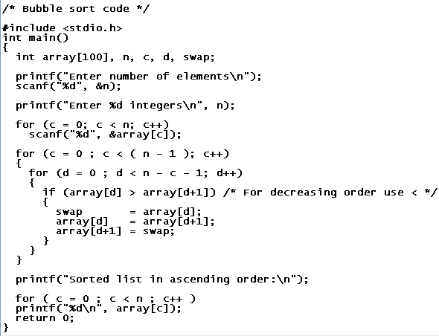
Program: Bubble Sort

Slide 20
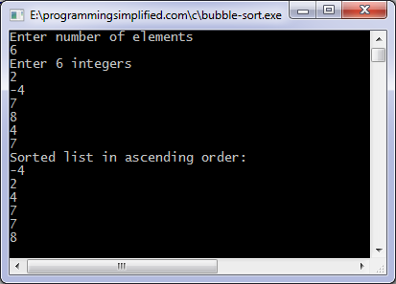
Output

Slide 21
Assignment
WAP for Bubble Sort using Functions

Slide 22
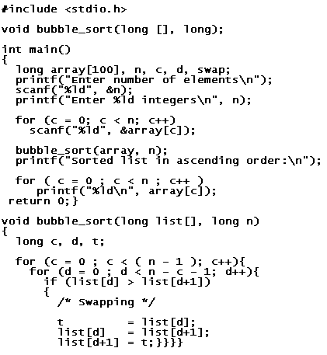
Bubble Sort Using Functions

Slide 23
Practice Example
Show the bubble sort results for each pass for the following initial array of elements.
35 18 7 12 5 23 16 3 1

Slide 24
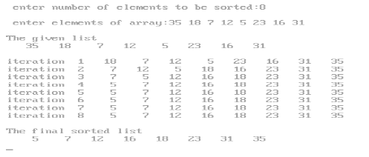
Output

Slide 25
Selection Sort

Slide 26
Selection sort
Given an array of length n,
Search elements 0 through n-1 and select the smallest
Swap it with the element in location 0
Search elements 1 through n-1 and select the smallest
Swap it with the element in location 1
Search elements 2 through n-1 and select the smallest
Swap it with the element in location 2
Search elements 3 through n-1 and select the smallest
Swap it with the element in location 3
Continue in this fashion until there’s nothing left to search

Slide 27
Example and analysis of selection sort
The selection sort might swap an array element with itself--this is harmless, and not worth checking for
Analysis:
The first pass requires n-1 comparisons to find the location loc of smallest element,
Second pass requires (n-2)…..and kth pass requires (n-k) and the last pass requires only one comparison
Work done in the inner loop is constant (swap two array elements)
Total comparison=f(n)=n(n-1)/2
F(n)=O(n²)
7
2
8
5
4
2
7
8
5
4
2
4
8
5
7
2
4
5
8
7
2
4
5
7
8

Slide 28
Code for Selection sort
void selectionSort(int a[], int n)
{ int i, temp, j, min;
for (i= 1; i <= n - 1; i++)
{ min = a[i-1];
for (j = i; j < n-1; j++)
{ if (a[j] < min)
{ min = a[j];
loc = j; }}
if(loc!=i-1)
{temp = a[i-1]; a[i-1] = a[loc]; a[loc] = temp; } }

Slide 29
Insertion Sort

Slide 30
Insertion Sort
Idea: like sorting a hand of playing cards
Start with an empty left hand and the cards facing down on the table.
Remove one card at a time from the table, and insert it into the correct position in the left hand
compare it with each of the cards already in the hand, from right to left
The cards held in the left hand are sorted
these cards were originally the top cards of the pile on the table

Slide 31
Insertion Sort
To insert 12, we need to make room for it by moving first 36 and then 24.
6
10
24
36
12

Slide 32
Insertion Sort
6
10
24
36
12

Slide 33
Insertion Sort
6
10
24
36
12

Slide 34
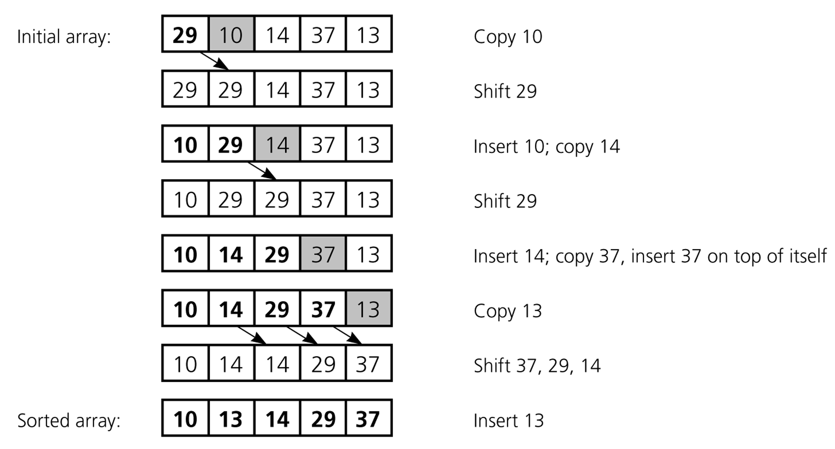
Insertion Sort Example
An insertion sort of an array of five integers

Slide 35
Insertion Sort Algorithm
void insertionSort(int a[], int n) {
int j, temp;
for (int i = 1; i < n-1; i++) {
temp = arr[i];
j = i-1;
while (a[j]>temp && j >= 0) {
a[j+1] = a[j];
j=j-1;
}
arr[j+1] = temp;
}
}

Slide 36
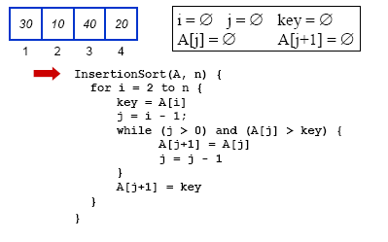
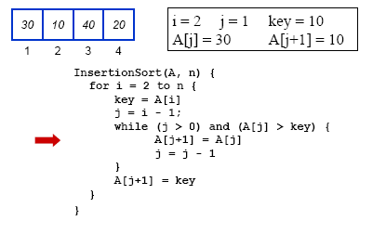
Example

Slide 37
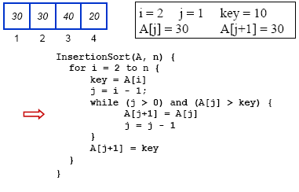
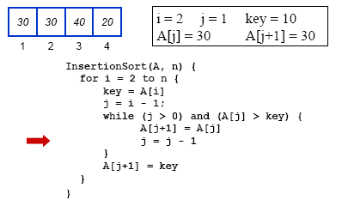
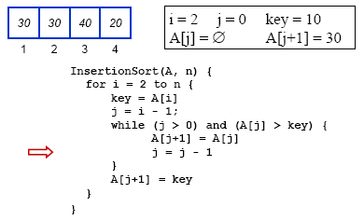
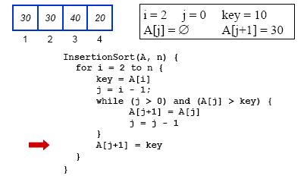

Slide 38
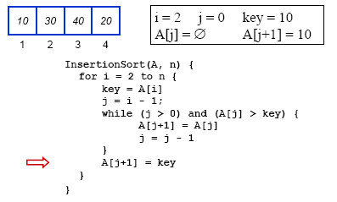
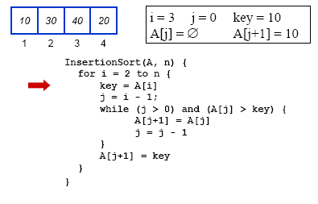
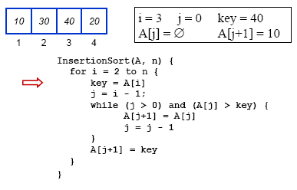
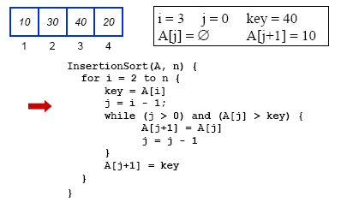

Slide 39
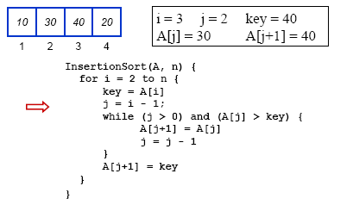
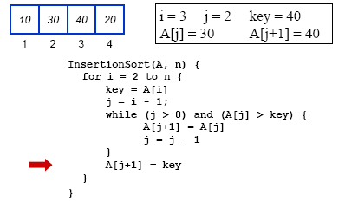
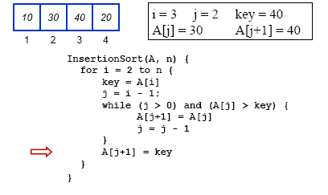
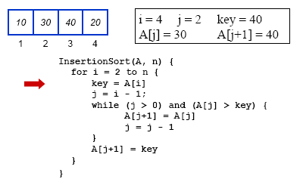

Slide 40
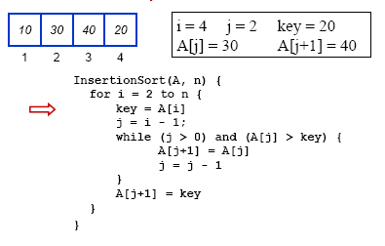
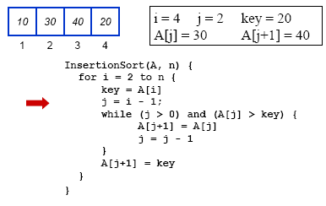
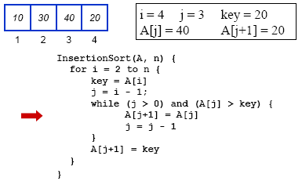
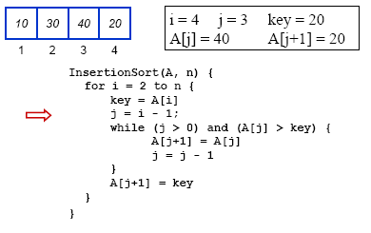

Slide 41
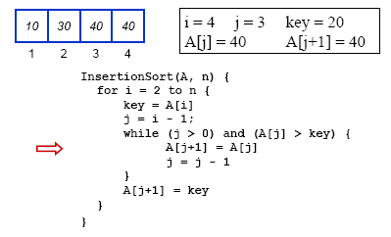
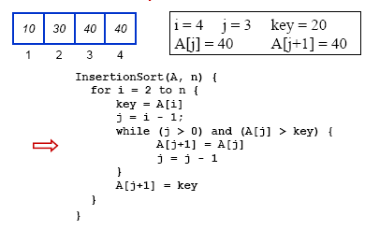
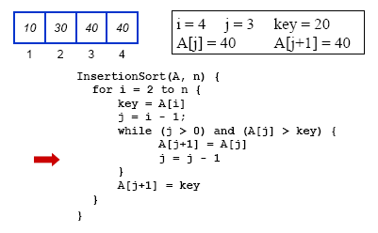
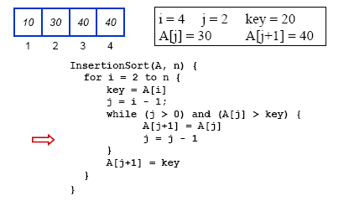

Slide 42
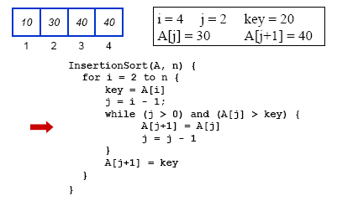
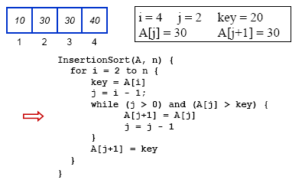
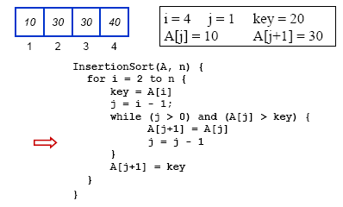
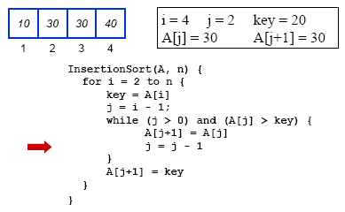

Slide 43

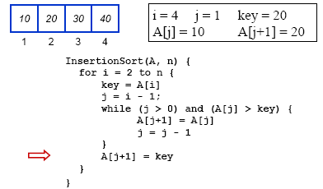
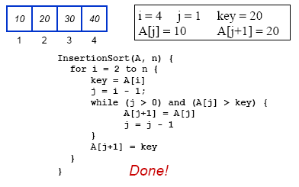

Slide 44
Insertion Sort: Cost Function
1 operation to initialize the outer loop
The outer loop is evaluated n-1 times
5 instructions (including outer loop comparison and increment)
Total cost of the outer loop: 5(n-1)
How many times the inner loop is evaluated is affected by the state of the array to be sorted

Slide 45
Advantages of insertion sort
It is easy to implement and efficient to use on small sets of data.
It can be efficiently implemented on data sets that are substantially sorted.
It requires less memory space.

Slide 46
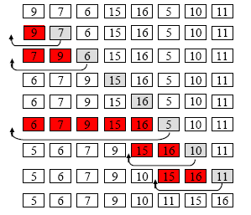
Insertion Sort Execution Example

Slide 47
Summary
Bubble sort, selection sort, and insertion sort are all O(n²)
As we will see later, we can do much better than this with somewhat more complicated sorting algorithms
Within O(n²),
Bubble sort is very slow, and should probably never be used for anything
Selection sort is intermediate in speed
Insertion sort is usually the fastest of the three--in fact, for small arrays (say, 10 or 15 elements), insertion sort is faster than more complicated sorting algorithms
Selection sort and insertion sort are “good enough” for small arrays

