Slide 1
LESSON PLAN
Class: XII D Subject: COMPUTER SCIENCE
AIM: To improvise their skills of programming and arouse their interest in the other related topics.
TOPICS:
SORTING IN ARRAYS

Slide 2
SORTING
The process of arranging the array elements in increasing (ascending) or decreasing (descending)order is known as sorting. There are several sorting techniques are available.
1. Selection sort,
2. Insertion sort,
3. Bubble sort,
4. Quick sort, heap short etc.

Slide 3
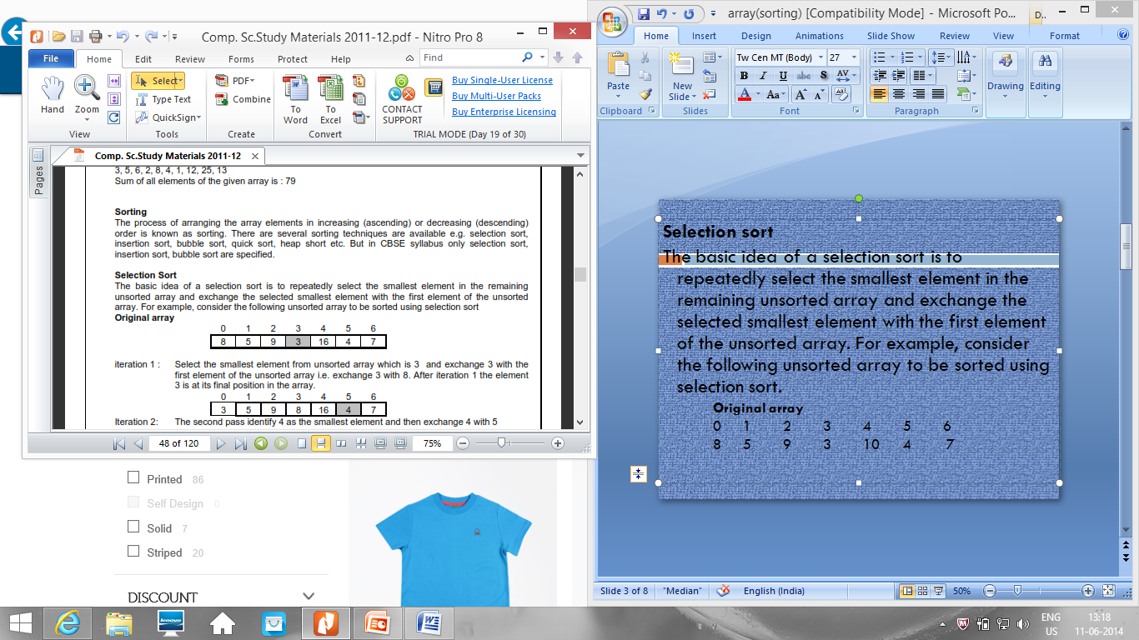
Selection sort
The basic idea of a selection sort is to repeatedly select the smallest element in the remaining unsorted array and exchange the selected smallest element with the first element of the unsorted array. For example, consider the following unsorted array to be sorted using selection sort.

Slide 4
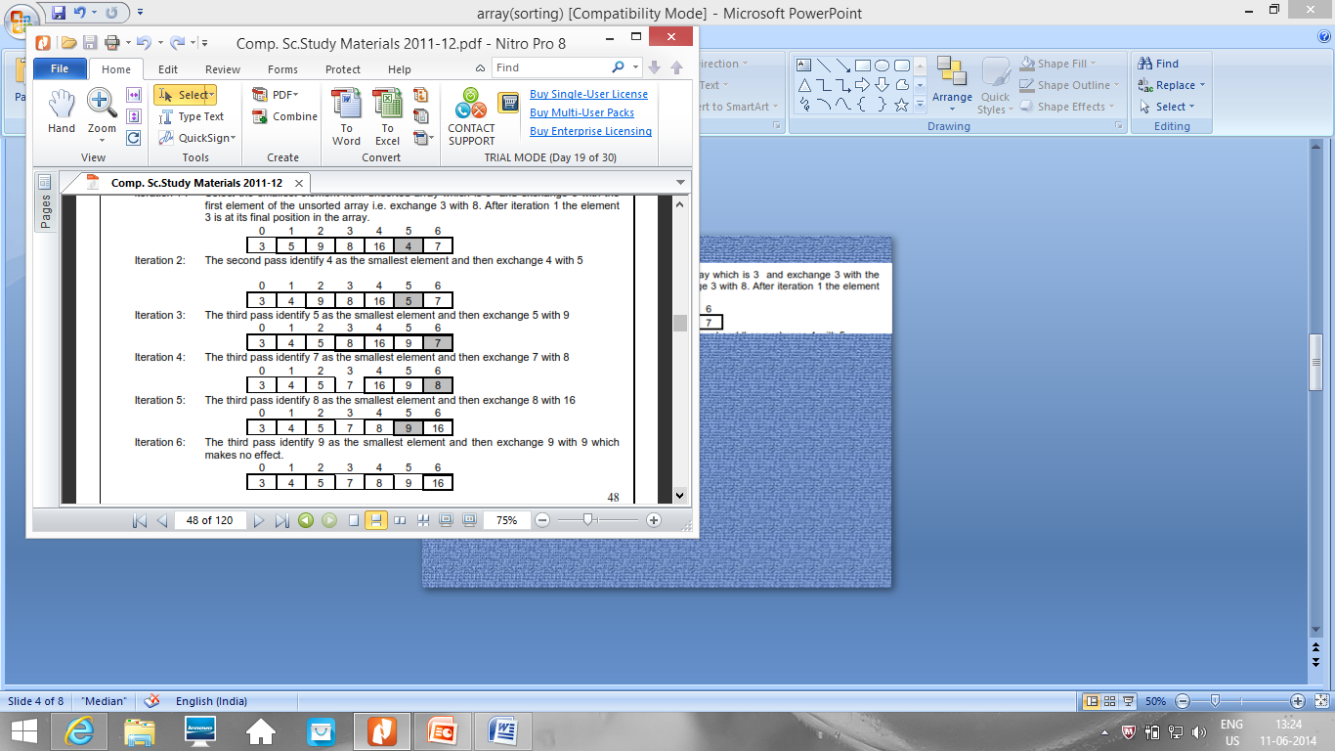

Slide 5
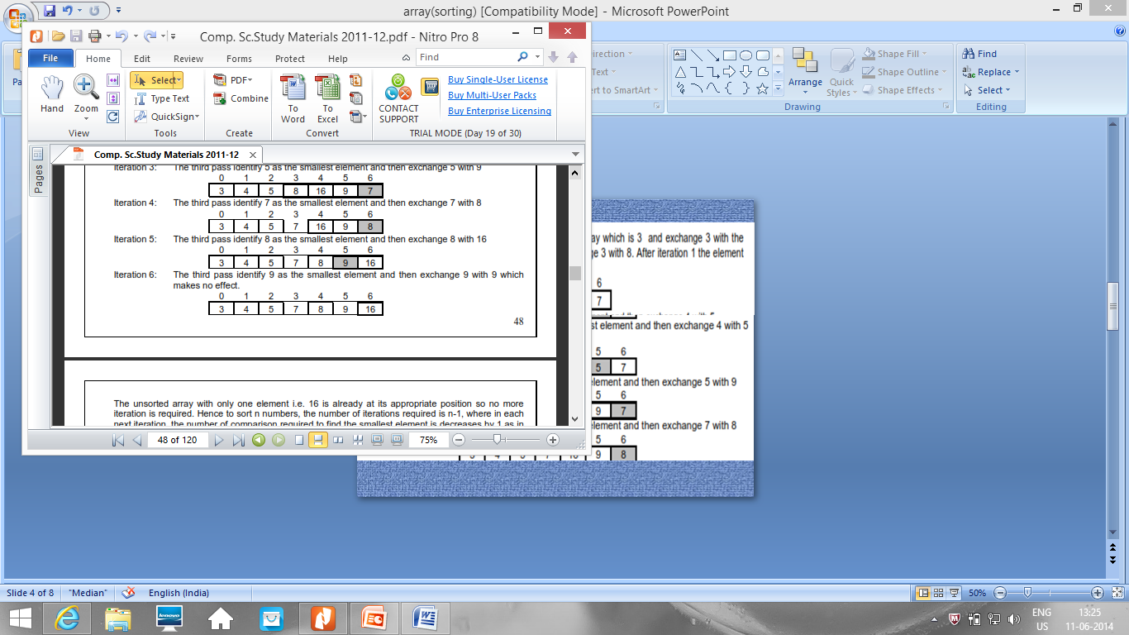

Slide 6
#include<iostream.h>
void select_sort(int a[ ], int n)
{int i, j, p, small;
for(i=0;i<n-1;i++)
{small=a[i];
p=i;
for(j=i+1; j<n; j++)
{ if(a[j]<small)
{ small=a[j];
p=j;
}
} a[p]=a[i];
a[i]=small; }}

Slide 7
Insertion Sort
Insertion sort algorithm divides the array of n elements in to two subparts, the first subpart contain a[0]
to a[k] elements in sorted order and the second subpart contain a[k+1] to a[n] which are to be sorted.
The algorithm starts with only first element in the sorted subpart because array of one element is itself
in sorted order. In each pass, the first element of the unsorted subpart is removed and is inserted at
the appropriate position in the sorted array so that the sorted array remain in sorted order.

Slide 8
int binary_search(int a[ ], int size, int item)
{ int first=0,last=size-1,middle;
while(first<=last)
{ middle=(first+last)/2;
if(item==a[middle])
return middle; // item is found
else if(item< a[middle])
last=middle-1;
else
first=middle+1;
}
return -1; //given item is not present in the array
}

