Slide 1


Slide 2
Program to convert Infix into Postfix
void main()
{
int i=0, j=0;
char infix_exp[SIZE], postfix_exp[SIZE];
char item, x;
printf("\nEnterthe arithmetic expression in Infix notation:");
gets(infix_exp);
item = infix_exp[i++];

Slide 3
//Read symbol from Input string one at a time.
while(item != '\0')
{ //If the symbol is left parenthesis
if(item == '(')
{ push(item);}
//If the symbol is an operand
else if((item >= 'A' && item <= 'Z') || (item >= 'a' && item <= 'z'))
{ postfix_exp[j++] = item;}
//If the symbol is an operator
else if(is_operator(item) == 1)
{ x = pop();
while(is_operator(x) == 1 && precedence(x) >= precedence(item))
{
postfix_exp[j++] = x;
x = pop(); }
push(x);
push(item); }
//If the symbol is a right parenthesis
else if(item == ')')
{
x = pop();
while(x != '(')
{
postfix_exp[j++] = x;
x = pop(); } }

Slide 4
//If the symbol is any other invalid character
else {
printf("\nInvalid Arithmetic Expression.\n");
getch();
exit(0);}
item = infix_exp[i++]; }
postfix_exp[j++] = '\0';
printf("\nArithmetic expression in Postfix notation: ");
puts(postfix_exp);
}
//Function to check whether the symbol is an operator.
int is_operator(char symbol)
{
if(symbol == '^' || symbol == '*' || symbol == '/' || symbol == '+' || symbol == '-')
{ return 1; }
else
{ return 0; }
}
//Function which returns the precedence of the operator.
int precedence(char symbol)
{ if(symbol == '^')
{ return(3); }
else if(symbol == '*' || symbol == '/')
{ return(2); }
else if(symbol == '+' || symbol == '-')
{ return(1); }
else
{ return(0); }
}

Slide 5
//Function for push operation
void push(char item)
{
if(top >= SIZE-1)
{
printf("\nStack Overflow. Push not possible.\n");
}
else
{
top = top+1;
stack[top] = item;
}
}
//Function for pop operation
char pop()
{
char item = NULL;
if(top <= -1)
{
printf("\nStack Underflow. Pop not possible.\n");
}
else
{
item = stack[top];
stack[top] = NULL;
top = top-1;
}
return(item);
}

Slide 6
POSTFIX
In Postfix notation the expression is scanned from left to right. When a number is seen it is pushed onto the stack; when an operator is seen the operator is applied to the two numbers popped from the stack and the result is pushed back to the stack.
Ex: 6 5 2 3 + 8 * + 3 + * is evaluated as follows:

Slide 7
C code of Postfix Calculations
#include<stdio.h>
#include<stdlib.h>
#define STACKSIZE 20
typedef struct{
int top;
int items[STACKSIZE];
}STACK;
void push(STACK *, int);
int pop(STACK *);
int calculate(char []);

Slide 8
int main()
{
int result;
char E[50];
printf("Enter your Postfix expression(don't use space character):\n");
scanf("%s",E);
result = calculate(E);
printf("The result of the Postfix expression %s=%d\n",E,result);
return 0;
}

Slide 9
int calculate(char exp[])
{
STACK s;
s.top =-1; /*indicates that the stack is empty at the beginning*/
int i,num1,num2,value;
for(i=0; exp[i]!='\0';i++)
{
if(exp[i] >='0' && exp[i] <='9') /*checks if exp[i] has a digit*/
push(&s,(int)(exp[i] -'0')); /*converts digit into integer*/
else{
num1=pop(&s);
num2=pop(&s);
switch(exp[i]){
case '+': value=num2+num1;break;
case '-': value=num2-num1;break;
case '*': value=num2*num1;break;
case '/': value=num2/num1;break;
default : printf("Illegal Operator\n");
exit(1);
}
push(&s,value);
}
}
return pop(&s);}

Slide 10
void push(STACK *Sptr, int ps) /*pushes ps into stack*/
{
if(Sptr->top == STACKSIZE-1){
printf("Stack is full\n");
exit(1); /*exit from the function*/
}
else {
Sptr->top++;
Sptr->items[Sptr->top]= ps;
}
}
int pop(STACK *Sptr)
{
int pp;
if(Sptr->top == -1){
printf("Stack is empty\n");
exit(1); /*exit from the function*/
}
else {
pp = Sptr->items[Sptr->top];
Sptr->top--;
}
return pp;
}

Slide 11
Circular Queues and DeQueue

Slide 12
Limitation of
Array Implementation of Queue

Slide 13
INSERT / REMOVE ITEMS
Assume that the rear= MAXQUEUE-1
items[MAXQUEUE-1] | X | rear=MAXQUEUE-1
. | .
. | .
items[3] | D | front=3
items[2] | C
items[1] | B
items[0] | A
What happens if we want to insert a new item into the queue?

Slide 14
INSERT / REMOVE ITEMS
What happens if we want to insert a new item F into the queue?
Although there is some empty space, the queue is full.
One of the methods to overcome this problem is to shift all the items to occupy the location of deleted item.

Slide 15
REMOVE ITEM
items[MAXQUEUE-1]
. | .
. | .
items[3] | D | Rear=3
items[2] | C
items[1] | B | Front=1
items[0] | A

Slide 16
REMOVE ITEM
items[MAXQUEUE-1]
. | .
. | .
items[3] | D | Rear=3
items[2] | C
items[1] | B | Front=1
items[0] | B

Slide 17
REMOVE ITEM
items[MAXQUEUE-1]
. | .
. | .
items[3] | D | Rear=3
items[2] | C
items[1] | C
items[0] | B

Slide 18
REMOVE ITEM
items[MAXQUEUE-1]
. | .
. | .
items[3] | D | Rear=3
items[2] | D
items[1] | C
items[0] | B

Slide 19
REMOVE ITEM
items[MAXQUEUE-1]
. | .
. | .
items[3] | D
items[2] | D | Rear=2
items[1] | C
items[0] | B | Front =0

Slide 20
Modified Remove Operation
  char remove(struct queue *qptr)
  {
  char p;
  int i;
  if(qptr->front > qptr->rear){
  printf("Queue is empty");
  exit(1);
  }
  else
  {
  p=qptr->items[qptr->front];
  for(i=1;i<=qptr->rear;i++)
  qptr->items[i-1]=qptr->items[i];
  qptr->rear--
  return p;
  } }

Slide 21
INSERT / REMOVE ITEMS
Since all the items in the queue are required to shift when an item is deleted, this method is not preferred.
The other method is circular queue.
When rear = MAXQUEUE-1, the next element is entered at items[0] in case that spot is free.

Slide 22
Initialize the queue.
items[6] |  | front=rear=-1
items[5]
items[4]
items[3]
items[2]
items[1]
items[0]

Slide 23
Insert items into circular queue
Insert A,B,C to the rear of the queue.
items[6]
items[5]
items[4]
items[3]
items[2]
items[1] |  | Front =0
items[0] | A | rear=0

Slide 24
Insert items into circular queue
Insert A,B,C to the rear of the queue.
items[6]
items[5]
items[4]
items[3]
items[2]
items[1] | B | rear=1
items[0] | A | front=0

Slide 25
Insert items into circular queue
Insert A,B,C to the rear of the queue.
items[6]
items[5]
items[4]
items[3]
items[2] | C | rear=2
items[1] | B
items[0] | A | front=0

Slide 26
Remove items from circular queue
Remove two items from the queue.
items[6]
items[5]
items[4]
items[3]
items[2] | C | rear=2
items[1] | B
items[0] | A | front=1

Slide 27
Remove items from circular queue
Remove two items from the queue.
items[6]
items[5]
items[4]
items[3]
items[2] | C | rear=2
items[1] | B | front=2
items[0] | A

Slide 28
Remove items from circular queue
Remove one more item from the queue.
items[6]
items[5]
items[4]
items[3]
items[2] | C | rear=front=-1
items[1] | B
items[0] | A

Slide 29
Insert D,E,F,G to the queue.
items[6] | G | rear=6
items[5] | F
items[4] | E
items[3] | D | front=3
items[2] | C
items[1] | B
items[0] | A

Slide 30
Insert H and I to the queue.
items[6] | G
items[5] | F
items[4] | E
items[3] | D | front=3
items[2] | C
items[1] | B
items[0] | H | rear=0

Slide 31
Insert H and I to the queue.
items[6] | G
items[5] | F
items[4] | E
items[3] | D | front=3
items[2] | C
items[1] | I
items[0] | H | rear=1

Slide 32
Insert J to the queue.
items[6] | G
items[5] | F
items[4] | E
items[3] | D | front=3
items[2] | ?? | rear=2
items[1] | I
items[0] | H

Slide 33
Circular Queue Program
#include<stdio.h>
#define max 5
int front, rear, q[max];
void main()
{
int c;
front =rear= -1;
do
{
printf("1:insert\n2:deletion\n3:display\n4:exit\nenter choice:");
scanf("%d",&c);
switch(c)
{
case 1:enqueue();break;
case 2:dequeue();break;
case 3:qdisplay();break;
case 4:printf("pgm ends\n");break;
default:printf("wrong choice\n");break;
}
}while(c!=4);
}

Slide 34
void enqueue(void)
{
int x;
if((front==0&&rear==max-1) || (front==rear+1))
{ printf("Queue is overflow\n"); return; }
if(front == -1)
front=rear=0;
else
{ if(rear==max-1)
rear=0;
else
rear++;
}
printf("enter the no:\n");
scanf("%d",&x);
q[rear]=x;
return; }

Slide 35
void dequeue()
{
int y;
if(front == -1)
{ printf("q is underflow\n");return; }
y=q[front];
if(front==rear)
front=rear= -1;
else
{
if(front==max-1)
front=0;
else
front++;
}
printf("%d succ. deleted\n",y);
return;
}

Slide 36
void qdisplay()
{
int i,j;
if(front==rear==-1)
printf("q is empty\n");return;
printf("elements are :\n");
for(i=front; i!=rear; i=(i+1)%max)
{
printf("%d\n",q[i]);
}
printf("%d\n",q[rear]);
return;
}

Slide 37
Double Ended Queues
(Deques)

Slide 38
Double Ended Queues(Deques)
It is a homogeneous list of elements in which insertion and deletion operations are performed from both the ends i.e, we can insert elements from the rear end or from the front ends.
A deque is a double-ended queue—items can be inserted and removed at either end

Slide 39
Types of Deques
There are two types of deques. These two types are due to the restrictions put to perform either the insertions or deletions only at the end.
They are :
  Input Restricted Deque
    Elemnts can be removed from both ends
    Elements can be inserted only at one end
  Output Restricted Deque
    Elements can be inserted from both ends
    Elements can be removed only at one end

Slide 40
Double Ended Queues(Deques)
Four Operations :
1=> Insertion of an element at the REAR end of the queue
2=> Deletion of an element from the FRONT end of the queue
3=> Insertion of an element at the FRONT end of the queue
4=> Deletion of an element from the REAR end of the queue
For an input-restricted deque only the operations 1,2,4 are valid.
And for an output-restricted deque only the operations specified in 1,2,3 are valid.

Slide 41
Array Implementation

Slide 42
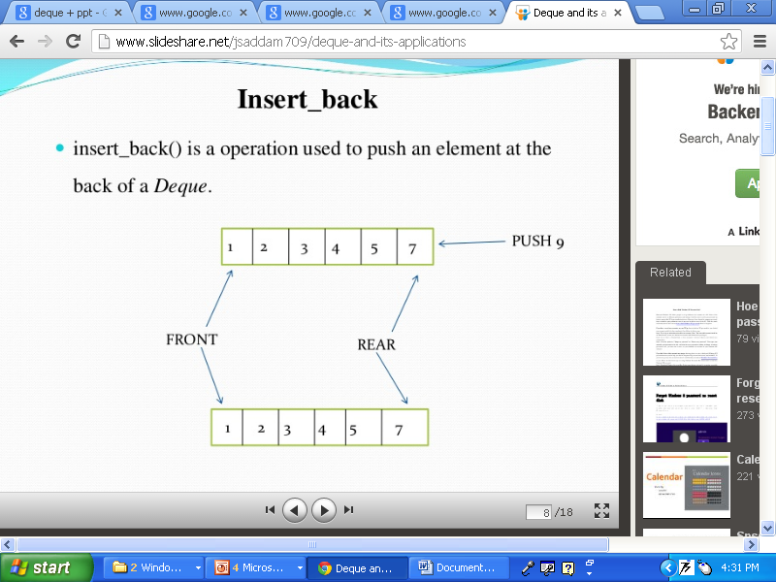
a) Insertion of an element at the REAR end of the queue
This operation inserts element at the rear side of a Deque
dqinsert_rear 9
1 | 2 | 3 | 4 | 5 | 7 | 9

Slide 43
a) Insertion of an element at the REAR end of the queue
void dqinsert_rear(int q[10], int front, int rear,int item,int MAXSIZE)
{
if(rear == (MAXSIZE-1))
{
printf(" QUEUE is full ");
return;
}
rear=rear+1;
q[rear]=item;
}

Slide 44
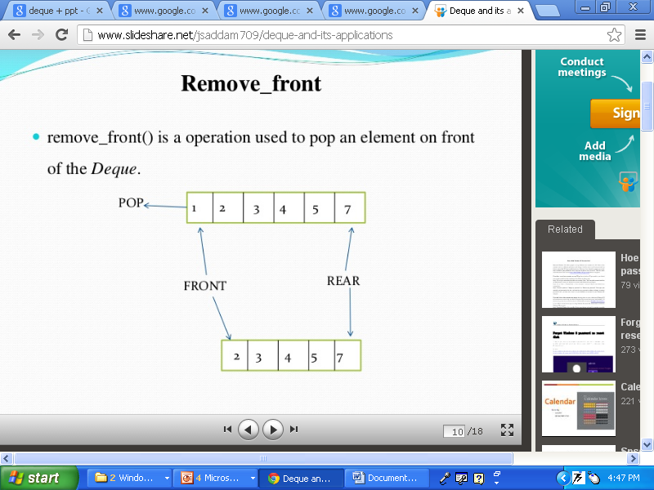
b) Deletions of an element from the FRONT end of the queue
This operation is used to delete an element from front end of deque
dqdelete_front

Slide 45
b) Deletions of an element from the FRONT end of the queue
void dqdelete_front(int q[10],int front,int rear,int item)
{
if(front== rear+1)
{
printf(" QUEUE is empty ");
return;
}
item=q[front];
front=front+1;
}

Slide 46
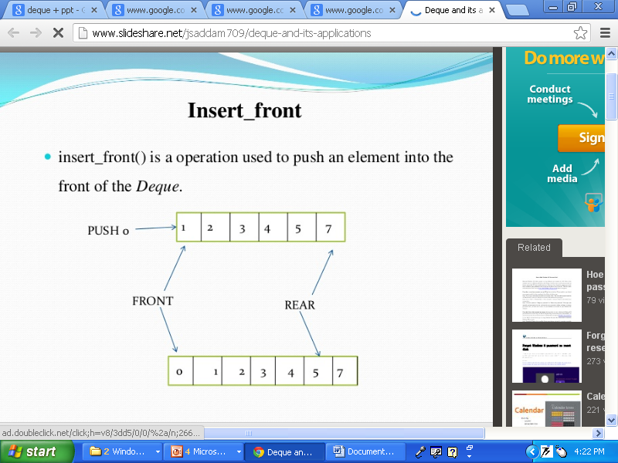
3) Insertion of an element at the FRONT end of the queue
This operation inserts an element at the FRONT end of the queue.
Dqinsert_front

Slide 47
3) Insertion of an element at the FRONT end of the queue
void dqinsert_front(int q[10], int front, int rear, int item)
{
if(front == 0)
{
printf(" QUEUE is full");
return;
}
front=front-1;
q[front]=item;
}

Slide 48

d) Deletion of an element from the REAR end of the queue
This operation is used to delete an element from rear end.
dqdelete_rear

Slide 49
d) Deletion of an element from the REAR end of the queue
void dqdelete_rear( int q[10], int front, int rear, int item)
{
if(front == rear+1)
{
printf(" QUEUE is empty ");
return;
}
item=q[rear];
rear=rear-1;
}

Slide 50
END

