Slide 1
LINKED LIST

Slide 2
Linked Lists
A linked list is a linear collection of data elements, called nodes, where the linear order is given by means of pointers.
Each node is divided into two parts:
The first part contains the information of the element and
The second part contains the address of the next node (link /next pointer field) in the list.

Slide 3
Definition
A linked list is simply a chain of structures which contain a pointer to the next element.
It is dynamic in nature. Items may be added to it or deleted from it at will.
Types of LL
– Singly Linked Lists
– Doubly Linked Lists
– Circular Lists
This definition applies only to Singly Linked Lists - Doubly Linked Lists and Circular Lists are different.

Slide 4
The composition of a Linked List
Each node in a linked list contains one or more members that represent data.
In addition to the data, each node contains a pointer, which can point to another node.
Data members
Pointer

Slide 5
Linked Lists
A linked list is called "linked" because each node in the series has a pointer that points to the next node in the list.
Head: pointer to the first node
The last node points to NULL

Slide 6
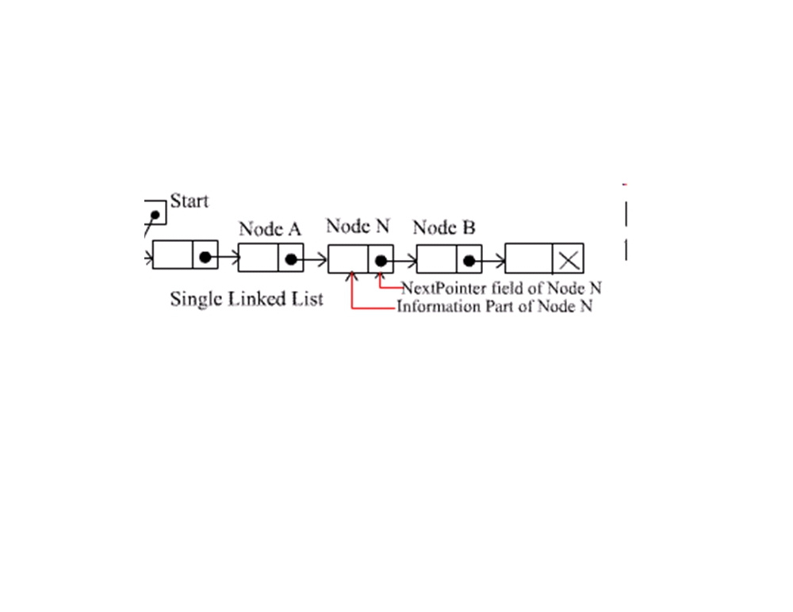
A list item has a pointer to the next element, or to 0 if the current element is the tail (end of the list). This pointer points to a structure of the same type as itself.
This structure that contains elements and pointers to the next structure is called a Node.

Slide 7
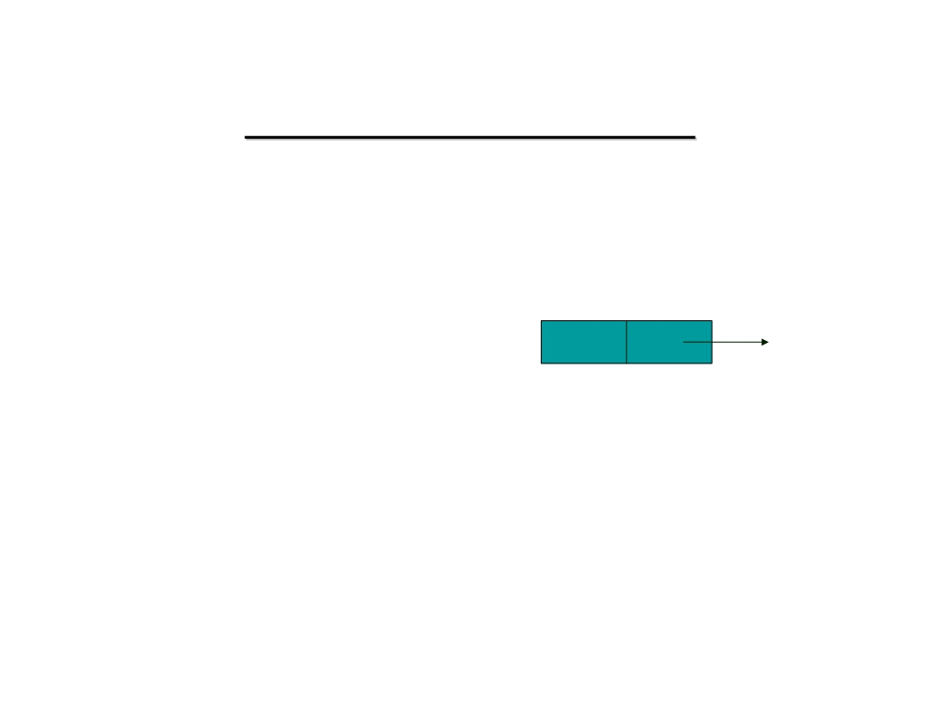
Linked List Implementation
• We can define structures with pointer fields that refer to the structure type containing them
struct list {
int data;
data next
struct list *next; }
• The pointer variable next is called a link. Each structure is linked to a succeeding structure by way of the field next. The pointer variable next contains an address of either the location in memory of the successor struct list element or the special value NULL.
Data Structure, 2012

Slide 8

Basic Operations on a Linked List
1. Traverse (walk) the list.
Given a pointer to the first node of the list, step through the nodes of the list
2. Search for a node
3. Add/Insert a node.
4. Delete a node.
Data Structure, 2012

Slide 9

Implementation in C
Creation, Traversal, Display and Search
Data Structure, 2012

Slide 10
Creation of Single Linked List
Step 1: Include header files
Step 2: Define Node Structure
Step 3: Create Node
Step 4: Fill information
Step 5: Create first node
Step 6: Create 2nd or nth node

Slide 11
SELF REFERENTIAL STRUCTURE FOR LINKED LIST DECLARATION
typedef struct list_node *list_ptr;
typedef struct list_node {
char data[15];
list_ptr link;
}
list_ptr ptr = NULL;

Slide 12
A PROGRAM TO CREATE A TWO NODE LIST
list_ptr create( )
{
/* create a linked list with two nodes */
list_ptr first, second;
first = (list_ptr) malloc(sizeof (list_node));
second = (list_ptr) malloc(sizeof (list_node));
second ->link = NULL;
second -> data = 100;
first -> data = 10;
first -> link = second;
return first;

Slide 13
A TWO NODE LIST
ptr
10
20
NULL

Slide 14

Creation of Single Linked List
void create() {
else {
char ch; do
current->next=new; current=new;
{
}
struct node *new,*current, *start; new =(struct node *)malloc(sizeof(struct node));
printf("\n Press any key to create another node: ");
ch=getche();
printf("\nEnter the data : "); scanf("%d",&new->data); new->next=NULL;
}while(ch!='n');
printf(“Single linked list is created \n"); }
if(start==NULL) {
start=new; current=new;
}
Data Structure, 2012

Slide 15
TRAVERSING A LINKED LIST
//new: head points to a dynamic linked list
new = start ;
while (new != NULL) {
printf (“%s”, new->data);
new = new->next;
}

Slide 16
Function to traverse linked list
Void display( struct node *start)
{
struct node *new;
new = start;
do {
printf(“%d”, new->data);
new = new->next;
} while(new!=NULL);
}

Slide 17
Simple linear linked list constructed in c. Adding 10 nodes into the list. Nodes consists 1 to 10 integers.

Slide 18
#include "stdio.h"
#include "stdlib.h"
struct Node
{
int data;
struct Node *next;
};
typedef struct Node node;
int main(){
node *newnode,*head,*first;
int i;
head=NULL;
first=NULL;
for(i=1;i<=10;i++) {
newnode=(node*)malloc(sizeof(node));
newnode->data=i
newnode-> next = NULL;
if(head==NULL){
head=newnode;
first=newnode; }
else
{head->next=newnode;
head=newnode; }
}
//Print the nodes in the list
newnode=first;
while(newnode!=NULL) {
printf("%d\t",newnode->data);
newnode=newnode->next; }}

Slide 19

Insertion of a node
Data Structure, 2012

Slide 20

Add / Insert a node
• There are four steps to add a node to a linked list:
– Create a new node ( Allocate for the new node).
– Determine the insertion point
– Point the new node to its successor.
– Point the predecessor to the new node.
Data Structure, 2012

Slide 21

Possible cases of InsertNode
1. Insert into an empty list
2. Insert in front
3. Insert at back
4. Insert in middle
But, in fact, only need to handle two cases
– Insert as the first node (Case 1 and Case 2)
– Insert in the middle or at the end of the list (Case 3 and Case 4)
Data Structure, 2012

Slide 22
OPERATIONS ON SINGLY LINKED LIST
void addfirst();
void addlast();
void addmid();

Slide 23

Case 1: Insert as 1st node
• Create a node
• Fill data
• Make its next pointing to Null
• Attach this newly created node to start
• Make new node as Starting node
Data Structure, 2012

Slide 24
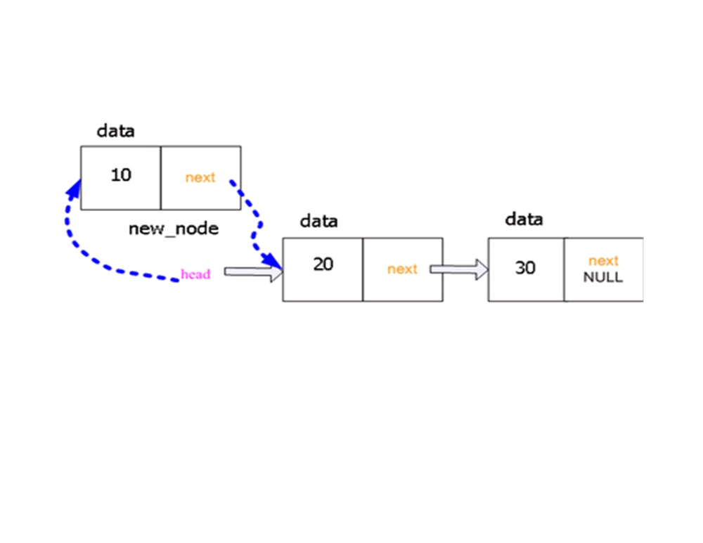
Data Structure, 2012

Slide 25
Adding a node in the beginning
void addfirst()
{
struct node *temp;
temp=(node *)malloc(sizeof(node));
printf("Enter the data....\t");
scanf("%d",&temp->item);
temp->next=head;
head=temp;
}

Slide 26

Insertion at End
• Create a node
• Fill data
• Make its next pointing to Null
• Traverse the list up to last node
• Make link between last node and new node.
Data Structure, 2012

Slide 27
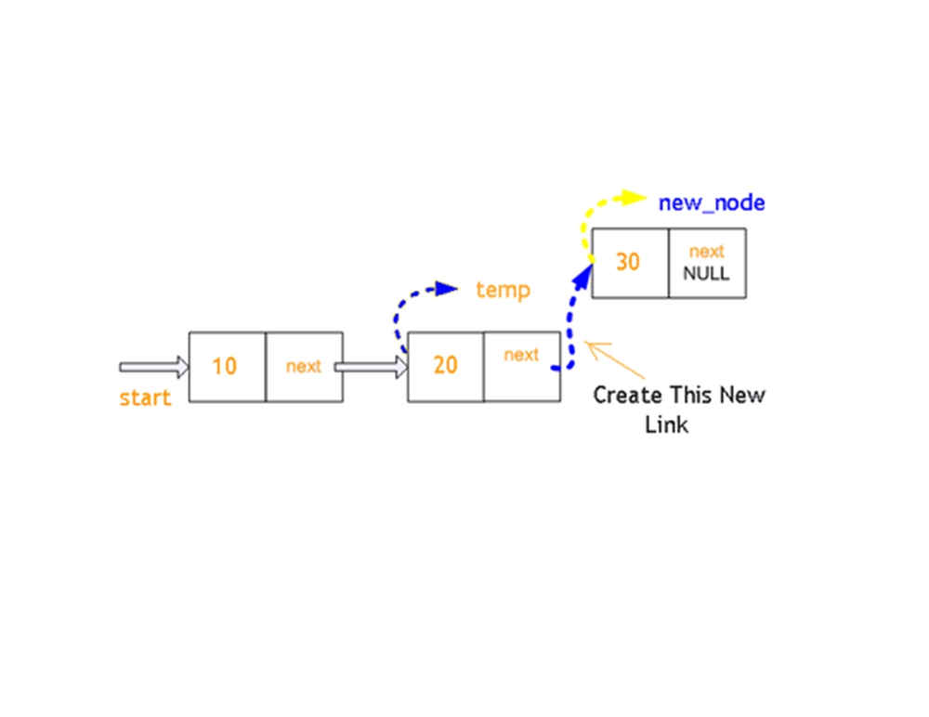
Data Structure, 2012

Slide 28
Adding a node in the last
void addlast()
{
Struct node *temp,*cur;
cur=head;
temp=(node *)malloc(sizeof(node));
printf("\nEnter the data....");
scanf("%d",&temp->item);
temp->next=NULL;
while(cur->next!=NULL){
cur=cur->next;
}
cur->next=temp;
cur=temp;
}

Slide 29
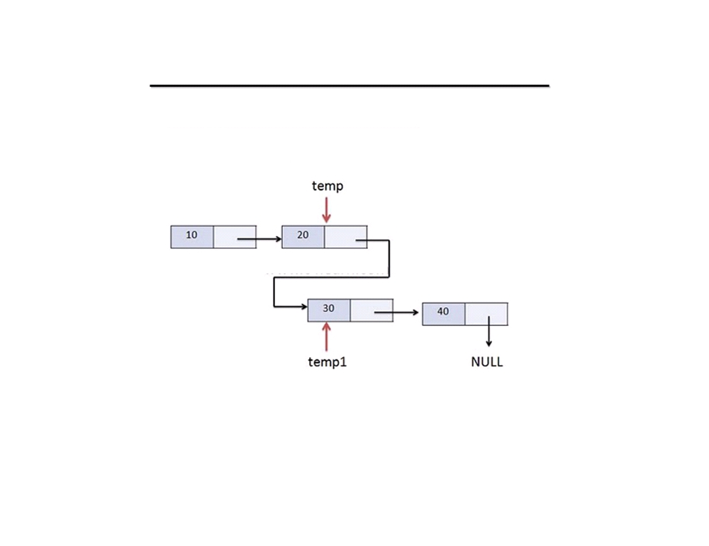
Insert node in Middle (Step 1)
Data Structure, 2012

Slide 30
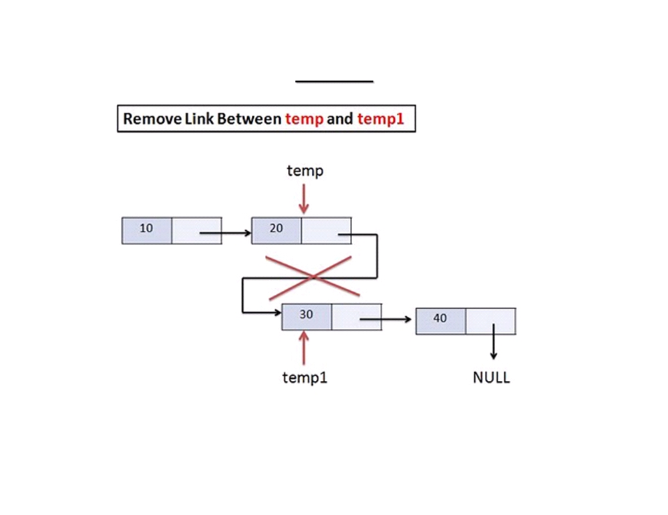
Step 2
Data Structure, 2012

Slide 31
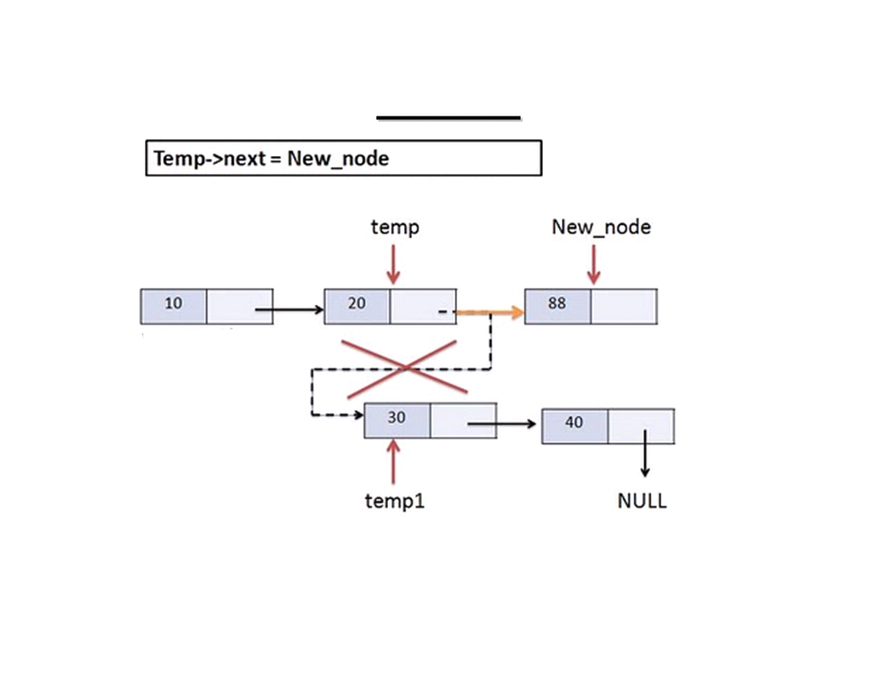
Step 3
Data Structure, 2012

Slide 32
Adding a node anywhere in the LL
void addmid()
{int i=1,pos;
node *cur,*temp;
cur=head;
temp=(node *)malloc(sizeof(node));
printf("Enter the data...");
scanf("%d",&temp->item);
printf("\nEnter the position\t");
scanf("%d",&pos);
while(pos!=i+1 && cur!=NULL) {
cur=cur->next;
i++; }
if(pos==i+1) {
temp->next=cur->next;
cur->next=temp;}}

Slide 33
DELETION OF NODE FROM THE LINKED LIST

Slide 34
Deletion of node from the beginning
void delfirst()
{
node *temp=head;
head=head->next;
printf("Deleted item is %d\n", temp->item);
free(temp);
}

Slide 35
Deletion of node from the end
void dellast()
{node *temp,*cur=head;
while(cur->next->next!=NULL){
cur=cur->next;}
temp=cur->next;
cur->next=NULL;
printf("Deleted item is %d\n",temp->item);
free(temp);}

Slide 36
Deletion of node in between
void delmid(){
int i=1,pos;
node *cur=head,*temp;
printf("Enter the position to be deleted\t");
scanf("%d", &pos);
while(pos!=i+1&&cur->next!=NULL){
cur=cur->next;
i++;}
if(pos==i+1){
temp=cur->next;
cur->next=temp->next;
printf("Deleted item is %d\n", temp->item);
free(temp);}}

Slide 37
Calculate the Length of linked list
void count()
{
struct node *temp;
int length = 0;
temp = start;
while(temp!=NULL)
{
length++;
temp=temp->next;
}
printf(“\nLength of Linked List : %d", length);
}

Slide 38
WAP to create a Sorted Linked List.

Slide 39
void addNode(unsigned int id) {
node *curr, *new;
new = (node *)malloc(sizeof(node));
if (new == NULL) {
printf("Memory not available to create link. Exiting.\n");
exit (EXIT_FAILURE);}
new->id = id;
new->next=NULL;

Slide 40
// If Head is NULL, the list doesn't yet exist, so we create one.
if (head == NULL) {
head = new;
new->next = NULL;
return;
}
// does our new element go before the first one?
if (new->id < head->id) {
new->next = head;
head = new;
return;
}
// if our element goes in the middle, this code will scan through to find out exactly where it belongs.
curr = head;
while ( (curr->next != NULL) ) {
if ((new->id < curr->next->id)) {
if((new->id > curr->id)) {
new->next = curr->next;
curr->next = new;
return;
} }
curr = curr->next; // move to the next node.
}

Slide 41
Searching through the linked list.
Searches through the linked list and returns a pointer the first occurrence of the search key or returns NULL pointer if the search key is not in the list.

Slide 42
Searching an element
int search(int num)
{
int flag = 0;
struct node *temp;
temp = start;
while(temp!=NULL) {
if(temp->data == num) return(1);
temp = temp->next;
}
if(flag == 0) return(0); // Not found }

Slide 43
WAP in C to input an Integer in a linked list such that node of a list contain the individual digits of an integer in the order.

Slide 44
Reversing a linked list
void reverse_list(){
struct node *temp,*temp1,*var;
temp=head;
var=NULL;
while(temp!=NULL)
{
temp1=var;
var=temp;
temp=temp->next;
var->next=temp1;
}
head=var;}

Slide 45
Problem 3:
Partition a linked list around a value x, such that all nodes less than x come before all nodes greater than or equal to x.

Slide 46
Struct node list_partition(Node * head, int x)
{
Node * head1, * rear1, * head2, * rear2;
temp=head;
head1 = rear1 = head2 = rear2 = NULL;
while (temp != NULL){
if (temp->data >= x)
{
if (head2 == NULL){
head2 = rear2 = head;
}
else {
rear2->next = head;
rear2 = head;
}
}
else
{
if (head1 == NULL){
head1 = rear1 = head;
}
else{
rear1->next = head;
rear1 = head;
}
}
temp = temp->next;
}

Slide 47
if (rear1 != NULL)
{
rear1->next = head2;
return head1;
}
else
{
return head2;
}
}

Slide 48
Problem 6:
Check whether a link list is a palindrome.

Slide 49
linkpalindrome(Node * head)
{
int len = 0;
for (; head != NULL; head=head->next, len++);
int comp_len = len / 2;
Node * head2 = head;
int counter = len - comp_len;
for (; counter > 0; head2 = head2->next, counter--);
Node * new_head2 = reverse(head2);
Node * p = new_head2;
while (p != NULL){
if (p->data != head->data) return false;
p = p->next;
head = head->next;
}
return true;
}

