Slide 1
Polynomial Addition using Linked lists

Slide 2
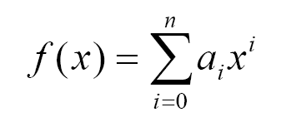
Polynomial ADT
A single variable polynomial can be generalized as:
An example of a single variable polynomial:
4x⁶ + 10x⁴ - 5x + 3
Remark: the order of this polynomial is 6
(look for highest exponent)

Slide 3
Polynomial ADT
What kinds of operations?
Here are the most common operations on a polynomial:
Add & Subtract
Multiply
Differentiate
Integrate
etc…

Slide 4
Polynomial ADT
What kinds of operations?
Here are the most common operations on a polynomial:
Add & Subtract
Multiply
Differentiate
Integrate
etc…

Slide 5
Polynomial ADT (continued)
Why implement this?
Calculating polynomial operations by hand can be very cumbersome. Take differentiation as an example:
d(23x⁹ + 18x⁷ + 41x⁶ + 163x⁴ + 5x + 3)/dx
= (23*9)x⁽⁹⁻¹⁾ + (18*7)x⁽⁷⁻¹⁾ + (41*6)x⁽⁶⁻¹⁾ + …

Slide 6
Polynomial (continued)
How to implement this?
There are different ways of implementing the polynomial :
Array (not recommended)
Linked List (preferred and recommended)

Slide 7
Polynomial (continued)
Array Implementation:
p1(x) = 8x³ + 3x² + 2x + 6
p2(x) = 23x⁴ + 18x - 3
p1(x)
p2(x)
6 | 2 | 3 | 8
-3 | 18 | 0 | 0 | 23
0
2
0
2
4
Index represents exponents

Slide 8
Polynomial ADT (continued)
This is why arrays aren’t good to represent polynomials:
p3(x) = 16x²¹ - 3x⁵ + 2x + 6
6 | 2 | 0 | 0 | -3 | 0
…………
0 | 16
WASTE OF SPACE!

Slide 9
Polynomial ADT (continued)
Advantages of using an Array:
  only good for non-sparse polynomials.
  ease of storage and retrieval.
Disadvantages of using an Array:
  have to allocate array size ahead of time.
  huge array size required for sparse polynomials. Waste of space and runtime.

Slide 10
Polynomial ADT (continued)
Linked list Implementation:
p1(x) = 23x⁹ + 18x⁷ + 41x⁶ + 163x⁴ + 3
p2(x) = 4x⁶ + 10x⁴ + 12x + 8
P1
23
9
18
7
41
6
18
7
3
0
TAIL (contains pointer)
P2
4
6
10
4
12
1
8
0
NODE (contains coefficient & exponent)

Slide 11
Polynomial ADT (continued)
Advantages of using a Linked list:
  save space (don’t have to worry about sparse polynomials) and easy to maintain
  don’t need to allocate list size and can declare nodes (terms) only as needed
Disadvantages of using a Linked list :
  can’t go backwards through the list
  can’t jump to the beginning of the list from the end.

Slide 12
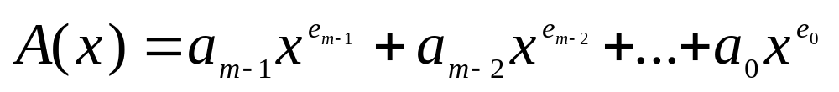
Polynomials
Representation
struct polynode {
int coef;
int exp;
struct polynode * next;
};
typedef struct polynode *polyptr;
coef exp next

Slide 13


Slide 14
polyptr createPoly()
{
polyptr p, tmp, start=NULL;
int ch=1;
while(ch)
{
p=(struct polynode*)malloc(sizeof(struct polynode));
printf("Enter the coefficient :");
scanf("%d",&p->coef);
printf("Enter the exponent : ");
scanf("%d",&p->exp);
p->next=NULL;
//IF the polynomial is empty then add this node as the start node of the polynomial
if(start==NULL)
start=p;
//else add this node as the last term in the polynomial ls it
else
{
tmp=start;
while(tmp->next!=NULL)
tmp=tmp->next;
tmp->next=p;
}

Slide 15
printf("MORE Nodes to be added (1/0): ");
scanf("%d",&ch);
}
return start;
}
start
3 14
2 8
1 0
null

Slide 16
Displaying the Polynomial
void display(struct polynode *head)
{
struct polynode *list;
list=head;
if( list==NULL)
{ printf(“polynomial empty”);
return;}
else
{ while(list!=NULL)
printf("%d X^ %d + " ,list->coef,list->exp);
list=list->next; }
}

Slide 17


Slide 18
Polynomial ADT (continued)
Adding polynomials using a Linked list representation: (storing the result in p3)
To do this, we have to break the process down to cases:
Case 1: exponent of p1 > exponent of p2
  Copy node of p1 to end of p3.
[go to next node]

Slide 19
Polynomial ADT (continued)
Case 2: exponent of p1 < exponent of p2
  Copy node of p2 to end of p3.
[go to next node]
Case 3: exponent of p1 = exponent of p2
  Create a new node in p3 with the same exponent and with the sum of the coefficients of p1 and p2.

Slide 20
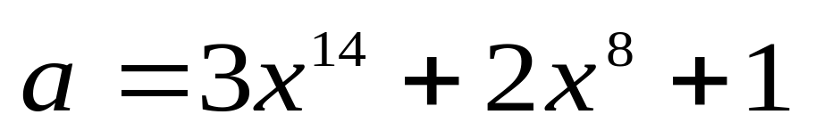
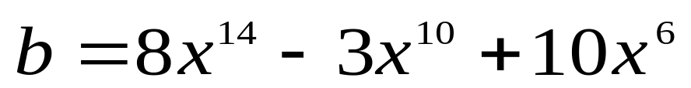
Example
a
3 14
2 8
1 0
null
b
8 14
-3 10
10 6
null

Slide 21
Adding Polynomials
3 14
2 8
1 0
a
8 14
-3 10
10 6
b
11 14
a->expon == b->expon
d
3 14
2 8
1 0
a
8 14
-3 10
10 6
b
11 14
-3 10
a->expon < b->expon

Slide 22
3 14
2 8
1 0
a
8 14
-3 10
10 6
b
11 14
-3 10
2 8
d
a->expon > b->expon

Slide 23
C Program to implement polynomial addition
struct polynode
{
int coef;
int exp;
struct polynode *next;
};
Typedef struct polynode polyptr;

Slide 24
void poly_add(struct polynode *p1,struct polynode *p2)
{
struct polynode *start3;
start3=NULL;
while(p1!=NULL && p2!=NULL)
{
if(p1->expo > p2->expo)
{ start3=insert(start3,p1->coef,p1->expo);
p1=p1->link; }
else if(p2->expo > p1->expo)
{ start3=insert(start3,p2->coef,p2->expo);
p2=p2->link; }
else if(p1->expo==p2->expo)
{ start3=insert(start3,p1->coef+p2->coef,p1->expo);
p1=p1->link;
p2=p2->link; }
}

Slide 25
/*if poly2 has finished and elements left in poly1*/
while(p1!=NULL)
{
start3=insert(start3,p1->coef,p1->expo);
p1=p1->link;
}
/*if poly1 has finished and elements left in poly2*/
while(p2!=NULL)
{
start3=insert(start3,p2->coef,p2->expo);
p2=p2->link;
}
printf("Added polynomial is : ");
display(start3);
}/*End of poly_add() */

Slide 26
struct polynode *insert(struct polynode *start, int co, int ex)
{
struct polynode *ptr,*tmp;
tmp=(struct polynode *)malloc(sizeof(struct polynode));
tmp->coef=co;
tmp->expo=ex;
/*If list is empty*/
if(start==NULL)
{
start=tmp;
}
else /*Insert at the end of the list*/
{
ptr=start;
while(ptr->link!=NULL)
{ ptr=ptr->link;}
ptr->link=tmp->link;
ptr=tmp;
}
return start; }/*End of insert()*/

Slide 27
main()
{
polyptr Apoly,Bpoly;
clrscr();
printf("Enter the first polynomial : \n");
Apoly=createPoly();
display(&Apoly);
printf("\n");
Bpoly=createPoly();
display(&Bpoly);
printf("\nResult is : ");
C=addTwoPolynomial(&Apoly,&Bpoly);
display(&C);
getch();
}

Slide 28
Exercise
Write a program to implement polynomial multiplication.

Slide 29
void poly_mult(struct polynode *p1, struct polynode *p2)
{
struct node *start3;
struct node *p2_beg = p2;
start3=NULL;
if(p1==NULL || p2==NULL)
{ printf("Multiplied polynomial is zero polynomial\n");
return;
}
while(p1!=NULL)
{ p2=p2_beg;
while(p2!=NULL)
{ start3=insert_s(start3, p1->coef * p2->coef, p1->expo+p2->expo);
p2=p2->link; }
p1=p1->link;
}
printf("Multiplied polynomial is : ");
display(start3);
} /*End of poly_mult()*/

