Slide 1
WATER Web Application TEst Repair
Shauvik Roy Choudhary,
Dan Zhao, Husayn Versee, and Alessandro Orso
Georgia Institute of Technology
Notes:
Hi,
Today I’ll be presenting WATER to you – which stands for Web Application Test Repair
This work was done in collaboration with students Dan Zhao, Husayn Versee and my advisor Alex Orso at Georgia Tech

Slide 2



Web Application Testing
Web
Application
Tests
Browser
Automation Framework
Web Application
Web
Application
Tests
http://www.website.com
Web
Application
Tests
Test Machine
Test Slave
Web Server
Notes:
Before I start, let me give you a brief overview of web application testing.
Since web applications are distributed in nature, the testing of such applications is also distributed. This figure shows a sample test deployment that is distributed across multiple machines.
Web application tests are written by a developer/tester and run on the test machine. These tests consist of commands sent to one or more test slave machines.
On the slave, a browser automation framework accepts these commands and launches a browser and controls it to load and interact with a remote web application.
The results of the interaction are sent back to the test machine so that it can compute the pass/fail result of the test case.

Slide 3
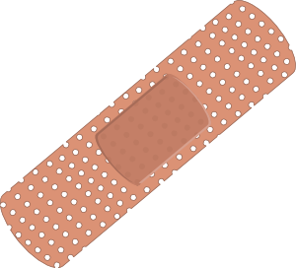

Web Application Test Repair
Outdated tests
Changed
Web
Application
Tests
Browser
Automation Framework
http://www.website.com
Web Application*
Test Machine
Test Slave
Web Server
Web
Application
Tests*
Web
Application
Tests*
Web
Application
Tests*
Notes:
But what happens if the web application gets changed? Some of the tests might be outdated.
One can’t just discard these outdated tests because that would affect the quality of the test suite.
Instead, these tests should be repaired (preferably automatically) to match the new version of the web application and presented to the developer for review.
Developer review is required because of 2 reasons:
There might be more than 1 repairs that are possible
Since the new version is considered as an oracle, the repairs might silently allow bugs. So, the developer needs to approve the repairs and accept the repaired test cases.

Slide 4
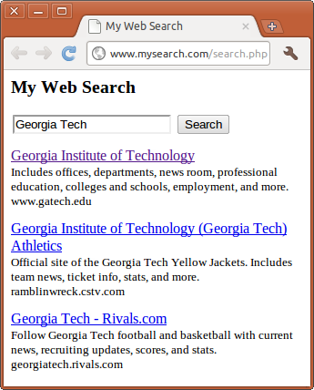
Motivating Example
<html>
<body>
<h2>My Web Search</h2>
<form>
<input type="text" name="q"/>
<input id="search" type="submit" value="Search">
</form>
<div>
<a href="http://www.gatech.edu/">
Georgia Institute of Technology
</a>
<p>Includes offices, departments, news
room, professional education...</p>
<span>www.gatech.edu</span>
</div>
<div>...</div>
<div>...</div>
</body>
</html>
HTML Source of “My Web Search”
Notes:
To give you more insight, let me present a motivating example to you.
This is the screenshot of a simple web search application where the user enters a query in the textbox and hits the search button to get the search results below.
This is the HTML source of the search results page. As you can see the various tags in the HTML correspond to the various elements on the webpage.
e.g., the form tag corresponds to the highlighted HTML form and the div tag corresponds to the highlighted search result.
Now that we understand this web application, let us look at a sample test case.

Slide 5
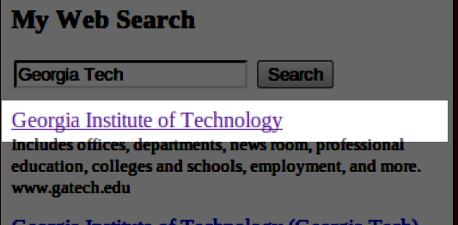
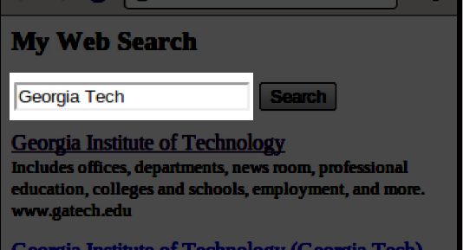
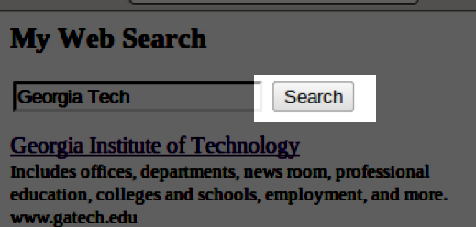
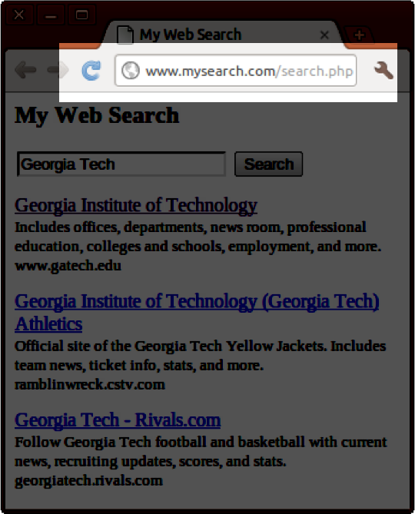
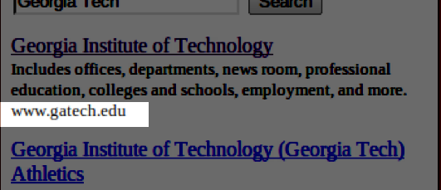
Motivating Example
<html>
<body>
<h2>My Web Search</h2>
<form>
<input type="text" name="q"/>
<input id="search" type="submit" value="Search">
</form>
<div>
<a href="http://www.gatech.edu/">
Georgia Institute of Technology
</a>
<p>Includes offices, departments, news
room, professional education...</p>
<span>www.gatech.edu</span>
</div>
<div>...</div>
<div>...</div>
</body>
</html>
Command | Arg 1 | Arg 2
open | /search.php
type | q | Georgia Tech
clickAndWait | id=search
assertText | document.links[0] | Georgia Institute of Technology
assertText | //body/div[1]/span | www.gatech.edu
A Selenium Test Case for “My Web Search”
HTML Source of “My Web Search”
Notes:
The test case shown is written using the selenium test framework and consists of commands which take arguments.
Let me walk you through this test.
The first command loads the search.php page in the browser.
The next command types out the query text Georgia Tech in the input box.
The third command clicks on the button identified by id=search and waits for the page to load
The next two commands are asserts that check the value contained in elements against expected values. The first uses the DOM API to locate the first link & matches it’s text against Georgia Institute of Technology And the second locates the span tag using it’s xPath locator and compares its value to Georgia Tech.
Now that you know how this test case works, let me present some changes to the web application and show you how they affect the test case.

Slide 6
Motivating Example
Change 1
<html>
<body>
<h2>My Web Search</h2>
<form>
<input type="text" name="q"/>
<input id="searchBtn" type="submit" value="Search">
</form>
<div>
<a href="http://www.gatech.edu/">
Georgia Institute of Technology
</a>
<p>Includes offices, departments, news
room, professional education...</p>
<span>www.gatech.edu</span>
</div>
<div>...</div>
<div>...</div>
</body>
</html>
Command | Arg 1 | Arg 2
open | /search.php
type | q | Georgia Tech
clickAndWait | id=search
assertText | document.links[0] | Georgia Institute of Technology
assertText | //body/div[1]/span | www.gatech.edu
A Selenium Test Case for “My Web Search”
HTML Source of “My Web Search”
Notes:
For the first change, the id of the button is changed as shown. This results in the click command to fail as it can no longer locate the button using the old id.
To repair this test, one would update the test case with the new id.

Slide 7
Motivating Example
Change 2
<html>
<body>
<h2>My Web Search</h2>
<form>
<input type="text" name="q"/>
<input id="search" type="submit" value="Search"> </form>
<div>
<a href="http://www.gatech.edu/">
Georgia Tech
</a>
<p>Includes offices, departments, news
room, professional education...</p>
<span>www.gatech.edu</span>
</div>
<div>...</div>
<div>...</div>
</body>
</html>
Command | Arg 1 | Arg 2
open | /search.php
type | q | Georgia Tech
clickAndWait | id=search
assertText | document.links[0] | Georgia Institute of Technology
assertText | //body/div[1]/span | www.gatech.edu
A Selenium Test Case for “My Web Search”
HTML Source of “My Web Search”
Notes:
In the next change, the link text of the search result is changed from Georgia Institute to Georgia Tech, leading to an assertion failure.
This can be fixed by changing the expected value to match the actual value.

Slide 8
Motivating Example
Change 3
<html>
<body>
<h2>My Web Search</h2>
<form>
<input type="text" name="q"/>
<input id="search" type="submit" value="Search"> <a href="adv.php">Advanced Search</a>
</form>
<div>
<a href="http://www.gatech.edu/">
Georgia Institute of Technology
</a>
<p>Includes offices, departments, news
room, professional education...</p>
<span>www.gatech.edu</span>
</div>
<div>...</div>
<div>...</div>
</body>
</html>
Command | Arg 1 | Arg 2
open | /search.php
type | q | Georgia Tech
clickAndWait | id=search
assertText | document.links[0] | Georgia Institute of Technology
assertText | //body/div[1]/span | www.gatech.edu
A Selenium Test Case for “My Web Search”
HTML Source of “My Web Search”
Notes:
In the next change, the form contains a new link called “Advanced Search”.
Since this is now the first link, it gets selected instead by the highlighted assert and an Assertion failure is thrown.
To repair this command, Arg 1 needs to be fixed instead of the value.

Slide 9
Motivating Example
Change 4
<html>
<body>
<h2>My Web Search</h2>
<form>
<input type="text" name="q"/>
<input id="search" type="submit" value="Search">
</form> <div id=“container”>
<div>
<a href="http://www.gatech.edu/">
Georgia Institute of Technology
</a>
<p>Includes offices, departments, news
room, professional education...</p>
<span>www.gatech.edu</span>
</div>
<div>...</div>
<div>...</div> </div>
</body>
</html>
Command | Arg 1 | Arg 2
open | /search.php
type | q | Georgia Tech
clickAndWait | id=search
assertText | document.links[0] | Georgia Institute of Technology
assertText | //body/div[1]/span | www.gatech.edu
A Selenium Test Case for “My Web Search”
HTML Source of “My Web Search”
Notes:
In this change, a div tag is added to wrap the results and this leads to the xpath in the assert to be invalid. To fix this, one would update the xPath in Arg1

Slide 10
Types of Changes
Structural Changes
leads to
locator errors
form-data population problem
Content Changes
leads to
obsolete content problem
Blind Changes
do not reflect on the client side
Notes:
Structural changes – tag or tag attributes are added, changed or removed.
Content changes – the actual value residing in a tag gets changed leading to an assertion failure – because the expected value is obsolete.
Blind Changes – changes that do not directly reflect on the client side. E.g., server side logic change that cannot be inferred from the client side alone.
Our current technique doesn’t handle these and we plan to address this in future work by incorporating details from the server side.
Now that you have seen the type of changes, let me show you how we address these in our technique.

Slide 11
Technique
Web-App
old
Web-App
new
Tests
with
repairs
Tests
with
repairs
Test
Tests
with
repairs
Execute test
Execute candidates
(1)
(3)
DOM Tree
DOM Tree
+
Failure Message
Discard failed
Suggest passed
Generate
repair candidates
(2)
Notes:
Here I will present the high level view of our technique which accepts a test case along with old and new versions of the web application.
The first step is to execute the test on both versions to gather information.
In particular, we capture the DOM Tree (which is the browsers internal representation of a web page) for both versions & the failure information from the new version.
This is fed to a component that generates repair candidates. These are essentially modified versions of the test case with different repairs applied.
These tests are executed on the new version of the web app. Those that fail are discarded and the passing suggestions are presented to the developer.
Now, let me give you some more indight into how repair candidates are generated.

Slide 12
Repairing Locators
Error messages:
“Locator not found” – Moved Element
“Assertion failed” – Wrongly selected element
body
body
div
div
div
div
div
div
h1
a
ul
div
div
h1
a
ul
div
div
div
ul
div
ul
div
div
div
New DOM Tree
div
div
div
div
div
div
div
Old DOM Tree
div
div
DOM Node locating properties = { id, xpath, class, linkText, name }
Notes:
At first the technique attempts to repair locators.
These are the two messages that trigger this repair. Locator error can be due to a moved element whereas assertion failure might be due to a wrongly selected element.
To repair, we first load the old dom tree, select the element that cannot be located in the new tree and perform a search for candidates.
Our search is two fold. At first we extract certain properties of the node from the OLD DOM tree. These properties are important, since test frameworks like selenium allow locating DOM elements based on these.
The next step is to find matches based on a computed similarity index. To compute this, we consider the xPath similarity and match in certain other properties of the nodes.
After we have similar candidates, we replace the locator of the green node with that of each of these and generate multiple tests as described before.

Slide 13
Repairing Asserts & Form data
Repairing failing asserts
Replace expected value with actual value
Negate assertion condition
Form data population
Find newly added elements in the DOM
Choose random values for the elements to generate repair candidates

Slide 14
Empirical Evaluation
RQ1: Can WATER suggest repairs for most broken test scripts in a web application?
RQ2: Can WATER do so without providing too many false positives?

Slide 15



Subjects
Three real world web applications with test cases.
Type | Content Management System | Business Process Management | User Automation Scripts

Slide 16
Subjects
Three real world web applications with test cases.
Type | Content Management System | Business Process Management | User Automation Scripts
Platform | PHP | Java | DSL

Slide 17
Subjects
Three real world web applications with test cases.
Type | Content Management System | Business Process Management | User Automation Scripts
Platform | PHP | Java | DSL
Test Scripts | 42 selenium tests | 16 selenium tests | 180 (out of 5123) scripts translated to selenium

Slide 18
Subjects
Three real world web applications with test cases.
Type | Content Management System | Business Process Management | User Automation Scripts
Platform | PHP | Java | DSL
Test Scripts | 42 selenium tests | 16 selenium tests | 180 (out of 5123) scripts translated to selenium
Test scripts run on | Versions from SVN | Versions from SVN | Live site daily

Slide 19
Results
Versions | T_{broken} | C_{fail} | S_{avg} | T_{fix} | V_{fix}
19478 – 19480 | 2 | (4,4) | (3,3) | 2 | 19484
20430 – 20431 | 1 | (1) | (1) | 1 | 20448
20739 – 20740 | 1 | (1) | (0) | 0 | 20776
20769 – 20770 | 2 | (1,1) | (1,1) | 2 | 20777
Versions | T_{broken} | C_{fail} | S_{avg} | T_{fix} | V_{fix}
963271 – 963410 | 2 | (1,1) | (1,1) | 1 | v1.7
997469 – 997470 | 1 | (5) | (1.4) | 1 | v1.29
Notes:
Columns – versions, broken tests, commands, suggestions, fixed tests, version in which fix appeared

Slide 20
Results (continued)
Script | Domain | Changed | Fixed | Suggestions
10043 | careers.yahoo.com | Form | No | (15, 15, 0)
10754 | www.icade.fr | Form, Reloc. | No | 0
11525 | www.terra.com.br | Link text | Yes | 285
13389 | www.terra.com.br | Link text | Yes | 285
18164 | www.google.com.br | Link text | Yes | 1

Slide 21
Discussion
RQ1: Effectiveness
WATER could suggest repairs to broken test cases
Joomla & Ofbiz studies: Suggestions correspond to actual fixes made by developers.
RQ2: Efficiency (wrong suggestions)
Joomla & Ofbiz study: 1-3 suggestions
Coscripter study: 1-285 suggestions
Notes:
Weak oracle or non-existence of the test-oracle

Slide 22
Related Work
Repair of JUnit tests
Daniel et. al (ReAssert) [ASE’09][ISSTA’10]
Regression testing for Web applications
Alshahwan & Harman [ICST’08]
Dobolyi & Weimer [ISSRE’09]
Roest, Mesbah & Van Deursen [ICST’10]
GUI Test repair
Memon & Soffa [FSE’03]
Grechanik, Xie & Fu [ICSE’09]
Notes:
Alshahwan - repair user session data during regression testing.
Dobolyi – detect regression errors by using a precise comparator derived from other similar web applications
Roest - a pipelined oracle comparator to ignore irrelevant differences for regression testing
Memon - graph representation of GUIs to find unusable tests and then to repair them
Grechanik - static analysis to assess change impact & suggest changes

Slide 23
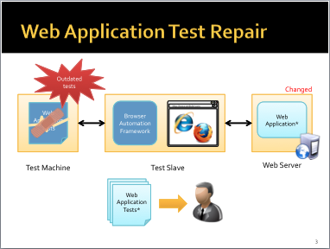
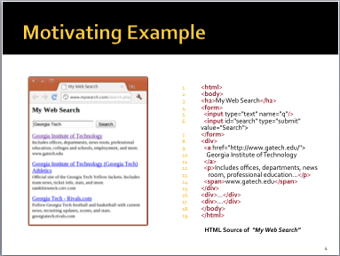
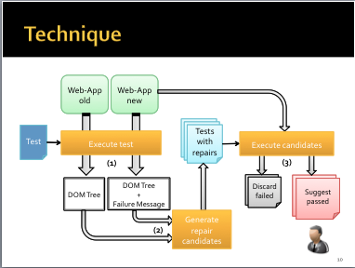
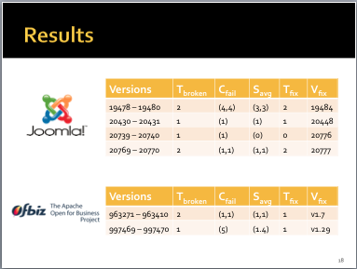
Summary
Notes:
In summary, I introduced web application testing and motivated the the need to repair tests. Then I presented my WATER technique followed by results of the empirical evaluation.
For future work, we would like to combine information from the server-side to improve our technique. Also, we would like to perform further experimentation with more subjects and incorporate user feedback to strengthen our technique.

