Slide 1


ViewPoints: Differential String Analysis for Discovering Client- and Server-Side Input Validation Inconsistencies
Muath Alkhalaf¹ Shauvik Roy Choudhary²
Mattia Fazzini² Tevfik Bultan¹
Alessandro Orso² Christopher Kruegel¹
¹UC Santa Barbara ²Georgia Tech
Notes:
Why do you need static analysis (vs. dynamic symbolic execution)? →
1- we do not bound loops, we do not bound strings
2- extraction phase is separate and could be done statically for javascript or manually
You compare dynamically extracted code with statically extracted code? → counter example to confirm not a false negative
The configuration file gives the url to the form but what about the field? → we use heuristics
You use configuration files which may be easier to just compare function calls entries in these configuration files?

Slide 2













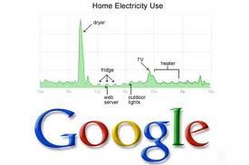




Web Software is Becoming Increasingly Dominant
Web applications are used extensively in many areas:
We will rely on web applications more in the future:
Web software is also rapidly replacing desktop applications
Notes:
Web software is becoming increasingly dominant nowadays and it is used extensively in many areas.
We rely more and more on web software and it is rapidly replacing desktop applications.
the use of web applications in safety
critical areas is increasing so their trustworthiness is becoming a critical issue.

Slide 3
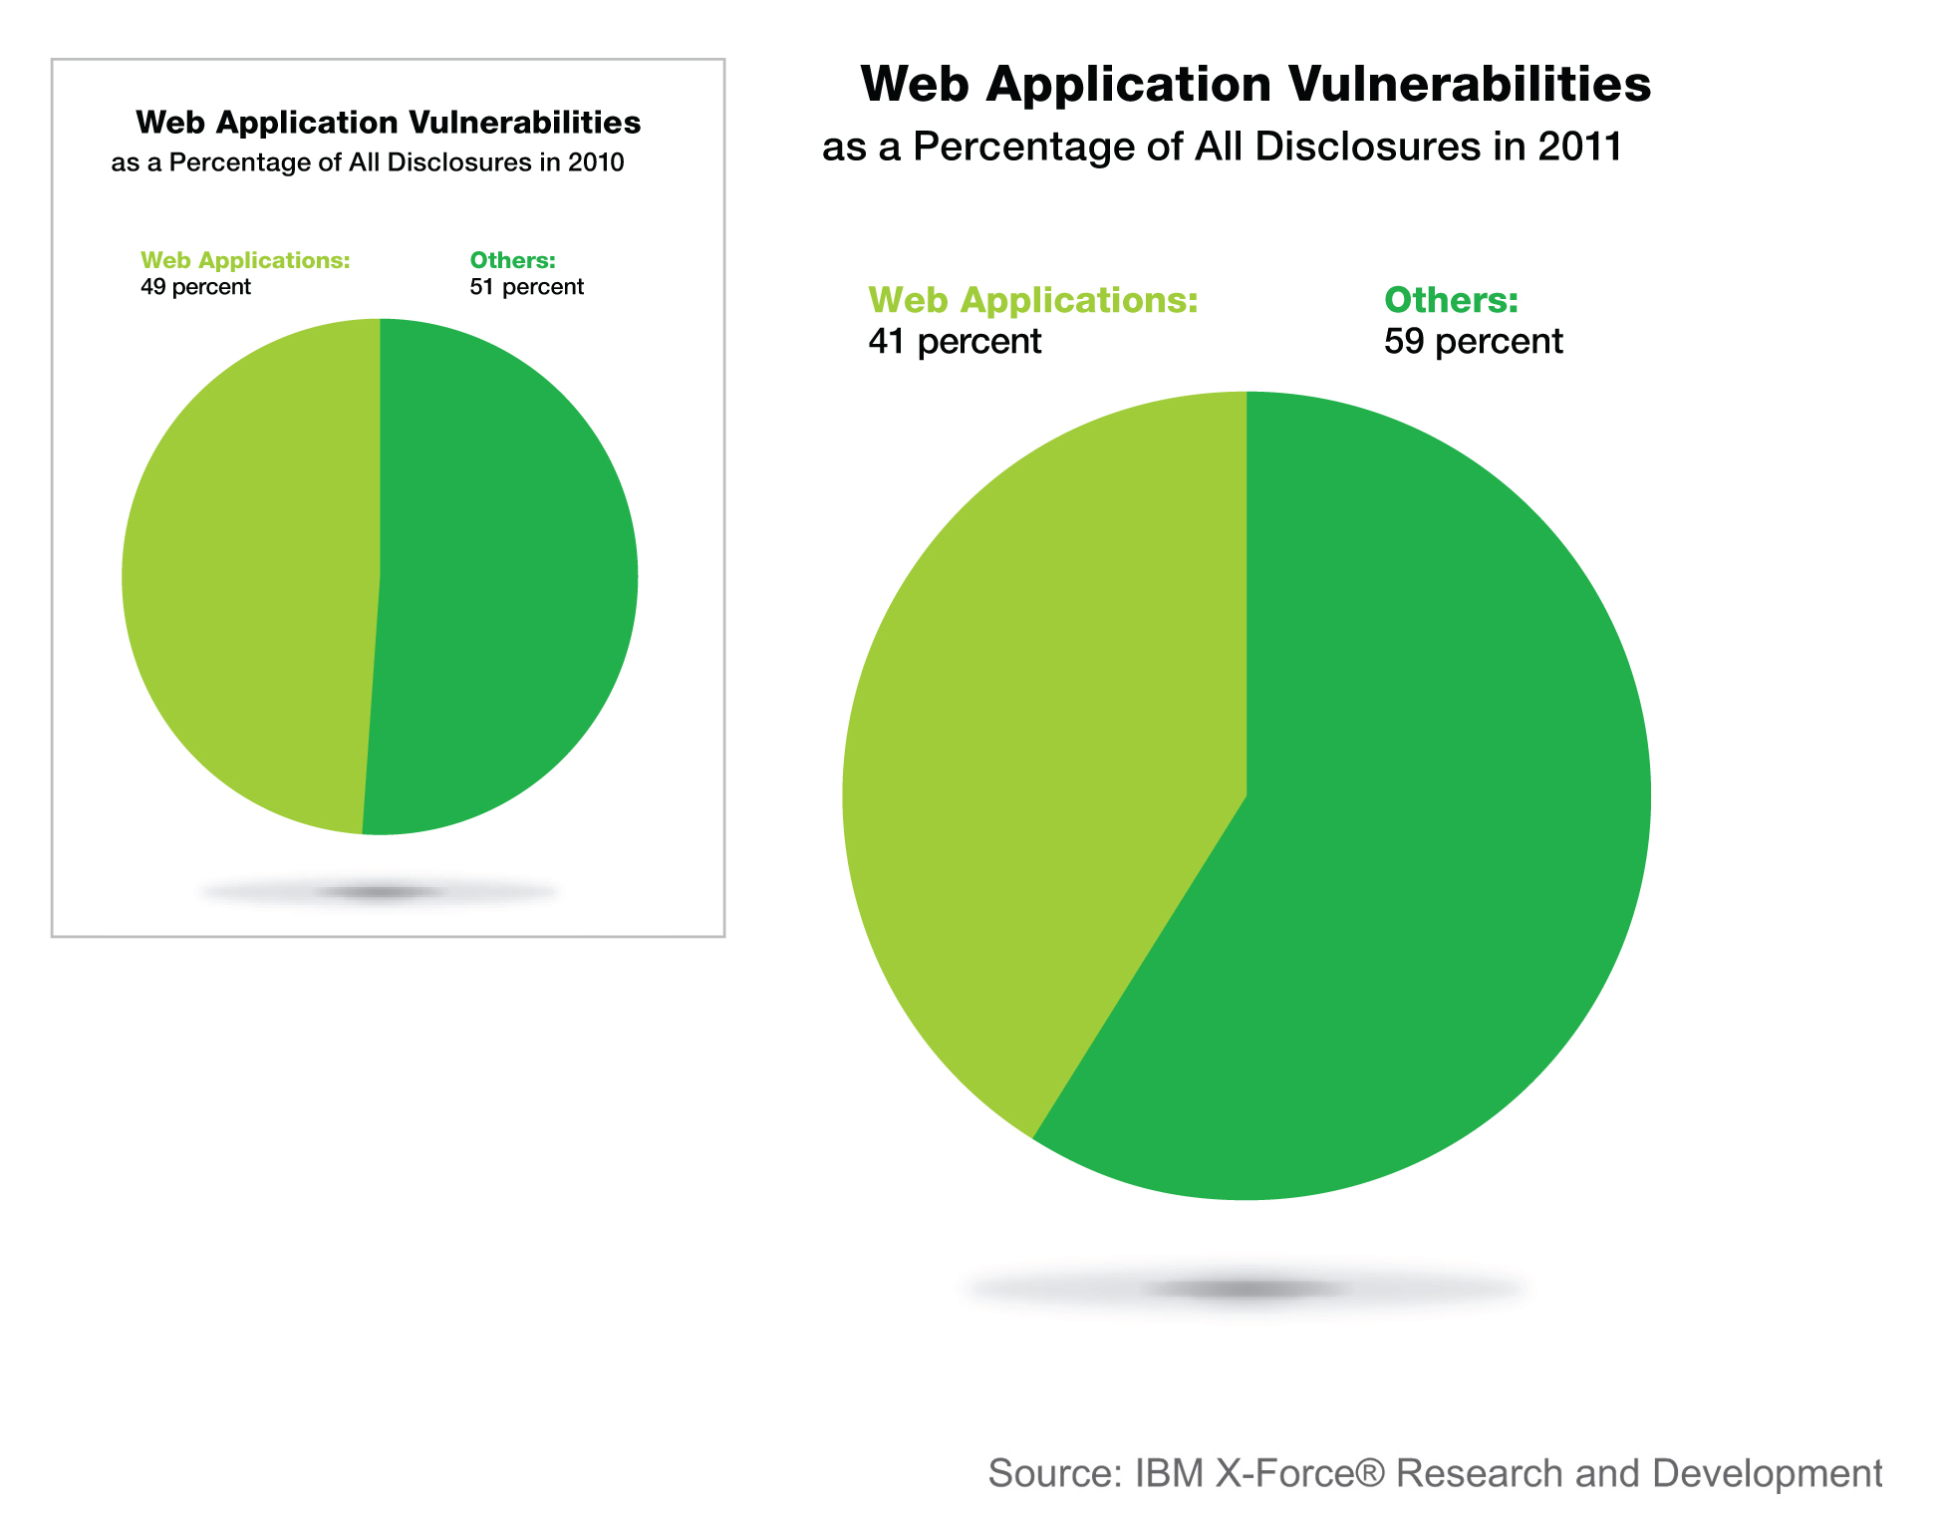
Web applications are not trustworthy
IBM X-force report
Notes:
Web applications are notorious for security vulnerabilities,
Their global accessibility makes them a target for many malicious users

Slide 4
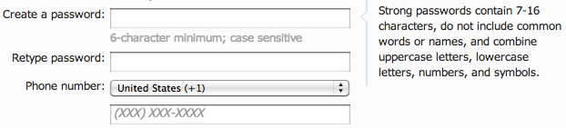
Why Do We Need Input Validation?
The user input comes in string form and must be validated before it can be used
Input validation uses string manipulation which is error prone
We need to verify input validation to assure:
Correctness
Security
Consistency
Notes:
Developers need input validation to avoid security
vulnerabilities and to force certain policies on user input. For example, the developer here
wants to force the user to use a password with more than six characters.
The problem is that input comes in a string form so we need string manipulation operations
to verify this input. But string manipulation operation are error prone and may cause input
validation to be incorrect.
So we need to verify the correctness of input validation to guarantee application’s corrctness,…(etc)

Slide 5
Three tier architecture
Web applications use the 3-tier architecture
Most web applications check the inputs both on the client side and the server-side
This redundancy is necessary for security reasons (client-side checks can be circumvented by malicious users)
Not having client-side input validation results in unnecessary communication with the server, degrading the responsiveness and performance of the application
Client Side
Javascript
Server Side
PHP
Java
DB
Notes:
Most web application nowadays follow the 3-tier architecture in which …etc.
With the three tier architecture, user input is checked both on the client and the server side.
On the server side input validation is needed for security reasons since attackers may bypass client side input validation.
On the client side input validation is needed to increase application’s usability, responsiveness and performance.

Slide 6
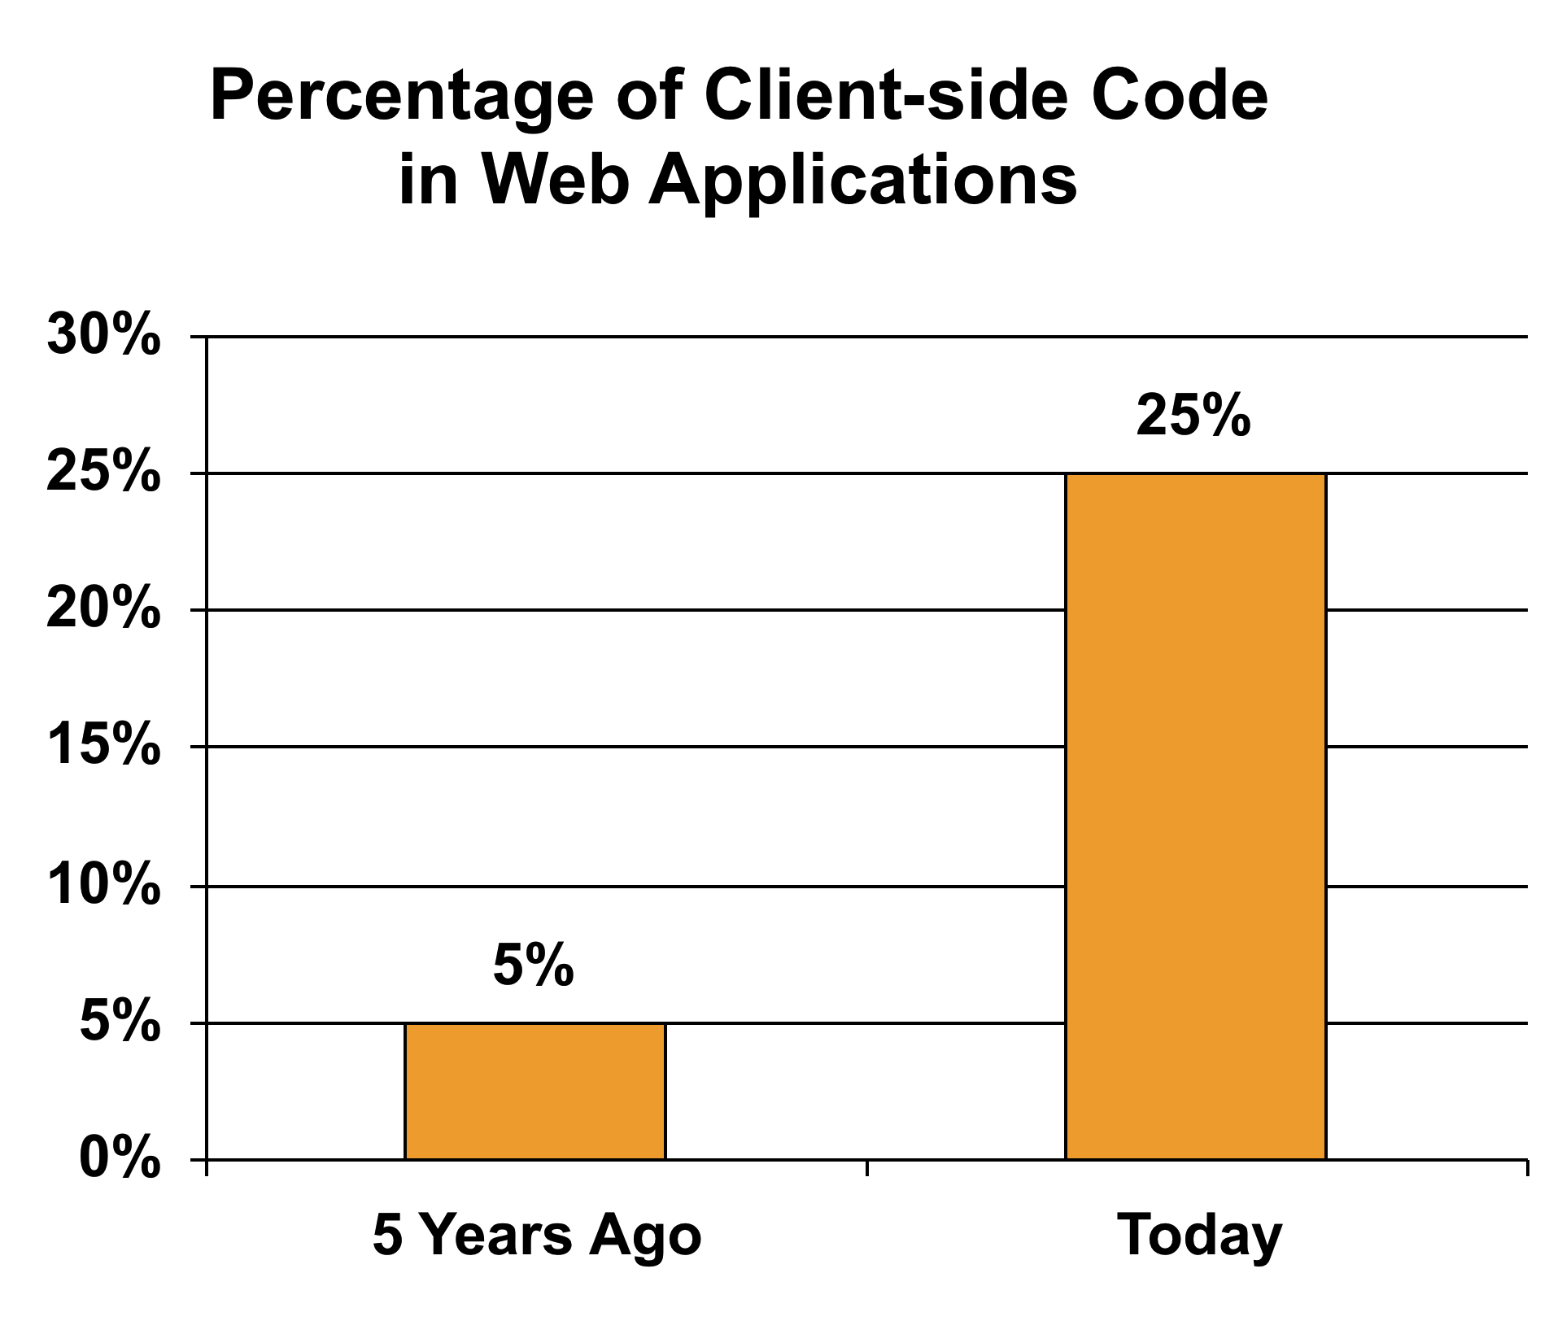
Client-Side is popular
Size of Client Side code is growing rapidly
Over 90% of web sites use javascript source: W3Techs
Source: According to an IBM study performed in 2010 - Salvatore Guarnieri

Slide 7
Input validation functions
True
(valid)
Input Validation Function
Input
False
(Invalid)
Notes:
So what is an input validation function?
An input validation function is a function which takes a set of inputs and then either accepts the input if it is valid by returning true
Or rejects the input if it is invalid by returning false.

Slide 8
A Javascript Input Validation Function
function validateEmail(form) {
var emailStr = form["email"].value;
if(emailStr.length == 0) {
return true;
}
var r1 = new RegExp("( )|(@.*@)|(@\\.)");
var r2 = new RegExp("^[\\w]+@([\\w]+\\.
[\\w]{2,4})$");
if(!r1.test(emailStr) &&
r2.test(emailStr)) {
return true;
}
return false;
}
Notes:
Here is a javascript input validation function taken from a message board web application. This function is used
to verify email addresses. If the input is a valid email address then it will accept this input by returning true. If the
input is an invalid email address then it will reject this input by returning false.

Slide 9
A Java Input Validation Function
public boolean validateEmail(Object bean, Field f, ..) {
String val = ValidatorUtils.getValueAsString(bean, f);
Perl5Util u = new Perl5Util();
if (!(val == null || val.trim().length == 0)) {
if ((!u.match("/( )|(@.*@)|(@\\.)/", val)) &&
u.match("/^[\\w]+@([\\w]+\\.[\\w]{2,4})$/”,
val)){
return true;
} else {
return false;
}
}
return true;
}
Notes:
Here is the corresponding java input validation function from the same application.

Slide 10
Under Constrained Validation Function
A function that accepts some bad input values
Good
input
True
(valid)
Bad
input
False
(Invalid)

Slide 11
Over Constrained Validation Function
A function that rejects some good input values
Good
input
True
(valid)
Bad
input
False
(Invalid)

Slide 12
How to Check Validation Function Correctness?
How can we check the validation functions?
One approach that has been used in the past:
Specify the input validation policy as a regular expression (attack patterns, max & min policies) and then use string analysis to check that validation functions conform to the given policy.
Someone has to manually write the input validation policies
If the input validation policies are specific for each web application, then the developers have to write different policies for each application, which could be error prone
Notes:
How do we check correctness of input validation functions?
A previous approach is to verify these functions against pre-specified policies such as attack patterns.
If they violate these policies then we consider them to be incorrect.
The problem with this approach is if the input validation policies are specific for each web application.
In this case the developer has to manually write new policies for each new web application which is an error prone process.
We propose a new approach in which developers do not need to pre-specify any policies.

Slide 13
Differential Analysis
The approach we present in this paper does not require developers to write specific policies
Basic idea: Use the inherent redundancy in input validation to check the correctness of the input validation functions
Notes:
We utilize this inherent redundancy in input validation and verify the client and server side input validation against each other.

Slide 14
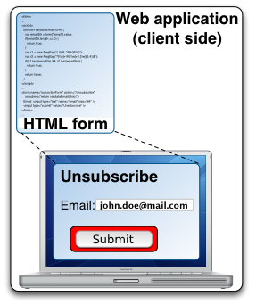

Motivating Scenario
Submit
Notes:
Let us take a look at how the client and server side input validation functions interact with each other …
what could go wrong during this interaction.

Slide 15
Client Accepts – Server Rejects
Reject
ERROR
Submit
Notes:
What could go wrong?

Slide 16


Client Accepts – Server Rejects
Client Validation Function
Server Validation Function
Good
input
True
True
input
Bad
input
False
False
Two problems may occur:
Either the client side input validation function was under constrained and accepted bad inputs
Or the server side input validation function was over constrained and rejected some good input
Notes:
What happened? Input was accepted by the client but rejected by the server.
Two possible errors may have caused this:
Either the client side input validation was under constrained and accepted some bad input. This is a usability issue and it
will confuse the user.
Or the server side was over constrained and rejected some good input. This is a bad bug that affects the overall correctness
of the application.

Slide 17
Client Rejects
Reject
Submit

Slide 18
Client Rejects
Client Validation Function
Server Validation Function
Good
input
True
True
input
False
False
A problem may occur:
the client side input validation function was over constrained and rejected some good input
What happens when Input value is bad and the server accepts this value?

Slide 19

Client Rejects – Server Accepts
…<script…>…
Submit
Attack

Slide 20
Client Rejects – Server Accepts
Client Validation Function
Server Validation Function
True
True
Bad
input
False
False
The server side input validation function was under constrained and accepted bad inputs
Serious security problem

Slide 21
Approach
Notes:
We have seen how the client and the server side input validation differ from each other. How to detect these inconsistencies?
Our approach goes as following:
We first map input validation operations on the client to input validation operations on the server.
Then we extract the client input validation functions along with the corresponding server input validation functions.

Slide 22
Mapping & Extraction Phase

Slide 23


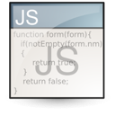




Input Validation Mapping
Web Application
Analyzer
Dynamic Extraction
for JavaScript
J2EE Web App
Per Input
Validation Configuration
Static Extraction
for Java Routines
For each input, we obtain
Domain information
Multiple parameterized validation functions with parameter values
Path to access the web application form
Web Deployment
Descriptor
Notes:
We first analyzes the web deployment descriptor, which is part of every J2EE web application.
From this descriptor, it obtains references to the different web components, libraries and framework configuration files.
It then performs framework specific analysis each web application input to obtain:
Domain information (i.e., data types)
the references to the parameterized validation functions with the parameter values (e.g., validateEmail and email reg-ex).
and URL path from where the form containing the input can be accessed (needed for the JS dynamic extraction)
After obtaining this information for each input, ViewPoints proceeds to perform Dynamic extraction for JS & static extraction of the Java input validation routines.

Slide 24
Dynamic Extraction for Javascript
Why extraction
Lots of event handling, error reporting and rendering code
Why dynamic?
Javascript is very dynamic
Object oriented
Prototype inheritance
Closures
Dynamically typed
eval
Notes:
First we do dynamic extraction for javascript:
Why do we need extraction?
Because javascript input validation code has lots of event handling, error reporting and rendering code and we want to just extract input validation operations.

Slide 25
Dynamic Extraction for Javascript
Exec Path
Dynamic Slice
Number of valid inputs
Inputs are selected heuristically
Instrument execution
HtmlUnit: browser simulator
Rhino: JS interpreter
Convert all accesses on objects and arrays to accesses on memory locations
Run Application
Dep Analysis
Input
Notes:
We do dynamic extraction of js by first running the web application with a number of inputs selected heuristically

Slide 26

Static Extraction for Java
Parsing and CFG
Construction
Transformations
and Slicing
(uses Soot)
Input validation routines
Static Slice
Control flow graph
Transformations
Library call and parameter inlining
Framework specific modeling and transformation
Constant propagation and Dead code elimination
Slicing (PDG based)
Forward slicing on input parameter
Backward slicing for the true path
Notes:
We do static extraction for java validation operation:
- For each input, It first collects the java validation routines
- It then parses the relevant class files and builds the CFG using the Soot program analysis framework.
- We have implemented several transformations in Soot to inline library calls and parameter queries (i.e., code that queries the parameters from the session bean).
- We also modeled several framework specific routines to simplify our analysis.
- The constant propagation and dead code elimination phases were called after the transformation to remove any unnecessary code for our analysis.
- After these transformations, ViewPoints performs forward slicing on the input parameter followed by backward slicing from the "return true" statement to obtain a minimal slice which is essentially a CFG with string operations on the input leading to the path to "return true" statements.

Slide 27
Input Validation Modeling

Slide 28
Compute Client & Server DFAs
Compute two automata for each input field:
Client-Side DFA A_{c}
L(A_{c}) Over approximation of set of values accepted by client-side input validation function
Server-Side DFA A_{s}
L(A_{s}) Over approximation of set of values accepted by server-side input validation function
We use automata based static string analysis to compute L(A_{c}) and L(A_{s})

Slide 29
Static String Analysis
Static string analysis determines all possible values that a string expression can take during any program execution
We use automata based string analysis
Associate each string expression in the program with an automaton
The automaton accepts an over approximation of all possible values that the string expression can take during program execution
We built our javascript string analysis on Closure compiler from Google and java string analysis on Soot
Flow sensitive, intraprocedural and path sensitive

Slide 30
Symbolic Automata
Explicit DFA representation
Symbolic DFA representation
.
.
.
.
.
.
1
0
.
.
.
.
.
.
2
.
.
.

Slide 31
Fixpoint & Widening
Σ*
We use an automata based widening operation to over-approximate the fixpoint
Widening operation over-approximates the union operations and accelerates the convergence of the fixpoint computation
Due to
loops we
need fixpoint
computation
.
.
.
Lattice with
infinite height
.
.
.
.
.
.
Ø

Slide 32
Modeling String Operations
Modeling string operations
CONCATENATION
y = x + “b”
REPLACEMENT
Language based replacement
replace(x, “a”, “d”)
RESTRICTION
If (x = “a”){ … }
c
Input
a
b
c
Output
a
b
Input
a
a
d
Output
d
c
Input
d, a
Output
a

Slide 33
String Analysis Example Client-Side
Σ*
var emailStr = form["email"].value;
Σ*
ε
emailStr.length == 0
return true
if (Pred ≡ var.length == intlit)
return Σ^{intlit};
Yes
((Σ⁺\(( )|(@.*@)|(@\.)))|
(^[\w]+@([\w]+\.[\w]{2,4})$))
No
Σ⁺
!r1.test(emailStr) &&
r2.test(emailStr)
if (Pred ≡ regexp.test(var))
if (checkregexp(regexp)=partialmatch)
return CONCAT(CONCAT(Σ∗, L(regexp)),
Σ∗);
else
return L(regexp);
return true
Yes
No
(( )|(@.*@)|(@\.))|
(Σ⁺\(^[\w]+@([\w]+\\.[\w]{2,4})$))
return false
L(A_{c}) = (Σ*\(( )|(@.*@)|(@\.)))|(^[\w]+@([\w]+\.[\w]{2,4})$)
Notes:
1- Simplified version of an extracted email input validation function
2- No error reporting code or event handling, only string operations and constraints
3- Does not use regular expressions to validate input but instead deals with string variables
as vectors of characters → challenging to model as regular operations
4- What do we want to do?
a- We want to compute accepted string values that may reach return true program point
b- then compare them to the max policy

Slide 34
String Analysis Example Server-Side
Σ*
String val = ValidatorUtils.getValueAsString(bean, f);
Σ*
( *)
!(val == null ||
val.trim().length == 0)
return true
if (Pred ≡ var.length == intlit)
return Σ^{intlit};
No
Yes
[^ ]⁺
(((@.*@)|(@\.))|
([^ ]⁺\(^[\w]+@([\w]+\.[\w]{2,4})$)))
!u.match("/( )|(@.*@)|
(@\\.)/", val)) &&
u.match("/^[\\w]+@([\\w]+\\.
[\\w]{2,4})$/”, val)
if (Pred ≡ regexp.match(var))
if (checkregexp(regexp)=partialmatch)
return CONCAT(CONCAT(Σ∗, L(regexp)),
Σ∗);
else
return L(regexp);
return false
No
Yes
([^ ]⁺\(( )|(@.*@)|(@\.))|
(^[\w]+@([\w]+\.[\w]{2,4})$))
return true
L(A_{s}) = ([^ ]⁺\(( )|(@.*@)|(@\.))|(^[\w]+@([\w]+\.[\w]{2,4})$))

Slide 35
Inconsistency Identification
Notes:
The last step is to find the inconsistencies between the client and the server side input validation

Slide 36
Computing Difference Signature
Compute two difference signatures:
L(A_{s-c}) = L(A_{s}) \ L(A_{c})
L(A_{c-s}) = L(A_{c}) \ L(A_{s})
If L(A_{s-c}) ≠ Ø
If L(A_{c-s}) ≠ Ø
Notes:
How do we find inconsistencies? We compute two difference signatures:
We first compute the difference between the language of the server side dfa and the language of the client side dfa. If the difference is not empty then there is a possible inconsistency where the server side accepts more than the client side.
We then compute the difference between the language of the client side dfa and the language of the server side dfa. If the difference is not empty then there is a possible inconsistency where the client side accepts more than the server side.

Slide 37


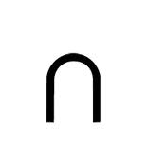
Client – Server Relation
Five possible relationships between L(A_{c}) and L(A_{s})
Client
Server
Server
Client
Server
Client
L(A_{s}) L(A_{c})
L(A_{c}) L(A_{s})
Client
Server
Client
Server
L(A_{c}) = L(A_{s})
L(A_{c}) L(A_{s}) ≠ Ø
L(A_{c}) L(A_{s}) = Ø
Notes:
Let us take a look at the possible relations between languages accepted by the client and the server side and see what are the possible inconsistencies between the two.
…
Based on these relations let us see what happens when we compute the difference signatures

Slide 38
Server-Client Difference Signature
We compute L(A_{s-c})
Client
Server
Client
Server
L(A_{s-c}) = Ø
L(A_{s-c}) ≠ Ø
Server
Client
Server
Client
Server
Client
Notes:
For the server-client difference signature:
The first two cases here do not contains inconsistencies.
While the remaining three cases actually contain an inconsistency which is the light blue area.

Slide 39
Client-Server Difference Signature
We compute L(A_{c-s})
Client
Server
server
client
L(A_{c-s}) = Ø
L(A_{c-s}) ≠ Ø
Client
Client
Server
Client
Server
Server
Notes:
Same thing can be said about the client-server difference signature

Slide 40
Computing Inconsistencies for the Two Example Functions
Compute two difference signatures:
L(A_{c-s}) = L(A_{c}) \ L(A_{s}) = Ø
L(A_{s-c}) = L(A_{s}) \ L(A_{c})
L(A_{s}) = ([^ ]⁺\(( )|(@.*@)|(@\.))|(^[\w]+@([\w]+\.[\w]{2,4})$))
\
L(A_{c}) = (Σ*\(( )|(@.*@)|(@\.)))|(^[\w]+@([\w]+\.[\w]{2,4})$)
=
L(A_{s-c}) = [ ]+
Counter Example = “ “
Notes:
Let us go back and take a look at the two example input validation functions that we have seen before.
The difference between the client and the server was empty which means the client does not accept more than the server.
On the other hand the difference between the server and the client was not empty. It actually consists of all strings with one or more white spaces. This means that the server accepts such strings while the client does not.
As a counter example, we generate a string with a single white space.

Slide 41
Evaluation
Analyzed a number of Java EE web applications
Name | URL
JGOSSIP | http://sourceforge.net/projects/jgossipforum/
VEHICLE | http://code.google.com/p/vehiclemanage/
MEODIST | http://code.google.com/p/meodist/
MYALUMNI | http://code.google.com/p/myalumni/
CONSUMER | http://code.google.com/p/consumerbasedenforcement
TUDU | http://www.julien-dubois.com/tudu-lists
JCRBIB | http://code.google.com/p/jcrbib/

Slide 42
Extraction Phase Performance
Subject | Frm | Inputs | VI_C | ET_C(s) | VI_S | ET_S(s)
JGossip | 25 | 83 | 74 | 329.8 | 83 | 4.38
Vehicle | 17 | 41 | 41 | 155.5 | 41 | 2.04
MeoDist | 18 | 62 | 62 | 192.2 | 62 | 1.93
MyAlumni | 46 | 141 | 0 | 0 | 141 | 4.28
Consumer | 3 | 21 | 14 | 68.4 | 21 | 1.1
Tudu | 3 | 11 | 0 | 0 | 11 | 0.78
JcrBib | 21 | 45 | 0 | 0 | 45 | 1.51
Notes:
First let us take a look at the performance of the extraction phase.
The largest number of inputs comes from MyAlumni web application which 141.
The largest extraction time is for client side of Jgossiop which is 329.8 seconds for all inputs.
You may notice that the extraction time for the server side is much smaller since we need to execute the client side.

Slide 43
Analysis Phase Memory Performance
Subject | Client-Side DFA |  |  |  |  |  |  | Server-Side DFA
 | Avr size (mb) | Min |  | Max |  | Avr |  | Avr size (mb) | Min |  | Max |  | Avr
 |  | S | B | S | B | S | B |  | S | B | S | B | S | B
JGOSSIP | 6.0 | 4 | 10 | 35 | 706 | 6 | 39 | 6.1 | 4 | 24 | 35 | 706 | 6 | 41
VEHICLE | 4.8 | 4 | 24 | 7 | 41 | 5 | 26 | 4.8 | 4 | 24 | 7 | 41 | 5 | 26
MEODIST | 5.7 | 5 | 25 | 5 | 25 | 5 | 25 | 5.7 | 5 | 25 | 5 | 25 | 5 | 25
MYALUMNI | 3.2 | 4 | 10 | 4 | 10 | 4 | 10 | 3.2 | 3 | 24 | 5 | 25 | 5 | 25
CONSUMER | 5.3 | 4 | 10 | 17 | 132 | 5 | 25 | 5.3 | 4 | 24 | 17 | 132 | 7 | 41
TUDU | 6.1 | 4 | 10 | 4 | 10 | 4 | 10 | 6.1 | 3 | 24 | 23 | 264 | 8 | 68
JCRBIB | 5.4 | 4 | 10 | 4 | 10 | 4 | 10 | 5.4 | 5 | 25 | 5 | 25 | 5 | 25
Notes:
Now let us take a look at the performance of the modeling and inconsistency checking phases.
We can see that the largest average memory consumption was about 6 mega bytes per DFA

Slide 44
Analysis Phase Time Performance & Inconsistencies That We Found
Subject | Time (s) | AC-S | AS-C
JGossip | 3.2 | 9 | 2
Vehicle | 1.5 | 0 | 0
MeoDist | 1.7 | 0 | 0
MyAlumni | 2.9 | 141 | 0
Consumer | 1.0 | 7 | 0
Tudu | 0.6 | 11 | 0
JcrBib | 1.2 | 45 | 0
Notes:
The largest analysis time is about 3 and a half seconds.
We found two inconsistencies where the server side accepts more than the client side.
We found a large number of inconsistencies where the client side accepts more than the server side. This is due to the fact that some applications lack client side input validation.

Slide 45
Related Work
String Analysis
String analysis based on context free grammars: [Christensen et al., SAS’03] [Minamide, WWW’05]
Application of string analysis to web applications: [Wassermann and Su, PLDI’07, ICSE’08] [Halfond and Orso, ASE’05, ICSE’06]
Automata based string analysis: [Xiang et al., COMPSAC’07] [Shannon et al., MUTATION’07]
Input Validation Verification
FLAX [ P. Saxena et al., NDSS’10 ]
Kudzu [ P. Saxena et al., SSP’10 ]
NoTamper [ P. Bisht et al., CCS’10 ]
WAPTEC [ P. Bisht et al., CCS’11 ]
[ M. Alkhalaf et al., ICSE’12 ]

Slide 46
Questions

Slide 47
Web applications are not trustworthy
Extensive string manipulation:
Web applications use extensive string manipulation
To construct html pages, to construct database queries in SQL, to construct system commands, etc.
The user input comes in string form and must be validated before it can be used
String manipulation is error prone
Notes:
Web application are not trustworthy because they extensively use string manipulation.

