Slide 1
Remote Client-Side Monitoring for Web Applications
Shauvik Roy Choudhary, Alex Orso
Georgia Institute of Technology
Notes:
Good Morning, I am Shauvik from Georgia Tech and today I’ll be presenting to you my paper on “Remote Client-Side Monitoring for Web Applications”.
At the start, lets look at our motivation in this area…

Slide 2
Motivation
Paradigm shift from Web 1.0 to Web 2.0
Heavy client-side scripts
From synchronous to asynchronous
Multitude of client-side environments
New problems for testing
Notes:
As we know, that recently there has been a shift from Web 1.0 to Web 2.0
In this transition, we have seen that client side scripts have got heavier, we have moved from synchronous to asynchronous communication and that we have a multitude of client side environments.
All this has lead to new problems in testing.
Lets have a look at these issues in more detail….

Slide 3

Heavy client side scripts
More and more logic pushed to the browser (Javascript, Flash, Silverlight, …)
Little/no information on the server about client-side execution
Notes:
Client-side scripts have become heavy as more and more logic is being pushed from the server to the browser in the form of Javascript, Flash, Silverlight and many more technologies.
Although with so many things going on at the client-side, the server has little or no information about the browser execution.

Slide 4
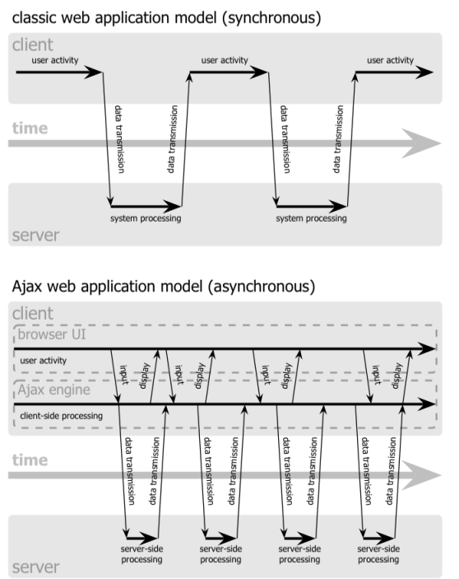
From synchronous to asynchronous
Concurrency
Non-determinism
Additional complexity of testing environment
Notes:
Next, we have seen that we have moved from a synchronous communication model to an asynchronous model.
In the old model, the browser had to wait until the response was received for the request it sent.
But in the asynchronous model, it can send requests and retrieve data from the server in the background without disturbing the display and behavior of the existing page.
Although Ajax has brought a richer user experience to the user, there can inherent issues related to concurrency and non-determinism involved due to the sequence of messages that are sent back and forth. This leads to additional complexity in the testing environment.

Slide 5

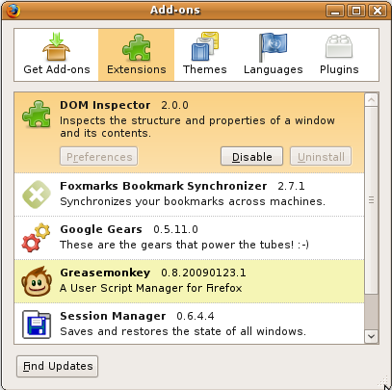
Multitude of client-side environments
Browsers
Browser Extensions
X
Notes:
More over we have a multitude of client side environments that are due to the numerous range of browsers running on different platforms. Moreover the client side behavior is also affected by the numerous browser extension that each browser has.
Lets look at an example of a sample browser configuration..

Slide 6

An Example Client Side Configuration
Cookie used to track upload status
Cookie used to check if stats should be displayed
Page A
File Upload
URL:
http://www.site.com
Developer/Tester needs client-side insight for errors that might occur only in a particular context
Page B
Display Stats
setCookie(“status”, “uploaded”)
If (!getCookie(“status”)) {
setCookie(“status”, “display”)
reloadPage();
}
Local Database
Cookies
Cookies
Extensions
Notes:
Browser behavior, (as we saw on the previous slide) depends not only on the browser and the platform it is running on but also on the numerous configurations that can be due to local database, temporary files, cookies and browser extensions.
Lets look at an example. Say, developer A implements a webpage called “File Upload”. We see that the browser loads the page and stores a cookie in which the developer stores the file upload status. Since a cookie is stored on the disk, it is persistent between requests.
Not, lets see another page implemented by developer B. Here we see that developer B also decided to use the same cookie name for tracking another functionality. This causes a bug and would not be discovered if page A and page B are never tested together.
Although this was a trivial example, such errors can be caused due to any of the client side configurations in an browser environment. So, the bottom-line is that the developer or tester needs to have client-side insight for errors that might occur in a particular context.

Slide 7
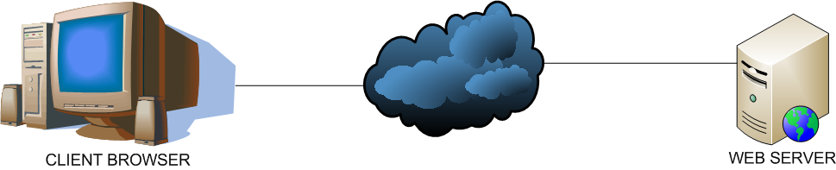

A normal web application scenario
index.html
HTTP response
HTTP request
Internet
Notes:
Before we look into our technique, let us have a look into a normal web application scenario.
As we know, the client browser makes an HTTP request to the server over the Internet.
The Web server on receiving this request, generates an HTTP response in the form of an HTML page and send it back to the client. This page is then rendered by the browser.

Slide 8
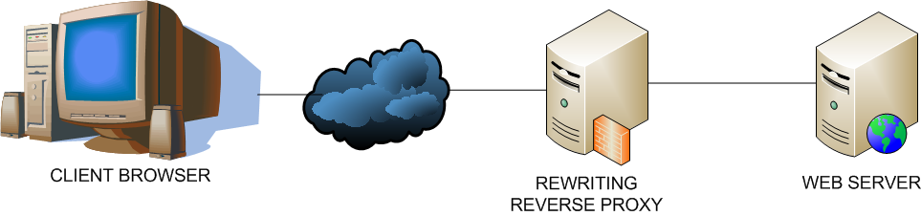
Our monitoring technique
index.html
JS Agent
index.html
HTTP response
HTTP response
HTTP request
Internet
JS Agent
Injection policy
Notes:
Our monitoring technique makes use of a rewriting reverse proxy.
A reverse proxy is often used on the server side to shield the server from direct internet traffic.
By rewriting we mean that the reverse proxy is capable of rewriting the data that it relays.
Lets have a look at how our proxy does this.
When the proxy receives an HTTP request, it forwards it to the webserver.
But when the webserver generates an HTTP response, our proxy looks at it’s injection policy and injects a Javascript agent into the HTTP response. This is then sent over to the client browser which on rendering the page also loads our JS Agent.

Slide 9
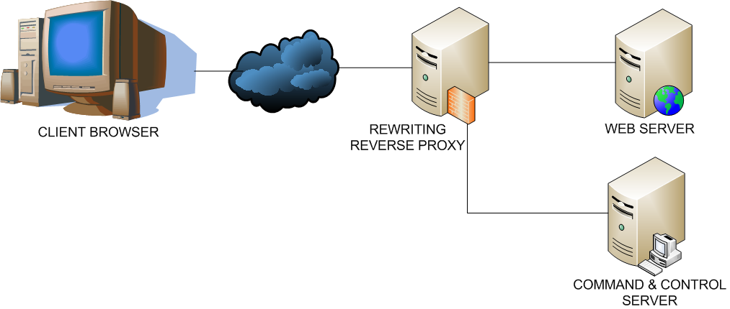
Command and Control
Command response
Command request
HTTP request
Web Application Data
Monitoring Data
Monitoring Data
JS Agent
Commands
Notes:
Ok, so now we have a JS Agent. But how do we make it do what we need to.
For this, we have introduce a command and control server.
Lets see how the CnC server operates in conjunction to the proxy.
When the browser sends an HTTP request, the reverse proxy can identify it as Web application data and forwards it to the Web Server.
Since HTTP doesn’t support PUSH, we make our JS Agent poll the CnC server.
When the JS Agent sends a command request to the CnC server, the proxy identifies as monitoring data using a URL reg-ex match and forwards it to the CnC server. The CnC server processes this request and if it needs the JS Agent to perform any action, it prepares a set of commands that are sent to it. The JS Agent then processes these commands and sends them back to the CnC server.
This is how our technique can get information about remote client end. Now, lets see what commands can achieve…..

Slide 10
What can commands do?
Query
HTML DOM node (web page elements)
Javascript objects, variables, arrays
Notify – Interact with user
Display a message (HTML alert or layered dialog)
Update
Add/Change a node in the HTML DOM
Add more Javascript to page or change existing code
…
Notes:
Commands can Query client-side execution state like the elements of the HTML DOM or Javascript objects.
The user can be notified using an HTML alert or a layered dialog box.
Commands can even update the client-side DOM, add or change Javascript in the page.
Although we have implemented these 3 command types, there are more things that can be done with such a general technique.

Slide 11
Sample Command
1. <commands>
2. <cmd>
3. <id>8de9</id>
4. <name>ALERT</name>
5. <param>Hello World!</param>
6. </cmd>
7. <cmd>
8. <id>3bsd</id>
9. <name>DUMP</name>
10. <param>myObj</param>
11. <param>myArray</param>
12. </cmd>
13. </commands>
Notes:
Now lets see how commands looks like. Here we see that the CnC server sends two commands to the JS Agent.

Slide 12
Sample Command
Id:8de9
Alert(Hello World !)
Id:3bsd
Dump(myObj)
Dump(myArray)
1. <commands>
2. <cmd>
3. <id>8de9</id>
4. <name>ALERT</name>
5. <param>Hello World!</param>
6. </cmd>
7. <cmd>
8. <id>3bsd</id>
9. <name>DUMP</name>
10. <param>myObj</param>
11. <param>myArray</param>
12. </cmd>
13. </commands>
Notes:
The first command hows an HTML alert box in the browser with text “Hello World!”
The second command asks the JS Agent to dump/return the values of an object and an array.
For these 2 commands, the JS Agent will send a response like this……

Slide 13
Sample Response
1. <responses>
2. <resp>
3. <id>8de9</id>
4. <status>1</status>
5. </resp>
6. <resp>
7. <id>3bsd</id>
8. <message>myObj={ "aString":"Howdy",
"anInteger":10,
"aBoolean":true }</message>
9. <message>myArray=[1,"foo","web"]</message>
10. </resp>
11. </responses>
Notes:
As you must have noticed that responses are matched to their commands by the unique id.

Slide 14
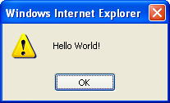
Sample Response
1. <responses>
2. <resp>
3. <id>8de9</id>
4. <status>1</status>
5. </resp>
6. <resp>
7. <id>3bsd</id>
8. <message>myObj={ "aString":"Howdy",
"anInteger":10,
"aBoolean":true }</message>
9. <message>myArray=[1,"foo","web"]</message>
10. </resp>
11. </responses>
Notes:
The first message was a notification request for which the JS Agent responded with a Status = 1, meaning that the HTML alert box was shown in the browser.

Slide 15
Sample Response
<script type="text/javascript">
myObj=new Object();
myObj.aString=“Howdy";
myObj.anInteger=10;
myObj.aBoolean=true;
</script>
1. <responses>
2. <resp>
3. <id>8de9</id>
4. <status>1</status>
5. </resp>
6. <resp>
7. <id>3bsd</id>
8. <message>myObj={ "aString":"Howdy",
"anInteger":10,
"aBoolean":true }</message>
9. <message>myArray=[1,"foo","web"]</message>
10. </resp>
11. </responses>
Notes:
For the second message we can see that the JS Agent encoded the member variables of the object and sent it back in command response.

Slide 16
Sample Response
<script type="text/javascript">
myArray=new Array();
myArray[0]=1;
myArray[1]=“foo”;
myArray[2]=“web”;
</script>
1. <responses>
2. <resp>
3. <id>8de9</id>
4. <status>1</status>
5. </resp>
6. <resp>
7. <id>3bsd</id>
8. <message>myObj={ "aString":"Howdy",
"anInteger":10,
"aBoolean":true }</message>
9. <message>myArray=[1,"foo","web"]</message>
10. </resp>
11. </responses>
Notes:
Similarly the array was encoded and sent back to the CnC server.
So, we saw that the it was possible to have the JS agent execute our commands.
But what about performance? …

Slide 17







Preliminary evaluation
Goal: Measure agent-injection overhead and JS agent performance
Subjects: 10 applications – sample code, open source projects and commercial websites
echo framework
Google
Web Toolkit
Notes:
We did a preliminary evaluation of our technique to measure the JS agent-injection overhead and the agent performance.
For our experiments, we considered 10 subject applications from sample code distributed with Ajax frameworks, open source web applications and commercial websites.

Slide 18
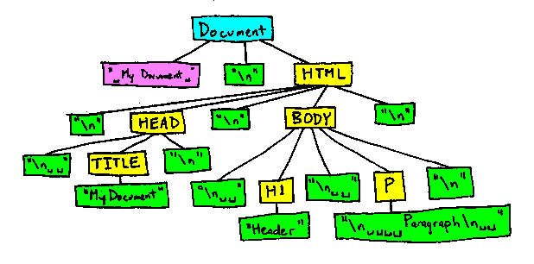

Experimental protocol
JSA injection overhead
JSA performance
index.html
URL:
http://www.site.com
JS Agent
X 100
Main page
Measure time to Inject the main page
Iterate window object and count number of visited elements
Notes:
To measure the JSA injection overhead, we measured the time taken to inject the JS agent into the main page of each application. To take care of transitory effects, we averaged the results over 100 attempts.
For measuring the JSA performance, we sent a command to the JS agent to iterate over the contents of the window object (i.e. HTML DOM and other browser window variables). The JS agent returns the number of elements it visited.

Slide 19
Results
JSA injection overhead
JSA performance
0.1 and 8 milliseconds per page
window object iterated in 3-4 ms
Application | # Objects | Time (ms)
Mail | 1286 | 9
Showcase | 4490 | 30
Chat Client | 147 | 2
Number Guess | 144 | 3
Interactive Test | 147 | 2
Drupal | 118 | 1
Joomla | 229 | 3
Wordpress | 176 | 3
iGoogle | 618 | 6
Amazon.com | 314 | 4
Notes:
Our applications have been arranged in their increasing order of page-size and it ranges from a few kbs to around 140kb. We see that the time to inject the agent remained quite stable in most cases and was in an acceptable range of of a few milli seconds.
The JSA performance results showed that the objects were iterated in a small time duration.
Now, as we have seen that this technique is feasible, lets look at some possible application scenarios.

Slide 20
Application Scenarios
Error Detection and Debugging
Logging and Recovery
Metrics Collection
Code Coverage
Click-streams / User Activity
Browser Statistics
Memory Profiling
Count variables, arrays, objects
Security checks
Notes:
The first thing that comes to mind is error detection and debugging. The browser has certain events and routines that it calls when an error is encountered. By attaching itself to this event, our JS agent can detect client-side errors and report it to the CnC server. The CnC server can then ask JS agent to provide additional information that is used for logging and possible error recovery.
Using the JS Agent, we can now collect a lot of metrics from the client-side. This may include Code Coverage, monitoring user activity and click streams and getting other statistics from the client-end.
The CnC server could get the count of Javascript elements from the agent and compute how much memory is being consumed on the client-side.
Additionally, the JS Agent can periodically perform security checks.

Slide 21
Summary and future work
Summary
General technique for remote monitoring of web applications
Proof-of-concept evaluation
Example applications
Future work
Complete implementation
Investigate applications
Additional experimentation
Notes:
In summary, we proposed a general technique for remotely monitoring the client-side code of web applications.
We performed a proof-of-concept evaluation of our technique and listed some example applications of this technique.
In future work, we would like to complete our implementation of this technique and investigate the applications in greater depth through additional experimentation.

Slide 22

Thank you !
Any Questions ?
shauvik@cc.gatech.edu
http://www.cc.gatech.edu/~shauvik
Notes:
Thank you.

Slide 23
Related Work
AjaxScope [Kiciman07]
Dynamic source level instrumentation
Nice but different scope:
Distribute tests across clients
No CSA:
Can’t perform corrective actions on the client-side
Can’t take decisions based on client-side actions

