Slide 1
Platform Support for Developing Analysis and Testing Plugins
Shauvik Roy Choudhary
with
Jeremy Duvall, Wei Jin, Dan Zhao, Alessandro Orso
School of Computer Science – College of Computing
Georgia Institute of Technology
Notes:
SEIF

Slide 2
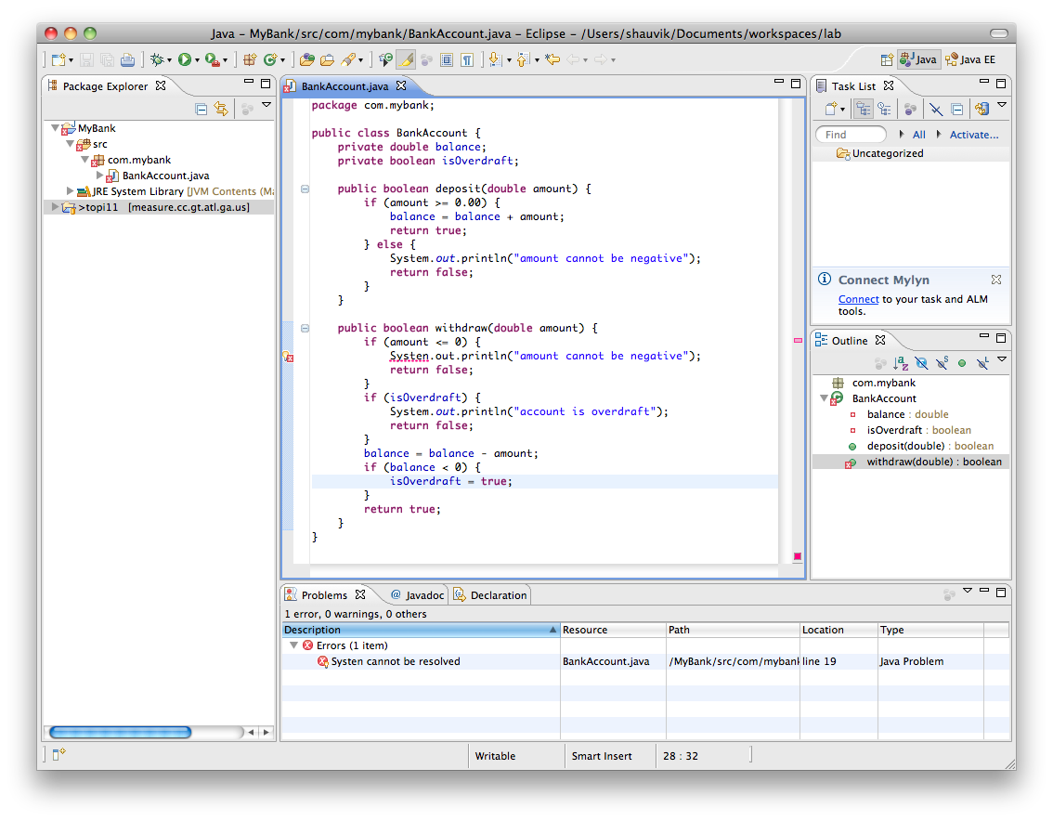
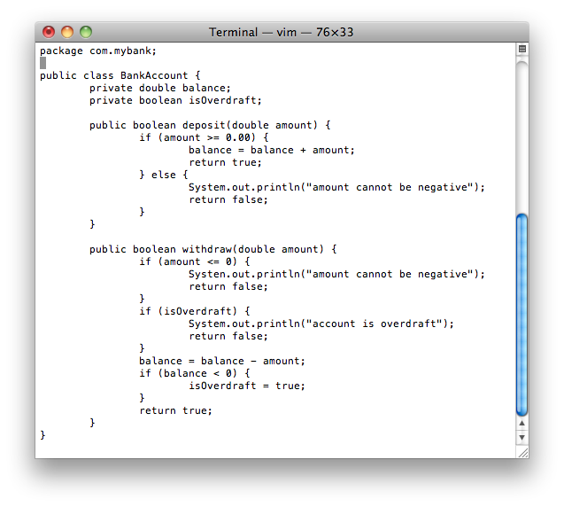
Development Environment

Slide 3
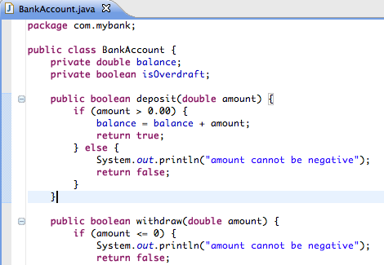
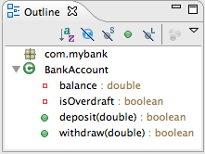





IDE features
IDE
Plug-in
Source Code
Editor
Views
SCM
Plug-in
Plug-in
Builders
Runtime
Debugger
Testing
… … …
Note: Plug-ins are called as Add-ins in Visual Studio

Slide 4


IDE features
IDE
Plug-in
Focus of this talk:
IDE Features for developing plug-ins that support
“Program Analysis and Software Testing”
Source Code
Editor
Views
SCM
Plug-in
Case Study: BERT
(BEhavioral Regression Testing)
[WODA’08][ICST’10][FSE-demo’10]
Plug-in
Builders
Runtime
Debugger
Testing
… … …
Note: Plug-ins are called as Add-ins in Visual Studio

Slide 5
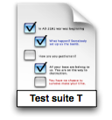
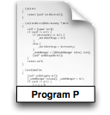
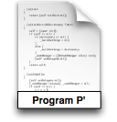
Regression Testing Process and Issues
?

Slide 6
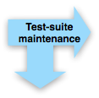








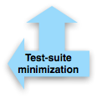
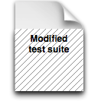

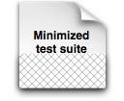

Regression Testing Process and Issues

Slide 7
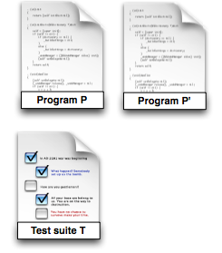


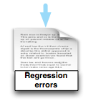
Traditional Regression Testing
Existing test suites typically target a small subset of the program behavior
Tests focus on core functionality
Oracles often approximated

Slide 8
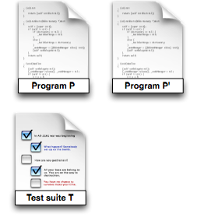
Traditional Regression Testing
BERT

Slide 9
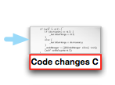



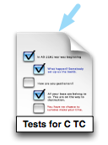
BERT
Phase I: Generation of test cases for changed code

Slide 10


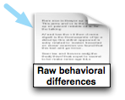
BERT
Phase II: Behavioral comparison

Slide 11



BERT
Phase III: Differential behavior analysis and reporting
Notes:
Refines and Ranks the behavioral differences

Slide 12
BERT
Traditional Regression Testing
Notes:
Refines and Ranks the behavioral differences

Slide 13
Our Experience
Programming language Java C#
Intercepting save and build events ✔ ✔
Triggering and checking build process ✔ ✔
Computing program differences ✔ ✖ (custom)
Generating test cases ✔ (Randoop, JPF) ✔ (PEX, Randoop.NET)
Instrumenting code ✔ (Javassist) ✔ (CCI)
Running test cases and code ✔ ✔
Visualizing information for user ✔ ✔
Notes:
Javassist – bytecode level
CCI – binary level

Slide 14
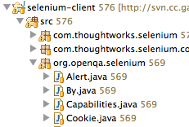


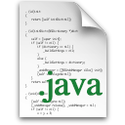

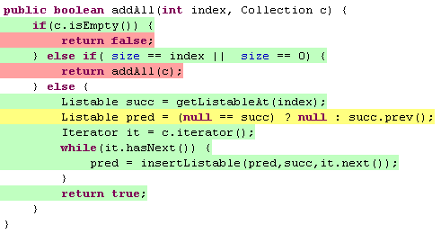








IDE Support for Program Analysis and Testing Plug-ins
Project Artifacts
and Events
Static Information
Dynamic Information
Graphical Features
Plug-in Development
Support
Notes:
Disclaimer: Not comprehensive

Slide 15
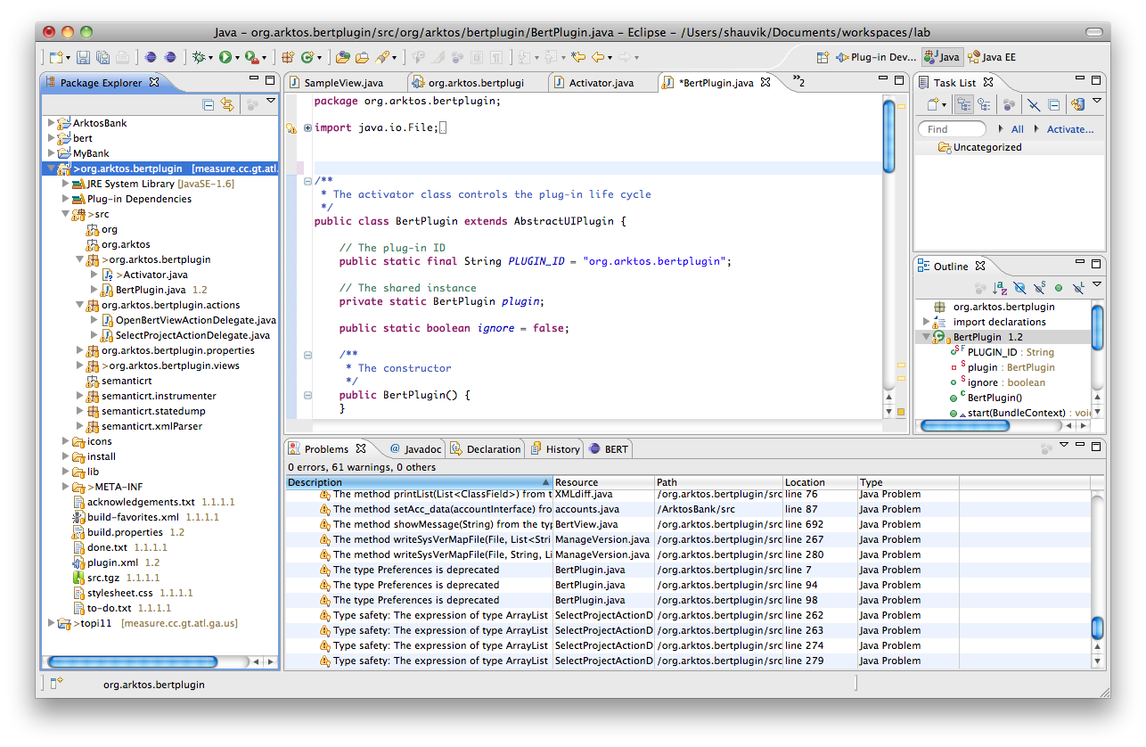
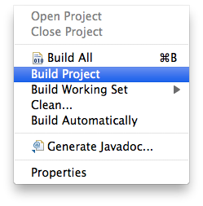
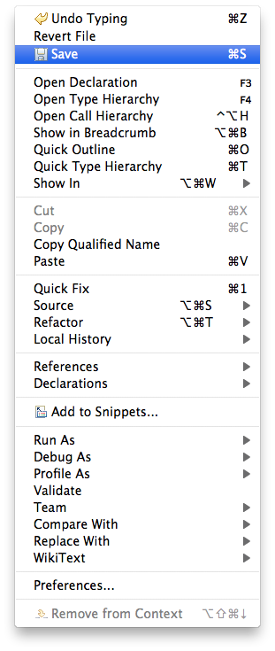
1. Project Artifacts and Events
Notes:
- Code — either in source or compiled form — and configuration files.
- Be aware of software development activities
Perform their tasks right after the activity occurs
Well supported but in very different ways

Slide 16
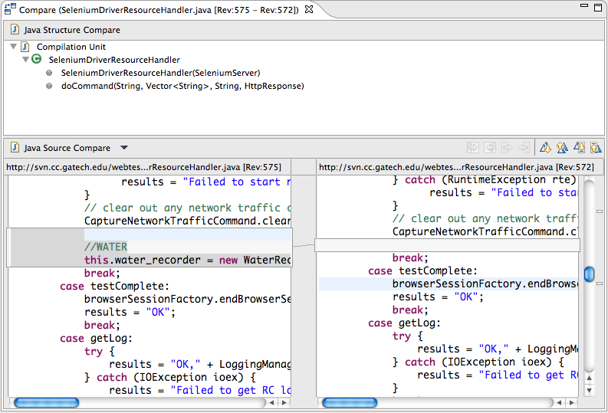
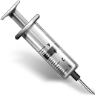
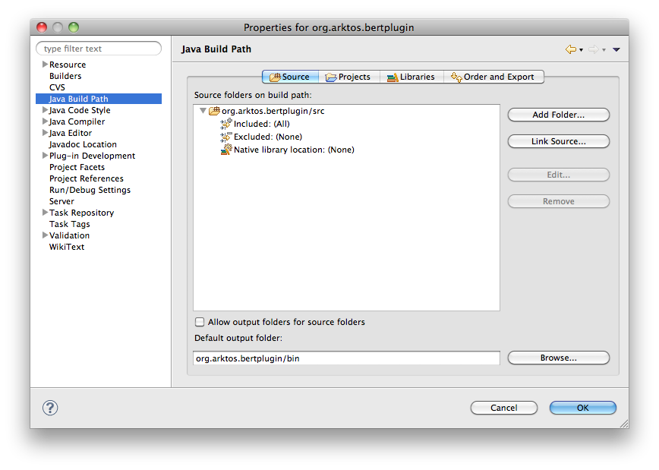

2. Static Information
Intermediate representations
Program differencing
Instrumentation
Build parameters
AST
Notes:
Intermediate representations. – ASTs, CFG, SDG
Differences – regression testing tasks on evolving programs, CVS-SVN, Local
Instrumentation -- need to add probes to do dyn activities like runtime monitoring, dynamic memory protection, or logging. Static Artifacts
Build Parameters – e.g., third party library, compiler option

Slide 17
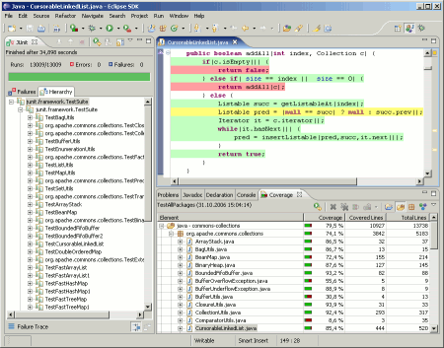
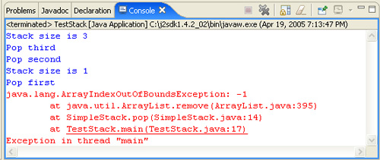
3. Dynamic Information
Test Execution
Runtime Metrics
Debugging information
Test
Run
Notes:
Test Execution -
- ability to execute test cases from within the IDE
Runtime Metrics
Debugging information
assist debugging activities by providing more information to developers
- current and past executions to give developers more insight about the program’s behavior

Slide 18
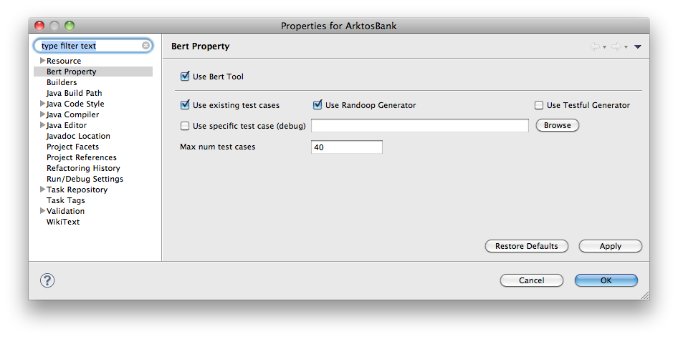
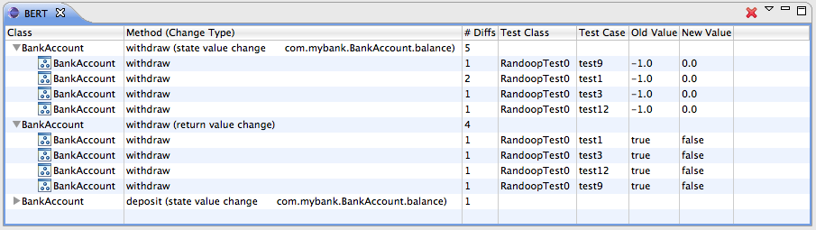
4. Graphical Features
Provide GUI hooks to access plug-in functionality
Obtain user input or tool preferences
Present data to user and allow them to interact with it

Slide 19
5. Plug-in Development Support
Development
API Documentation
Sample Code and Informal Documentation
Testing, Debugging, and Maintenance
Launch and monitor IDE instance

Slide 20
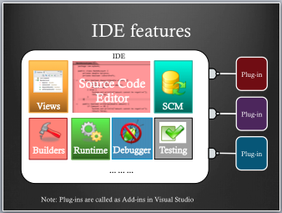
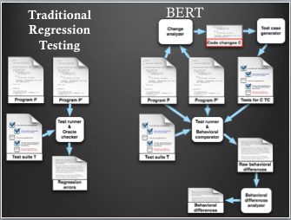
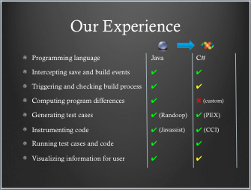
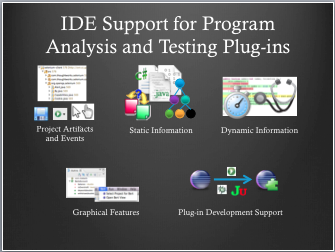
Summary
Notes:
In summary, we saw that IDEs provide features for plugin development. Next I gave you a brief overview of BERT and then presented our experience porting it from Eclipse to Visual Studio. And then I presented the features that we think IDEs should provide for developing Analysis and Testing plugins.

