Slide 1
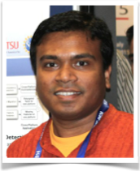
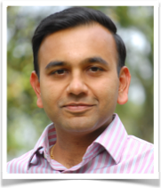
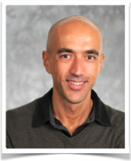


X-PERT A Web Application Testing Tool for Cross-Browser Inconsistency Detection
Shauvik Roy Choudhary, Mukul Prasad, Alessandro Orso
Labs of America
Notes:
Good afternoon.
I am Shauvik Roy Choudhary from Georgia Tech. I’ll be presenting our X-PERT tool, which detects cross-browser inconsistencies in web applications. This work was done in collaboration with Mukul Prasad, from Fujitsu Labs, and my advisor Alex Orso.

Slide 2




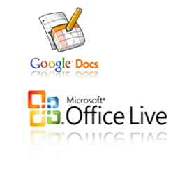






Web Applications
Notes:
We all use web applications for our day-to-day activities and we access such applications through web browsers.
I’m sure you have come across issues across browsers…
Inconsistencies in a web application’s behavior across browsers is a serious problem for developers and negatively affects the user of the web application.
Such inconsistencies can be in ..

Slide 3
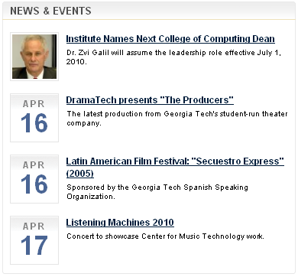
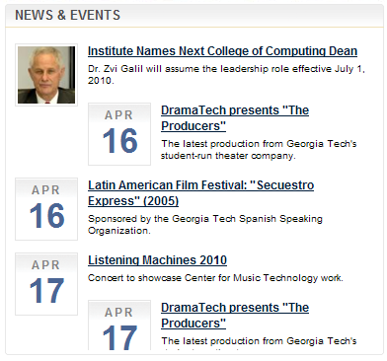
Layout Inconsistency
Mozilla Firefox
Internet Explorer
Notes:
The layout of the web application, where elements on the page are misaligned.

Slide 4
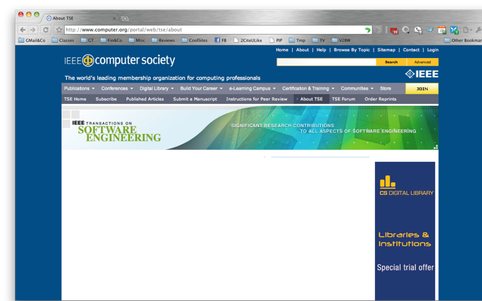
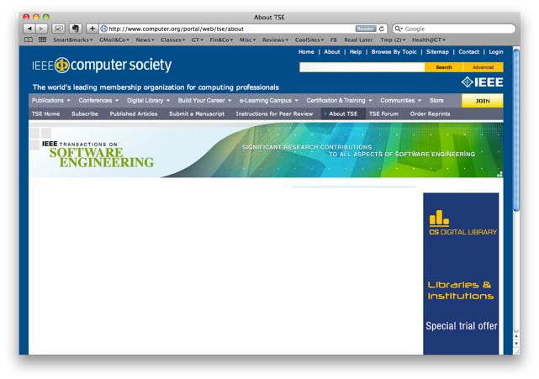
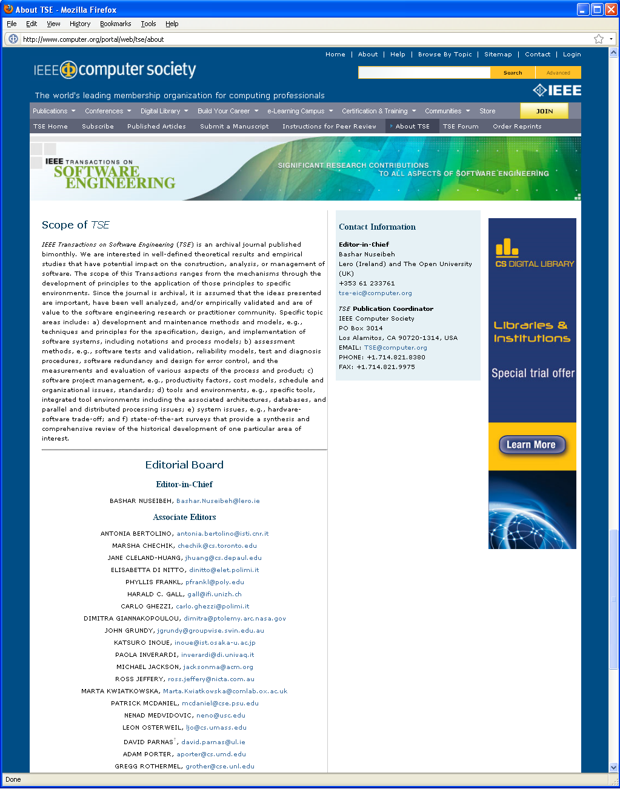
Content Inconsistency
Google Chrome
Apple Safari
Mozilla Firefox
Notes:
It can be in any content on the webpage, which is missing or wrongly rendered in a particular set of browsers.

Slide 5


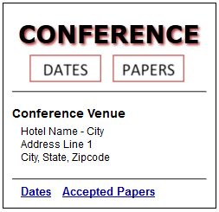

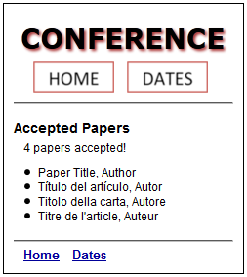
Behavior Inconsistency
Notes:
And finally, it can be in the behavior of widgets in the web application, which can be broken across browsers.

Slide 6

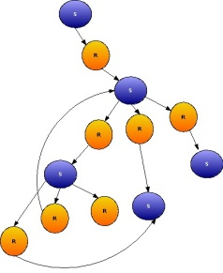


X-PERT
Technique [ICSM’10, ICST’12, ICSE’13]
Tool [ISSTA’14]
δ
δ
Error Report
Web Application
Model Generation
Model Comparison
Notes:
To automatically detect such issues, we developed X-PERT. The underlying technique was presented at ICSE last year and at ISSTA, we are presenting the X-PERT tool.
Basically, X-PERT works as follows. It takes a web application, explores it in different browsers to generate the browser-specific models of the web application. It then compares these models to detect all kinds of inconsistencies.

Slide 7
Come to our Demo!
ISSTA Reception
Today at 6pm
X-PERT: A Web Application Testing Tool for Cross-browser Inconsistency Detection
Shauvik Roy Choudhary, Mukul Prasad, and Alessandro Orso
Georgia Institute of Technology & Fujitsu Labs of America
Notes:
For more details about X-PERT, please come and see us at the demo this evening. Thank you!

