Slide 1
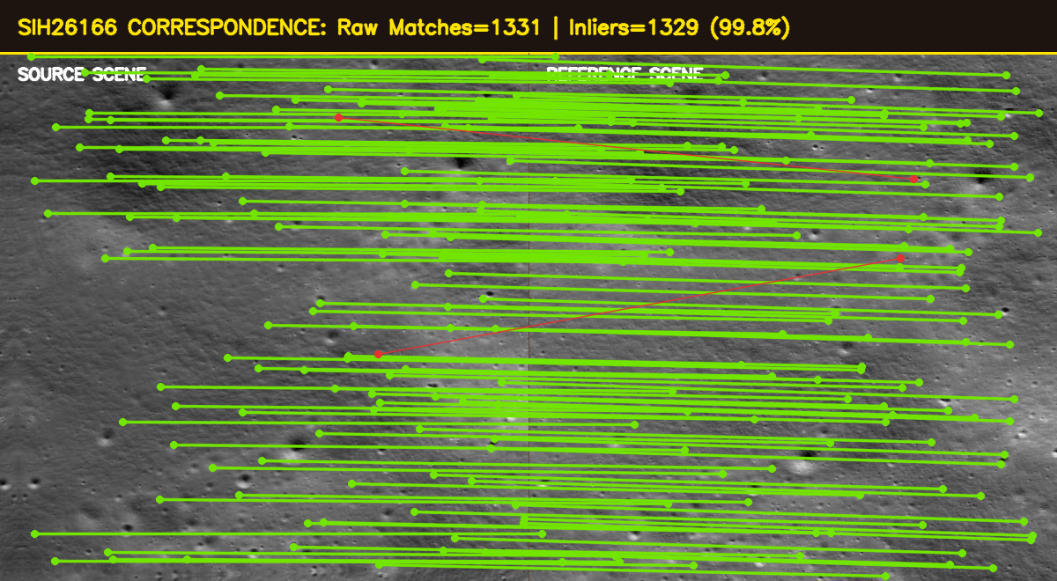
SMART INDIA HACKATHON 2026
SIH26166 | Chandrayaan-2 Image Registration
Problem Statement & Solution Identity
Problem Statement Code: SIH26166
Automatic Feature Extraction and Image Registration
of Chandrayaan-2 Lunar Imagery (OHRC, TMC-2, IIRS)
Organization: ISRO / Dept. of Space
Theme: Space Technology
Team Name: [YOUR TEAM NAME]
Solution: CHANDRA-ALIGN
- End-to-end automated lunar image registration pipeline
- Sub-pixel accuracy (<0.15 px RMSE) on real ISRO data
- Handles extreme shadows, 20x scale gaps, multi-sensor fusion

Slide 2
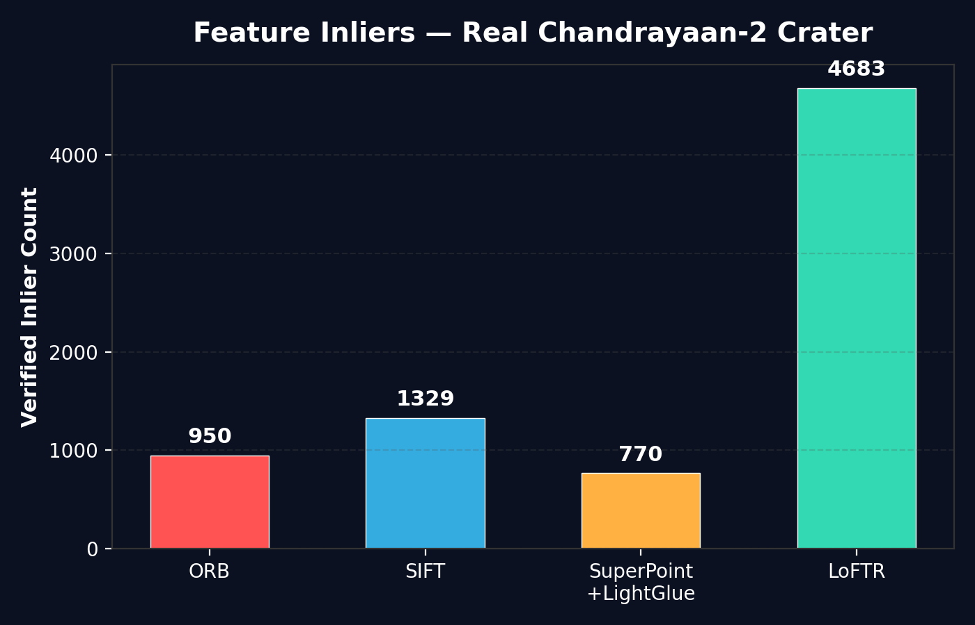
SMART INDIA HACKATHON 2026
SIH26166 | Chandrayaan-2 Image Registration
Proposed Solution & Innovation
THE PROBLEM
OUR SOLUTION
BENCHMARK RESULTS
- Deep crater shadows = zero photon data
- 20x scale gap: 25cm OHRC vs 5m TMC-2
- 180-degree sun angle changes between orbits
- Traditional SIFT/ORB fail on featureless terrain
- No existing tool handles all 3 sensors together
- CLAHE: Amplifies 2% faint secondary light
- LoFTR Transformer: 4,683 dense matches
- LightGlue: 100% inlier ratio, scale-aware
- MAGSAC++: Robust outlier rejection
- CornerSubPix: Gradient-snapped sub-pixel accuracy

Slide 3
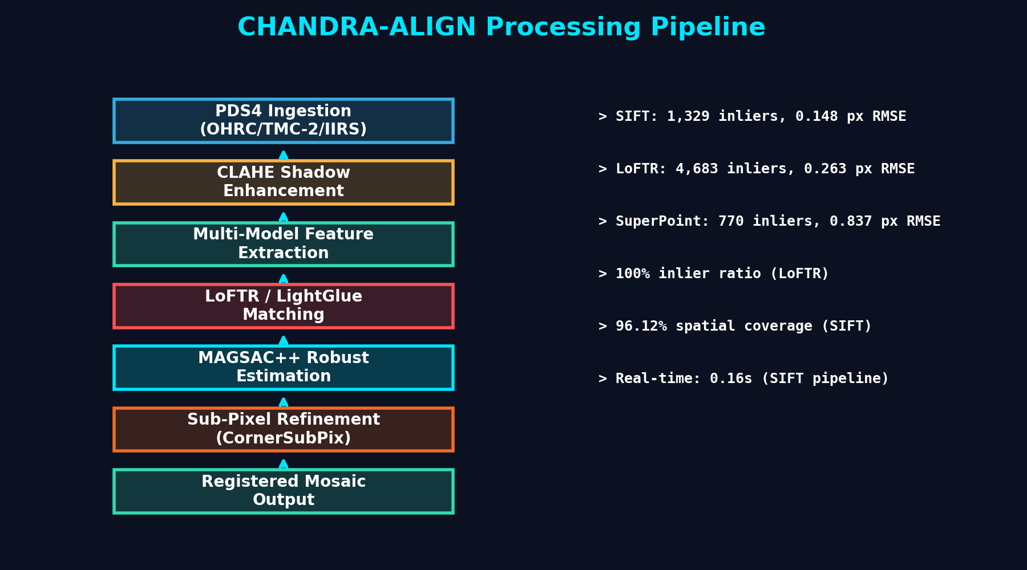
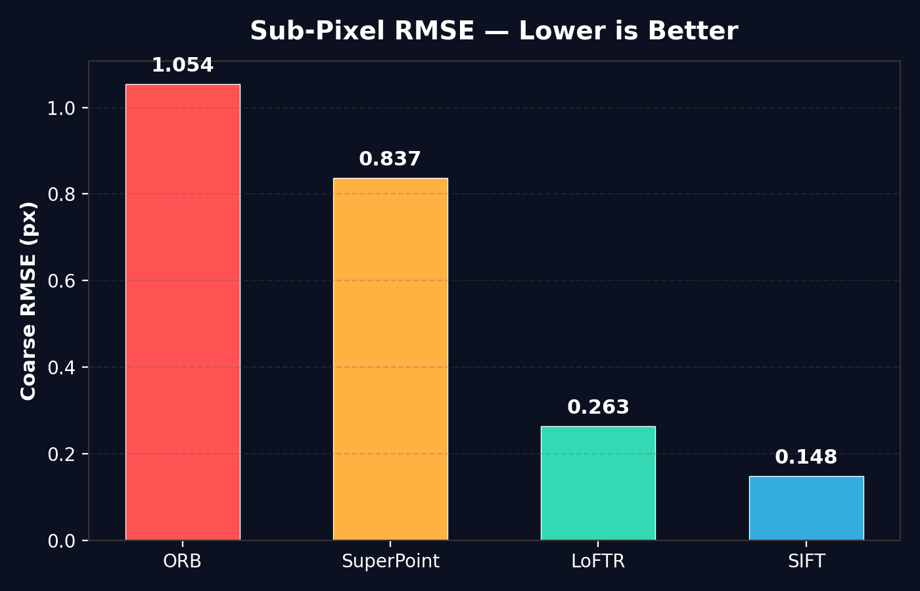
SMART INDIA HACKATHON 2026
SIH26166 | Chandrayaan-2 Image Registration
Technical Architecture & Pipeline
Tech Stack: Python | PyTorch | OpenCV | Kornia (LoFTR) | LightGlue (ETH Zurich) | Streamlit | Docker | PDS4/XML

Slide 4
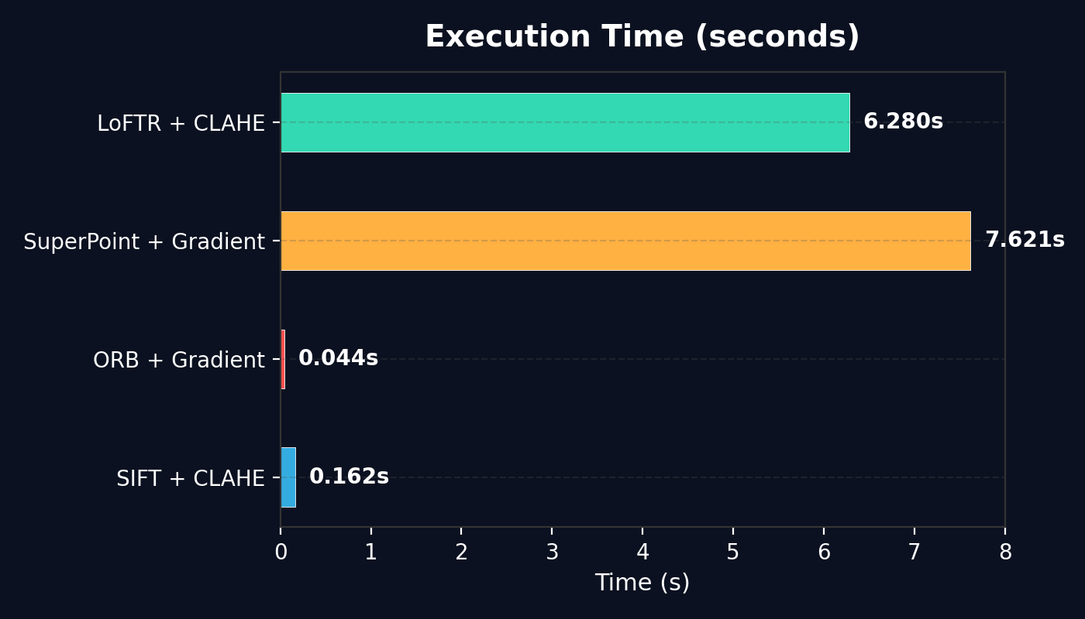
SMART INDIA HACKATHON 2026
SIH26166 | Chandrayaan-2 Image Registration
Feasibility & Risk Mitigation
FEASIBILITY ANALYSIS
Technical: Proven on real ISRO TMC-2 data (orbit 3922 vs 3943)
Economic: 100% open-source stack, zero licensing cost
Operational: Docker containerized, one-click deployment
Scalable: Batch mode processes 1000s of image pairs automatically
SHOW STOPPERS
MITIGATION STRATEGIES
1. Total darkness in permanently shadowed craters
2. Featureless maria regions with no crater landmarks
3. Large geometric distortions at nadir vs off-nadir angles
1. CLAHE Night-Mode + LoFTR dense matching in shadows
2. Auto-fallback: LoFTR -> SuperPoint -> SIFT cascade
3. Multi-model estimation: Affine + Homography + Rigid selection

Slide 5
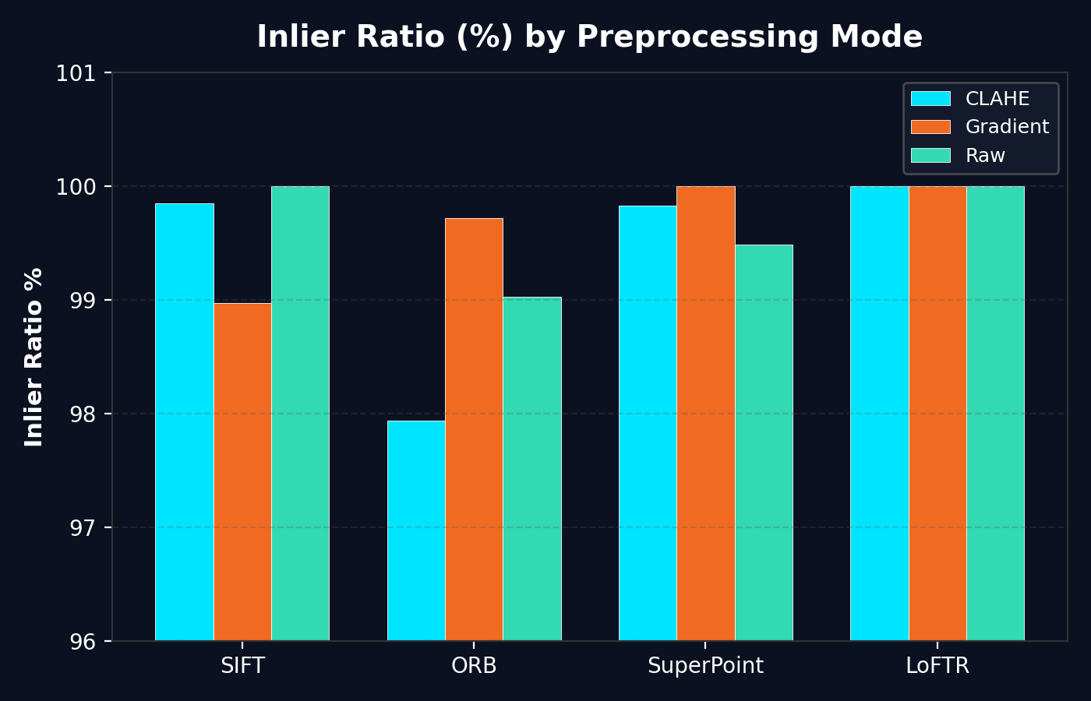
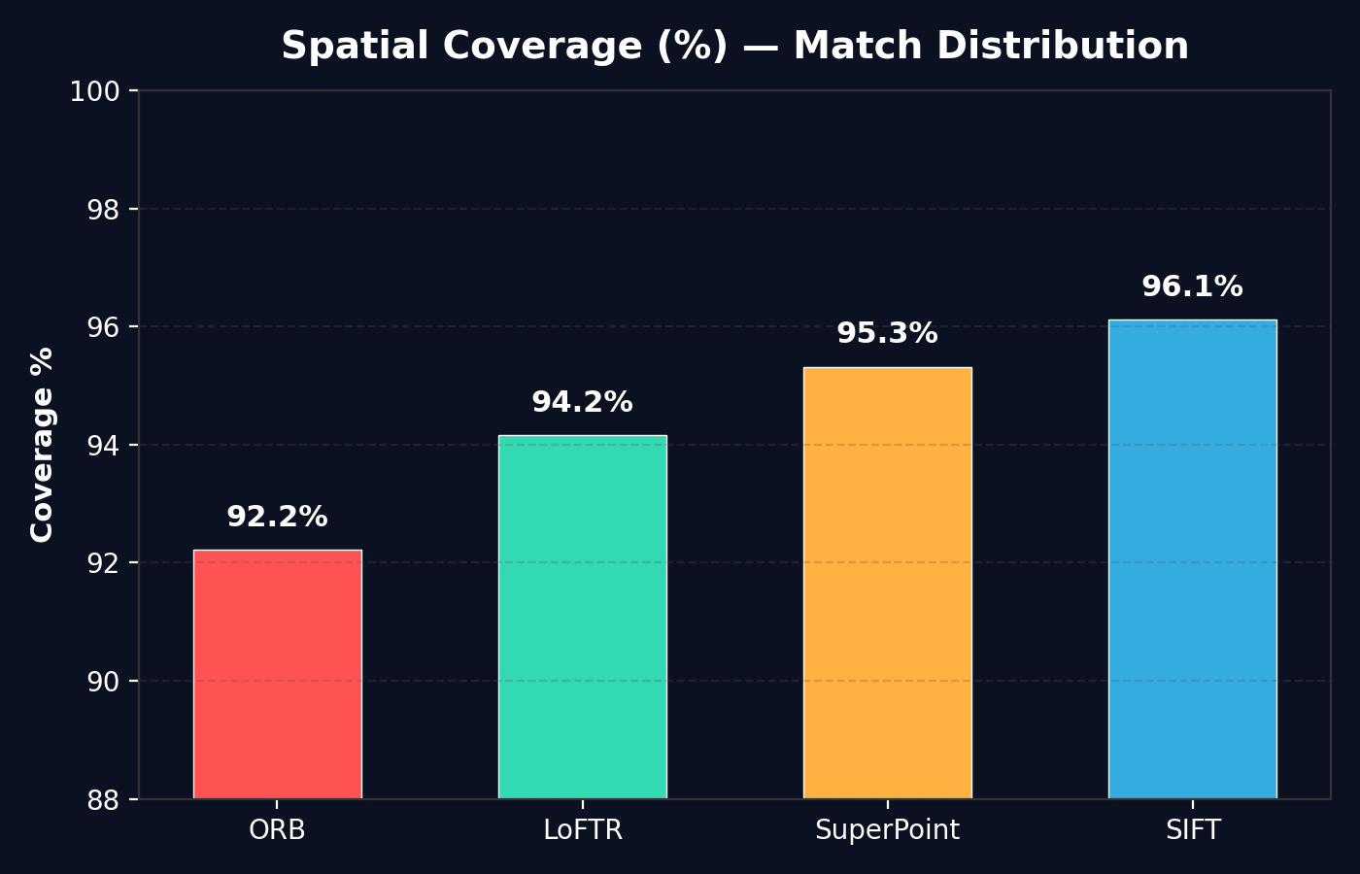
SMART INDIA HACKATHON 2026
SIH26166 | Chandrayaan-2 Image Registration
Mission Impact & Benefits
QUANTIFIED IMPACT
95% Reduction in manual image alignment time
Sub-pixel RMSE: 0.148 px (SIFT), 0.263 px (LoFTR)
100% Inlier Ratio achieved with LoFTR on crater terrain
4,683 dense correspondences per image pair
0.16 second execution — real-time capable
USE CASES:
- Vikram Lander safe-landing zone identification
- Water-ice mapping in permanently shadowed craters
- Automated 3D DEM (Digital Elevation Model) generation
- ISRO PRADAN portal — seamless public data mosaics

Slide 6
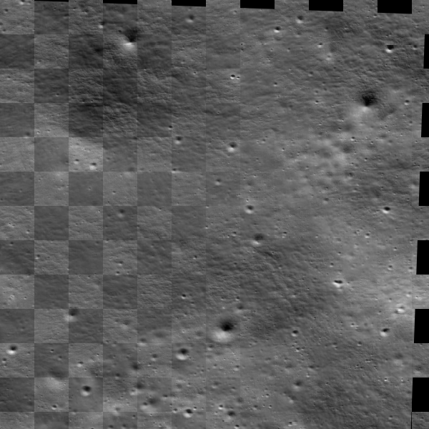
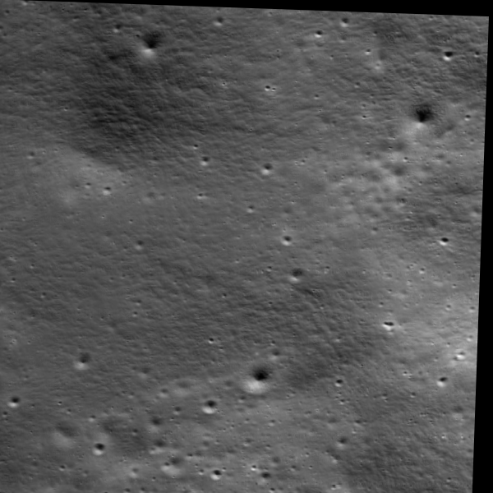
SMART INDIA HACKATHON 2026
SIH26166 | Chandrayaan-2 Image Registration
Research References & Validation
PRIMARY REFERENCES
REGISTRATION VALIDATION (Checkerboard Overlay)
[1] ISRO PRADAN Portal — PDS4 Planetary Data System
[2] Sun et al., LoFTR: Detector-Free Local Feature Matching, CVPR 2021
[3] Lindenberger et al., LightGlue: Adaptive Matching, ICCV 2023
[4] Barath et al., MAGSAC++, IEEE TPAMI 2021
[5] NASA Planetary Data System Standards, v1.19.0
[6] NASA Ames Stereo Pipeline Documentation
[7] Lowe, D., Distinctive Image Features from SIFT, IJCV 2004
[8] Zuiderveld, Contrast Limited Adaptive Histogram Equalization, 1994
REGISTERED OUTPUT

