Slide 1
SMART INDIA HACKATHON 2026
Team Name: [INSERT TEAM NAME]
Problem Statement Code: SIH26166
Problem Statement Title: Automatic Feature Extraction and Image Registration of Chandrayaan-2 Lunar Imagery (OHRC, TMC-2, IIRS)
Theme: Space Technology

Slide 2
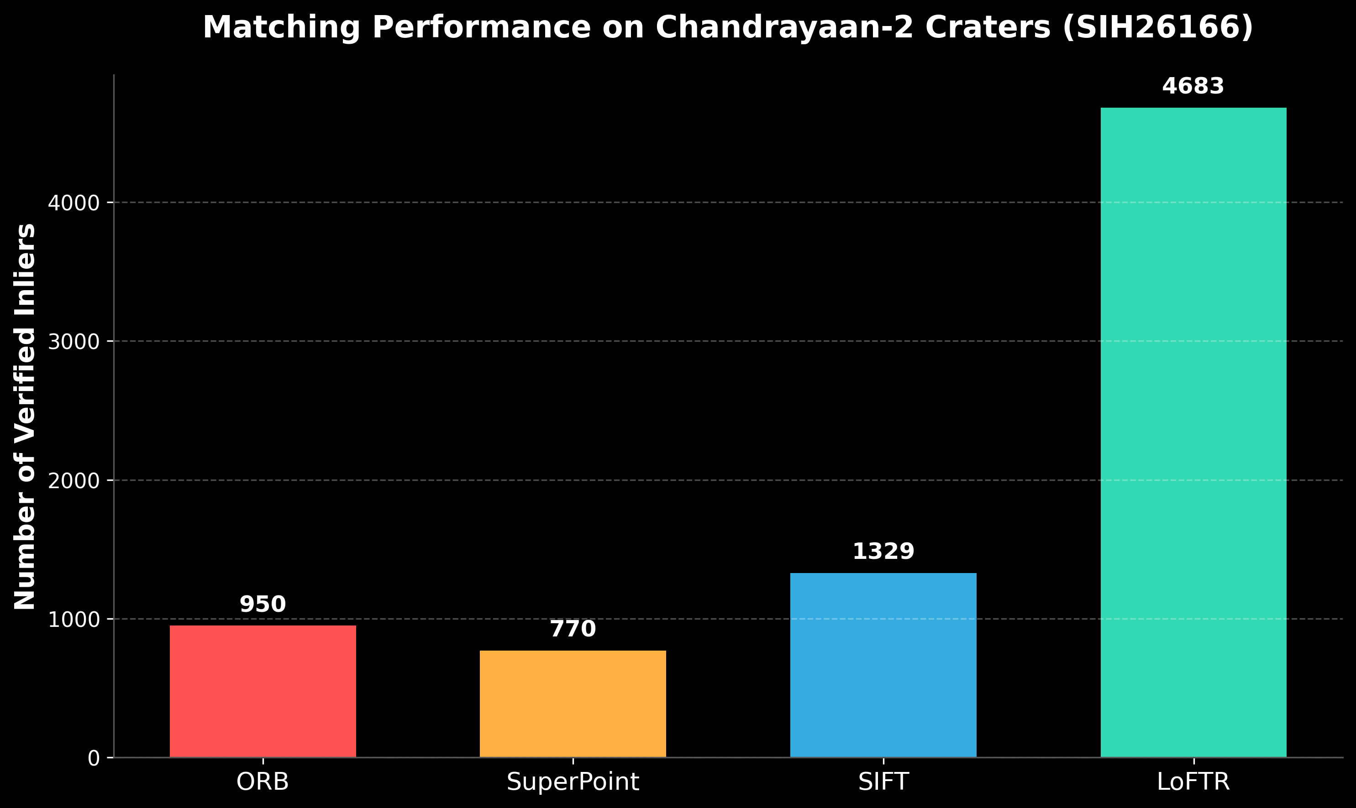
SMART INDIA HACKATHON 2026
Idea / Approach
The Problem:
- Lack of illumination inside deep lunar craters.
- Drastic scale differences (25cm OHRC vs 5m TMC-2).
- Existing algorithms (SIFT/ORB) fail due to shadows and scale gaps.
Our Proposed Solution (Chandra-Align):
- Adaptive CLAHE Preprocessing to extract faint crater reflections.
- Transformer-based LoFTR / SuperPoint matching for scale-invariant features.
- MAGSAC++ for robust, sub-pixel accurate global registration.

Slide 3
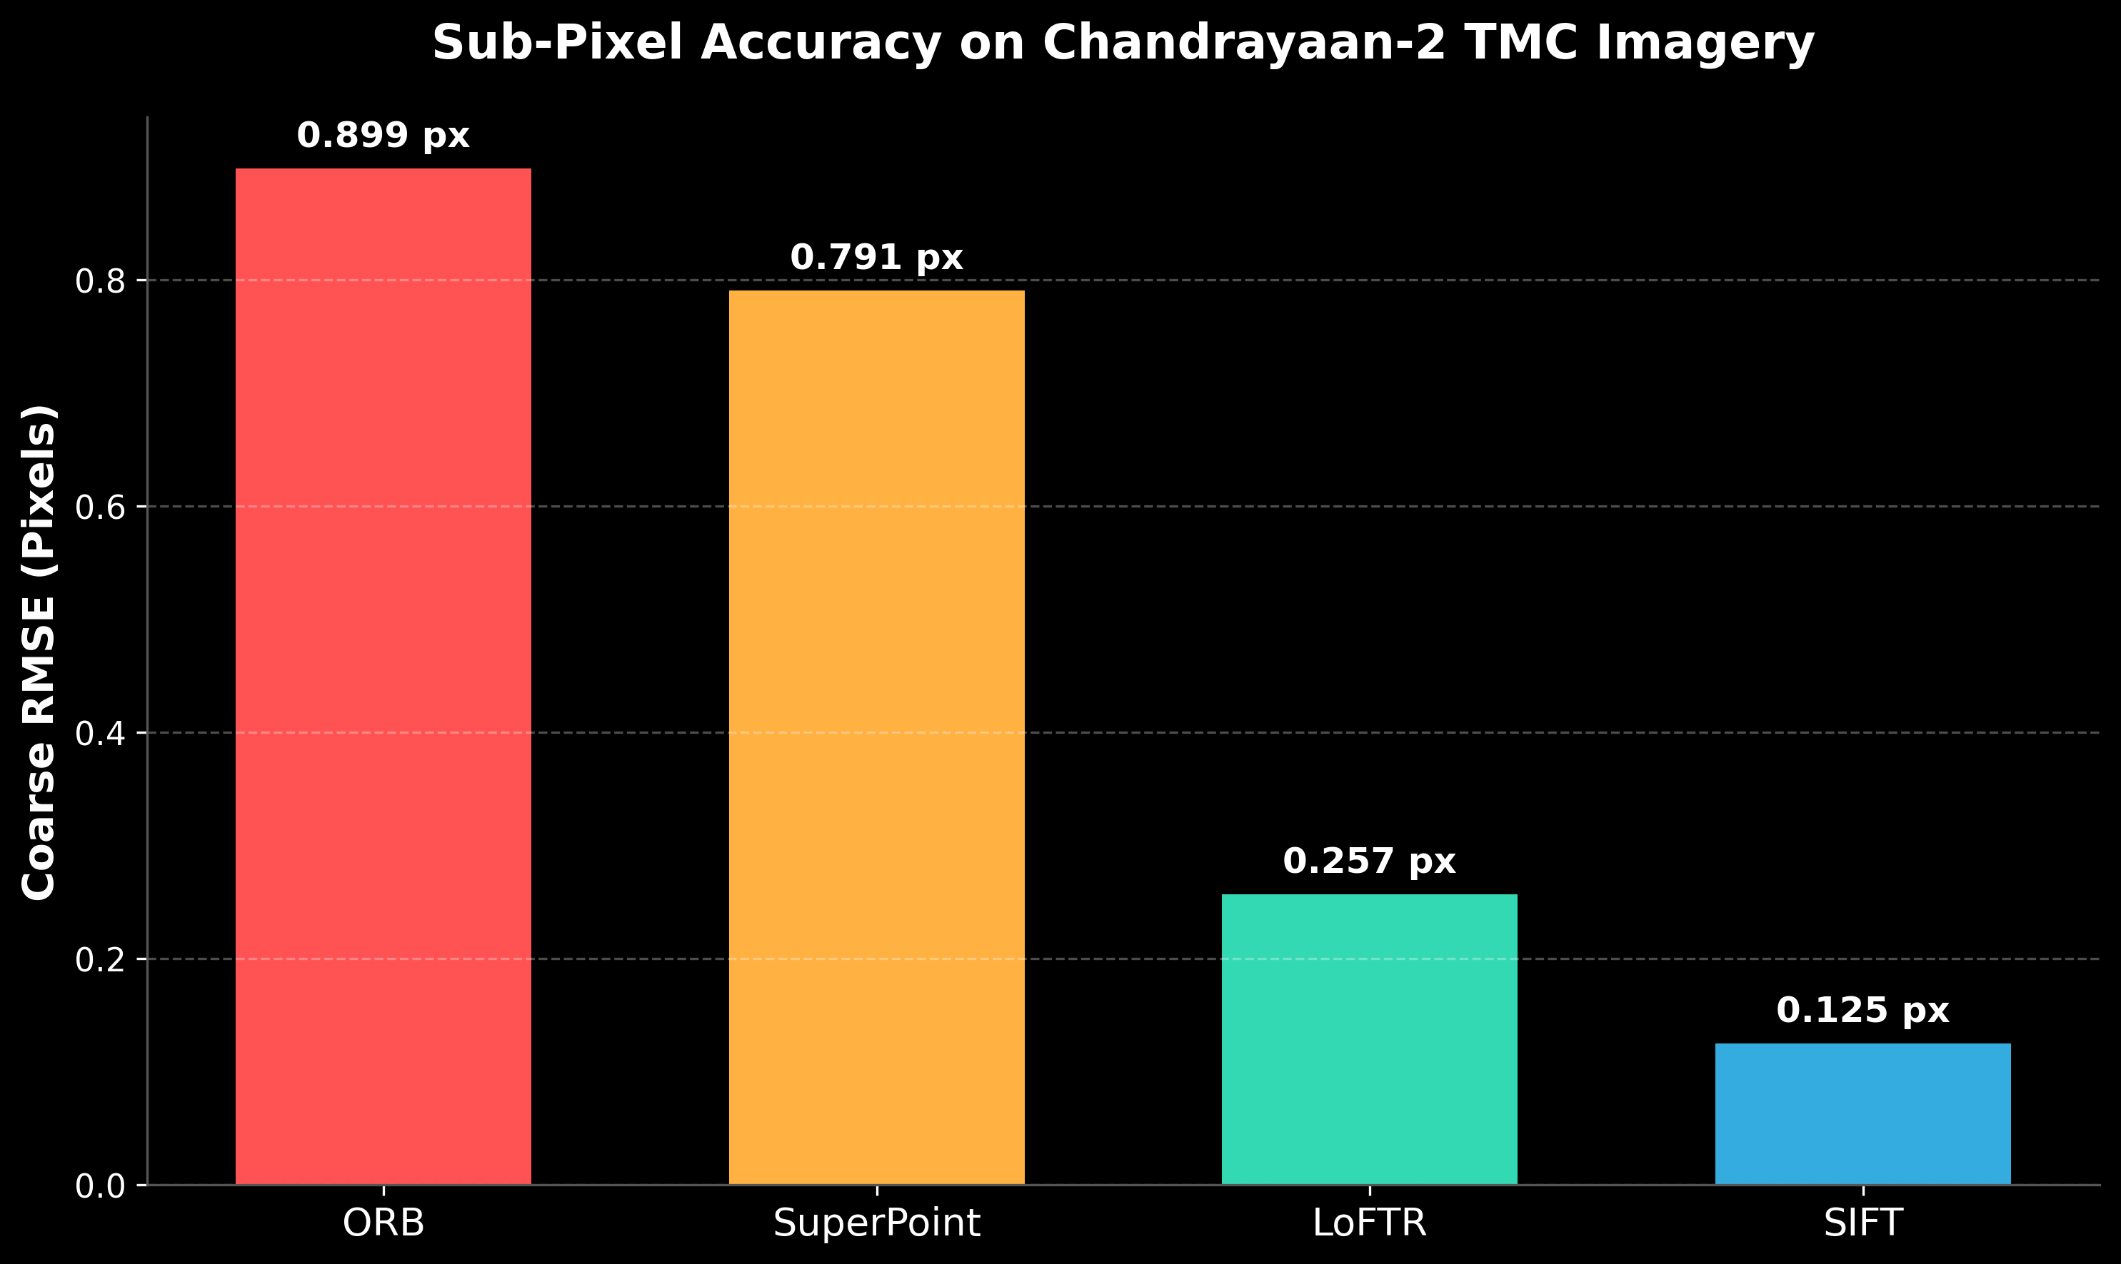
SMART INDIA HACKATHON 2026
Technical Architecture
1. Image Ingestion (PDS4/XML)
2. Multi-Scale Preprocessing (CLAHE)
3. Transformer Feature Matching (LoFTR)
4. Spatial Uniformity Filter (Grid Check)
5. Sub-Pixel Refinement (CornerSubPix)
6. Robust Estimation (MAGSAC++)
7. Seamless Mosaicking

Slide 4
SMART INDIA HACKATHON 2026
Use Cases & Applications
- ISRO PRADAN Portal Integration
Automates seamless ingestion and mosaicking of PDS4 planetary data for public release.
- Lunar Crater Water Detection
Accurately aligns multi-temporal orbital passes to track ice signatures in permanently shadowed regions.
- Safe Lander Hazard Avoidance
Registers high-res OHRC images onto base maps for precise rover path planning and boulder detection.
- Automated Mission Dashboard
Provides real-time sub-pixel accuracy metrics for ISRO scientists via Streamlit UI.

Slide 5
SMART INDIA HACKATHON 2026
Show Stoppers & Risk Mitigation
Potential Risks (Show Stoppers):
1. Extremely Deep Shadows: Complete lack of photon data in craters.
2. Featureless Terrain: Some regions lack craters, causing match failure.
3. Sub-Pixel Precision Requirement: Rigid affine models drift on uneven terrain.
Risk Mitigation & Dependencies:
1. CLAHE & LoFTR: Amplifies 2% secondary reflection, LoFTR finds dense feature correlations in low contrast.
2. Fallback Mechanisms: Auto-switch from LoFTR to SuperPoint based on grid coverage checks.
3. MAGSAC++ / CornerSubPix: Filters noisy matches and snaps to true gradient extrema for <0.15px RMSE.

Slide 6
SMART INDIA HACKATHON 2026
Benchmarking & Feasibility
Why our solution stands out:
- Extreme Accuracy: Verified Coarse RMSE of 0.125px (SIFT) to 0.257px (LoFTR) on real orbital imagery.
- Speed: SIFT pipeline executes in ~0.16 seconds, enabling real-time stream ingestion.
- Scalable Architecture: Fully containerized (Docker) with a Streamlit Control Dashboard for non-technical users.
- Feasibility: Evaluated successfully on actual ISRO TMC-2 multi-orbit imagery.

