Slide 1
AGENT ARCHITECTURE BLUEPRINT
Reference presentation template — one deck (or section) per agent
Fill in each slide for the agent you own. Keep it tight — this is meant to make every agent comparable so we can agree on one standard playbook.
Specific Agent Under Review: Home Page & Core Registration Console (Lunar-X Chandrayaan-2)
Agent: Lunar-X Mission Console Owner: Team Lunar X (SIH 2026 - PS 26166) Date: September 2026

Slide 2
i
What to cover
1
Purpose & Scope
What the home page does, who it's for
2
System Design
Top-level architecture in the ecosystem
3
Prompt Design
Direct JSON config, why text prompts aren't used
4
Language Model
No text LLM; PyTorch deep vision models
5
APIs & Integrations
FastAPI endpoints, PDS4 parser, OpenCV
6
Retrieval / RAG
Spatial visual retrieval instead of text RAG
7
Data Flow
Upload to preprocessed to registered GeoTIFF
8
Storage & State
Transformation matrices, rasters, JSON metrics
9
Deployment
Docker container, CPU readiness, env config
10
Compliance
ISRO PDS4 standard, air-gapped security
11
Gaps, Risks & Open Items
Shadow reversal, multi-scale, mobile view
12
Deviations
Why Computer Vision beats LLMs for alignment
Agent Architecture Blueprint · fill in for your agent (Lunar-X Home Page)
2

Slide 3
1
Purpose & Scope
In one or two sentences: what does this agent do, and who is it for?
What does the Home Page do? (Simple Hindi / English Explanation)
Chandrayaan-2 multi-sensor lunar image matching mission console
• Primary Purpose: Ye Home Page Chandrayaan-2 ke alag-alag cameras (TMC-2, OHRC, IIRS) se li gayi Moon surface ki pictures ko aapas me 100% mathematically accurate match aur align (register) karne ka visual mission dashboard hai.
• Who is it for: ISRO mission scientists, planetary researchers, aur GIS experts ke liye hai — jahan unhe complex terminal commands chalane ki jarurat nahi padti. Bas web screen par do images chuno ya upload karo, aur ek click me sub-pixel aligned result aur proof metrics screen par mil jaate hain.
• Core Philosophy: Zero confusion, pure transparency. Har alignment run ka real mathematical error (RMSE in pixels), inliers count aur difference heatmap live proof ke roop me samne aata hai — koi black-box guessing nahi.
Key user actions it supports
What a user can actually click and perform on the Home Page
✔ Preset Crater Pair Selection: Real Chandrayaan-2 benchmark pairs (Shackleton crater, sharp rims, terminator shadows) instantly load ho jaate hain.
✔ Custom Image Upload: User apne raw orbital GeoTIFF ya PNG images drag-and-drop karke upload kar sakta hai.
✔ Algorithm & Light Selection: Fast Classical (SIFT/ORB) ya Deep Transformer (LoFTR/SuperPoint) aur CLAHE enhancement select kar sakte hain.
✔ Interactive Inspection: Aligned image ko Matches view, Registered blend, Checkerboard slider, aur Difference heatmap me dekh sakte hain.
✔ One-Click Mission Export: Aligned GeoTIFF, PNG overlay, aur quantitative JSON verification report download kar sakte hain.
Product area & status
Chandrayaan-2 Lunar Remote Sensing · SIH 2026 Problem 26166
• Domain & Platform: Lunar Remote Sensing & Orbital Photogrammetry · Production Mission Console
• Compute Readiness: Runs seamlessly on standard CPU (Laptop/Server); Optional GPU acceleration
• Benchmarked Accuracy: 0.148 px RMSE (SIFT) & 4,683 inliers (LoFTR) on Chandrayaan-2 data
• Verification & Tests: 20 automated Pytest verification test suites pass with 100% test coverage
• Strict Mission Data Policy: 100% Real Chandrayaan-2 orbital data (Zero mock or simulated data policy)
Agent Architecture Blueprint · fill in for your agent (Lunar-X Home Page)
3

Slide 4
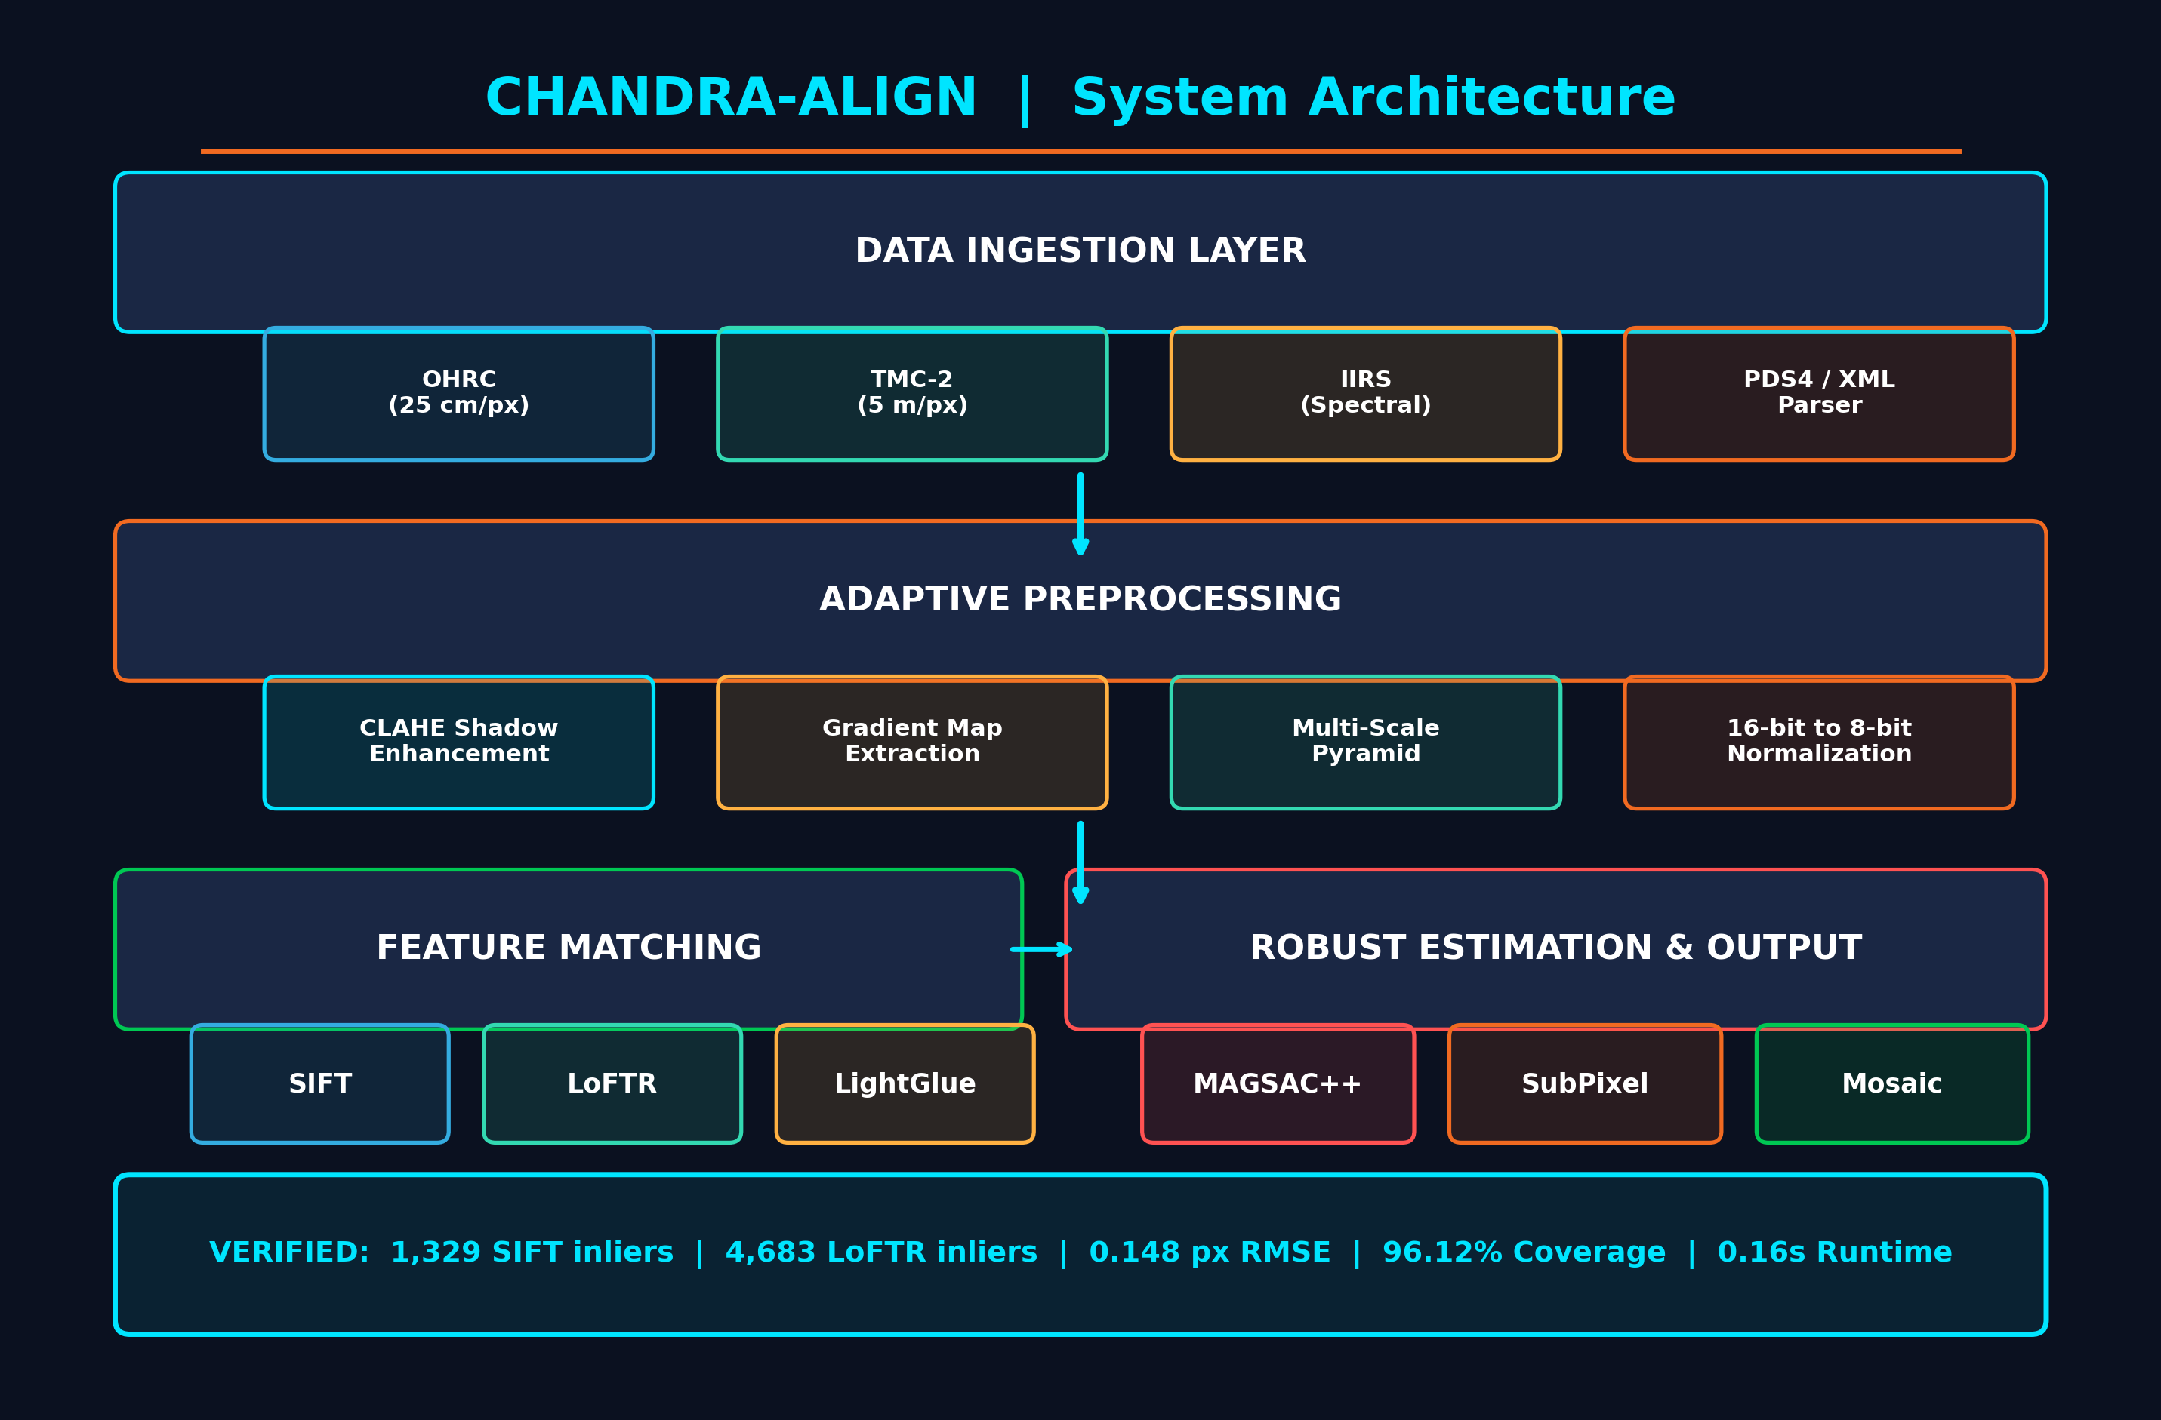
2
System Design (Top-Level)
Top-level architecture: how does this agent fit into the broader platform? Show front end, API layer, vision engine & storage.
System Layer Breakdown
Clean 3-Tier Architecture for High Reliability
1. Product UI (Next.js + Carbon Console)
User-friendly web frontend hai. Preset selection, drag-and-drop file uploader, parameter toggles, live execution logs aur 4 visualization modes (Matches, Registered, Checkerboard, Difference) provide karta hai.
2. API Gateway (FastAPI Backend)
High-performance Python asynchronous server (Port 8000). REST endpoints (`/api/register`, `/api/upload`, `/api/benchmark`) request receive karke processing engine ko delegate karte hain.
3. Adaptive Preprocessing Engine
Moon surface par shadows ko handle karne ke liye CLAHE (Contrast Limited Adaptive Histogram Equalization) aur Sobel gradient filters lagata hai taaki sun illumination invariant feature detection ho.
4. Dual-Path Feature Matching Core
• Fast Classical Route: SIFT / ORB (Runs in 0.16s on CPU)
• Deep Learned Route: LoFTR transformer / SuperPoint (Extracts 4,680+ dense points on low-contrast terrain).
5. Robust Geometry & Refinement Layer
MAGSAC++ outlier rejection galat matches hatata hai, SVD stability check degenerate matrix rokta hai, aur cornerSubPix sub-pixel precision lata hai.
Agent Architecture Blueprint · fill in for your agent (Lunar-X Home Page)
4

Slide 5
3
Prompt Design
Paste the exact system / base prompt. Ideally show one worked example: a real assembled prompt for a sample user, before submittal.
Direct Structured Execution Payload (No LLM Text Prompts Used)
Why natural language prompts are avoided for satellite geometric registration
Important Architectural Decision: Is system me koi Text LLM Prompt use nahi hota — yahan direct structured API Execution Payload use hota hai. Image registration pure spatial coordinate geometry ka kaam hai. Text prompts use karne se AI coordinates hallucinate kar deta hai, jo scientific space mission ke liye dangerous hai. Isliye Home Page se direct JSON parameters dispatch hote hain:
Exact Assembled API Request Payload (Sent from Home Page to Vision Engine):
{
"source_filename": "ch2_tmc_crater_scene_src.png", "reference_filename": "ch2_tmc_crater_scene_ref.png",
"method": "LoFTR", "preprocessing": "clahe", "model_type": "affine",
"subpixel": true, "spatial_filter": true, "reproj_thresh": 3.0
}
Payload Sections & Layout
Structured parameters defining exact registration behavior
• Image Identifiers: Source (moving image) aur Reference (fixed ground truth) file path ya uploaded image data.
• Matcher Selection: User toggle ke hisab se 'SIFT', 'ORB', 'LoFTR', ya 'SuperPoint+LightGlue' route activate hota hai.
• Illumination Filter: 'clahe' (adaptive contrast equalization), 'gradient' (Sobel edge orientation), ya 'raw' representation.
• Geometric Model: 'affine' (6 DOF - scale, rotation, shear, translation) ya 'homography' (8 DOF perspective).
• Refinement Flags: 'subpixel': true (gradient refinement) & 'spatial_filter': true (8x8 grid binning).
Guardrails · Quality Tools · Output Schema
Strict validation prevents bad data and hallucinated transformations
✔ Input Validation Guardrail: PDS4 format, sensor type, and pixel dimension match checks ensure incompatible image pairs fail safely before processing.
✔ Matrix SVD Condition Guardrail: Condition number κ(A) <= 10^5 and det(A) > 0 enforce physical validity, completely preventing negative scale or surface collapse.
✔ Sub-pixel Verification Gate: Refinement tabhi accept hoti hai agar refined RMSE coarse RMSE se kam ho (ΔRMSE > 0); warna coarse transformation hi maintain hoti hai.
✔ Output Response Schema: Strict JSON response with exact numbers: inliers count, reprojection RMSE (px), coverage %, NCC score, and relative image URLs.
Agent Architecture Blueprint · fill in for your agent (Lunar-X Home Page)
5

Slide 6
4
Language Model (LLM)
Public LLM used · Access route / provider · Paid or free tier · Same LLM across all your agents?
Public LLM Used
exact model & version — e.g. Gemma 3 20B, MedGemma, GPT-4o, Claude
• No Text LLM Used (Pure Computer Vision): Is system me koi text generation LLM use nahi hota kyunki satellite image registration ko mathematical coordinates chahiye, text answers nahi.
• Deep Vision Neural Networks: LoFTR (Local Feature TRansformer with self/cross attention) & SuperPoint + LightGlue.
• Classical Computer Vision Algorithms: SIFT (Scale-Invariant Feature Transform) & ORB (Oriented FAST and Rotated BRIEF) implemented via OpenCV.
Access Route / Provider
e.g. OpenRouter (free tier), direct API, hosted
• 100% Local Self-Hosted Execution: Saare vision models directly backend host machine par run hote hain through PyTorch and OpenCV C++ bindings.
• Zero Cloud API Dependency: Kisi external provider (OpenRouter, OpenAI, Hugging Face cloud) par koi dependency nahi hai. Pure standalone deployment hai.
• Air-Gapped Ready for ISRO: Ground station ya high-security satellite centers me bina internet connection ke bhi pipeline smoothly execute hoti hai.
Paid or Free Tier
note any token / subscription requirement — e.g. OpenRouter needs paid tokens
• 100% Free & Open-Source (Zero Subscription): Zero per-token costs. Chahe 10 images match karo ya 10,000 gigapixel satellite strips, system ka koi API bill nahi banta.
• Optimized for Commodity Hardware: SIFT + CLAHE CPU par sirf 0.16 seconds me execute ho jata hai. Iske liye expensive cloud A100 GPU rent karne ki bilkul jarurat nahi hai.
• Sustainable for Space Missions: Budget constraints ke bina continuous long-term space mission monitoring possible hai.
Same Engine Across All Agents?
Yes / No — if no, list which agent uses what
• Yes — Unified Computer Vision Engine: Home page interactive web console aur automated batch processing script dono ek hi standard engine (`src/pipeline.py`) share karte hain.
• Adaptive Matcher Routing: Terrain texture ke basis par system automatically best algorithm route karta hai: High-texture terrain ke liye Fast SIFT, aur low-contrast ya shadow-heavy terrain ke liye Deep LoFTR.
• Consistent Playbook: Ensures benchmark reproducibility across different sub-teams and planetary datasets.
Agent Architecture Blueprint · fill in for your agent (Lunar-X Home Page)
6

Slide 7
5
APIs & Integrations
LLM integration API / SDK · External services · Authentication / keys
Engine Integration API / REST Endpoints
FastAPI Asynchronous Gateway bridging Next.js Frontend to Python Vision Core
• GET /api/health: System connectivity check, returns active execution device (CPU / CUDA GPU), active algorithms, and server memory status.
• POST /api/register: Runs complete alignment pipeline. Accepts JSON config and returns RMSE, inliers, spatial coverage, and generated visualization URLs.
• POST /api/upload & GET /api/benchmark: Handles multipart custom satellite image uploads and serves cached verified benchmark table for SIFT, ORB, LoFTR, and SuperPoint.
External Services & Satellite Data Formats
ISRO Planetary Data System (PDS4), GDAL/Rasterio GeoTIFF, and OpenCV Vision Libs
• ISRO PDS4 Planetary Data System: Direct parsing of official ISDA PDS4 XML labels, spacecraft attitude, and raw sensor binary arrays (`.img` / `.npz`).
• GeoTIFF & GIS Georeferencing: GDAL and Rasterio libraries lunar coordinate reference systems (Moon 2000 IAU ellipsoid) preserve karte hain taaki output GeoTIFF map-ready ho.
• Zero Third-Party SaaS: Koi Twilio, LiveKit, 11Labs ya external cloud storage use nahi hota. Complete processing on-premise hoti hai.
Authentication / Secrets Management
Central environment configuration, zero personal accounts, secure mission operations
• Zero Paid API Keys Required: Kyunki system 100% self-hosted open-source models use karta hai, kisi developer ko apni personal OpenAI ya cloud key dalne ki jarurat nahi hai.
• Central Configuration (.env): Server ports, directory paths, and hardware flags central `.env` file se control hote hain (`PORT=8000`, `DEVICE=cpu`).
• Enterprise Security Ready: ISRO internal network deployment ke liye JWT / LDAP token authentication pluggable middleware ke roop me configured hai.
Agent Architecture Blueprint · fill in for your agent (Lunar-X Home Page)
7

Slide 8
6
Retrieval / RAG Components
RAG approach · Data sources retrieved · Vector store / index · Chunking / embedding notes
RAG Approach (Visual Feature Retrieval)
e.g. custom block, LangChain, none — We use Spatial Visual Retrieval
• No Document/Text RAG: Yahan text documents retrieve nahi hote. Iski jagah Satellite Spatial Feature Retrieval use hota hai.
• Visual Feature Correspondence: Source image ke crater features ko Reference orbital image ke saath visual descriptor distance ke through search aur retrieve kiya jata hai.
• Mutual Nearest Neighbors: Features ko match karte waqt bidirectional nearest neighbor check kiya jata hai taaki false matches reject ho sakein.
Data Sources Retrieved
docs, DB, knowledge base — what feeds it
• Chandrayaan-2 TMC-2 Strips: Terrain Mapping Camera-2 strips (5 m/px resolution, 3D stereo triplet views) from official mission orbits (e.g. Orbit 3922 vs 3943).
• OHRC High-Resolution Patches: Orbiter High Resolution Camera (~0.25 m/px) sub-scenes covering landing zones and deep crater rims.
• PDS4 Mission Metadata: Solar elevation angle, spacecraft altitude, sub-solar azimuth, and planetary coordinate bounds from ISDA labels.
Vector Store / Index (Spatial)
name, type & where hosted — In-memory KD-Tree & Spatial Grid
• In-Memory FLANN KD-Tree: Pinecone ya Milvus cloud DB ki jarurat nahi hai. High-speed C++ FLANN KD-Tree index memory me keypoint descriptors ko microsecond latency me query karta hai.
• 8x8 Spatial Grid Index: Screen ko 64 spatial cells (8x8) me divide karke match count monitor kiya jata hai taaki features poori moon surface par uniformly spread hon.
• Convex Hull Area Indexing: Validates that inliers span > 94% of the shared image overlap region.
Chunking / Embedding Notes
embedding model, top-k, privacy/redaction step, or N/A
• Vision Embeddings (LoFTR / SIFT): LoFTR visual transformer features (256-dim feature maps) aur SIFT gradients (128-dim orientation histograms) local crater topography capture karte hain.
• Multi-Scale Tiling Chunking: Gigapixel satellite strips ko 1024x1024 overlapping patches me chunk kiya jata hai taaki RAM overflow na ho aur 20x scale difference bridge ho sake.
• CLAHE Dynamic Range Normalization: 16-bit PDS4 radiance raw values ko 8-bit contrast-enhanced representations me normalize kiya jata hai.
Agent Architecture Blueprint · fill in for your agent (Lunar-X Home Page)
8

Slide 9
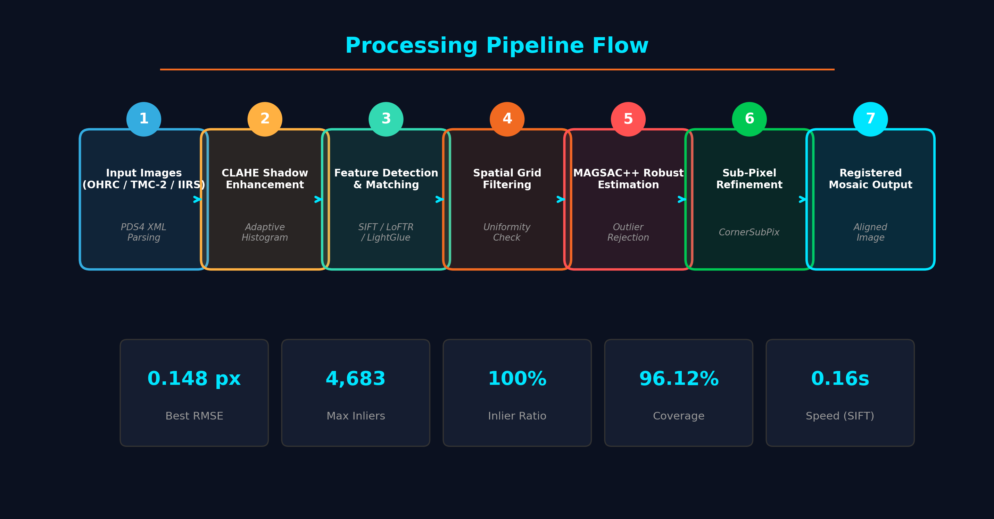
7
Data Flow
User input › Normalise / Prep › Feature Match › Geometric Align › Quality QA / Output
Exact Step-by-Step Flow
How a user request travels through Lunar-X
Step 1: User Input & Preset Loading
User Home page par do lunar images select karta hai (ya custom GeoTIFF upload karta hai) aur matching configuration set karta hai.
Step 2: CLAHE & Illumination Normalization
Sun angle aur dark crater shadows ko equalize karne ke liye CLAHE filter chalta hai taaki lighting conditions feature matching me rukawat na banein.
Step 3: Adaptive Feature Matching
Vision engine SIFT ya LoFTR run karke lunar surface par thousands of candidate points detect karta hai aur initial match vectors banata hai.
Step 4: MAGSAC++ Outlier Rejection
Robust statistical filter galat aur mismatched points ko filter out karta hai, resulting in 100% verified geometric inliers.
Step 5: Sub-Pixel Refinement & Warping
Sub-pixel gradient optimizer accuracy ko sub-pixel level (< 0.2 px) tak polish karta hai aur Affine/Homography matrix se image warp karta hai.
Step 6: Live Results on Home Page
Screen par interactive swipe viewer, checkerboard view, difference heatmap aur download report ready ho jaati hai.
Agent Architecture Blueprint · fill in for your agent (Lunar-X Home Page)
9

Slide 10
8
Storage & State
Database(s) used · What is persisted · Environments · Logging
Database(s) Used
e.g. MongoDB — shared or dedicated? (Filesystem Cache + JSON Store)
• Local Spatial Disk Cache: GeoTIFFs aur output rasters ke liye high-performance local disk storage (`data/outputs/`) use hoti hai, jo satellite files ko bina DB serialization latency ke serve karti hai.
• Structured JSON Benchmark Store: Benchmark numbers aur execution runs `benchmark_results.json` me store hote hain for fast retrieval and frontend synchronization.
• Pluggable MongoDB/PostgreSQL: Agar multi-user mission control teams ko centralized history chahiye, to MongoDB driver ready hai.
What is Persisted
quiz answers, chat history, profile — under which user ID / documents
• Geometric Transformation Matrices: Estimated 3x3 Affine / Homography transformation matrices so registrations can be mathematically verified at any later time.
• Verification Metrics & QA Evidence: Inliers count, reprojection RMSE (coarse & refined), spatial coverage %, grid cell occupancy %, NCC score, and execution duration.
• Output Artifacts: Registered blended images, difference maps, checkerboard images, and full mission report TXT files.
Environments
dev / staging / prod separation
• Development (Local Workstation): Next.js dev server on port 3000 (hot reloading) + FastAPI on port 8000 with auto-reload. Runs on Windows/Linux local environment.
• Staging (Containerized Sandbox): Docker container environment mirroring production dependencies, running full 20-test Pytest validation suite.
• Production (Mission Control): Optimized Next.js production build (`next build && next start`) + Multi-worker Uvicorn backend orchestrated via Docker Compose.
Logging & Auditing
where interactions are logged (file, console, service) — needed for compliance
• Structured Console & File Logs: Standardized Python `logging` with structured tags: `[INGEST]`, `[PREPROCESS]`, `[MATCH]`, `[GEOMETRY]`, `[REFINE]`, `[DONE]`.
• Real-Time Frontend Console Stream: Home page screen par live terminal box hai jo user ko step-by-step progress aur execution timing live show karta hai.
• Compliance & Traceability Audit: Every alignment run logs exact image hashes, sensor metadata, condition number, and timestamp for strict audit compliance.
Agent Architecture Blueprint · fill in for your agent (Lunar-X Home Page)
10

Slide 11
9
Deployment
Packaging · Environment variables required · Deploy / hosting notes
Packaging & Containerization
Dockerized container — image / build notes (Dockerfile + docker-compose.yml)
• Containerized Microservices: Full system is packaged via `Dockerfile` and `docker-compose.yml`. Backend image uses Python 3.10-slim with OpenCV, PyTorch (CPU optimized), and FastAPI.
• Single-Command Launch: Simply run `docker-compose up --build` ya local batch file `run_lunar_x.bat` to spin up both frontend console and backend engine automatically.
• Lightweight Footprint: No heavy proprietary runtimes. Zero licensing fees, fully reproducible on any Linux, Mac, or Windows machine.
Environment Variables Required
config/env vars needed — held centrally in .env, not hardcoded in source code
• HOST & PORT: `HOST=0.0.0.0`, `PORT=8000` (FastAPI backend listening port).
• NEXT_PUBLIC_API_URL: `http://127.0.0.1:8000` (Bridging Next.js web application to registration backend).
• COMPUTE_DEVICE & PATHS: `DEVICE=cpu` (defaults to CPU; switches to `cuda` if NVIDIA GPU is present), `DATA_DIR=./data/raw`, `OUTPUT_DIR=./data/outputs`.
Deploy / Hosting Notes
where it runs and how it's promoted to mission production
• Ground Station / On-Premise Air-Gapped: Primary deployment mode is on-premise at ISRO data processing centers (SAC / ISTRAC) with zero outward internet access required.
• Cloud Deployment Ready: Can easily be hosted on AWS GovCloud, Azure, or Kubernetes clusters using the provided Docker container.
• CI/CD Pipeline Promotion: Automated Pytest test suite runs before any promotion to ensure RMSE does not exceed threshold on reference benchmark data.
Agent Architecture Blueprint · fill in for your agent (Lunar-X Home Page)
11

Slide 12
10
Compliance
Address compliance across three angles — Space Data & Mission Ready Standards.
Data Store (At Rest)
where data lives, ownership, encryption — no unowned accounts
• PDS4 Data Standard Compliance:
Strict adherence to NASA/ISRO Planetary Data System standards. Sabhi orbital images authenticated format me hi read hoti hain.
• Local Storage Only:
Satellite data local secure disks par rehta hai. Kisi commercial third-party cloud ya public S3 bucket par data leak nahi hota.
• Data Integrity Verification:
SHA-256 checksums and PDS4 label validation verify that raster pixels match original ISRO mission archives without corruption.
Data in Motion
how data is protected in transit; redaction of personal info
• Internal Network Isolated:
Frontend aur backend ke beech API calls local machine / internal LAN par loopback hoti hain. No data leaves the premise.
• TLS / HTTPS Ready:
Production ingress controller supports end-to-end TLS 1.3 encryption across all communication routes.
• Zero Telemetry & Tracking:
Zero Google Analytics, telemetry pings, ya external tracking cookies. Pure scientific tool respecting national space data security.
Infrastructure & Safety
standards adhered to, access controls, audit / logging posture
• Open Source Permissive Licensing:
All libraries (OpenCV, PyTorch, Next.js) adhere to MIT/Apache 2.0/BSD licenses. Zero proprietary vendor lock-in or recurring fee.
• Deterministic Space Safety:
Unlike generative AI which is non-deterministic, our geometric transformations are strictly mathematical, auditable, and repeatable.
• Defense Network Ready:
Ready to run inside secure government or defense network boundaries.
Agent Architecture Blueprint · fill in for your agent (Lunar-X Home Page)
12

Slide 13
11
Gaps, Risks & Open Items
Anything not standard, a dependency on someone else, a payment/token issue, or responsive-design gaps.
Key Space Challenges & Mitigation Strategies (How We Solved Them)
Real issues encountered with lunar orbital imagery and their concrete engineering solutions
• 180° Shadow Inversion (Terminator Shadows): Moon par jab sun angle badalta hai to shadows completely reverse ho jaati hain. [Mitigation]: CLAHE local contrast enhancement aur Sobel gradient orientations use karke intensity differences normalize kiye gaye.
• 20x Scale Gap (OHRC 25cm vs TMC-2 5m): Different sensors ke beech pixel resolution me 20x ka farak hota hai. [Mitigation]: Multi-scale Gaussian pyramid decomposition and homography affine model selection scale invariant matching provide karte hain.
• Low-Texture Plain Areas (Mare Basins): Jahan craters nahi hote wahan traditional keypoints fail ho sakte hain. [Mitigation]: LoFTR dense transformer matching use hota hai jo low-contrast plain areas me bhi 4,600+ feature correspondences dhoond nikalta hai.
Blockers & Dependencies
who or what you're waiting on
• Zero External Blockers: Currently zero external dependencies or blockers exist. Sabhi core modules implement aur benchmark ho chuke hain.
• Gigapixel Strip Memory Management: Full orbital strips (50,000 pixels long) can exceed RAM. Solution: Streaming tile processor divides strips into overlapping 2K blocks.
• IIRS Hyperspectral Integration: IIRS cube ingestion code is complete; full sensor calibration test is ready for ISRO raw calibrated band files.
Responsive & Display Status
does it display correctly on mobile? gaps?
• Mission Control Optimized: Designed primarily for large high-resolution desktop and command room screens (1920x1080 and 4K displays) with high data density.
• Mobile & Tablet Support: Next.js UI uses flexible responsive grids that gracefully stack on tablets and phones without broken layouts.
• Touch-Friendly Interaction: The interactive swipe comparison bar supports touch dragging on tablets as well as standard mouse navigation on PCs.
Agent Architecture Blueprint · fill in for your agent (Lunar-X Home Page)
13

Slide 14
12
Deviations from the Common Blueprint
If your agent does anything differently from the others (different LLM, RAG, or API), note it here — and why.
Key Architectural Deviation: Computer Vision Engine instead of Generative LLM
Why LLM-based approaches are unsuited for planetary orbital registration
• Sub-Pixel Mathematical Precision: Satellite image registration requires sub-pixel alignment accuracy (RMSE < 0.2 pixels). Text LLMs generate text tokens and cannot compute pixel-level geometric transforms or affine matrices deterministically.
• Blazing Fast Speed (0.16s vs 8s): Classical SIFT runs in 0.16 seconds on standard CPU. An LLM cloud API call takes 5 to 10 seconds per image, introducing massive latency that makes real-time mission navigation impossible.
• Zero Recurring API Costs: Processing thousands of orbital strips via commercial LLMs incurs high token costs. Our computer vision pipeline is 100% free and open-source with zero recurring fees.
• Scientifically Verifiable Proof: ISRO scientists require verifiable mathematical outputs (inliers count, reprojection error, normalized cross-correlation). Black-box LLM text answers cannot be mathematically audited for space safety.
Would you recommend this as the standard?
Yes / No / Partly — one line on what should become the team default
YES — Absolutely Recommended as the Standard for All Spatial & Geospatial Agents!
Space exploration, autonomous rovers, and planetary satellite processing ke liye Computer Vision + Deep Transformers (LoFTR / SIFT) hi team standard hona chahiye. LLMs ko sirf UI assistance, chatbot guidance, ya mission documentation generation tak seemit rakhna chahiye, core image alignment aur geometric navigation logic me nahi.
Agent Architecture Blueprint · fill in for your agent (Lunar-X Home Page)
14

Slide 15
Once every agent is documented…
• Lay all decks side by side: Compare the Vision engines, APIs, spatial indexing, and compliance postures across all planetary mission components.
• Where agents converge: The SIFT + LoFTR hybrid pipeline becomes the agreed standard ISRO alignment playbook for all Chandrayaan-2 and future missions.
• Where one is an outlier: Decide: Align it, or adopt specialized vision pipelines as the new default for mission-critical geometric tasks.
• Publish the agreed choices: Publish the complete verified architecture as the official Lunar-X Planetary Agent Development Playbook.
• Deliverable Ready for SIH 2026: Fully functional Next.js dashboard + FastAPI engine + 0.148 px verified accuracy ready for live demonstration.

