Slide 1
PREDICATE NUMBER USING ARTIFICIAL Neural network
Shavej Shaikh 49
Shahnawaz Shaikh 50

Slide 2
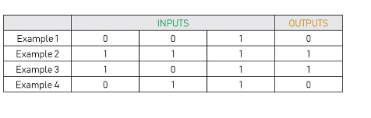
Problem statement
Each row is a training example of two inputs and one bias
Input and one output the neural network to be able to
predict. What the output should be for situation.
Example 5 | 1 | 0 | 0 | ?

Slide 3
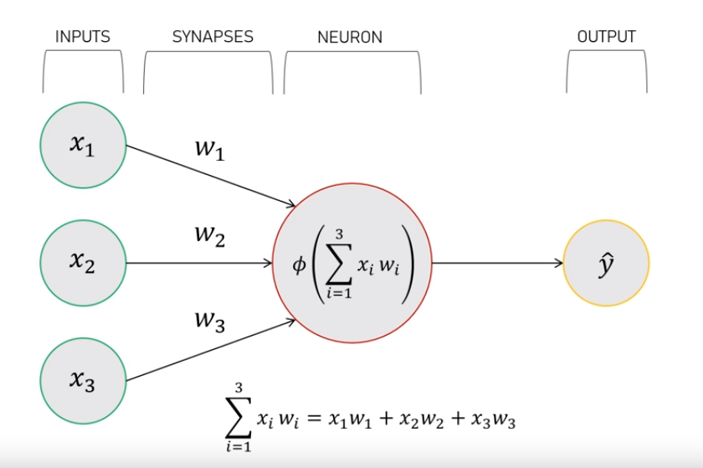
Perceptron
Neural network without hidden layer
Is called perceptron.
Its basic architecture consist of inputs, neuron,
output and synapses.
Synapses are connection between inputs and neuron.

Slide 4
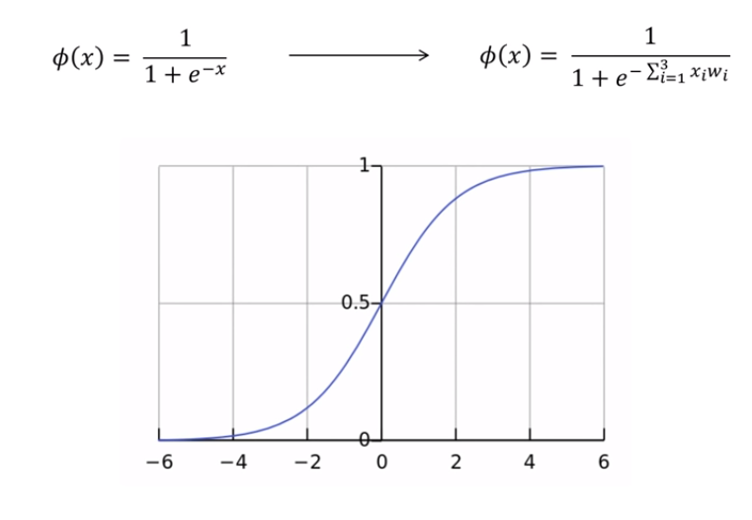
Sigmoid normalization function
The outcome in sigmoid normalization
will always in between 0 and 1.

Slide 5
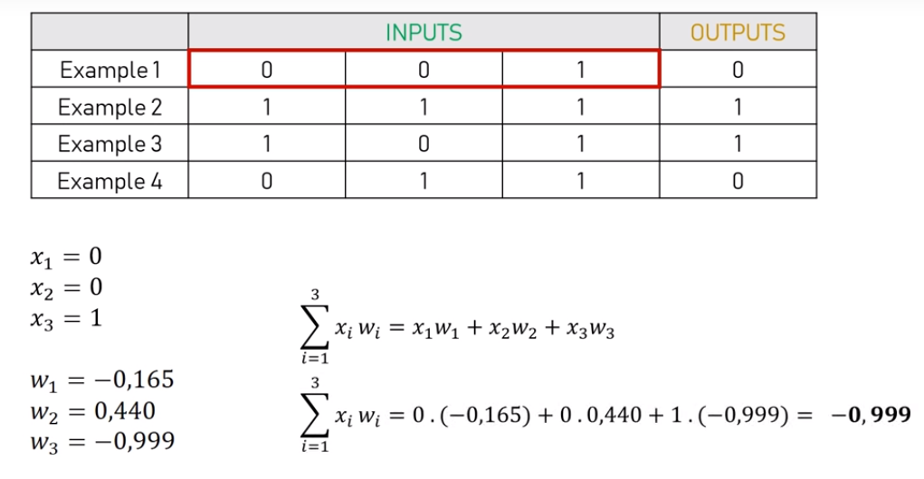
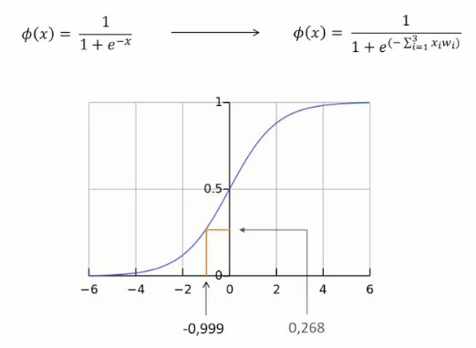
Solve problem

Slide 6
Training process
Take the inputs from the training example, and put them through formula to get the neuron’s output
Calculate the error, which is the difference between the output we got and the actual output
Depending on the severeness of the error adjust the weights accordingly.
Repeat this 20,000 times

Slide 7
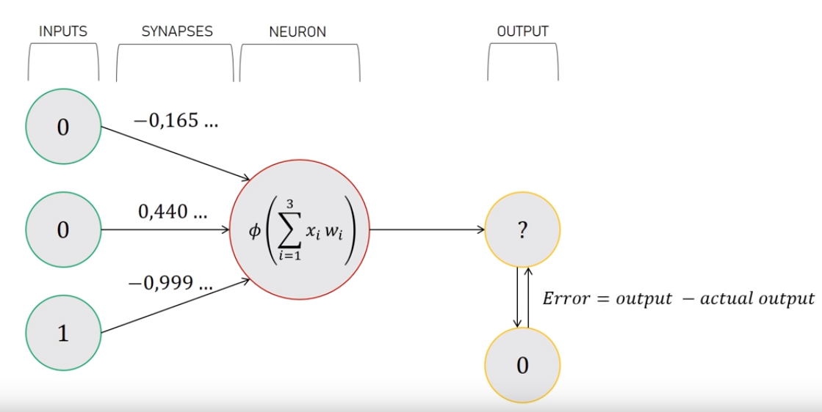
Calculate the error

Slide 8
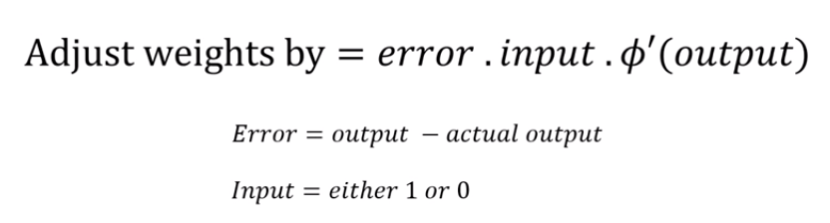
Error weighted derivative

Slide 9
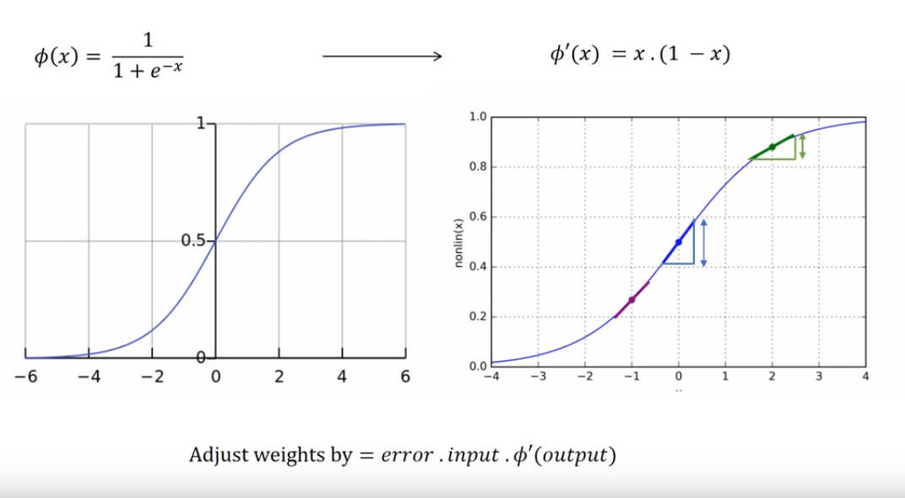
Adjustments

Slide 10
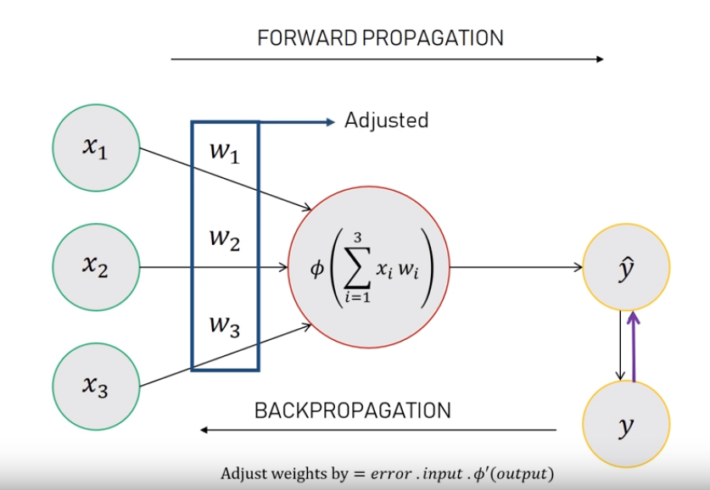
BACKPROPAGATION

