Slide 1
MONASH ENGINEERING
TRC 4001
Low-cost, Real time Vehicle Classification and Speed Estimation using Raspberry Pi 3
Prepared by: Shavin Tharinda Kaluthantri
Final Year Project Presentation
Supervised by: Dr. Madhavan Shanmugavel

Slide 2
1.0 Introduction

Slide 3
1.1 Problem Statement
Increase in number of vehicles leads to serious problems such as vehicle congestions, vehicle theft and accidents.
Statistic facts in Malaysia [1]:
2004 : 13 million vehicles, 326,815 road crashes
2014 : 25 million vehicles, 476,196 road crashes
20.4 % of these accidents have been fatal
There is a clear need for a reliable and efficient traffic surveillance system to manage and control urban traffic distributions.

Slide 4
1.2 Intelligent Transportation Systems
Intelligent Transportation systems (ITS) have been implemented on ground vehicles to improve safety, mobility and efficiency by obtaining important traffic information such as:
Traffic flow density,
Length of vehicle ques
Speed of the flow of traffic
ITS have turned their focus on vehicle detection, speed estimation and classification to obtain the required information

Slide 5
1.3 Existing Vehicle Classification and Speed Estimation Techniques
Hardware based Approaches
Technique Used | Advantages | Disadvantages
Hardware based Classification System Inductive Loops Infrared detectors Radars | Fast processing Easy to implement in real time. Not affected by weather and lighting conditions | Such detectors are large in size and are difficult maintain. Installation cost is very high Its installation causes damage to the road. Limited information

Slide 6
1.3 Existing Vehicle Classification and Speed Estimation Techniques
Software based Approaches
Technique used | Advantages | Disadvantages
Software based Classification System Video based detection | Easy Installation No damage to roads Provide much more information than hardware based detectors. | Low real time processing power. Require camera calibration Poor performance under Low lighting

Slide 7
1.4 Project Objectives
Design and develop a prototype of a highway traffic scenario.
Successfully perform vehicle recognition, vehicle Classification and Speed Estimation on the detected vehicles in real time.
Test and Evaluate the performance of the proposed system for a range of camera angles and Lighting Conditions

Slide 8
2. 0 Methodology

Slide 9
2.1 Experimental Setup
A prototype of a traffic scenario was built to test the performance of the vision based system and the Augmented Sensor Based system
Vehicles were built using Lego Mindstorms and embedded with NXT controllers.
Model Size : Actual size = 1: 20
The actual model cars are within the maximum allowable dimensions for ground vehicles as stated in the Mass, Loading and Access (MLA) Regulations in NSW

Slide 10
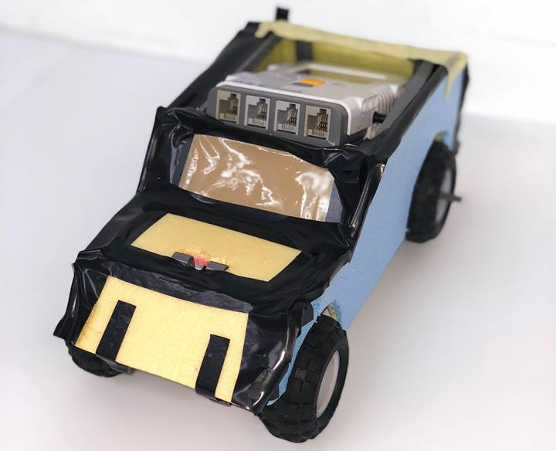
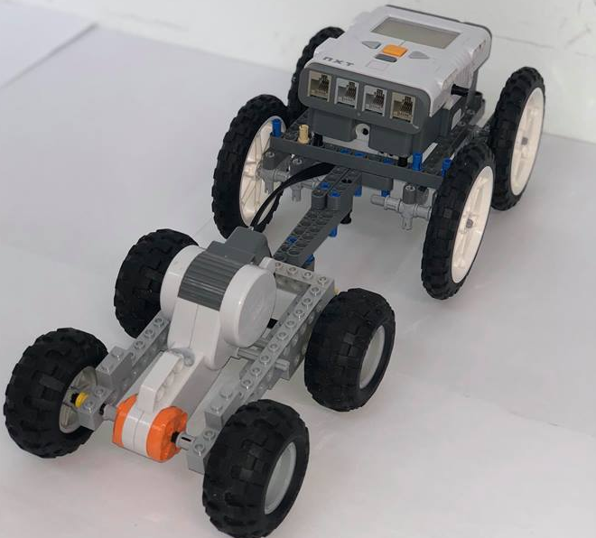
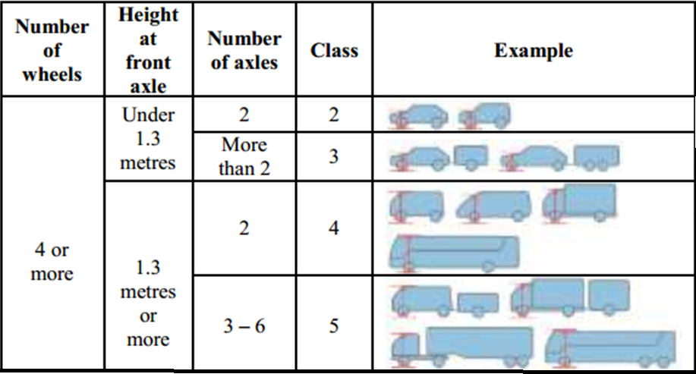
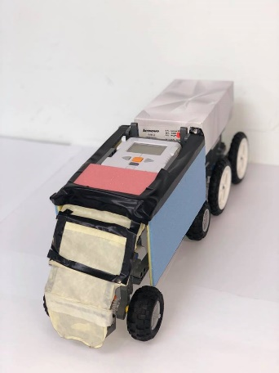
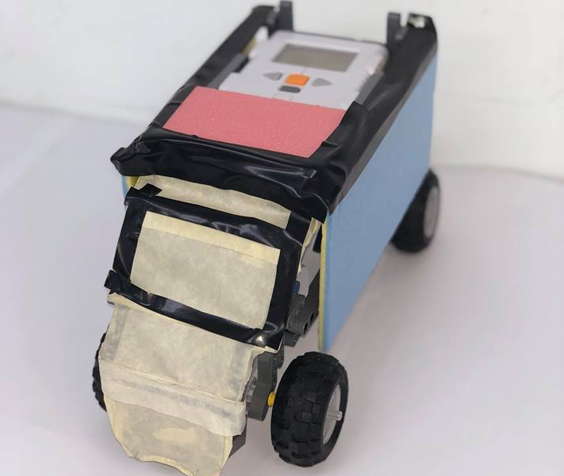
2.1 Experimental Setup
SUV – Class 2
Car Trailer– Class 3
Model Vehicle
Truck– Class 4
Truck Trailer – Class 5

Slide 11
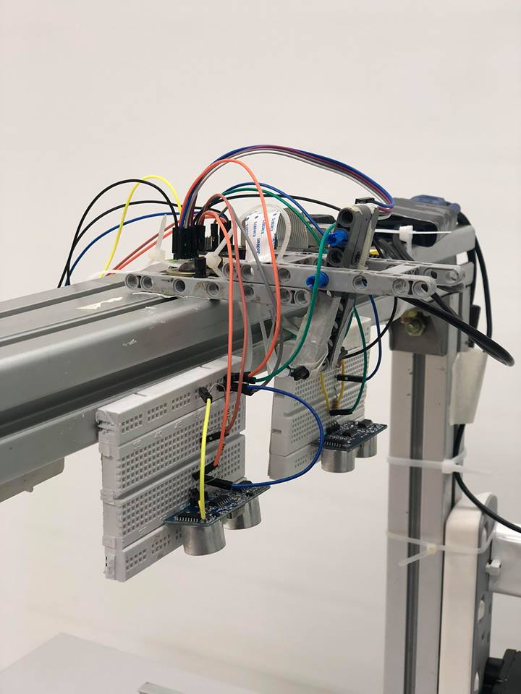
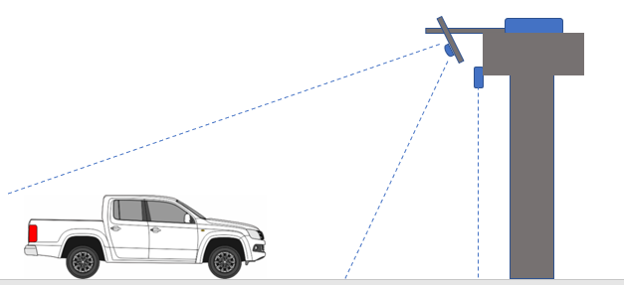
2.1 Experimental Setup
Microcontroller
Accelerometer
Camera
Model Vehicle
Ultrasonic Sensors
Gantry

Slide 12
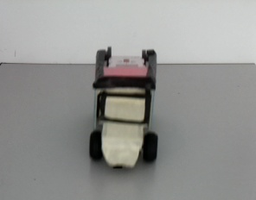
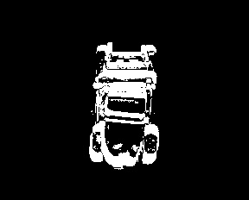
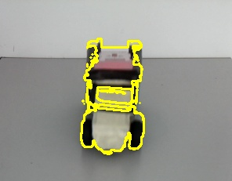
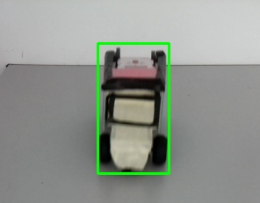
2.2 Vehicle Detection
Original Frame
Algorithms Used:
Frame Subtraction
Gaussian Filter
Thresholding
Algorithms Used:
Dilation
Contour Extraction
Algorithm Used:
Bound Rectangle formation

Slide 13
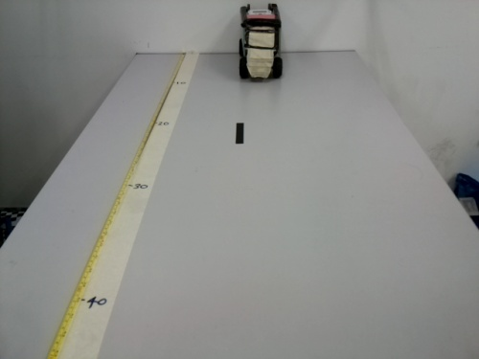
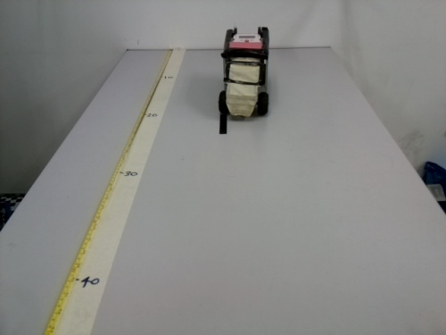
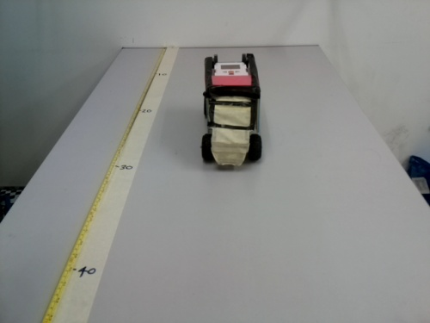
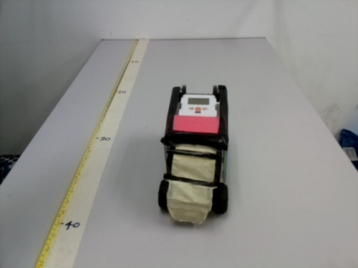
2.3 Speed Estimation
Non linearity of Depth information
There is non linear relationship between height of object viewed in an image and the actual distance to the object from the camera.
1
2
10cm
3
4
10cm

Slide 14
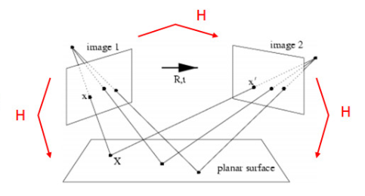




Speed Estimation
Obtaining Bird’s Eye view
The planar homography relates the transformation between two planes in scale form
Where, G- is projective Homography matrix
K – intrinsic Camera parameters

Slide 15
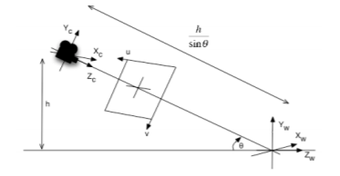
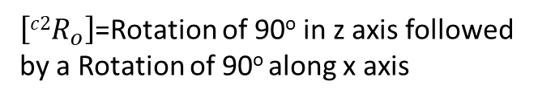



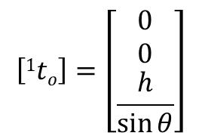
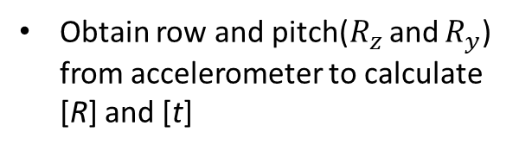
2.3 Speed Estimation
Current Camera pose
Required Camera pose
$$\left[{c2R}_{o}\right]=\left[\begin{matrix}\begin{matrix}0 & 1 & 0 \\ −1 & 0 & 0 \\ 0 & 0 & 1\end{matrix}\end{matrix}\right]$$
$$\left[1to\right]=\left[2to\right]$$
$\left[{c2R}_{o}\right]$=Rotation of 90º in z axis followed
by a Rotation of 90º along x axis
Obtain row and pitch($R_{z }$and $R_{y}$) from accelerometer to calculate [R] and [t]
$$\left[1to\right]=\left[\begin{matrix}0 \\ 0 \\ \frac{h}{\sin{θ}}\end{matrix}\right]$$
$$\left[{c1R}_{o}\right]= R_{z}×R_{y}$$

Slide 16
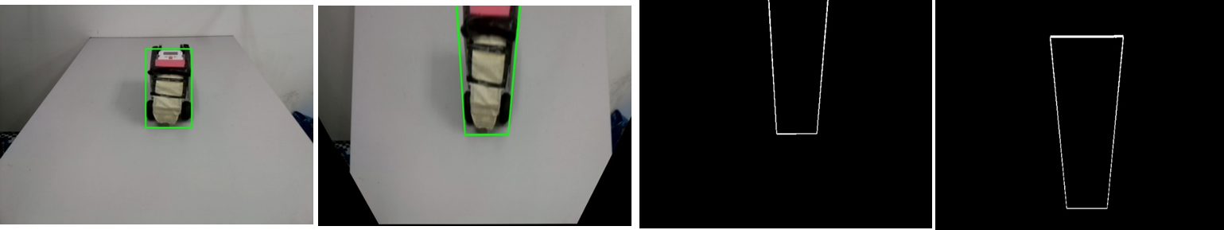


2.3 Speed Estimation
Distance and Speed estimation
l2
$v_{ins}=\frac{l_{1}−l_{2}}{f}, v_{avg}=\frac{\sum_{i=1}^{n}{v_{ins}(i)}}{n}$

Slide 17
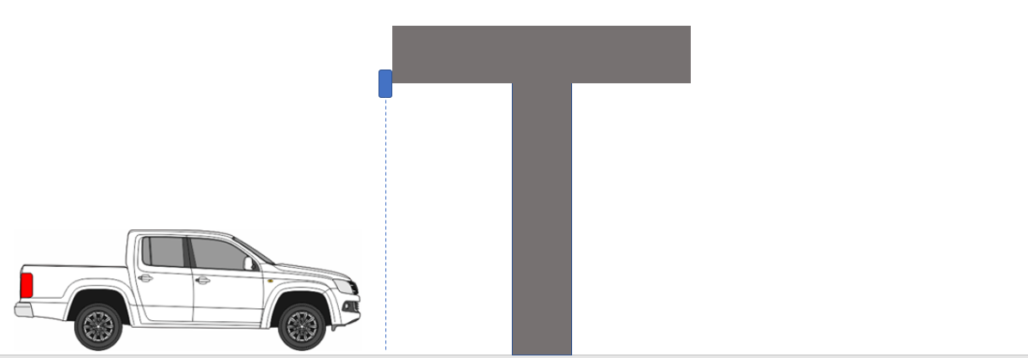
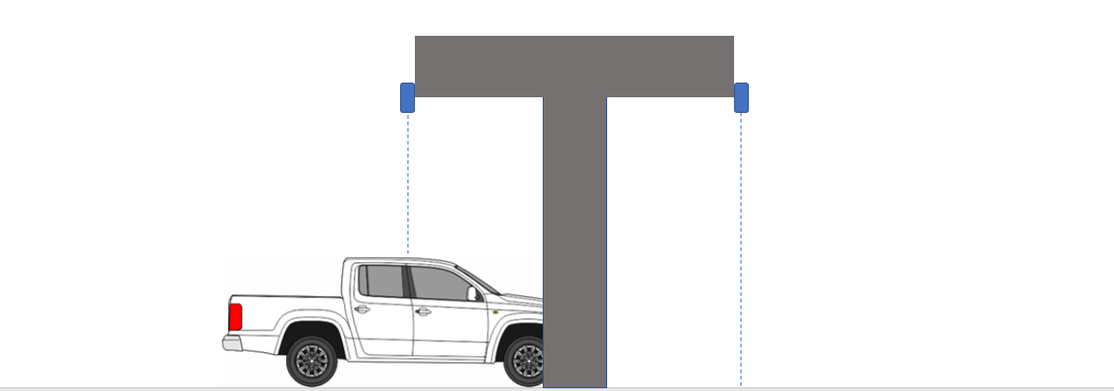
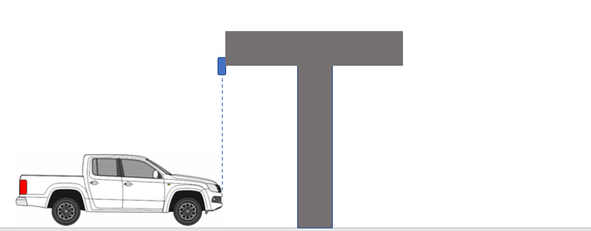
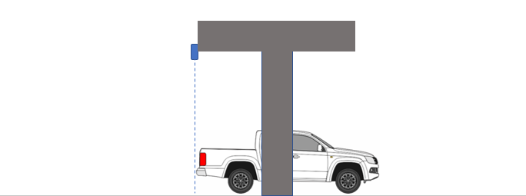
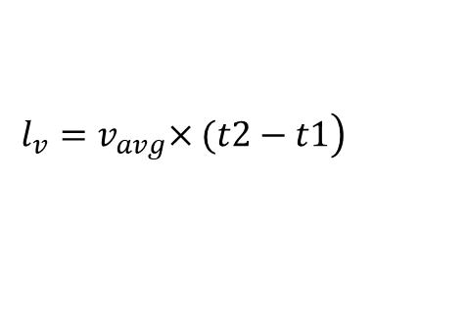

Length and height estimation
Sensors S1 and S2
Model vehicle
$$h_{max}$$
Gantry
Time = t1
$$\left.l_{v}{=v}_{avg}×(t2−t1\right)$$
Time = t2

Slide 18
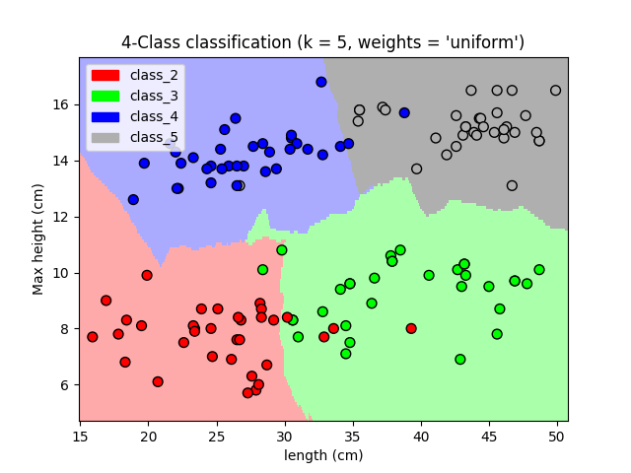
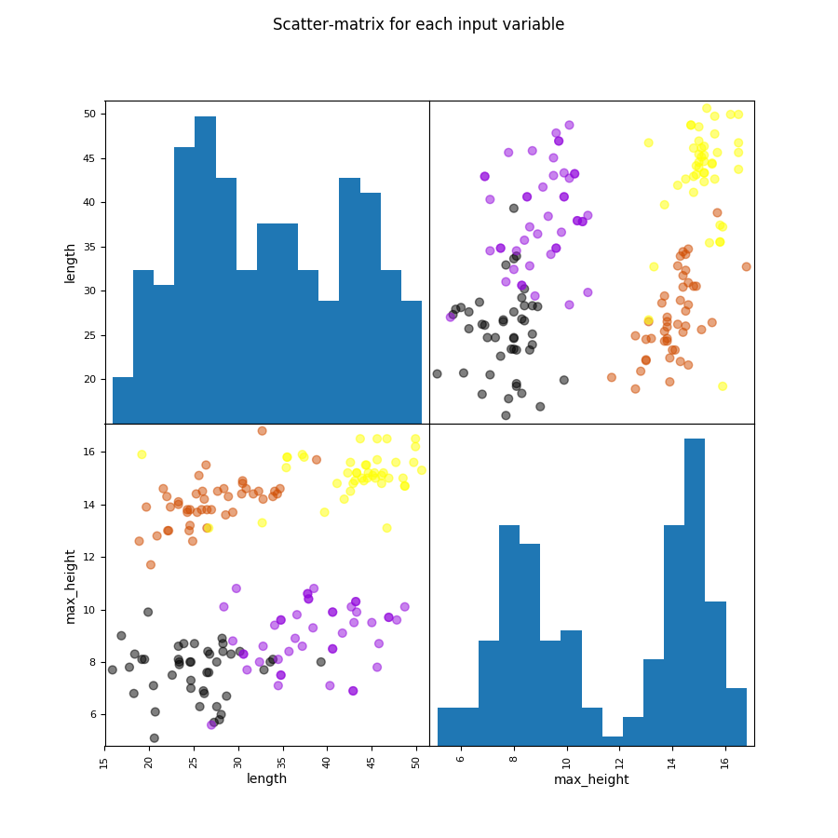
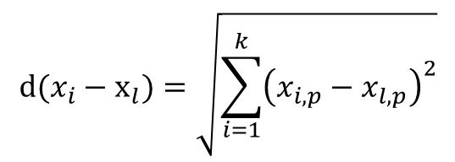
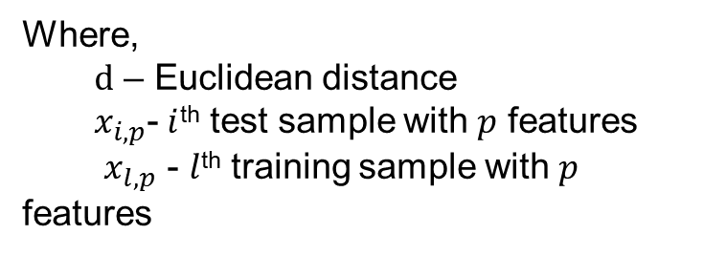
2.2 Vehicle Classification
Augmented System
Where,
$d$ – Euclidean distance
$x_{i,p}$-$i$^{th} test sample with $p$ features
$x_{l,p}$ - $l$^{th} training sample with $p$ features
$$d(x_{i}−x_{l})=\sqrt{\sum_{i=1}^{k}{{\left(x_{i,p}−x_{l,p}\right)}^{2}}}$$

Slide 19
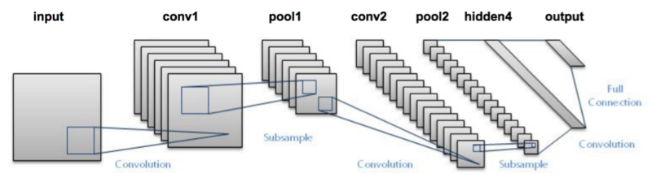
2.2 Vehicle Classification
Vision Based System
Due to restricted memory (1GB Ram) and limited processor speed of the Raspberry pi 3 microcontroller, training and testing large neural networks is not possible.
Therefore, the LeNet architecture[1] was implemented to classify vehicles in real time due to its computational efficiency, and smaller processing footprint.

Slide 20
2.2 Vehicle Classification
Creating a Dataset
Obtain cropped images from vehicle detection algorithm
The algorithm was run at different lighting conditions and at different camera angles to improve the training accuracy of the model.
The pictures were pruned to remove irrelevant images and several datasets

Slide 21
3.0 Results and Discussion

Slide 22
3.1 Performance of Speed Estimation

Slide 23
3.2 Performance of Augmented System

Slide 24
3.3 Evaluation of CNN models
Model | Size of Image | Epochs | Number of classes | Train accuracy | Validation accuracy | Duration (s) | Size (MB)
1 | 28x28 | 25 | 4 | 87.04% | 88.01% | 7.134 | 14.3
2 | 28x28 | 25 | 5 | 85.06% | 87.67% | 10.556 | 14.3
3 | 28x28 | 50 | 4 | 93.18% | 95.67% | 17.77 | 14.3
4 | 28x28 | 50 | 5 | 93.81% | 91.73% | 21.747 | 14.3
5 | 64x64 | 50 | 5 | 88.37% | 87.69% | 63.782 | 73.6
7 | 128x128 | 50 | 5 | 88.37% | 87.69% | 183.465 | 293

Slide 25
3.4 Performance of vision Based System

Slide 26
3.5 Classification Accuracy at Different Camera Angles

Slide 27
3.6 Classification Accuracy at Different Camera Angles

Slide 28
3.7 Additional Features
Shadow Elimination using OpenCV foreground Background detection libraries.
The raspberry pi and sensors can be integrated into one device to allow easy Installation of the system at highway gantries
The use of accelerometer allows direct implementation of the algorithms created since the calibration is performed automatically.
The use of inexpensive sensors and Microcontroller allow the system to be implemented at a Low-Cost.

Slide 29
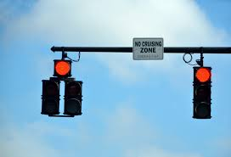
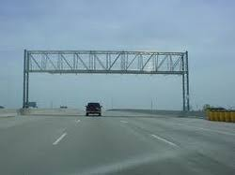
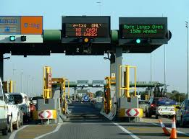
3.8 Possible Applications
Highway toll Gate Systems
Traffic Light Systems
Traffic Surveillance Systems

Slide 30
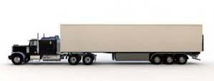
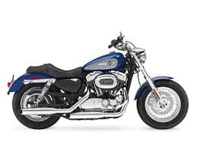
3.9 Future Work
Implement classification algorithm on vehicles of classes 1 and 6
Implement the system to classify and estimate speeds of multiple vehicles simultaneously.
Vehicle Tracking
Accident Detection

Slide 31
4.0 Conclusion
Developed several algorithms for vehicle detection, classification and speed estimation.
Application of the algorithms in real time.
Obtained maximum accuracy of 87.05% for speed estimation and 85.8% accuracy
Able to provide vital information required by Intelligent transportation System

Slide 32
5.0 References
[1] Abdelfatah, A., 2016. TRAFFIC FATALITY CAUSES AND TRENDS IN MALAYSIA.
[2] LeCun, Y., Bottou, L., Bengio, Y. and Haffner, P., 1998. Gradient-based learning applied to document recognition. Proceedings of the IEEE, 86(11), pp.2278-2324.
[3] Tuohy, S., O'Cualain, D., Jones, E. and Glavin, M., 2010. Distance determination for an automobile environment using inverse perspective mapping in OpenCV.
[4]Okabe, A., Boots, B., Sugihara, K. and Chiu, S.N., 2009. Spatial tessellations: concepts and applications of Voronoi diagrams (Vol. 501). John Wiley & Sons.

Slide 33
Thank you for listening!
Question and Answer Session

