Slide 1
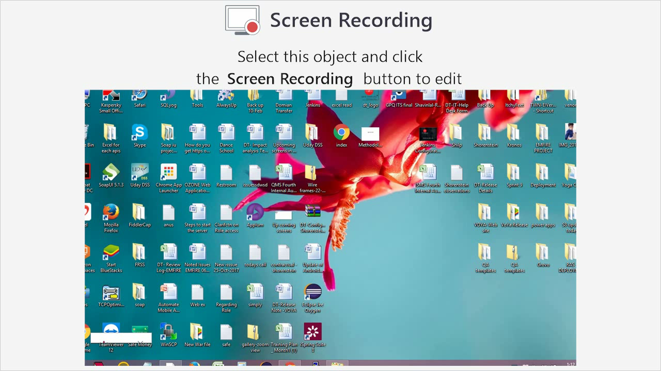
Need of Mobile Application Automation Testing

Slide 2
➢ Smartphone Apps have experienced explosive growth
since 2007
➢
Mobile App are more reliable for Organizations
➢
Mobile Apps bringing half of their Web Traffic
➢
In some cases, mobile apps are the only way
customers interact with their products.

Slide 3
Testing Mobile Applications
is:
➢
➢
➢
➢
More complex
Time consuming
Platform Variations
Quality Concerns
So, alike Manual
Mobile Testing
process,
we should also adopt
Mobile Automation Testing

Slide 4
Why
Mobile
Automation
Testing?

Slide 5
Various factors to
adopt
Mobile
Automation:
➢
➢
➢
➢
➢
Efficient
Faster
Reusability
Reliable
Cost Reduction

Slide 6


Slide 7
• Appium is an open-source test automation tool
• Allows testing for all types of Mobile Applications:
Native Apps, Hybrid Apps and Mobile Web Apps
• Importantly, it is Cross Platform

Slide 8
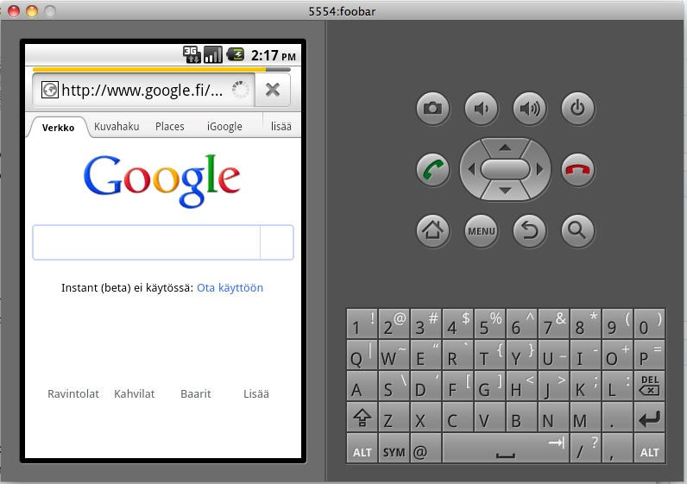
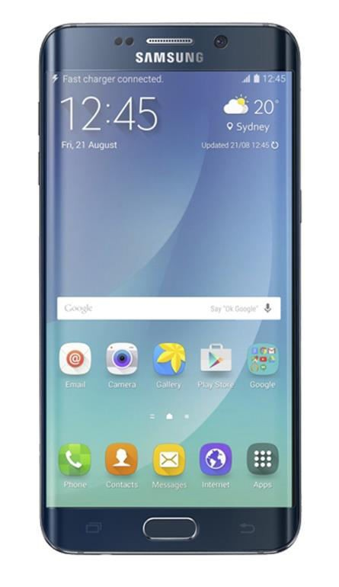
Appium handles both, Simulators
and Real devices

Slide 9
Appium supports Automation for all Apps
like Hybrid, Native and Web apps
Appium supports most of the Programming languages like java, ruby , php, C#
Appium is free and Open source

Slide 10
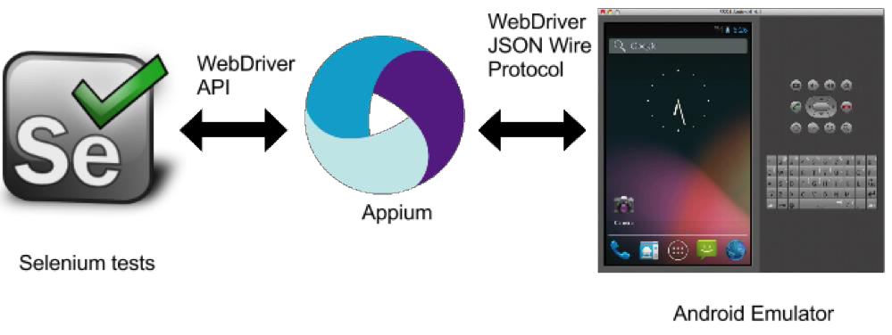
Appium is compatible with
Selenium Webdriver

Slide 11
Prerequisite to use Appium:
•
•
•
•
•
JDK (Java Development Kit) - V1.6(+)
Eclipse - Indigo(+)
Android SDK – With API level 17(+)
Selenium WebDriver JAR – 2.43.0(+)
Appium for Mac/Windows – 1.3.7.2(+)

Slide 12
How
Appium
works?
Working
Architecture

Slide 13
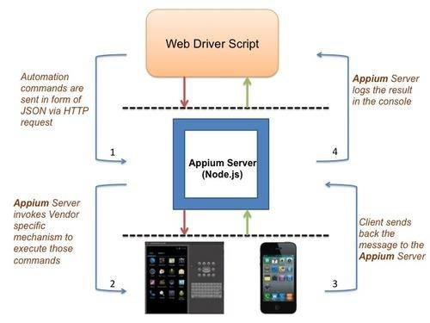
Working Architecture of Appium on Real
Devices/Simulator

Slide 14
Working flow:
1. From Web-driver, Automation Commands are sent in form
of JSON via HTTP request to Appium Server.
2. Appium Server invokes Vendor specific mechanism to
execute those commands on the Mobile-Device.
3. Client sends back the message to the Appium Server.
4. Appium Server logs the result in the console of the Web
Driver.

Slide 15

Limitations of Appium:
•
•
•
•
•
Doesn't support image comparison
Doesn’t support testing of Android Version lower than 4.2
Limited support for testing Hybrid App
Long time to configure Appium for both android and iOS
No Support to run Appium Inspector on Microsoft
Windows

