Slide 1
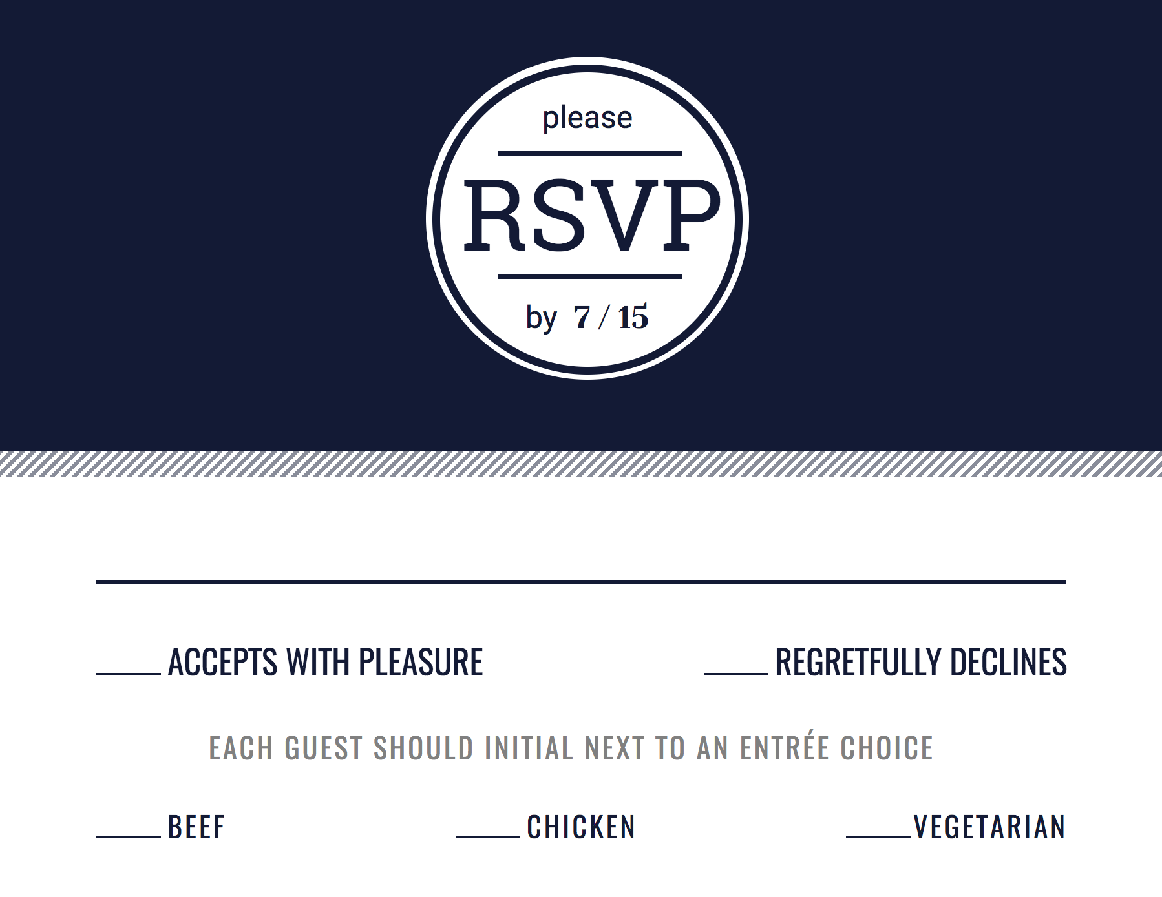

Slide 2

Notes:
Higher res

Slide 3


Slide 4
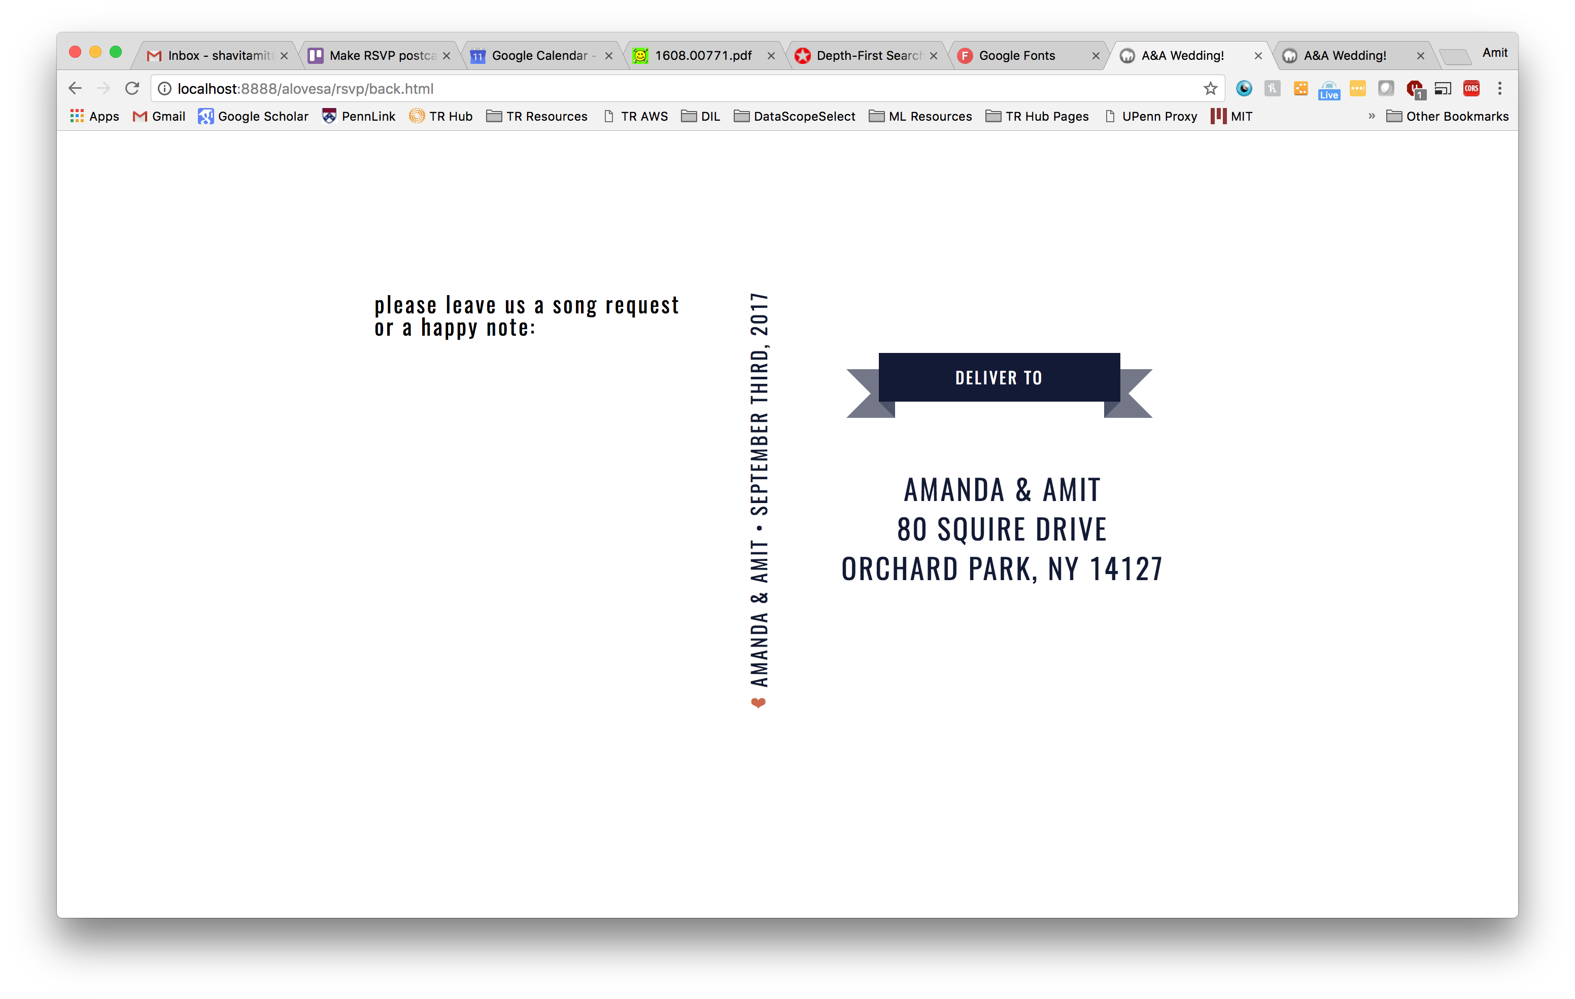

Slide 5
