Slide 1

Coffee-Stir
BeastJavaScript

Slide 2
Coffee-Stir
Coffee-Stir is a library from BeastJavascript that was created by Shavauhn Gabay. It can be used to Dynamically add CoffeeScript Files together.

Slide 3
Coffee-Stir
Coffee stir will handle the dependencies and allow them to be place in an order so that which ever file is needed will load first.

Slide 4
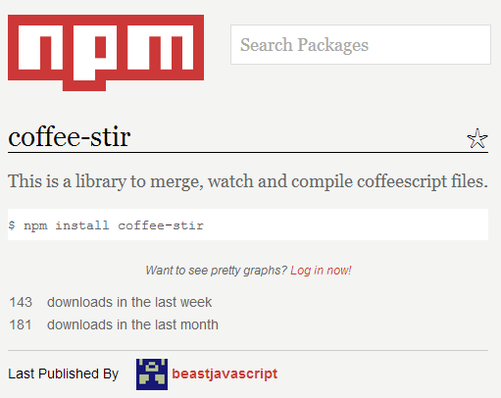
Coffee-Stir Installation
Coffee-stir can be found on the npm repository and a quick npm install will install it.

Slide 5
Usage
If you add a #include <filename>.coffee
This will load the file for you. You can have this in multiple files without worrying. Coffee Stir will handle all of that.

Slide 6
Options
coffee-stir –w this will watch the file and compile it again every time that it changes.
coffee-stir –o <filename>.coffee this will allow you to specify the filename you want as the output

Slide 7
Information
For more information checkout the official github page.
http://beastjavascript.github.io/Coffee-Stir/

