Slide 1
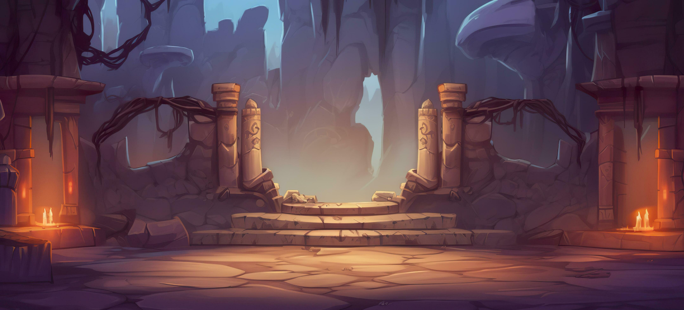
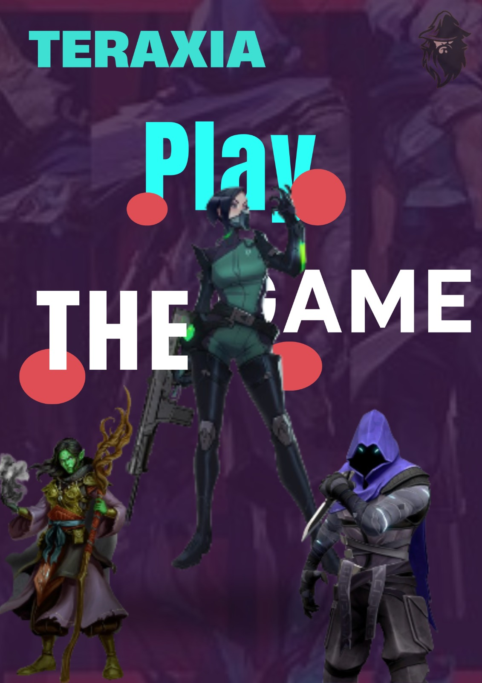
TERAXIA
"EMBARK ON AN EPIC JOURNEY IN THE WORLD OF MAGIC AND ADVENTURE!“
Welcome to the captivating realm of our RPG game, where you can unleash your imagination and dive into a world filled with mystical wonders. In this game, you will have the opportunity to choose from three unique classes: Warlock, Barbarian and Outlaw, each with their own set of extraordinary abilities and powers. As you begin your adventure, you will encounter a thrilling storyline that unfolds across three captivating quests. Each quest will challenge your skills, test your wit, and push you to the limits of your abilities. From battling formidable enemies to solving intricate puzzles, you'll need to use strategy and cunning to overcome the obstacles that lie in your path.

Slide 2
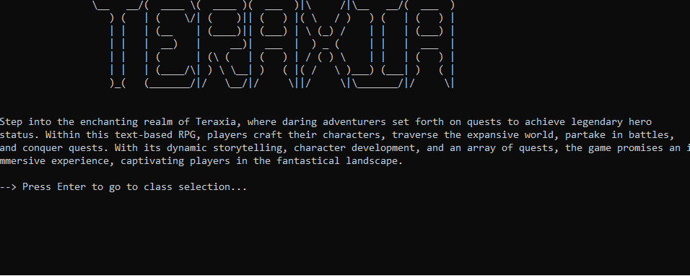
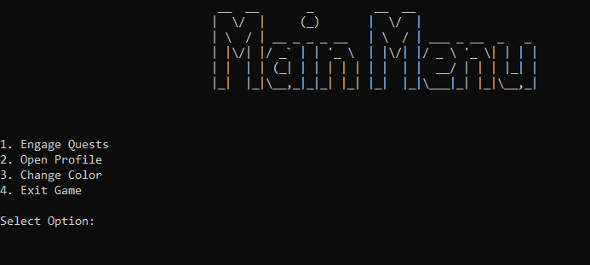
INTERACTIVE MENUS AND CAPTIVATING ASCII ART
Our game features fancy ASCII art implemented for user-friendly interaction. Different menu options are available for user to interact with.
DYNAMIC STORYTELLING
Your choices shape the destiny of your character in real-time. Navigate through a branching narrative, where the consequences of your decisions echo throughout the realms. The story evolves based on your actions, ensuring a unique and personalized adventure for every player.

Slide 3
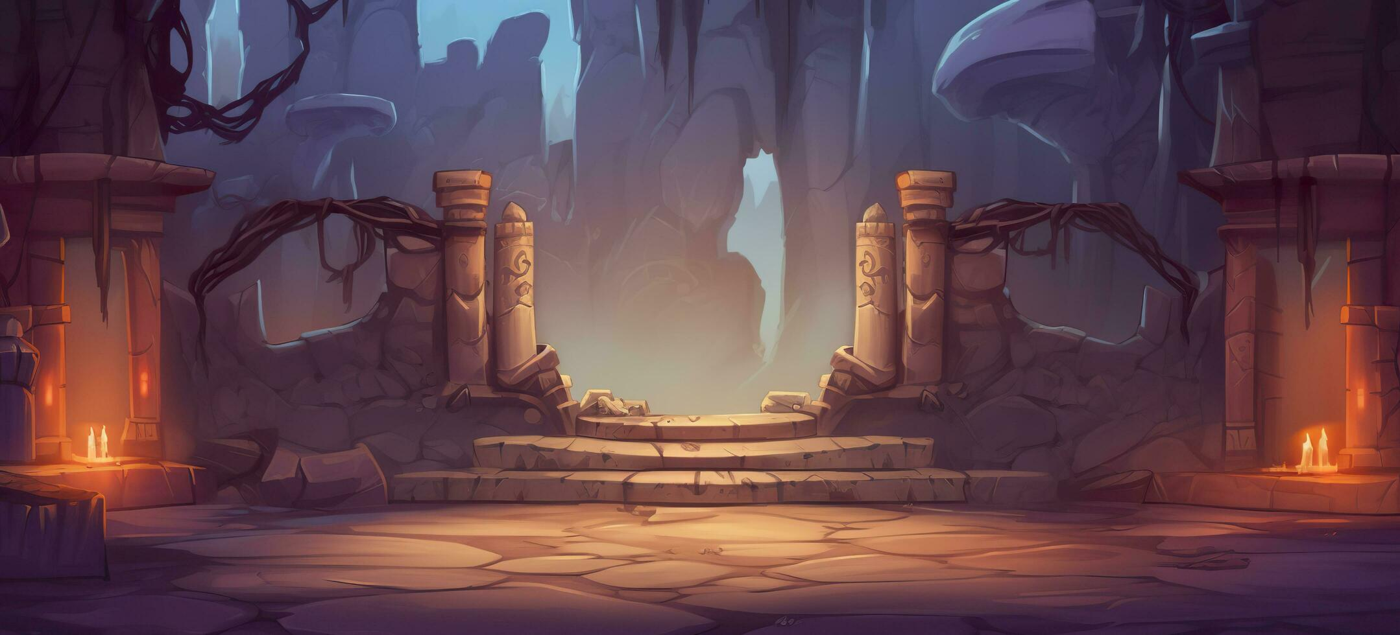
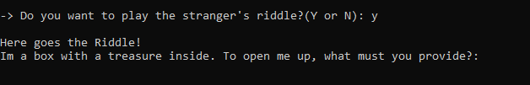
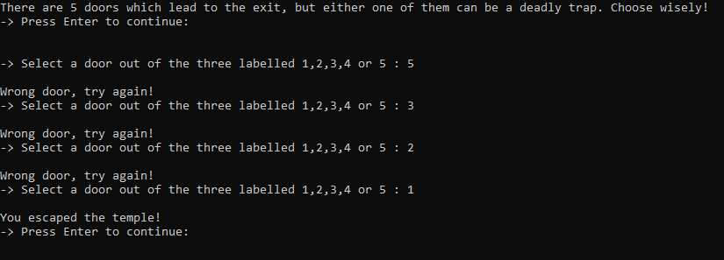
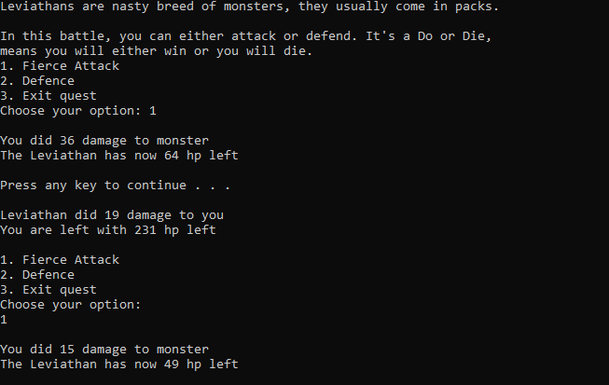
EXCITING AND MERSMERZING QUEST CHALLENGES
Each quest is a carefully crafted masterpiece, designed to captivate your senses and test your wits in the enchanting world of fantasy.
BATTLING SYSTEMS
Prepare for heart-pounding confrontations in our text-based RPG's turn-based battle system, enhanced by the unpredictable magic of the Random Number Generator (RNG).

Slide 4
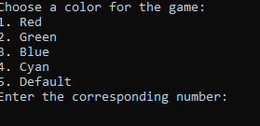
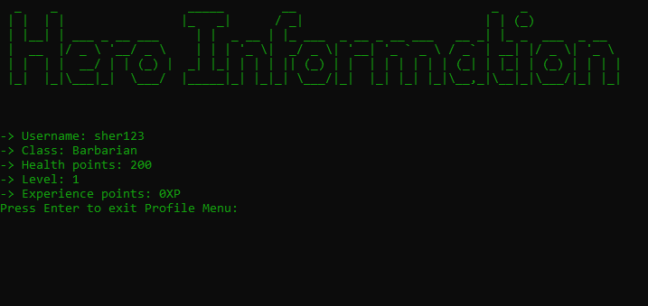
IMMERSE YOURESLF IN VIBRANT ADVENTURES: COLOR YOUR GAME!
Using ANSI Color charts, a menu for color choice has been created. 4 different colors can be used for the game, providing a colorful and interactive gameplay
As the pixels fade and the ASCII art recedes, we invite you to reflect on the tapestry of adventures woven through our text-based RPG. Your choices, battles, and quests have shaped a unique narrative, a story etched with the strokes of your imagination.

