Slide 1

Redis 深入浅出
Http://www.hoterran.info
Http://Weibo.com/hoterran

Slide 2
agenda
use
feature
architecture
admin
replication
presistence
misc

Slide 3
use
Download
  http://redis.googlecode.com/files/redis-2.2.11.tar.gz
install
Redis-server > /dev/null &
Redis-cli
http://try.redis-db.com/

Slide 4
use
set/get
lpush/lrem/rpop/
hset/hgetall
sadd/srem
multi/discard/exec

Slide 5
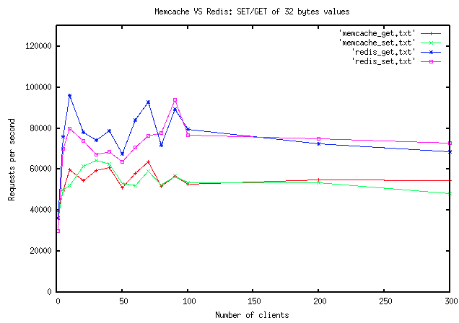
feature
Advanced key value store like memcachedb
  single threaded, no lock
  Event demultiplexer, no use libevent
  2w lines writen in c without 3rd library
  faster

Slide 6
feature
Difference with memached
  Data structure
    No only memcached k-v
    Linklist k-v1->v2->v3->v4...
    Set k - (v1,v2,v3,v4)
    Hash k – (k1 -v1, k2 – v2, k3 – v3)
    Need design a little
  Replication
  Presistence
  not support LRU
  Need multi instance use multi core

Slide 7
feature
Difference with MySQL
  Not Heap table store
  Not need index, so not execute plan
  Not compute statistic
  No sql
  No join
  Capacity size limited by cache
  a little design before dev
  High rw

Slide 8
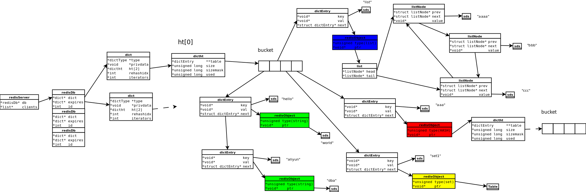
architecture

Slide 9
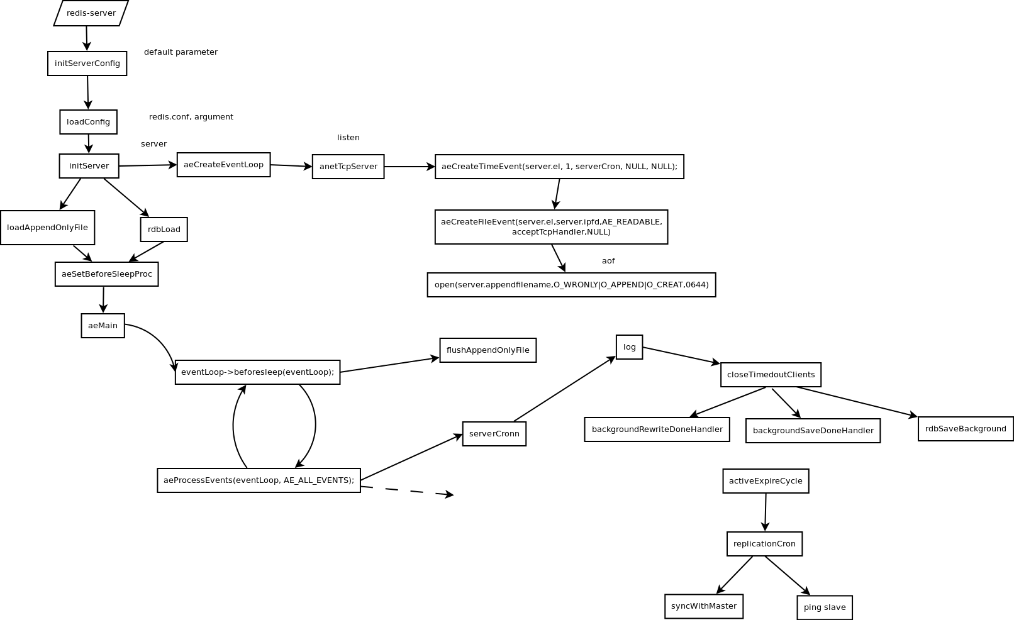
architecture

Slide 10
admin
Redis.conf parameter intro
Replication intro
Persistence intro

Slide 11
replication
procedure
  map
  Dual master mode?
  Master slave slave mode
defects
  Without resume broken transfer
    可以架两级slave解决?
  Without lag(slave position)

Slide 12
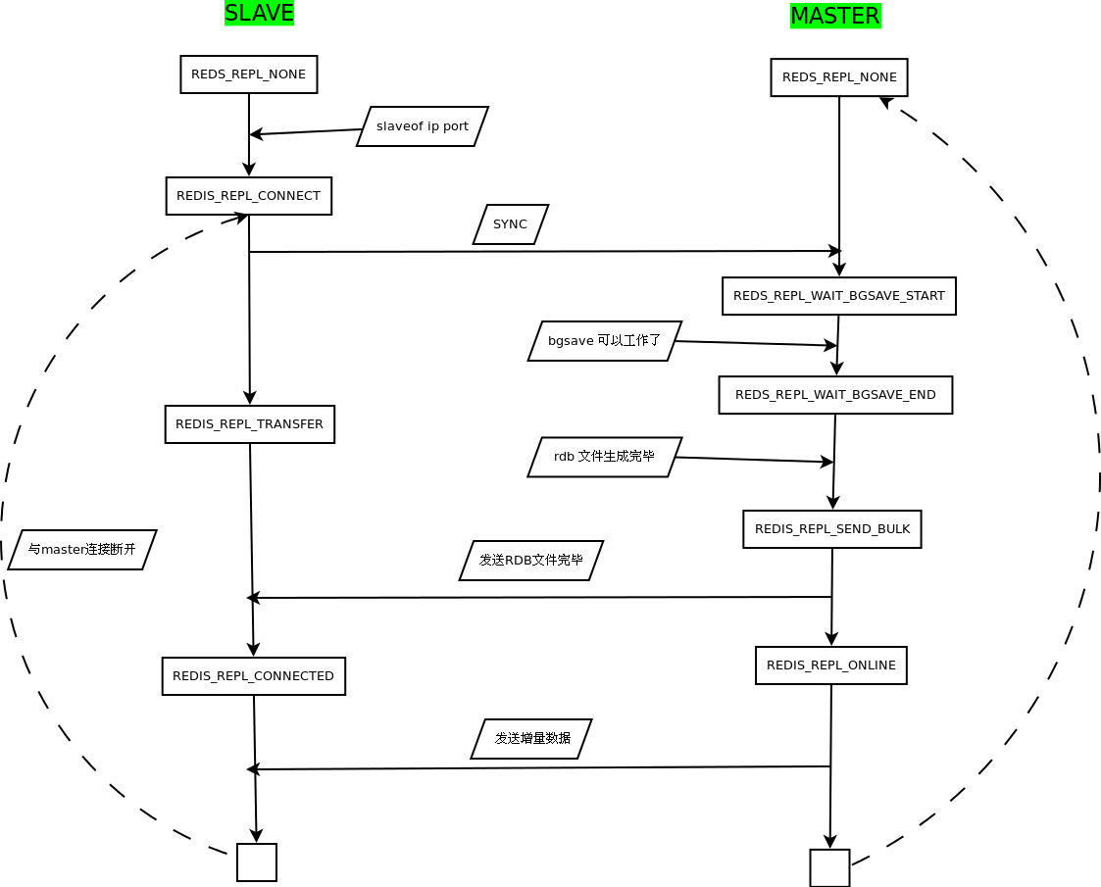
replication

Slide 13
replication
Case replication switch
  old redis version running on, say, redis:6379.
  Install and start a new redis on redis:6380 with a different dump file location.
  Execute SLAVE OF redis 6379 against redis:6380. Wait for first SYNC to complete.
  echo "enable server redis/redis-6380" | socat stdio unix-connect:/var/run/haproxy/admin.sock
  echo "disable server redis/redis-6379" | socat stdio unix-connect:/var/run/haproxy/admin.sock
  Execute SLAVE OF no one on redis:6380.
  Execute SHUTDOWN on redis:6379.
  Assuming that you've got a HAProxy config looking something like
  listen redis :6378
  server redis-6379 localhost:6379 check weight 256
  server redis-6380 localhost:6380 check disabled

Slide 14
persistence
Snapshot
  Fork process, loop hash table, save on file dump.rdb
  Yes!!! sequential write
  Write dump.rdb need O_DIRECT?
Aof
  Like binlog, for recover after crash
  appendfsync
  Aof file is big use bgrewriteaof

Slide 15
Login user
Design a login user system
  Heap table
    userid login_times last_login_time
    1 5 2011-1-1
    2 1 2011-1-2
    3 2 2011-1-3
  Last login man?
  Max login man?

Slide 16
Login user
data
  Set userid:1:login_times 5
  Set userid:2:login_times 1
  Set userid:3:login_times 2
  Set userid:1:last_login 2011-1-1
  Set userid:2:last_login 2011-1-2
  Set userid:3:last_login 2011-1-3
Last login
  lpush user_last_login 1
  lpush user_last_login 2
  lpush user_last_login 3
  ltrim user_last_login 0 1

Slide 17
Login user
Max login man
  zadd user:login_times 5 1
  zadd user:login_times 1 2
  zadd user:login_times 2 3
  zcard user:login_times
  zrangebyscore user:login_times 3 +inf withscores
Column store data?

Slide 18
tag
Relational is suitable?
  book
    id book author
    1 <<Diving into Python>> gun
    2 <<Ruby on rail>> japan
  Tag
    Tagname id
    Web 1
    Web 2
    Python 2
  Sql
  select id from tag t1, tag t2 where t1.tagname = 'web' and t2.tagname = 'python' and t1.id = t2.id

Slide 19
tag
Kv design
  set book:1 ”diving into python”
  Set book:2 ”ruby on rail”
  sadd tag:web 2
  sadd tag:web 1
  sadd tag:python 1
  sinter 'tag:web' 'tag:python'
  sunion tag:web 'tag:python'
  sdiff tag:web 'tag:python'
反思？

Slide 20
Sina weibo
Recent record
    List, Lrange(关注的人列表、粉丝列表、feeds列表)
Set
    Sadd|, sdiff, sinter (我的好友，我可能感兴趣的人)
Score
    Zadd, zset(feeds排名)
Hash
    Hincrby, hgetall(用户资料，关注数，粉丝数，微博数 )
Delete history data
    expire

Slide 21
Sina weibo
我关注的人
  sadd user:hoterran:follows user:foolishceo
  sadd user:hoterran:follows user:logzgh
  sadd user:hoterran:follows user:sqlrush
  smembers user:hoterran:follows
英杰关注的人
  sadd user:sqlrush:follows user:logzgh
  sadd user:sqlrush:follows user:hoterran

Slide 22
Sina weibo
我们共通关注的人
  sinter user:sqlrush:follows user:hoterran:follows
我的粉丝
  sadd user:logzgh:follows user:hoterran
  sadd user:hoterran.follower user:logzgh
  sadd user:hoterran.follower user:sqlrush
  smembers user:hoterran:follower

Slide 23
Sina weibo
我的好友
  sinter user:hoterran:follows user:hoterran:follower
我们都关注的人
  sinter user:sqlrush:follows user:hoterran:follows

Slide 24
Sina weibo
可能感兴趣的的人
  sadd user:sqlrush:follows user:free_yz
  sdiff user:sqlrush:follows user:hoterran:follows
我关注的人数，我的粉丝数，我的
  Hset hoterran:profile follows 1
  Hset hoterran:profile follower 2
  Hset hoterran:profile blog 3
  Hgetall hoterran:profile
  Hincrby hoterran:profile blog 1

Slide 25
Suitable scene
轻量级的高性能消息队列服务
生产者消费者
  Producer lpush
  Consumer blpop
Redis的主要缺点是数据库容量受到物理内存的限制，不能用作海量数据的高性能读写，并且它没有原生的可扩展机制，不具有scale（可扩展）能力，要依赖客户端来实现分布式读写，因此Redis适合的场景主要局限在较小数据量的高性能操作和运算上。

Slide 26
summary
Defects
  Failover
  Replication
  Dba level
  Memory limit size
Advantage
  High qps
  Data structure

Slide 27
qa
Replace aliWangwang k-v(blob)
Can satisfy Online Log requirement?

