Slide 1
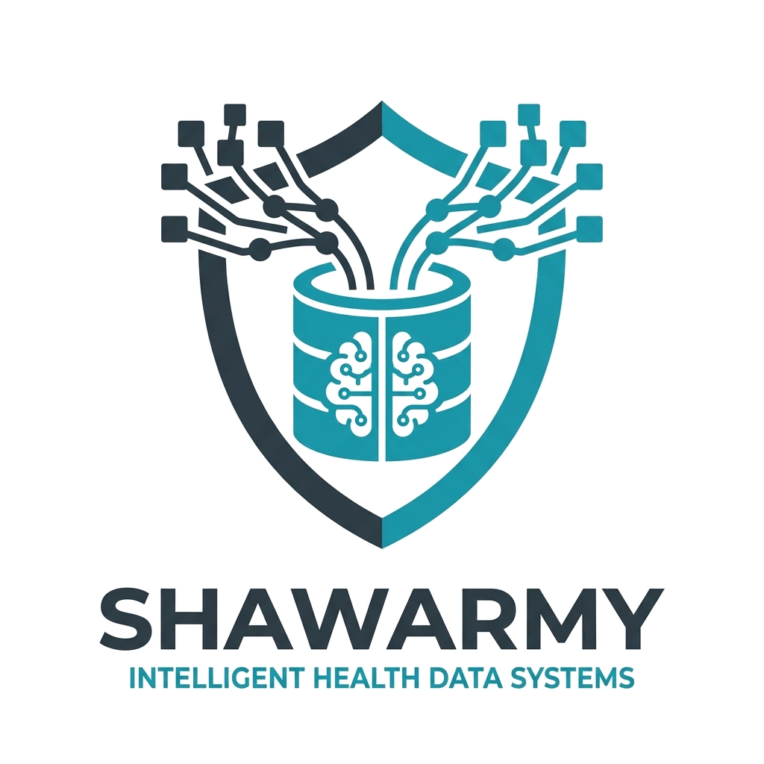

Smart Health
Data Mapping
From Raw Data to Actionable Insights — Automatically

Slide 2

THE CHALLENGE
Healthcare Data is Fragmented & Underused
Siloed Sources
Manual Effort
Lost Insights
Hospital systems, lab exports, PDFs, and free-text — all different formats, no common language.
Harmonization requires heavy manual work — slow, error-prone, and impossible to scale.
Valuable routine data sits unused. Predictive analytics, early warnings, and efficiency gains remain untapped.
1-2% efficiency gain equals to 1.6 billion in savings. This is doable.

Slide 3
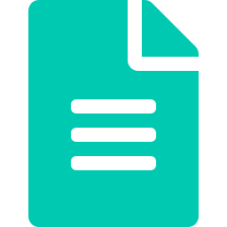


OUR SOLUTION
An Intelligent Data Harmonization Platform
AI-powered mapping · Automated ingestion · Interactive correction
Different Formats
AI Mapper
Dashboard
Unified DB
▶
▶
▶
CSV, PDF, Excel, free text
NLP + pattern recognition
Anomaly detection
Mapping intervention
Error & anomaly decisions
Analytics & alerts
epaCC schema

Slide 4


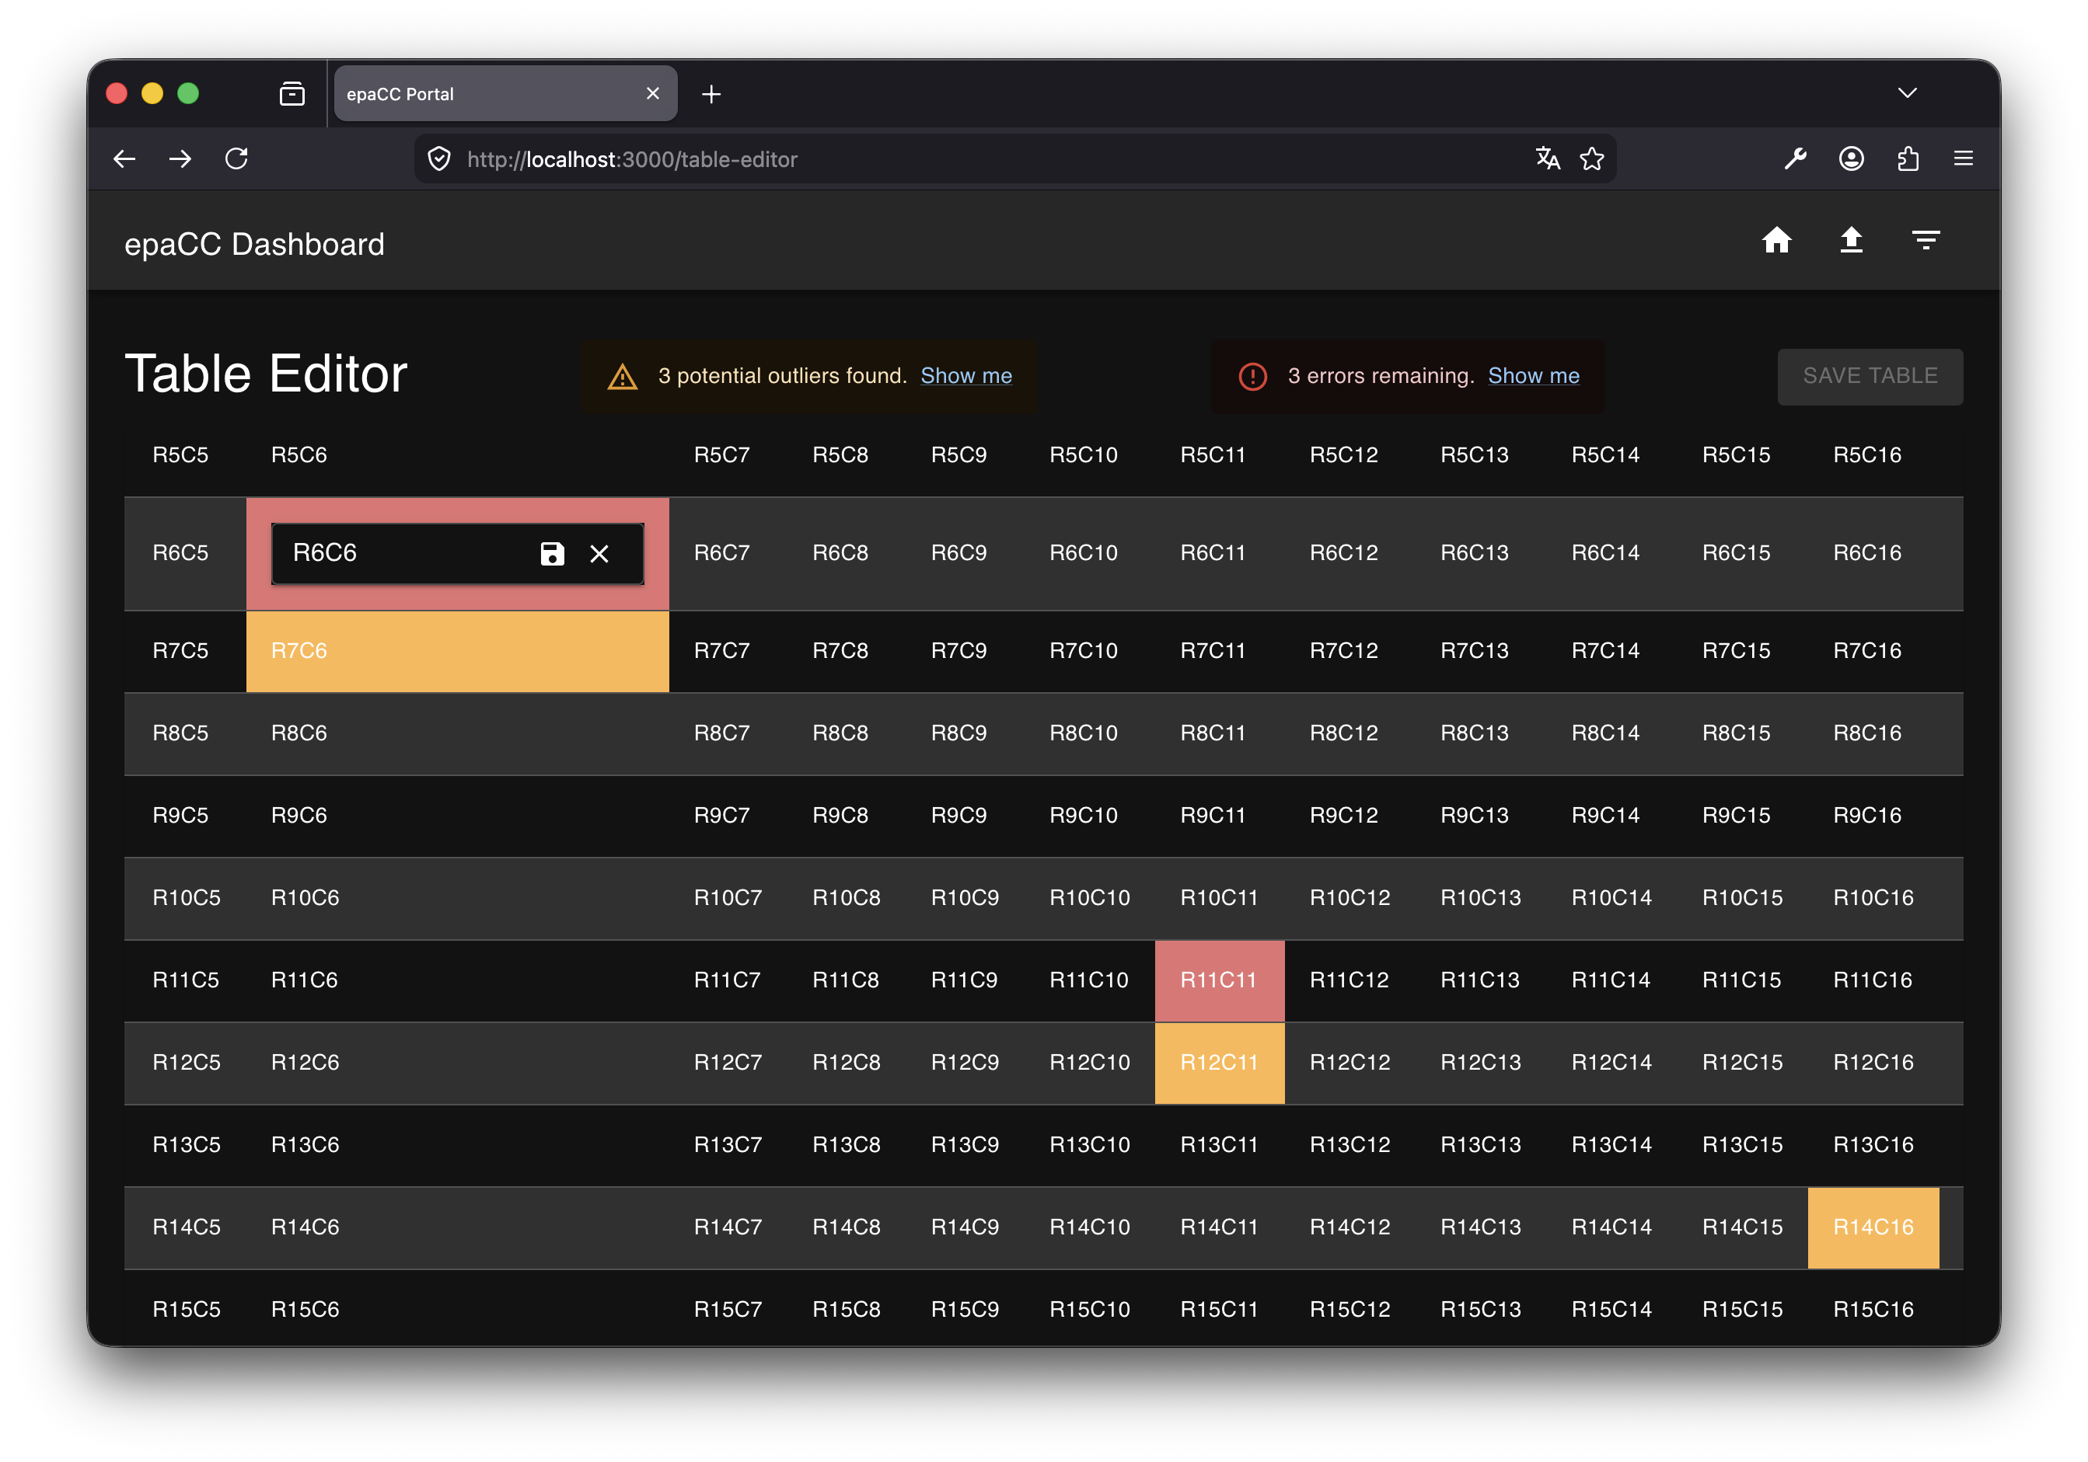
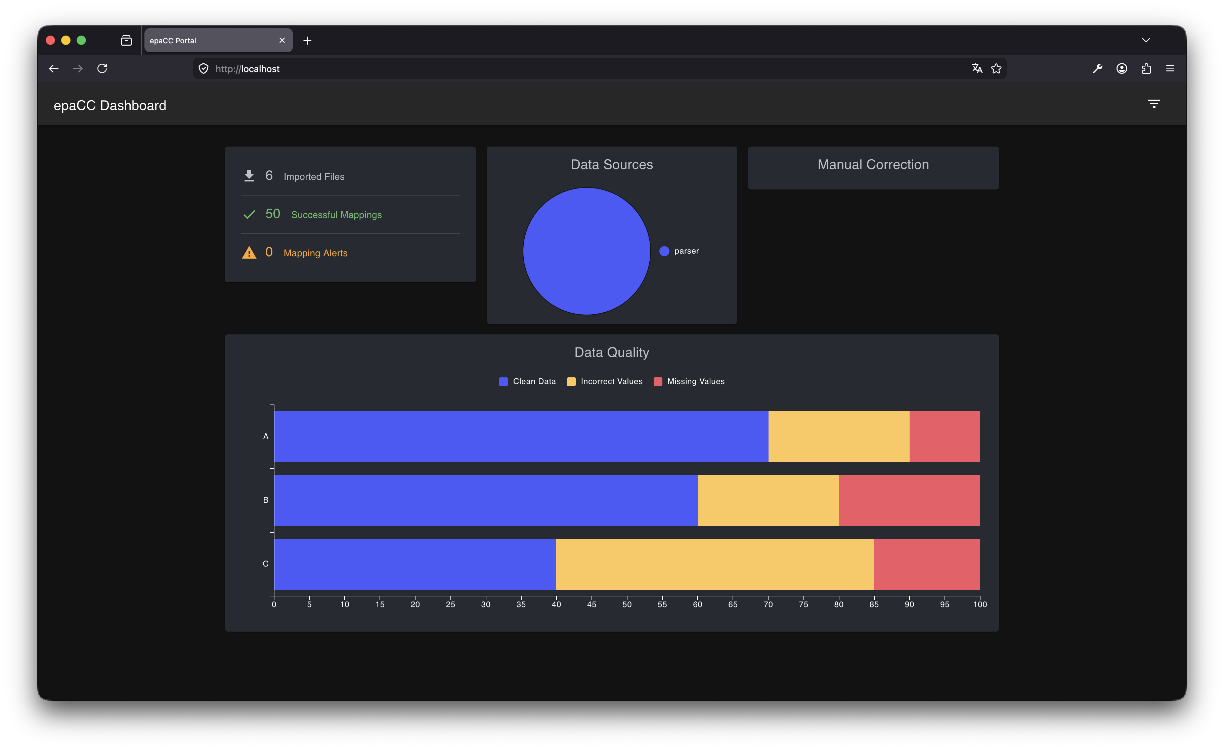
PRODUCT FEATURES
Everything in One Unified Web Interface
Smart & Assisted Data Mapping
Insightful Dashboard
Mostly automated, but allows for manual intervention
Completeness scores, anomaly heatmaps, live status.

Slide 5



BUSINESS IMPACT
Measurable Value at Scale
€800M–1.6B
10–20%
unpayable
Potential annual savings
from 1–2% DACH efficiency gain
Reduction in avoidable
complications via predictive care
Better insights into health data and indefinite chances to use them.
Digital twin of care situations across 1,400+ institutions
Enables advanced analytics & AI model training for 630K users
Accelerates product innovation with clean, unified data foundation

Slide 6
Smart Health Data Mapping
Your Healthcare Data. Unified. Intelligent. On-Premises.
✓ AI-driven mapping across all formats and sources
✓ Interactive dashboard with alerts & manual correction
✓ Fully offline capable — data stays in-house
Let's Build This Together →
epaSOLUTIONS
Healthcare Data Platform

