Slide 1



Slide 2
TL;DR
Recipe:
  Take a CSS prototype or a layout
  Cut out 'main' div
  Ajax load that div
  Animate that div
  Don't work in landing page (index)
Use our Cloud API
  What is a Cloud API?

Slide 3

CDN:
What is a CDN?

Slide 4
Structure
ROOT
  Landing page, or Layout (ex: header/footer)
aCDN
  Assets
  Libs
  App code
  View(*)

Slide 5
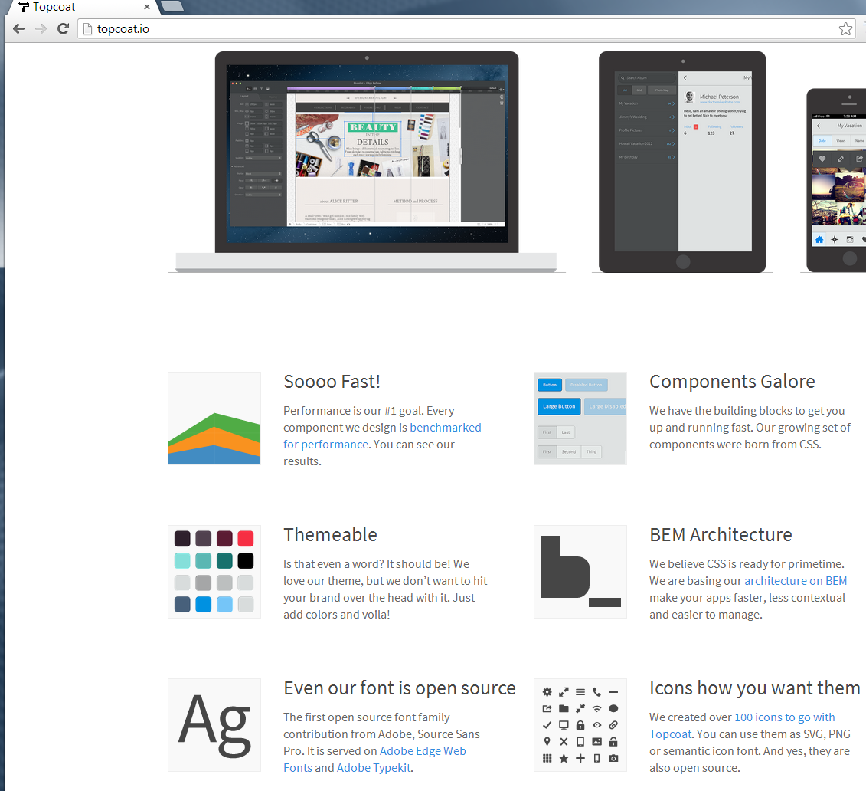
topcoat

Slide 6
TypeScript / ECMAscript 6
function foo() {
bar(1)
}
function bar(arg) {
console.log('yes, ' + arg)
}
foo()

Slide 7
LESS
Used by Libraries
  Ex: bootstrap
  Compiles CSS
  Advantages
    You can swap out base lib

Slide 8
$.get
Look up docs in Zepto.js
Loads a *DIV File*
  AKA: View!

Slide 9
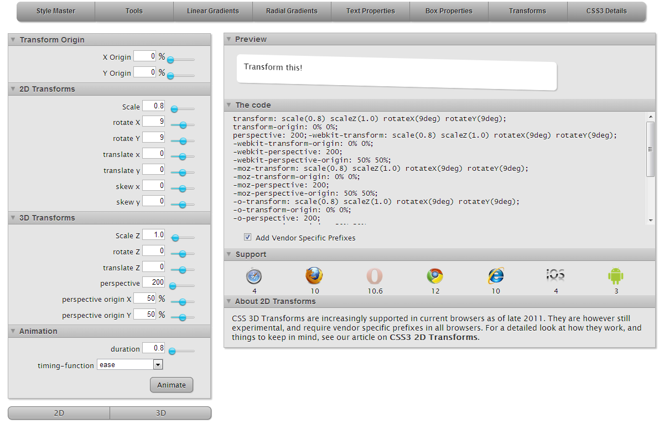

Slide 10
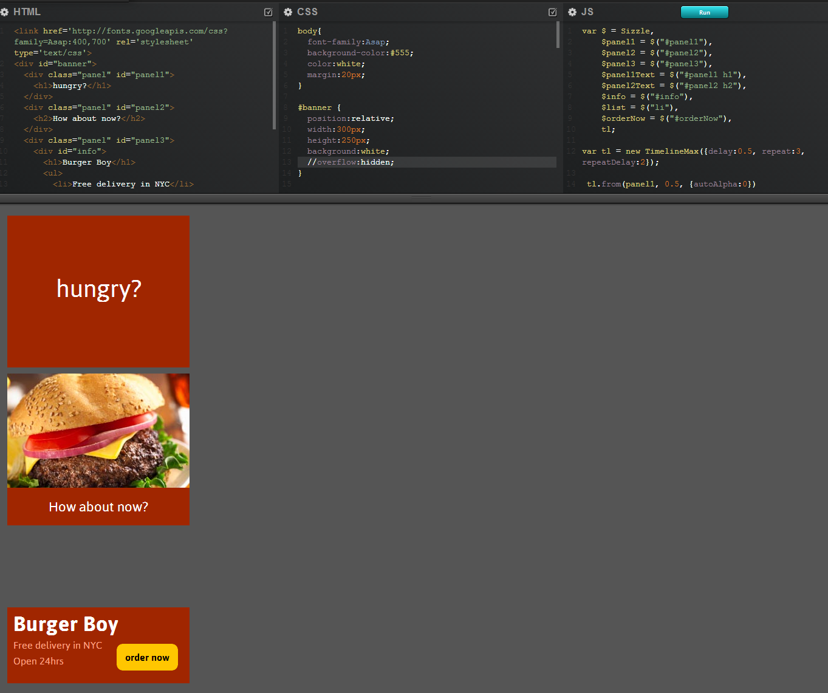

Slide 11
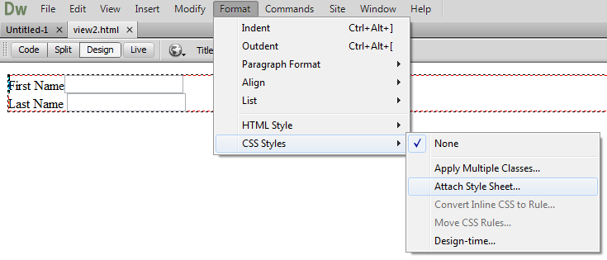

Slide 12


Slide 13
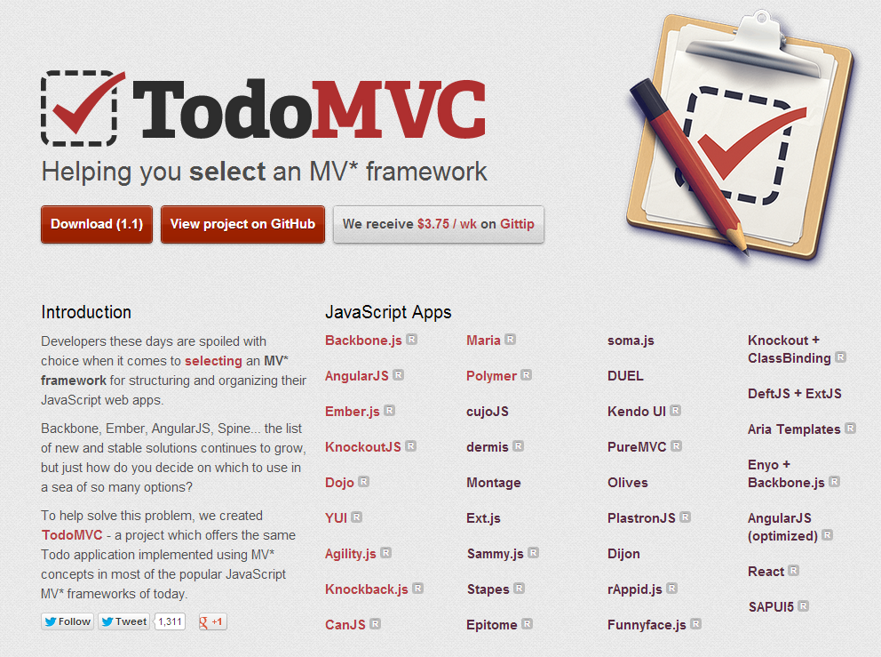

Slide 14
HTML 4 | HTML 5
JavaScript | ECMAScript 6
Canvas | Div
Typography | Animation
PSD | Experiments
px | Rem, em, percent
Jpg/png | Svg (or D3)
Degrading IE8 | Tablets
Document | SPA
View Source | Obfuscate
Native (Objective C, Java) | Cordova (PhoneGap)
Heavy | Minimal
Hosted | CDN
MV* js, JS | CSS Lib
Ruby, PHP, Python, JSP, ASP | API

Slide 15
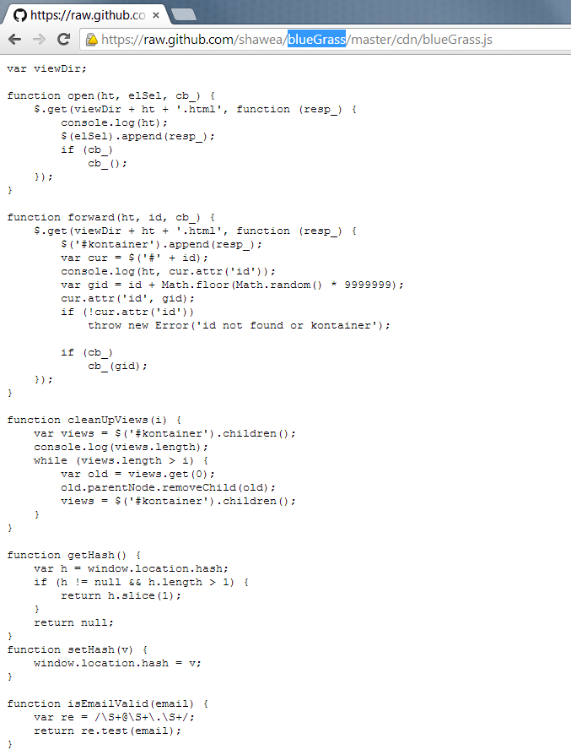

Slide 16
Demo
- Load
- Tsc
- View Sections
- Classes
- Start project
  Slider

Slide 17
TL;DR
Recipe:
  Take a CSS prototype or a layout
  Cut out 'main' div
  Ajax load that div
  Animate that div
  Don't work in landing page (index)
Use our Cloud API
  What is a Cloud API?

