Slide 1
Review:
Load subViews.

Slide 2
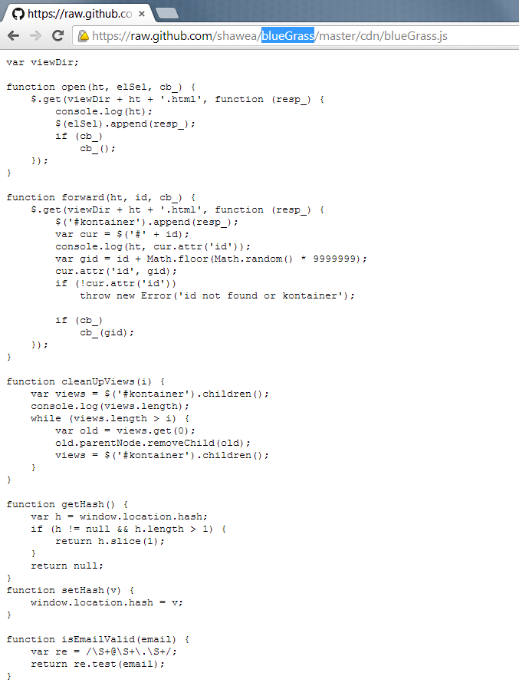

Slide 3
DOM
GPU vs CPU
DOM speed
  Vs JS

Slide 4

Ex: Dreamweaver
Example of View WYSWIG

Slide 5
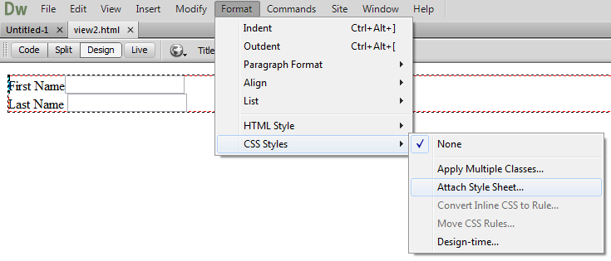

Slide 6
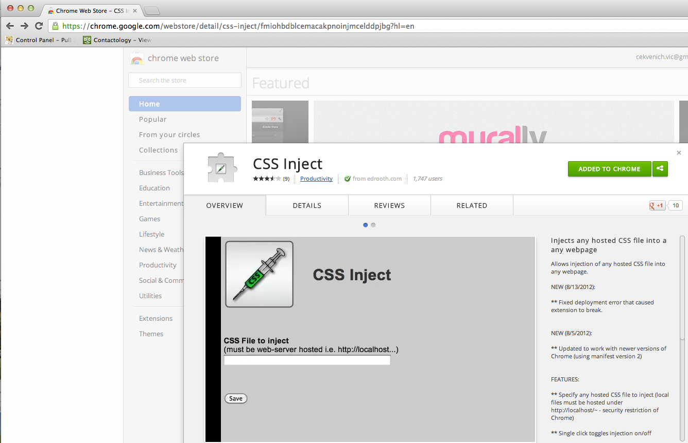

Slide 7
LAB2

Slide 8
BlueGrass pattern
Presenters
App
(or resize event)

Slide 9
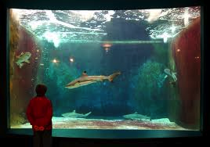
Classes Hint
Think fish swim in an aquarium -
Its not the aquarium moving fish around

Slide 10
Next lab:
Hashing functions()

Slide 11
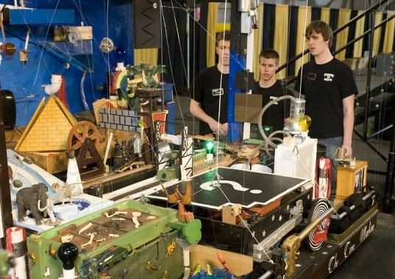

Slide 12
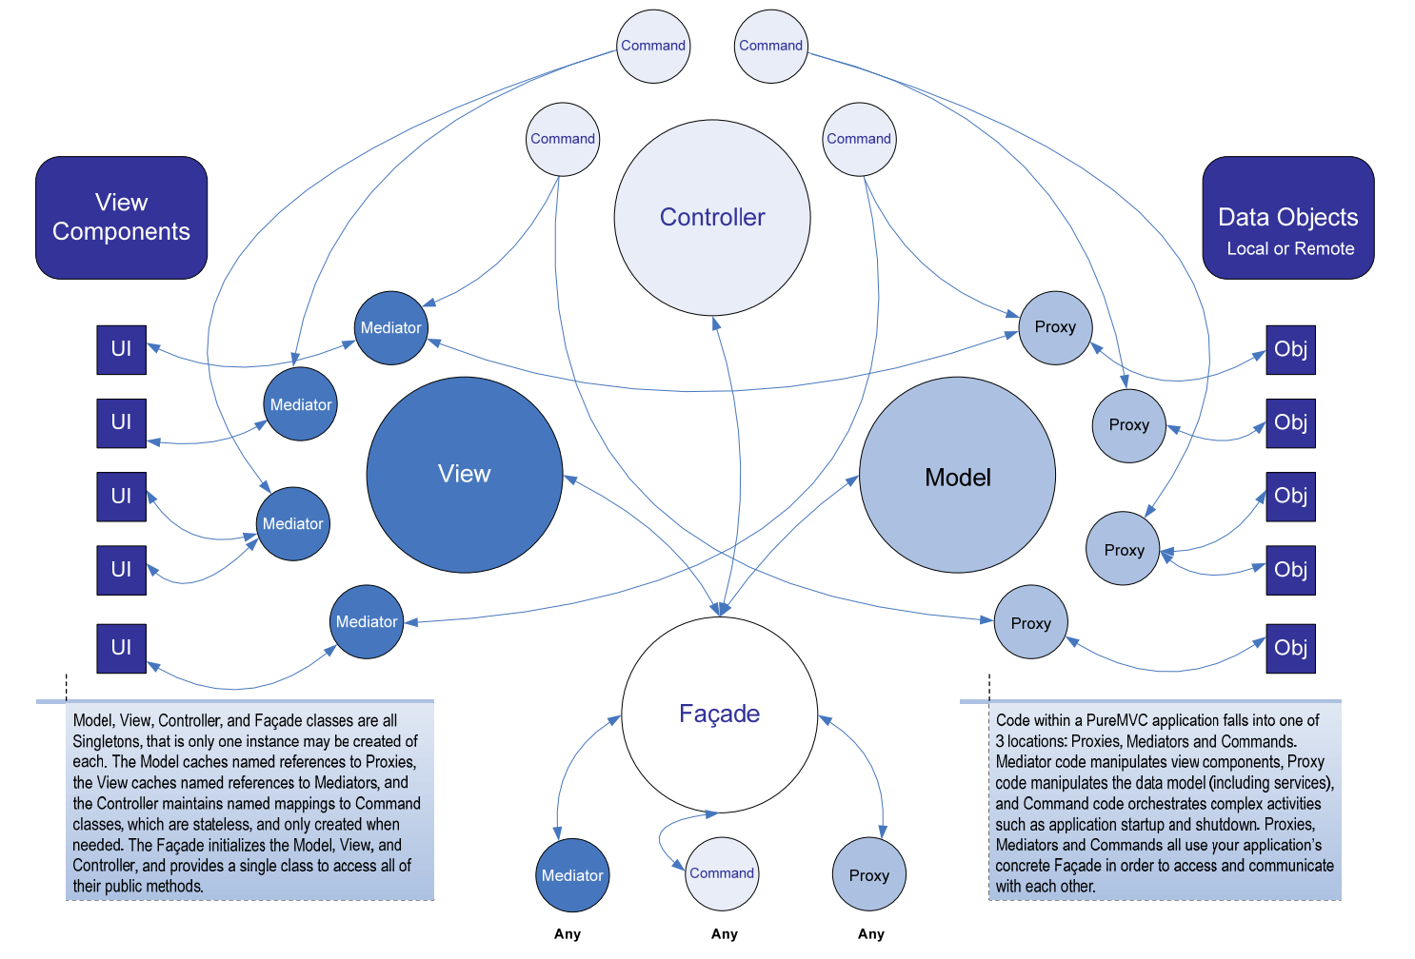
EJB?
- What comes after MVC?
- Java Applets?

Slide 13
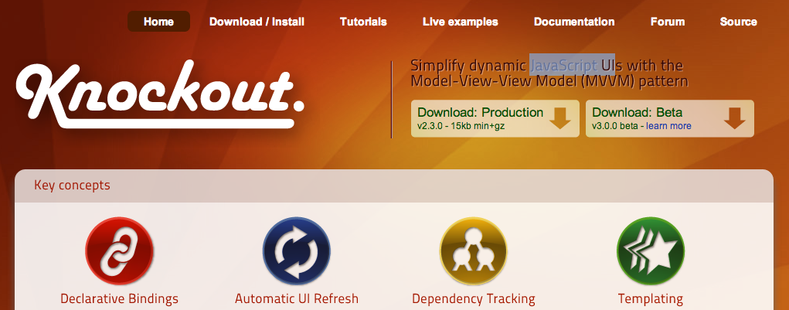

Slide 14
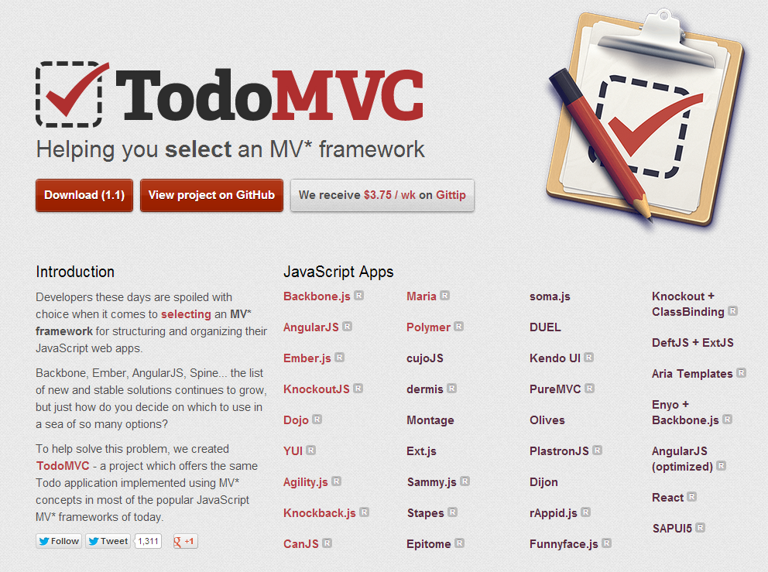
MVC like GWT?

Slide 15
Inspiration?
What is an example of a good app?
  Famo.us
  IntoTheArtic.gp (demo)
    How? GPU vs CPU video

Slide 16
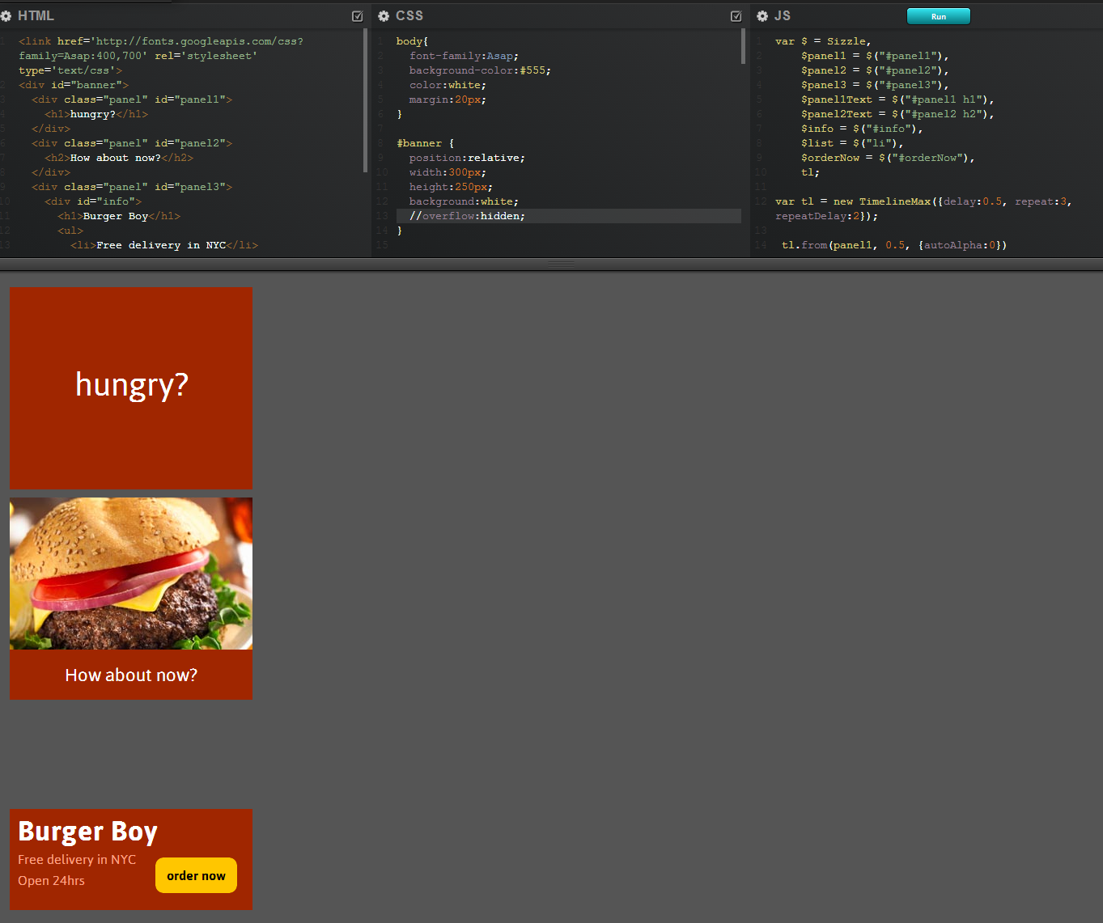

Slide 17
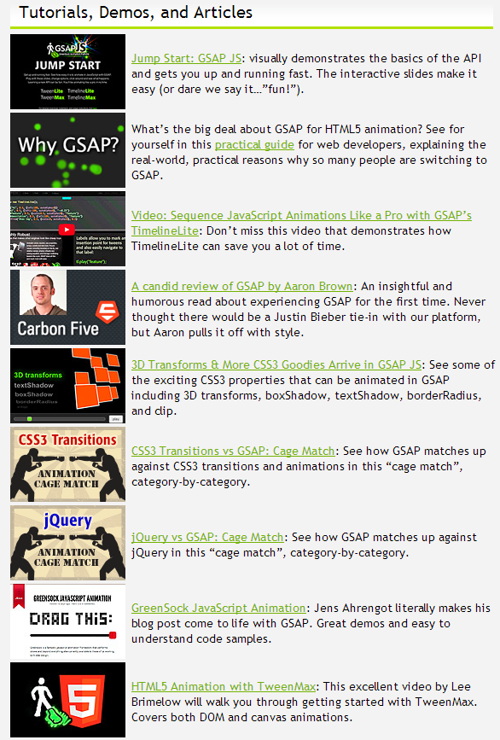

Slide 18
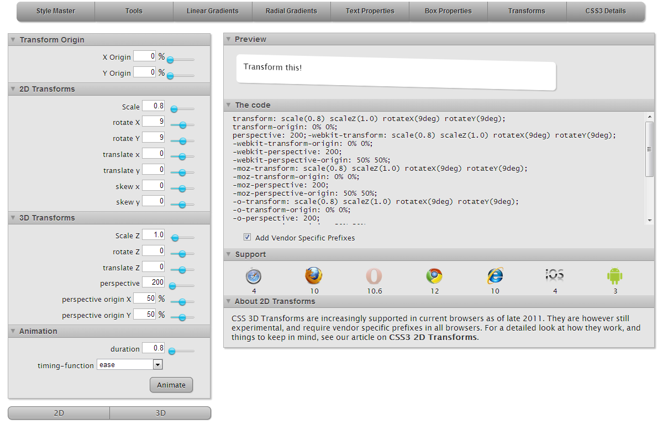

Slide 19
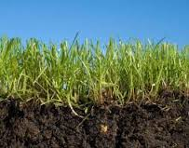

Slide 20
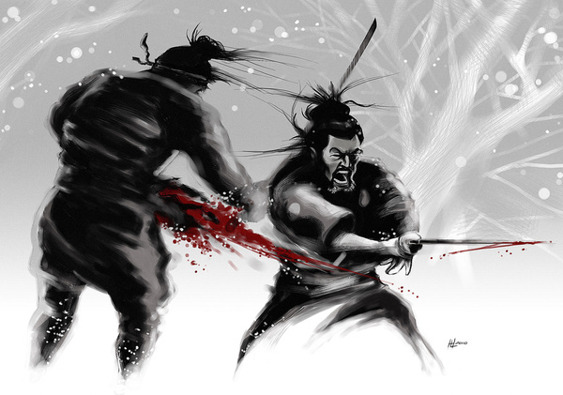

Slide 21
Lab3
ROOT: Greensock animation

Slide 22
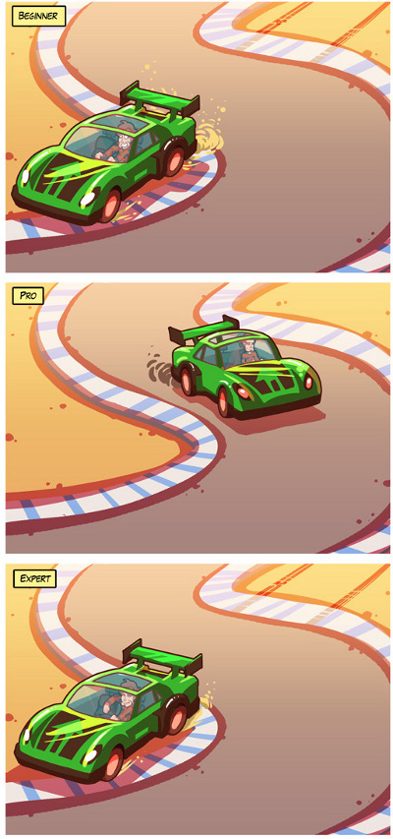

Slide 23
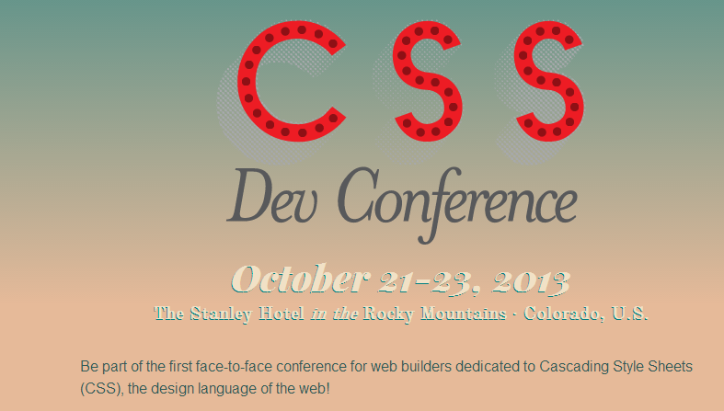

Slide 24
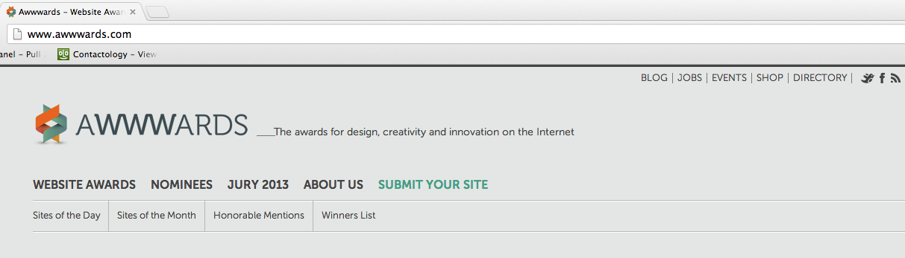

Slide 25
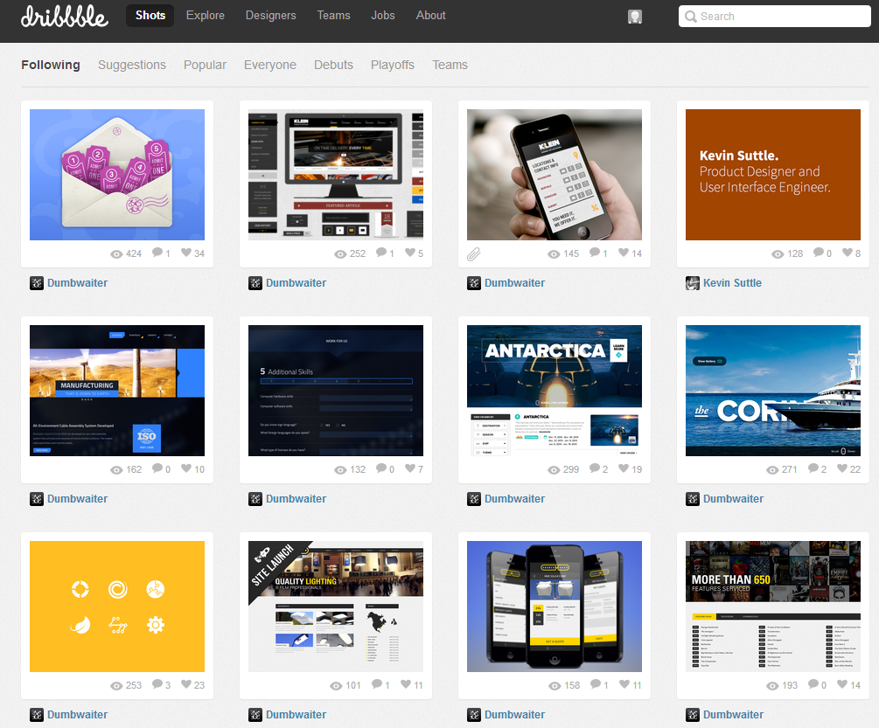

Slide 26
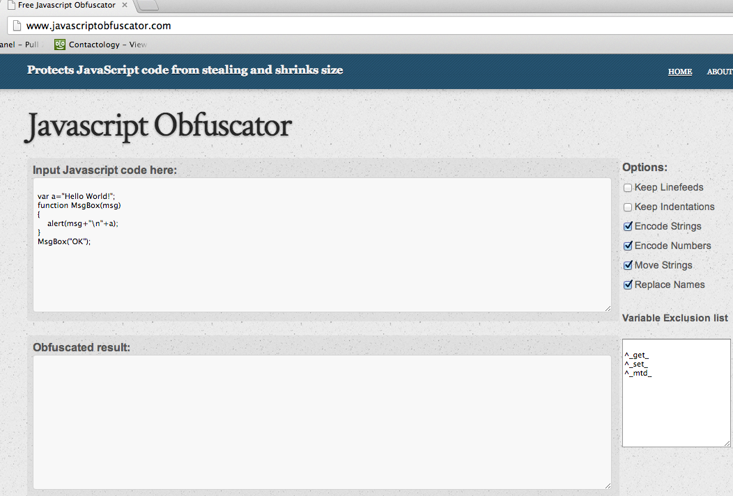

Slide 27
PhoneGap
- No Objective C
- No Android
- Cloud API
  No Ruby, Heroku, etc.
- Yes CDN.

Slide 28
HTML 4 | HTML 5
JavaScript | ECMAScript 6
Canvas | Div
Typography | Animation
PSD | Experiments
px | Rem, em, percent
Jpg/png | Svg (or D3)
Degrading IE8 | Tablets
Document | SPA
View Source | Obfuscate
Native (Objective C, Java) | Cordova (PhoneGap)
Heavy | Minimal
Hosted | CDN
MV* js, JS | CSS Lib
Ruby, PHP, Python, JSP, ASP | API

Slide 29
Design?
- Hamburger
- Background video
- Interaction:
  GIF
  Transitions
  Graphic animations
- Gestures
- Continuous re-design

Slide 30
Points:
- TypeScript
- DOM (js emit is evil)
- Greensock (GPU)
- 'Presenter' pattern
  Cloud API
: Interactive

Slide 31
Keep In Touch
Follow us! Use us! Talk to us! Feedback.
  @primusapi
  PrimusAPI.com

Slide 32
TL;DR
Recipe:
  Take a CSS prototype or a layout
  Cut out 'main' div
  Load that div (tbd)
  Animate that div
  Don't work in landing page (index)
Use our Cloud API
  What is a Cloud API?

