Slide 1
Example Perplexity and Class Label Cleaning
QIU Yaowen, 20784389, yqiuau@connect.ust.hk

Slide 2
Background
Some Examples are easier for humans to classify than others -> This should be also applied on DNNs
Previous works that consider classification difficulty are not ideal (rely on human, some are not about example)
Example Perplexity is proposed

Slide 3

Dataset - ImageNet
1000 Categories

Slide 4
Create a population of DNNs
Select 10 popular models (VGG, ResNet family, Xception …)
Create 9 smaller training set via sub-sampling (25% *3, 50% *3, 75%*3)
During each training session, choose 4 models close to convergence and 1 model at convergence
Total = 10 * (9+1) * (4+1) = 500 DNNs

Slide 5
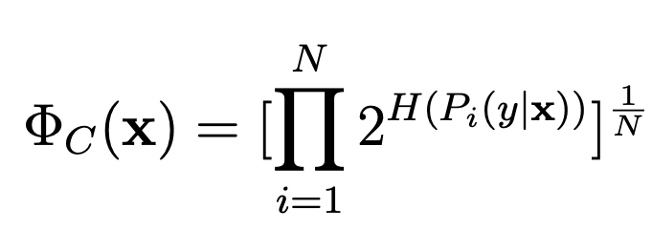
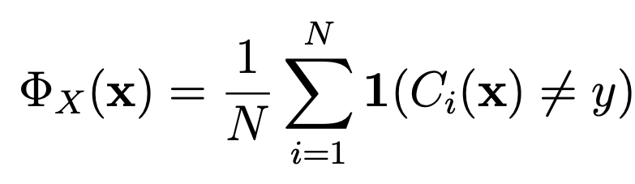
C-Perplexity and X-Perplexity
indicates the confidence that classifiers have when classifying the example. Higher C-perplexity, lower confidence. Minimum value = 1
Fraction of the classifiers that misclassifies the example, hence is between 0 and 1.

Slide 6
Project Objective
Using C/X Perplexity, perform data cleaning / label cleaning on the training set and/or validation set, to improve the classification result of models.

Slide 7
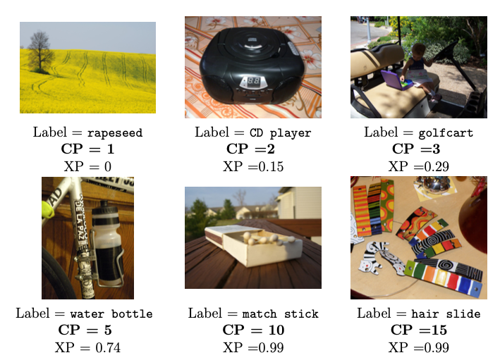
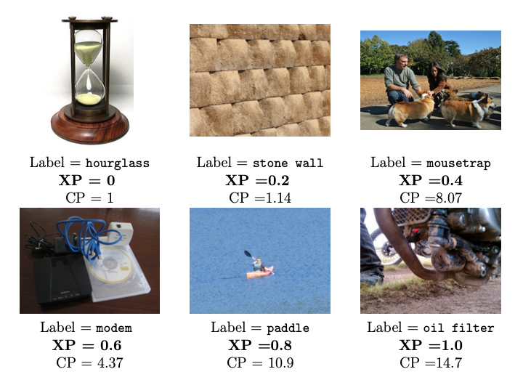
Observation
Examples with varying C-perplexity values.
Examples with varying X-perplexity values.

Slide 8
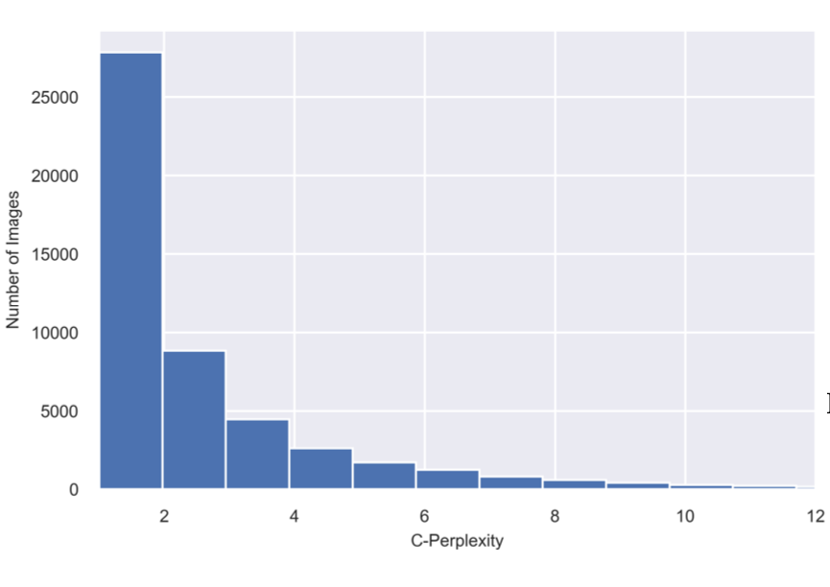
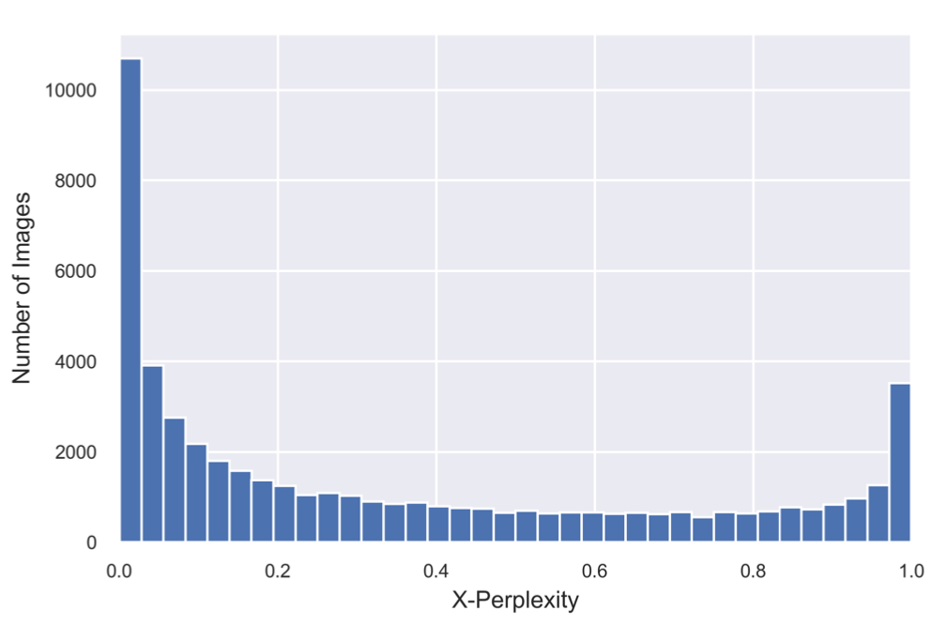
Observation
Distribution of examples over C-perplexity values
Distribution of examples over X-perplexity values

Slide 9
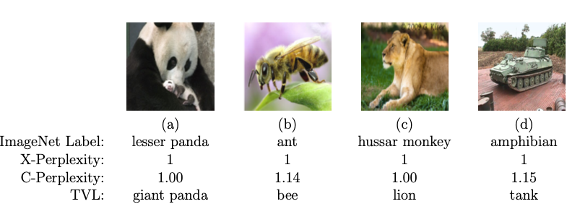
Observation
Imperfections in the ImageNet Dataset

Slide 10
Plan to do
1. select 1~2 Mainstream models, train them on full training set and validate on validation set (To get the baseline)
2. Clean the training set & validation set using:
Threshold filtering (remove extreme values)
3. Assign higher weight on examples with high perplexity in training
Using different function to compute weight
4. Compare the classification result with baseline

