Slide 1
Example Perplexity and Class Label Cleaning
QIU Yaowen, 20784389, yqiuau@connect.ust.hk

Slide 2
Plan
Training data
Data Pre-Processing
Do Nothing
Filter
Weight Reassignment
Train on same way
Baseline Model
Model *
Model *
Validation I
Validate & Compare Performance
Validation II

Slide 3
Evaluation
Loss Function
CE Loss
Metrics
Top 1/ Top 5 Accuracy on Valid I & Valid II
Top 1 / Top 5 Accuracy gap between Valid I & Valid II
3. Distribution of Label Precision

Slide 4
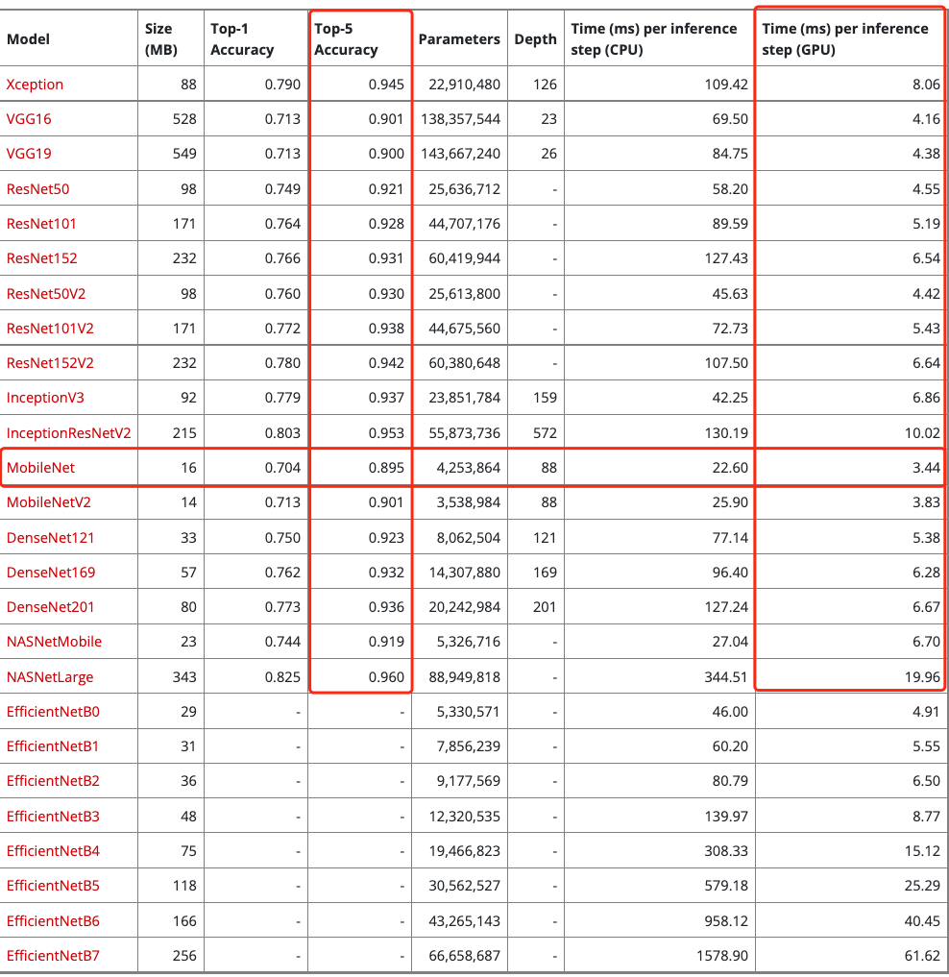
Baseline - Mobilenet

Slide 5
Baseline – Global Training Hyper-parameters
Parameters:
Epochs = 50
train_batch_size = 256
input_shape = (224,224)
nums_of_classes = 1000
optimizer = SGD(lr=0.01, momentum=0.8, nesterov=False), with step decay 0.5 per 10 epochs
Pre-processing:
Normalization : Rescale image to [0,1]
Randomness Control
Set seed to control the sequence of batch examples in data generator
Each model use same initial parameters

Slide 6
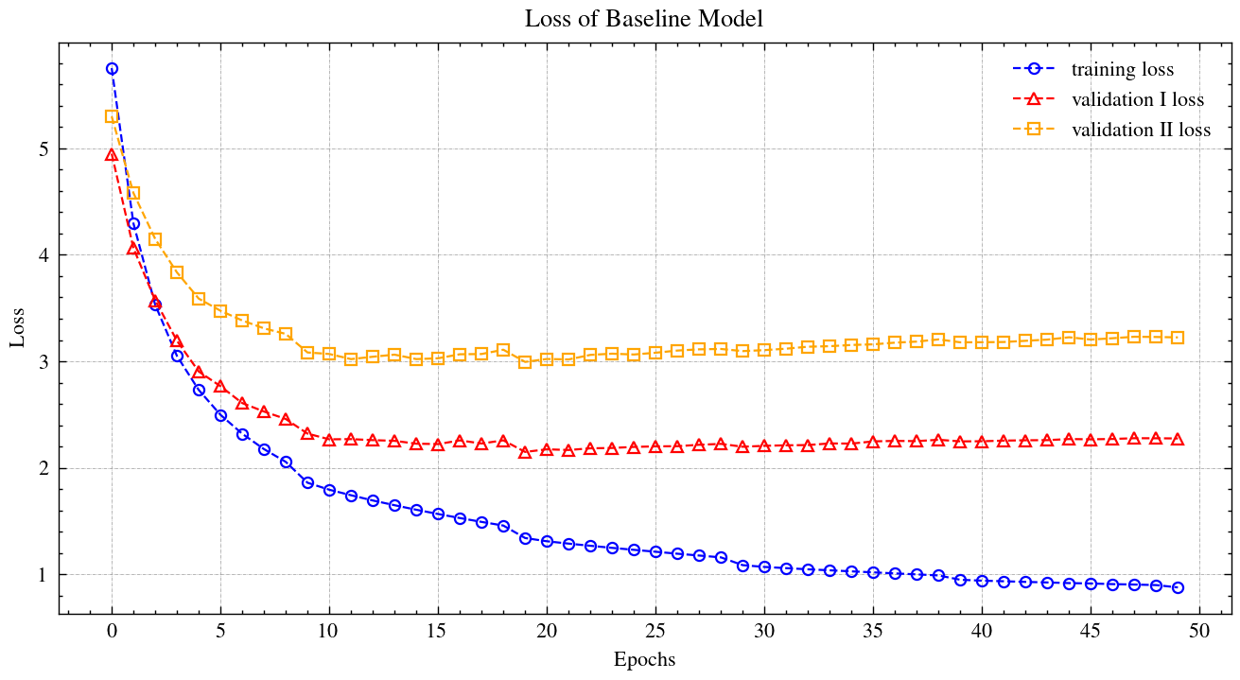
Baseline – Loss

Slide 7
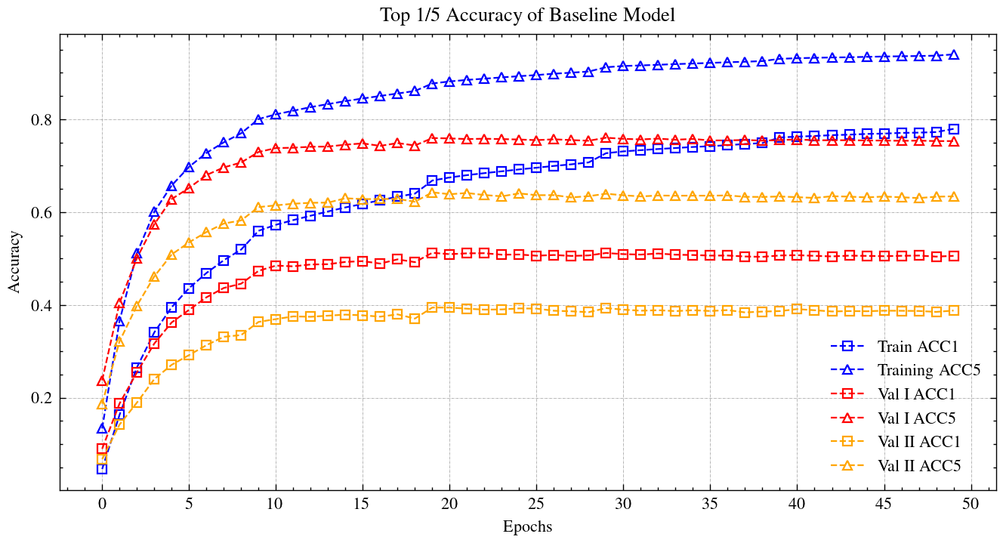
Baseline – Accuracy

Slide 8
Baseline – Result
Model | Top_1_Acc Train | Top_5_Acc Train | Top_1_Acc Val I | Top_5_Acc Val I | Top_1_Acc Val II | Top_5_Acc Val II | Gap Top1 | Gap Top5
Baseline | 77.92% | 93.97% | 50.57% | 75.29% | 38.79% | 63.39% | -11.78% | -11.90%
There is about 15% Top_1 Accuracy gap and Top_5 Accuracy gap between paper, may be due to:
- Different Training Hyper-parameters
- Bad Initialization
- Different training sequence
** I am running the baseline model with different params in parallel now, and it seems that it is closer to the origin paper. I will use it in the final report.

Slide 9
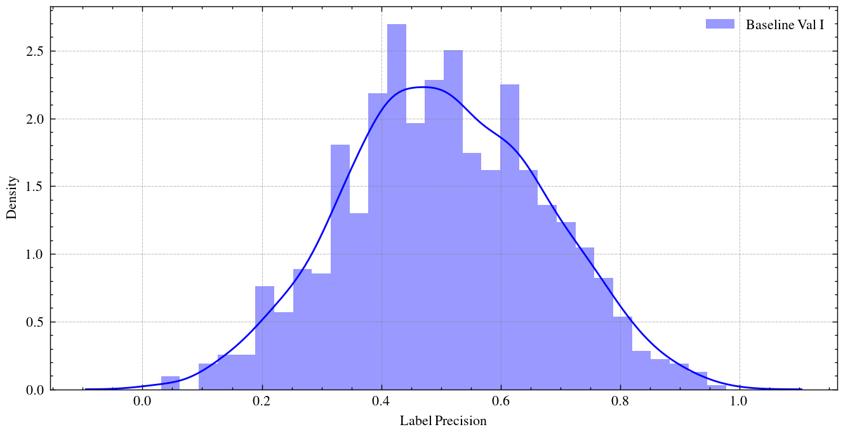
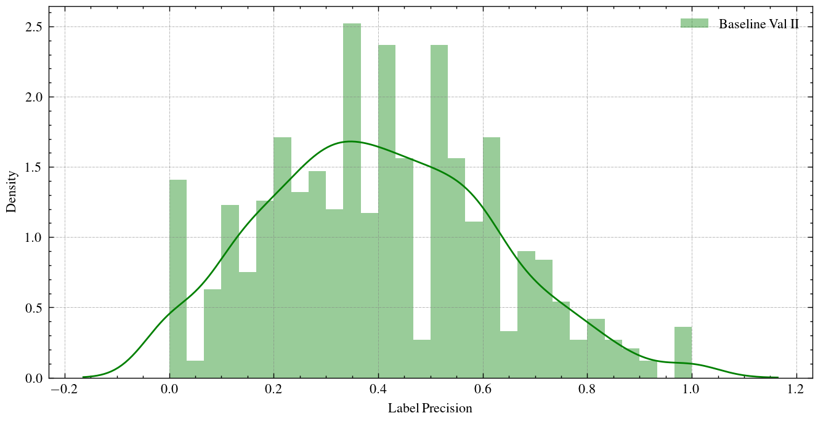
Baseline – Result

Slide 10
Filter Training Examples
Sort the training examples based on X_Perp/C_Perp in ascending order, respectively.
Define a threshold of percentile to prune examples larger than the threshold
.95
.90
.85
To maintain the label balance, randomly duplicates N examples from each category with replacement, where N = # of pruned examples
Train & Evaluate Model based on new Training data
Expect
- Increase Accuracy on Val I and/or Val II
- Decrease Gap Top 1 and/or Gap Top 5

Slide 11
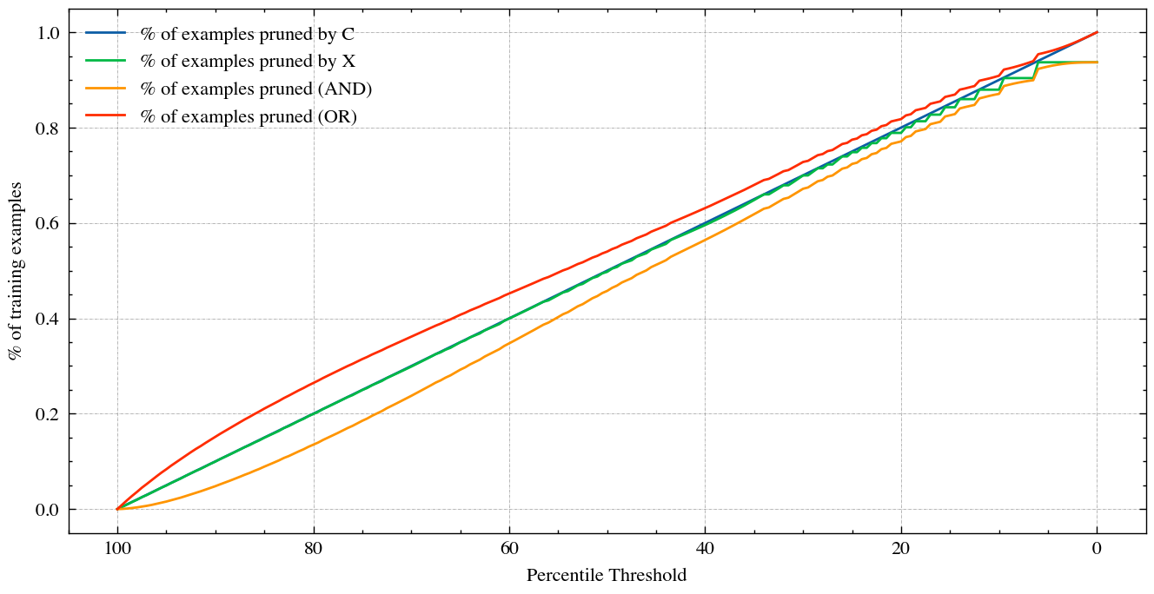
% of examples pruned
1. Relatively Linear Decay 2. Example with high X tends to has low C; vice versa

Slide 12
Filter Training Examples
Threshold | # of examples pruned by C_Perplexity | # of examples pruned by X_Perplexity | # of examples pruned (OR) | # of examples remaining
.95 | 64,059 | 63,278 | 107,107 | 1,174,060
.90 | 128,117 | 127,572 | 194,140 | 1,087,027
.85 | 192,175 | 191,792 | 269,967 | 1,011,470

Slide 13
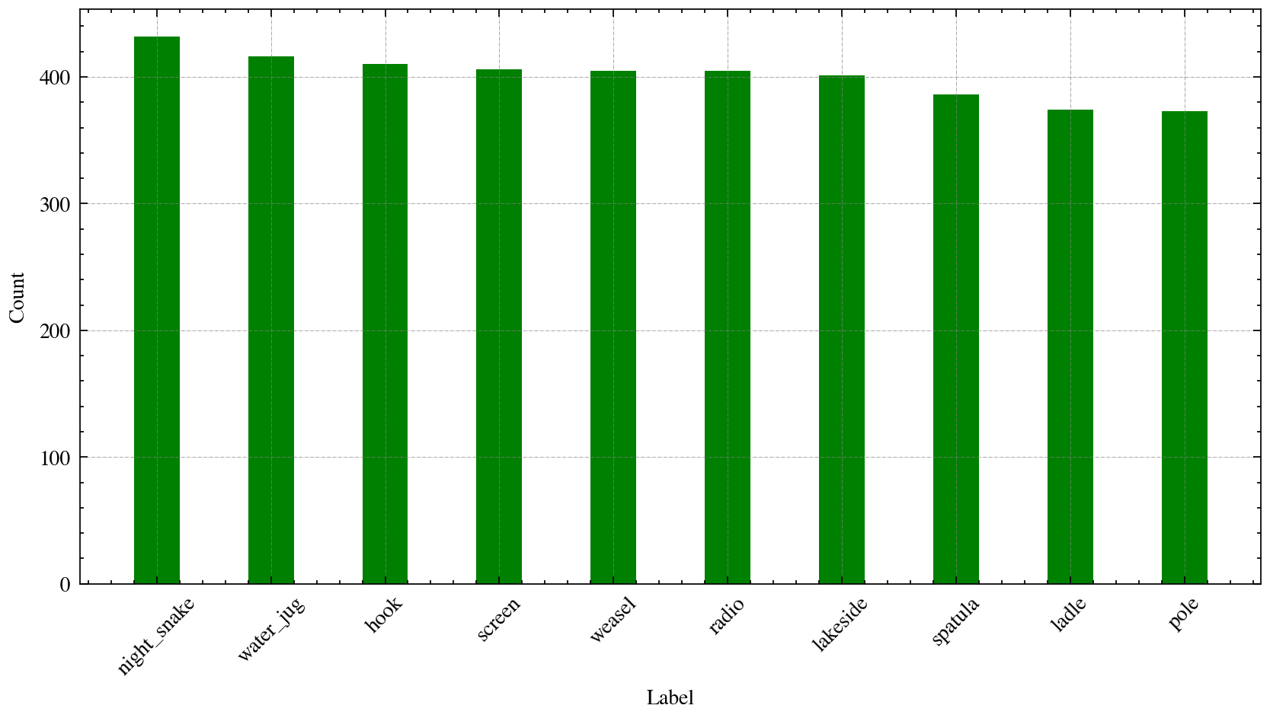
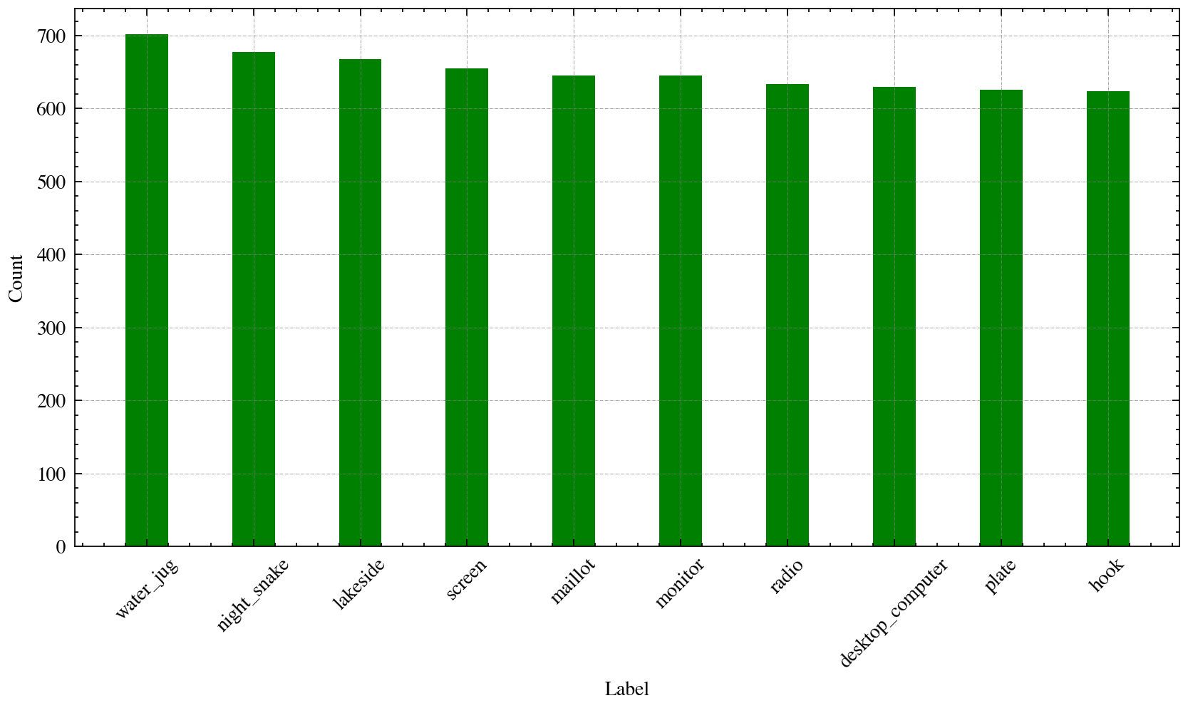
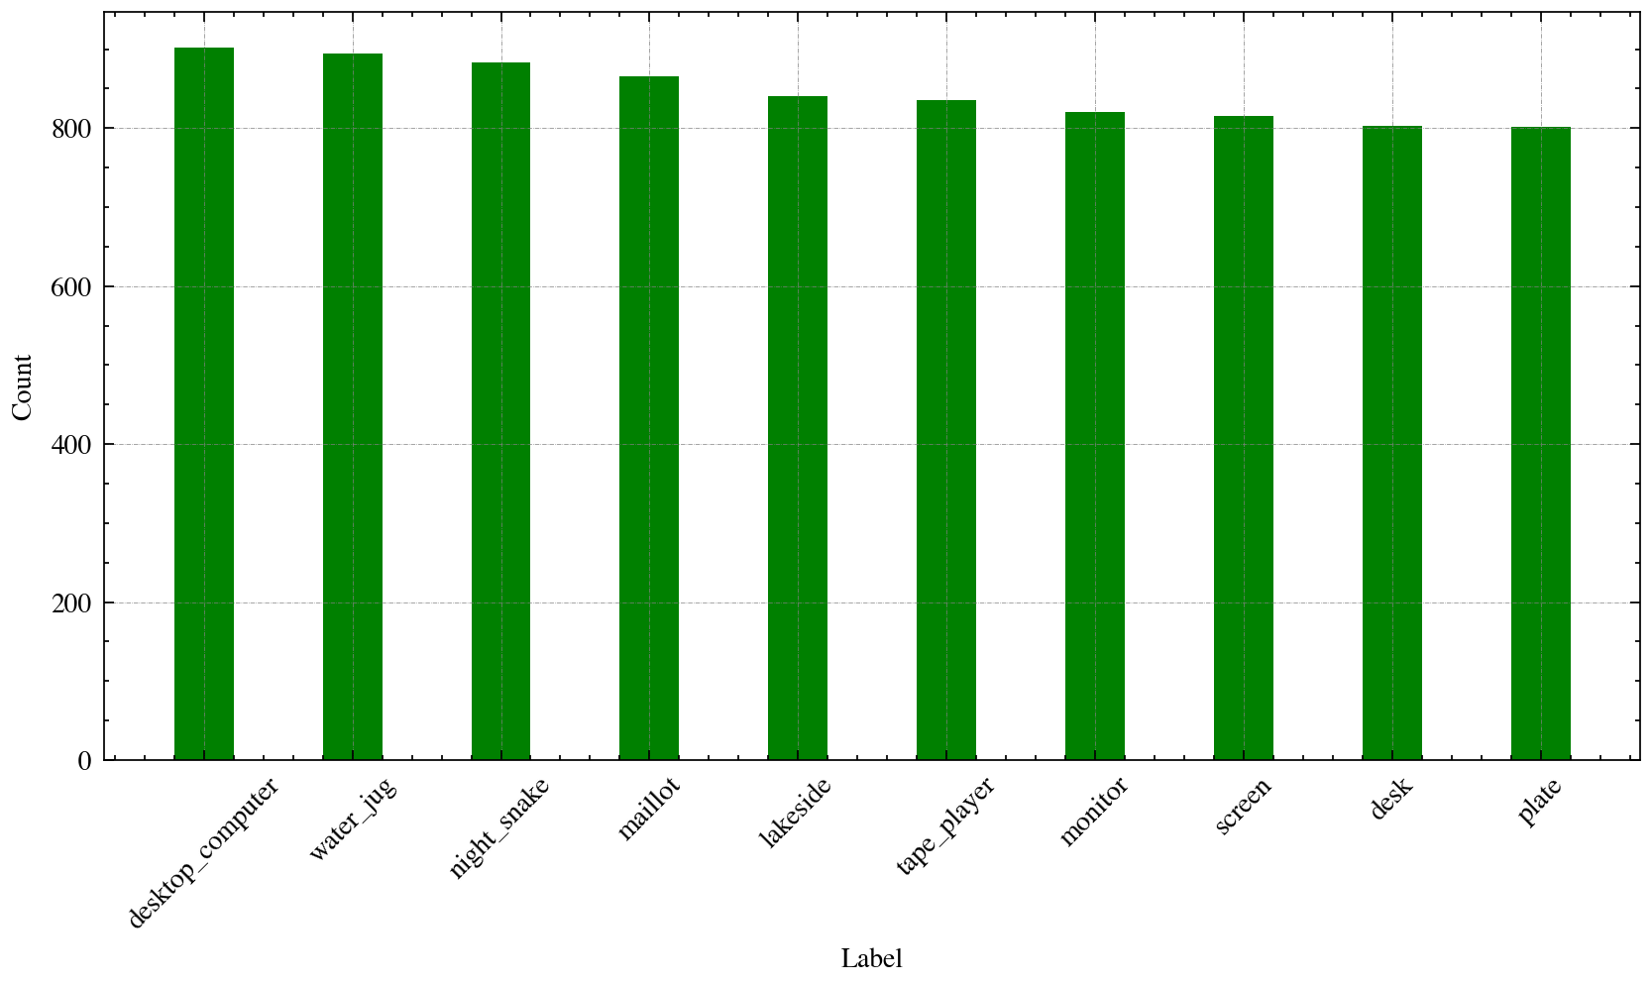
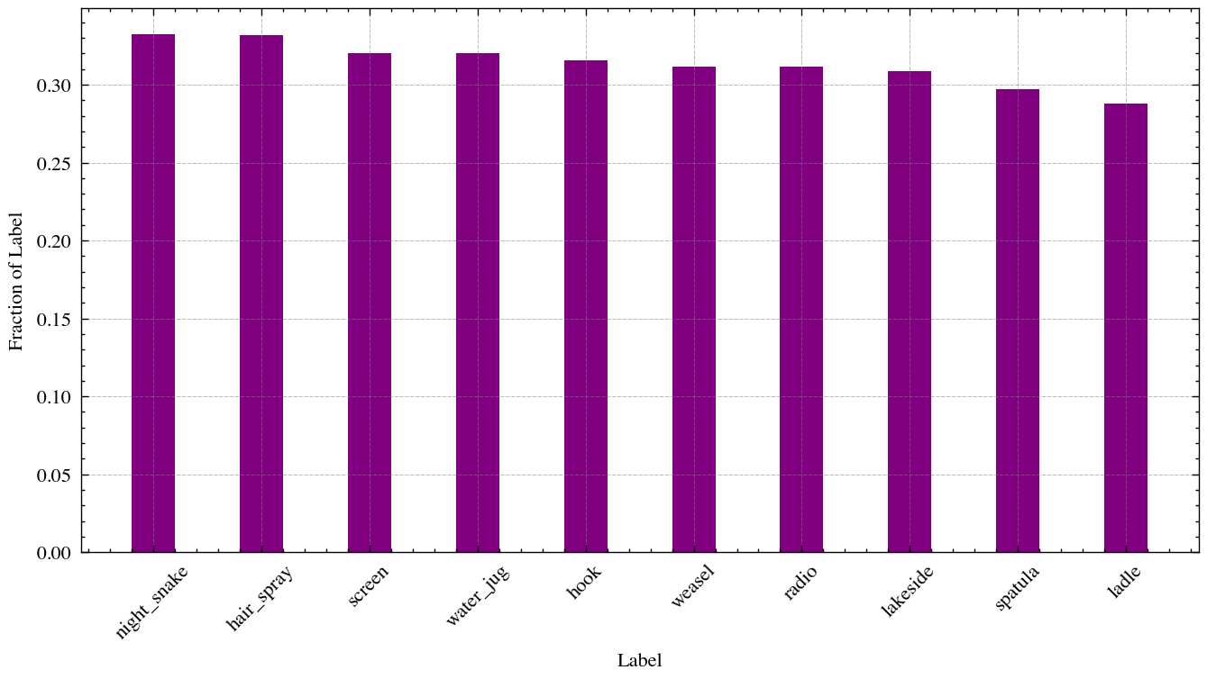
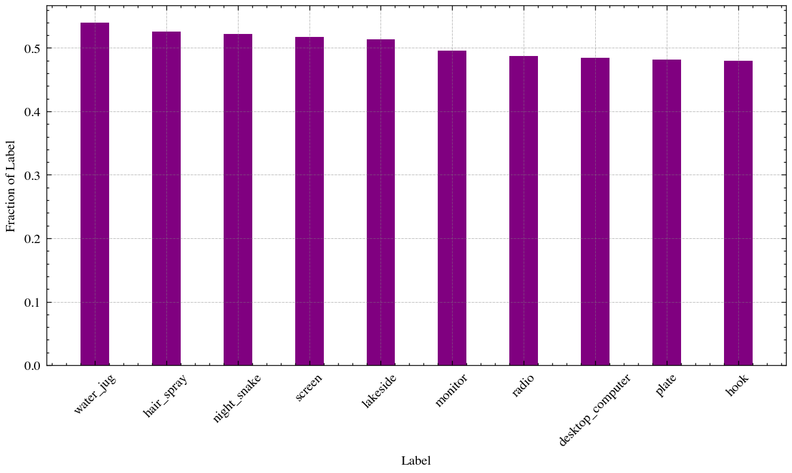
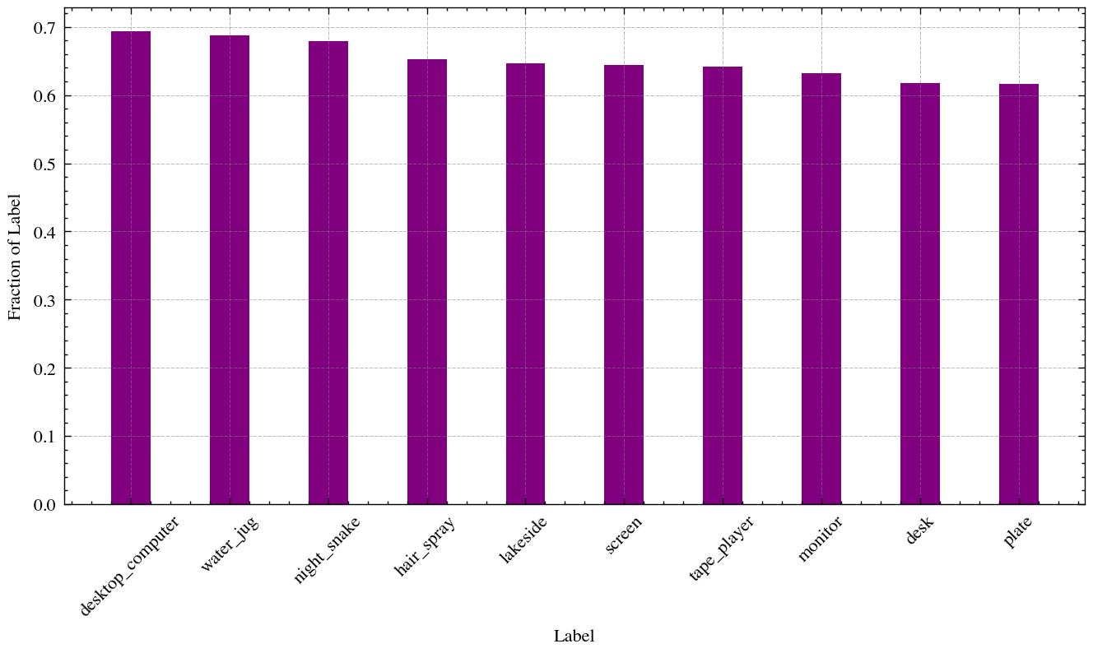
Filter Training Examples
Count:
Fraction:
Threshold = 0.95
Threshold = 0.90
Threshold = 0.85

Slide 14
Filter Training Example – Result
Model | Top_1_Acc Train | Top_5_Acc Train | Top_1_Acc Val I | Top_5_Acc Val I | Top_1_Acc Val II | Top_5_Acc Val II | Gap Top1 | Gap Top5
Baseline | 77.92% | 93.97% | 50.57% | 75.29% | 38.79% | 63.39% | -11.78% | -11.90%
.95 Threshold | 86.83% (+8.91%) | 97.14% (+3.17%) | 49.93% (-0.64%) | 74.43% (-0.86%) | 38.90% (+0.11%) | 62.69% (+0.30%) | -11.03% (+0.75%) | -11.74% (+0.16%)

Slide 15
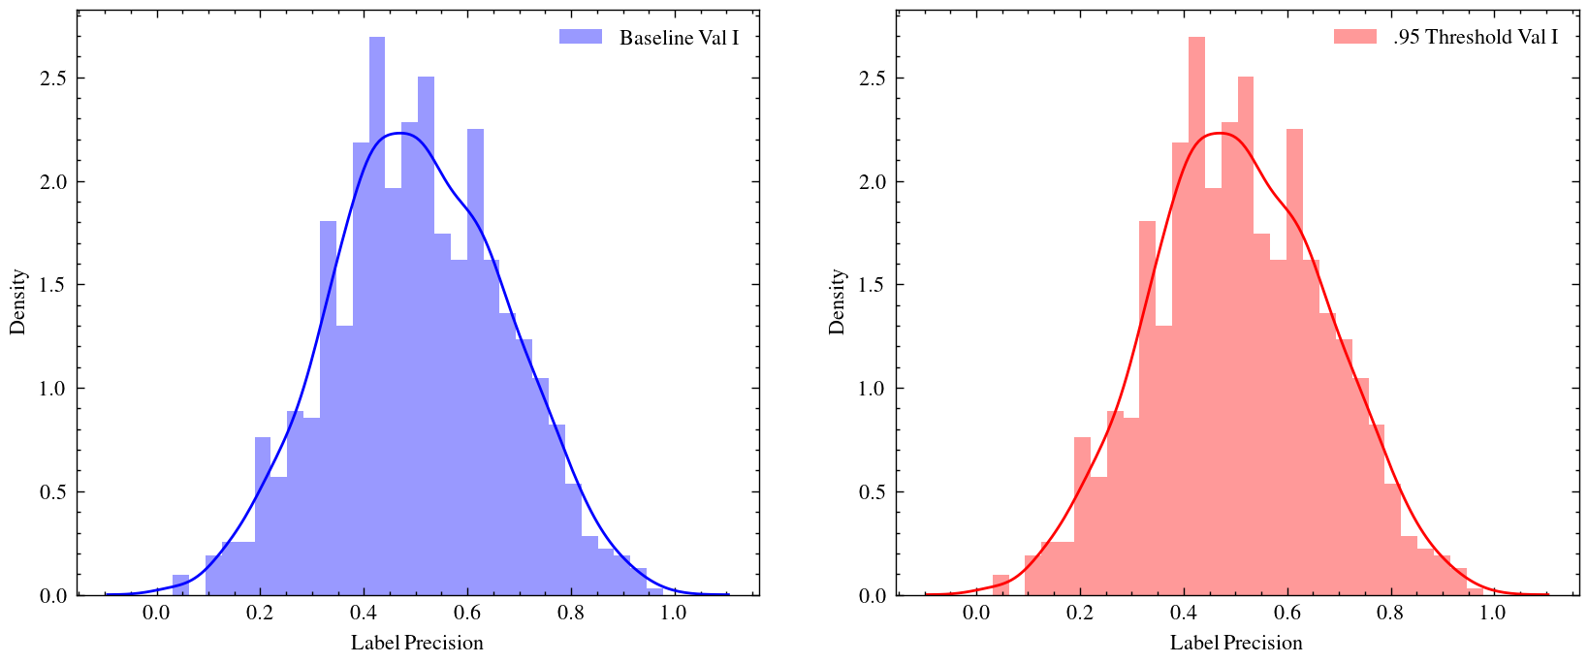
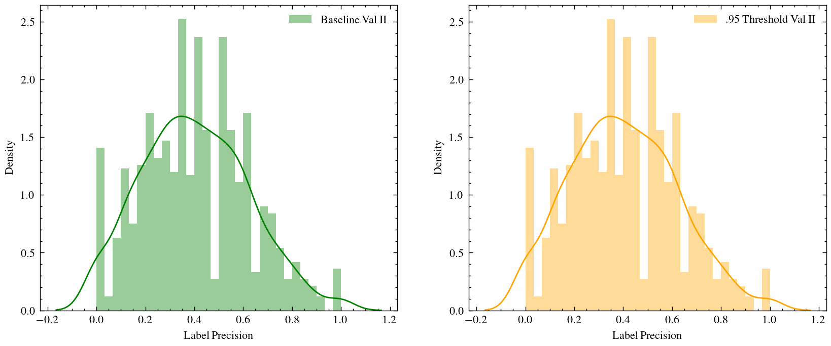
Filter Training Example – Result

Slide 16
Weight Reassignment
Ideas:
1. Paper discovers that wrong label is not rare in the validation dataset (label different from TVL or human) -> may also exist in training dataset
2. In such case, those examples are noise.
3. Model should not pay equal attention on those -> less weights
Expect
- Increase Accuracy on Val I and/or Val II
- Decrease Gap Top 1 and/or Gap Top 5

Slide 17
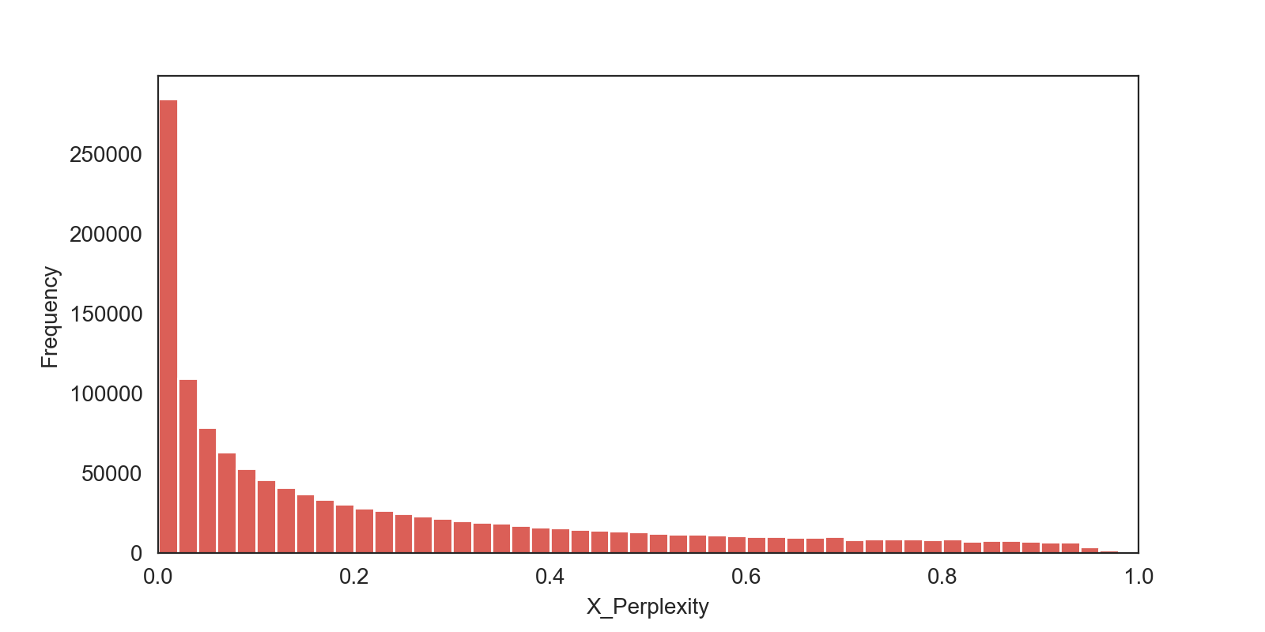
Review of distribution of X Perplexity

Slide 18
Property of Weight Function
we want examples with higher perplexity have lower weights. Therefore, the designed weight function should have following property:
1. the weight of examples should be monotonically decreasing with its X-perplexity
2. The derivative of the weight function should also decrease monotonically. Because the relative difficulty of classifying examples with perplexity = 0.8 and 0.4 should be larger than the difficulty of classifying examples with perplexity 0.4 and 0.2

Slide 19
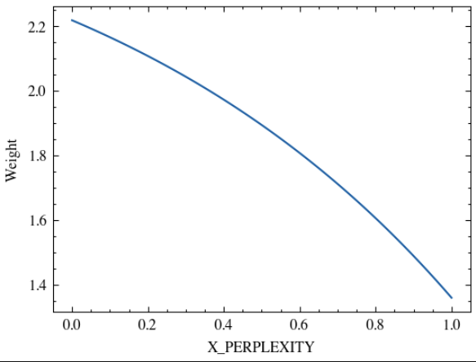
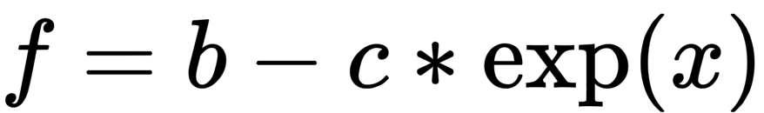
Weight Function of X Perplexity
For the weight, we want:
1. The minimum weight should greater than zero
2. The gap (maximum / minimum), should not be too larget, e.g. gap = 2. And we have b = gap * c * e
C = 0.5 and b = e in this case

Slide 20
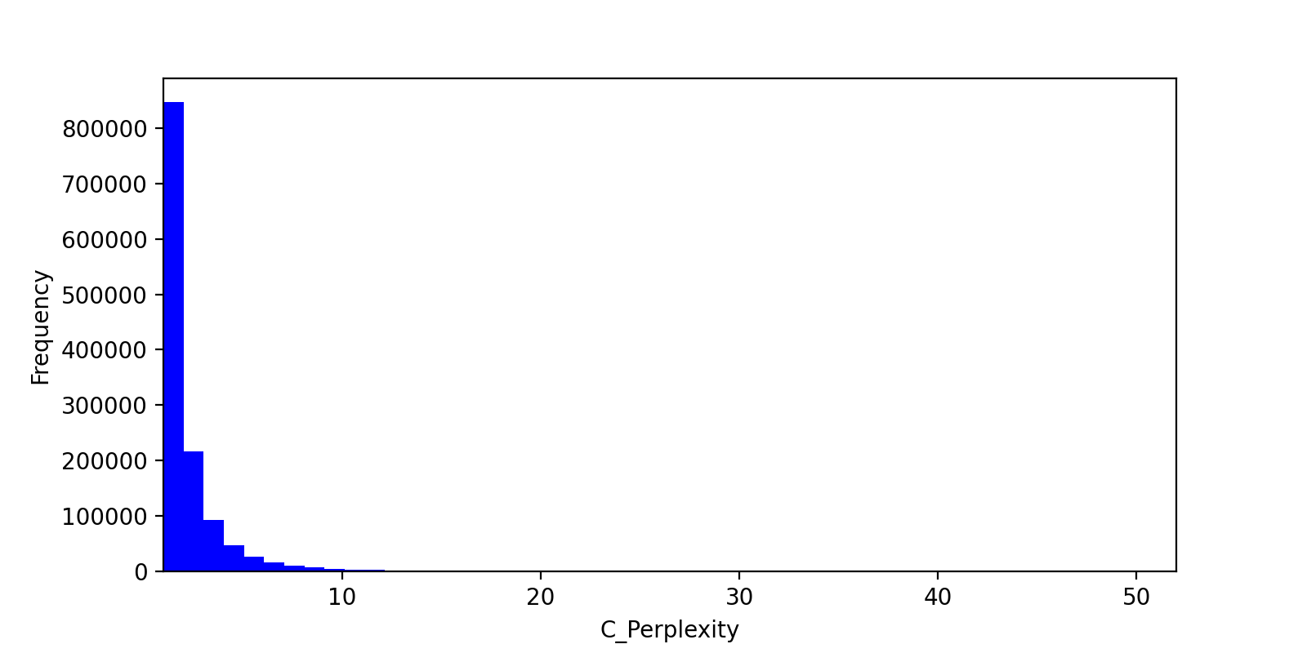
Review of distribution of C Perplexity

Slide 21
Property of Weight Function
the weight of examples with extreme high C perplexity will be extreme small, which makes the contribution of examples with low C Perplexity extreme high, just like we delete those examples.
Therefore, we need to change the property of weights assignment function for C Perplexity :
1. the weight of examples should be monotonically decreasing with its X-perplexity
2. The derivative of the weight function should also decrease with C Perplexity when it is small and increase with C Perplexity when it is large.

Slide 22
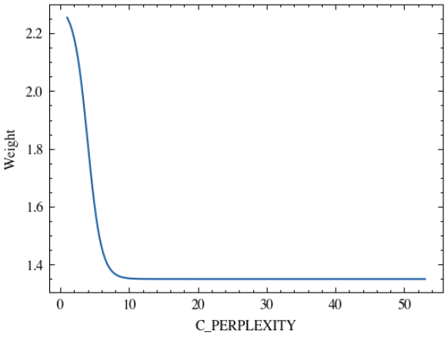
Weight Function of X Perplexity
when x < $\delta$, the derivative decrease; when x > $\delta$, the derivative increase
b = 2.3, c = 0.95, delta = 3.98(90% percentile of C Perplexity)

Slide 23
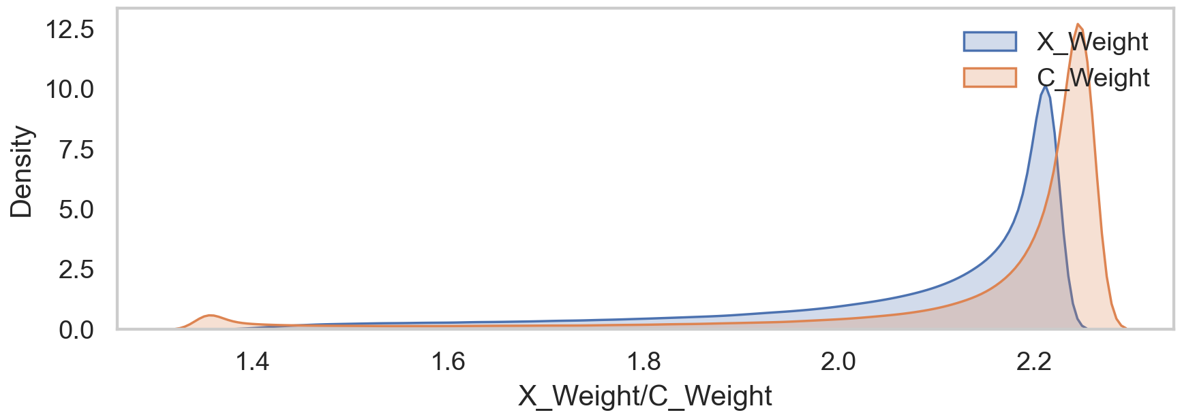
Distribution of New Weight

