Slide 1
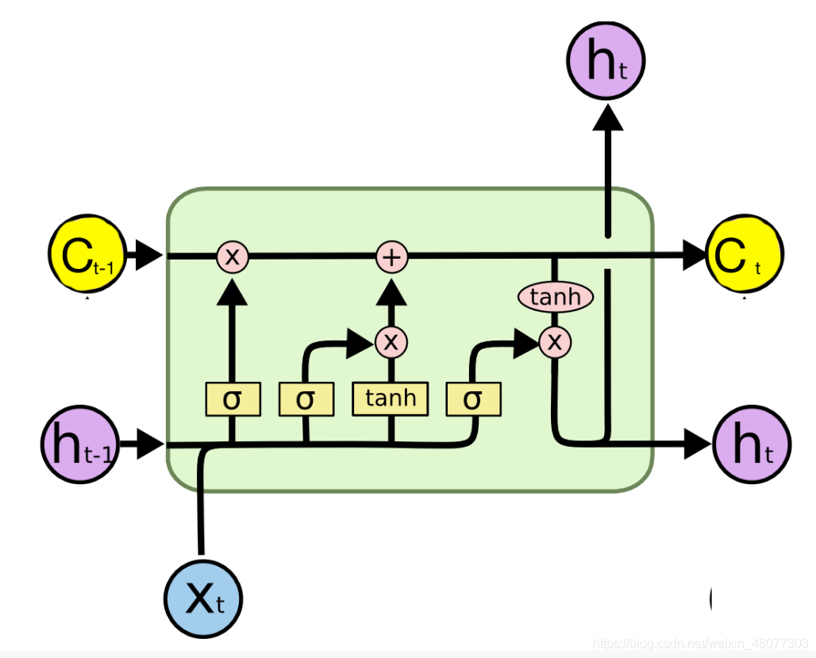
LSTM
Recurrent Structure
Gate Control Unit
Memory Cell

Slide 2
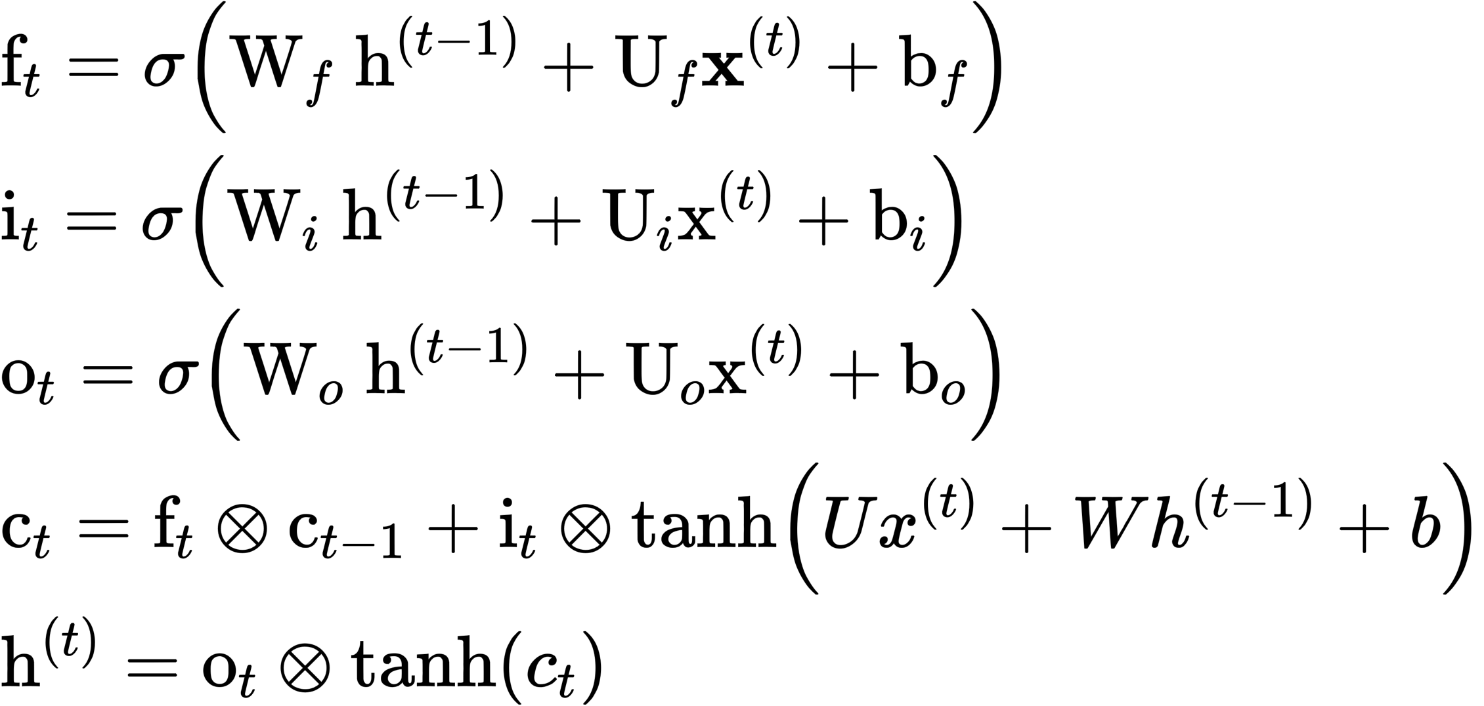
LSTM

Slide 3
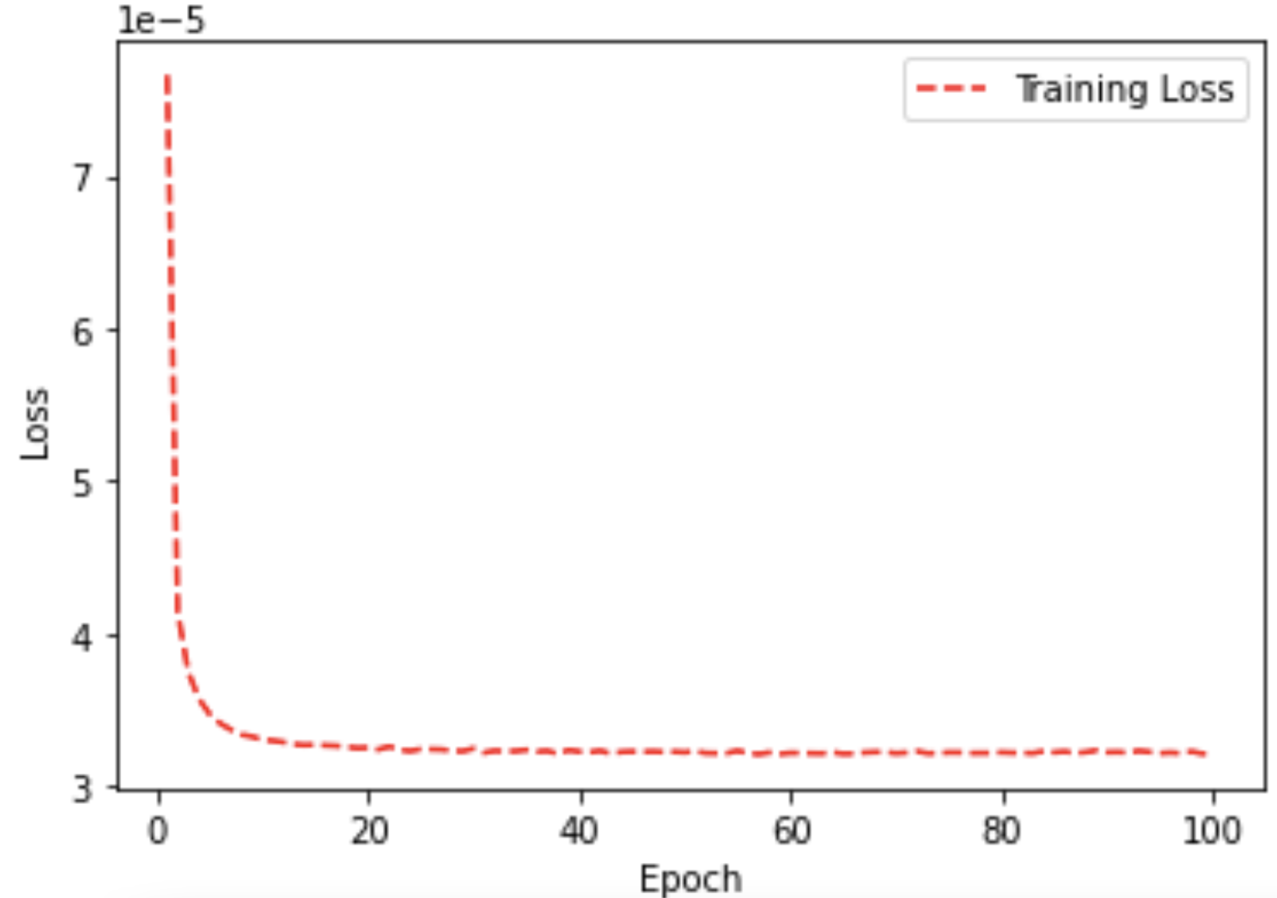
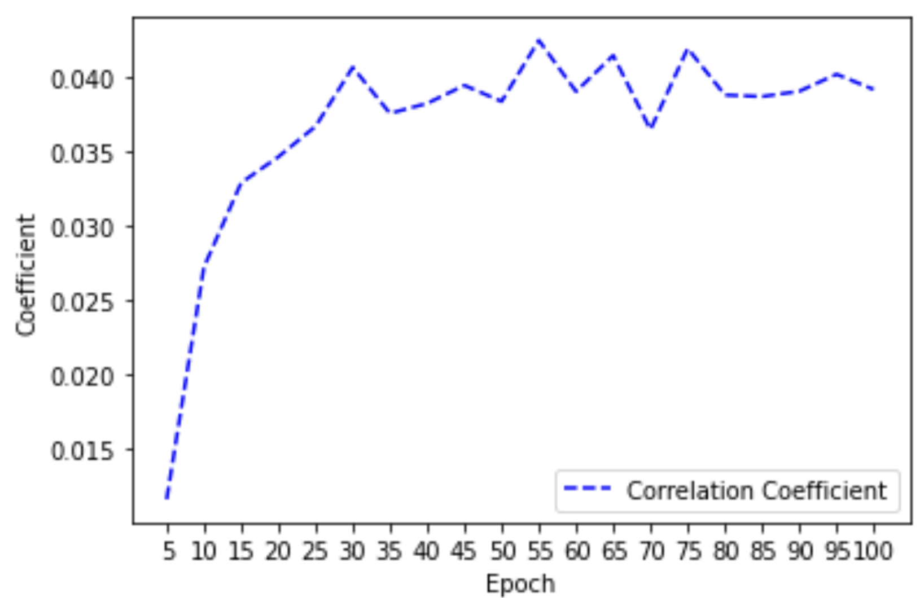
The result of the LSTM model
The model meets its convergence at last 20 epochs.
The coefficient increases in the first 30 epochs, fluctuates in the next 40 epochs, becomes steady in last 30 epochs.
Final Coefficient : 0.039
Time cost: 59’50’’

