Slide 1

My Books Searcher
Data processing workshop group 13
QIU Yaowen 1730026087
QIAO Heng 1730026086
WU Xiaoxuan 1730025130

Slide 2
CONTENTS
01.
Text Files Collection
02.
Indexing and ranking
03.
Web server and interface

Slide 3
1
Text Files Collection

Slide 4
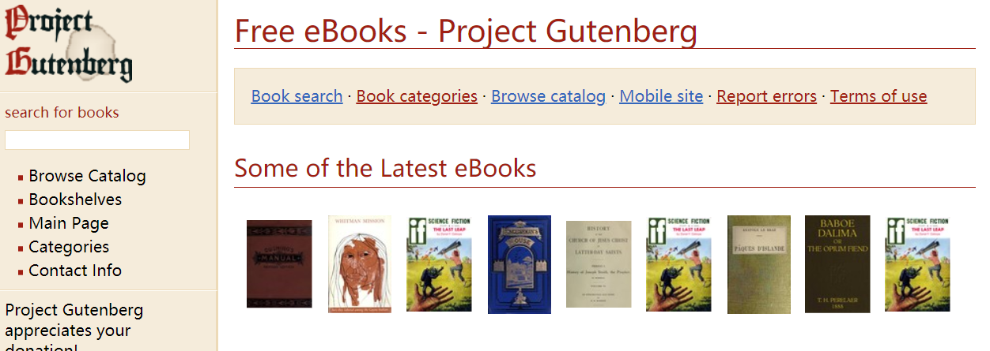
Project Gutenberg
·Library of over 60,000 free eBooks
·Licensed and Legal
·Easy to download
http://www.gutenberg.org/

Slide 5
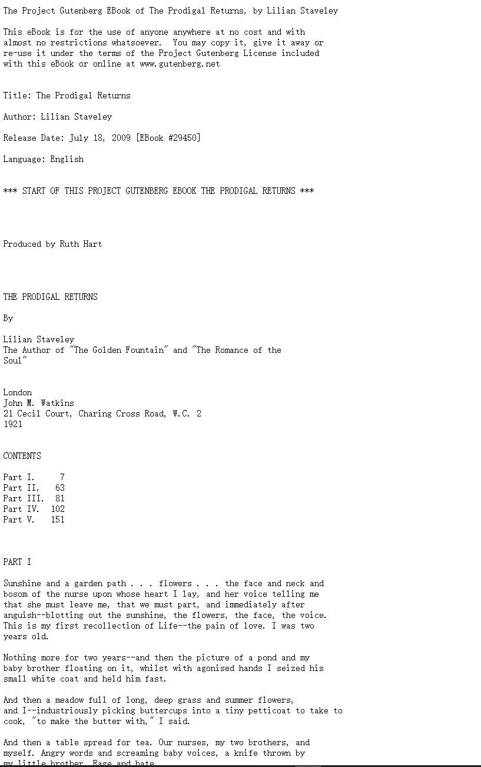
URL resolve
http://www.gutenberg.org/cache/epub/29450/pg29450.txt

Slide 6
Web crawlers
__main__
A loop to call
Download(i)
read_title(url)
read_pagehtml(url)
Data Aggregation
storageToLocalFiles(storagePath, data)
N = 649 text files(.txt)

Slide 7
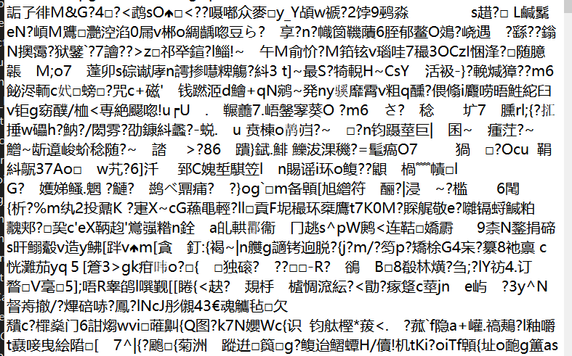
BUG & DEBUG
URLError(err) URLError:urlopen error [Errno 10060] :A connection attempt failed because the connected party did not properly respond after a period of time……
·Change the header
·Use exception mechanism
Write a cleaner programme

Slide 8
Some ideas about dynamic collection system
List websites or sources that require dynamic data collection(social media, news, etc)
Create a crawling programme for them specifically
Set a timing programme in the back-end to start the crawling programme.
Build the partial index for the new files every time after crawling
Merge the partial index to the main index file

Slide 9
2
Indexing and Ranking

Slide 10
Python based Indexing
dictionary = empty dictionary
For file in files:
set_of_word = set of words that only contain English letters
for word in set_of_word:
if (word is one of keys in the dictionary):
dictionary[word] append the current file name
else:
dictionary[word] append an empty list
Big file: 24.1s(create the dictionary) + 3.63s(write to .txt file = 27.73s
Small files(n = 30): 0.796s(create the dictionary) + 0.19s (write to text file) = 0.986s

Slide 11
Hadoop based Indexing
Big files : N = 649, Cost 1631 (ms)
Small files: N =30, Cost 1208 (ms)
Note: We to regular expression to eliminate the notation likes “!”£$%^&*()_+”……

Slide 12
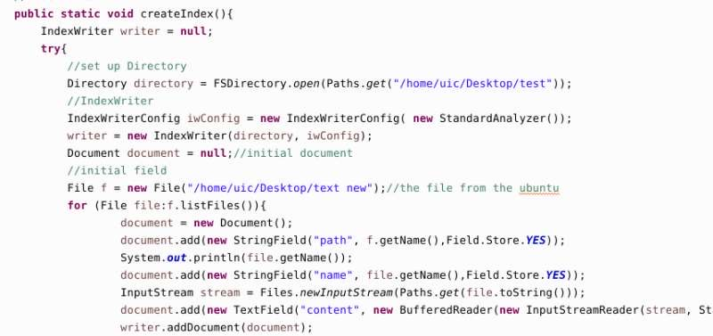
Lucene base indexing
-Download and build the environment for lucene on the terminal in the ubuntu.
-Design our method in the eclipse.
-Create Lucene index in ubuntu

Slide 13
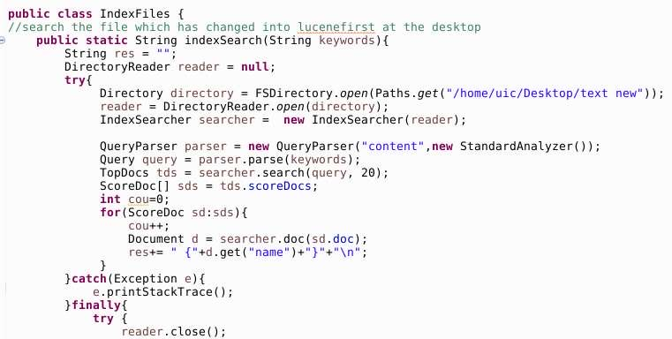
Lucene base indexing
Design our method in the eclipse.
By using Mapreduce to deal with Lucene index
Create search index class in the method

Slide 14
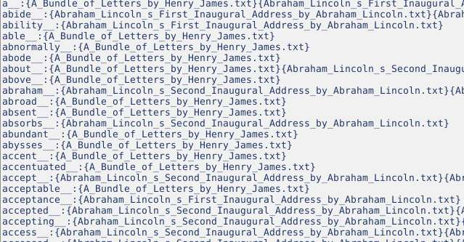

Lucene base indexing
Run and got the result
Time:

Slide 15
TF-IDF based Ranking
·Use TF-IDF to rank the order of our text files
·[Word, FileName ]:[TF-IDF value]
·Turn it into a dictionary in python

Slide 16
3
Server and UI

Slide 17

HOMEPAGE

Slide 18
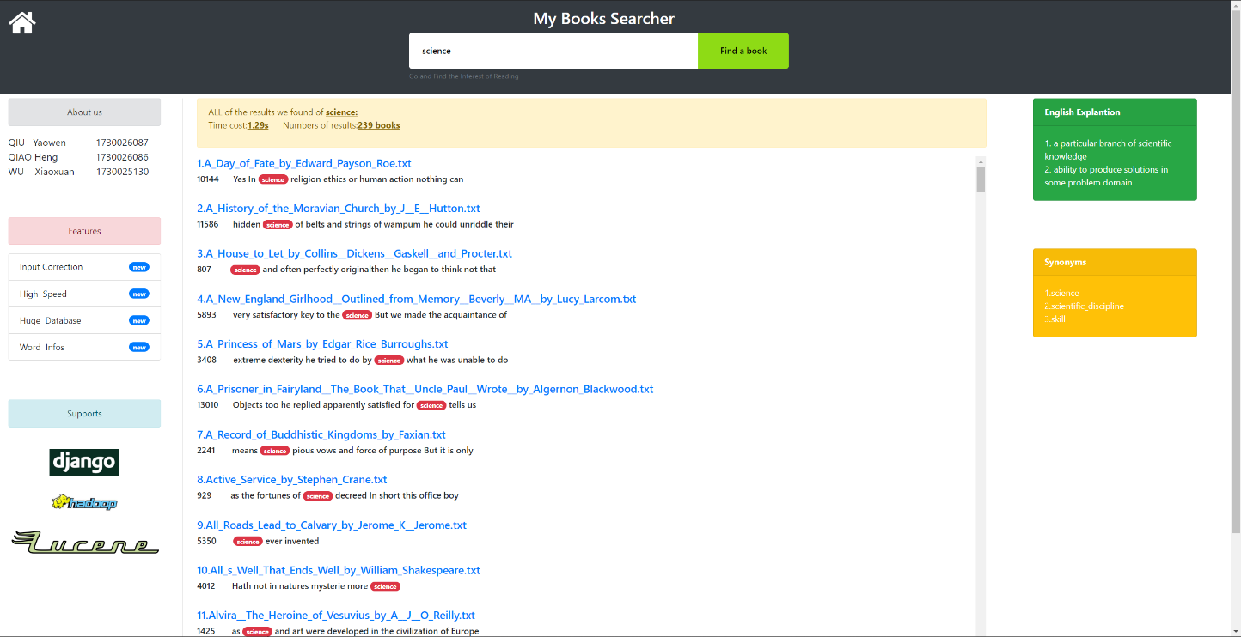
SEARCH PAGE

Slide 19
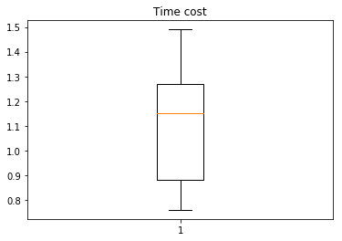
A. HIGH SPEED
Randomly choose 30 words for ten times

Slide 20
HIGH SPEED
Turn the index file into a global dictionary in Django
O(n) → O(1)
To acquire the context of input keyword, random access the text lines.
The linecache module allows one to get any line from any file ----- Python official Document
Used multiprocessing to return the file name and corresponding context
pool = ThreadPool(processes=20)
Speed will be improved if pagination was added

Slide 21

B. Input Corretion
1. Get the set of the union of word (about 320,000 words) from files
2. If the input word in the set, the spelling is correct
3. Else, use difflib.SequenceMatcher().quick_ratio() to get the ratio of levenshtein distance. Use the highest one as the correction. Second highest and Third highest as candidate words.

Slide 22
C. Hight Light the keyword and show context
Rank by TF-IDF
Linecache to jump to the direct line
Simple CSS style

Slide 23
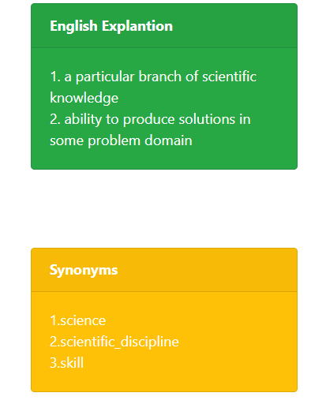
D. English Explanation and Synonyms
Package PyDictionary() provides this function. It is simple!

Slide 24
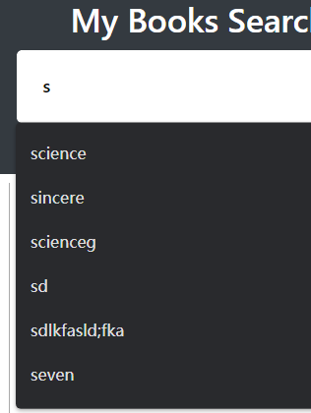
E. Auto-complete from historical records
<form method="POST" autocomplete="on" >

Slide 25

Contribution LIST
NAME | CONTRIBUTION
QIU Yaowen | Crawling programme, python index, Django servers, HTML
QIAO Heng | Crawling debug, Hadoop index, HTML
WU Xiaoxuan | Crawling debug, Lucene index, HTML
Notes:
亮亮图文旗舰店https://liangliangtuwen.tmall.com

Slide 26
DEMO
Notes:
亮亮图文旗舰店https://liangliangtuwen.tmall.com

