Slide 1

KUBERNETES / K8S
A quick insight
1.0.XX

Slide 2

Agenda
INTRODUCTION
COMPONENTS
ARCHITECTURE
HANDS ON
LET’S GET STARTED!

Slide 3

PRE-REQUISITES
BEFORE STARTING WITH KUBERNETES
MONOLITHS
The traditional approach of building applications.
MICROSERVICES
The modern approach of building applications.
CONTAINERS
Package of the application and all its requisites.
DOCKER
Shipping of the Containers.

Slide 4
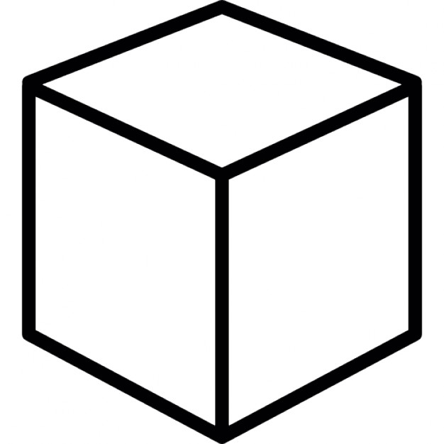
MONOLITHS
A common way to build applications even today.
Single deployable artifact.
Issues with Monoliths:
Longer deployment durations.
Complex to manage.
Difficult to scale.
Solution: MICROSERVICES

Slide 5
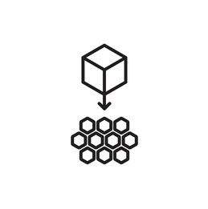
MICROSERVICES
Smaller individual artifacts.
Fault tolerant to some extent.
Easy to scale.
Challenge
Difficult to maintain version control and communicate among the services.
Containers are the perfect choice.

Slide 6
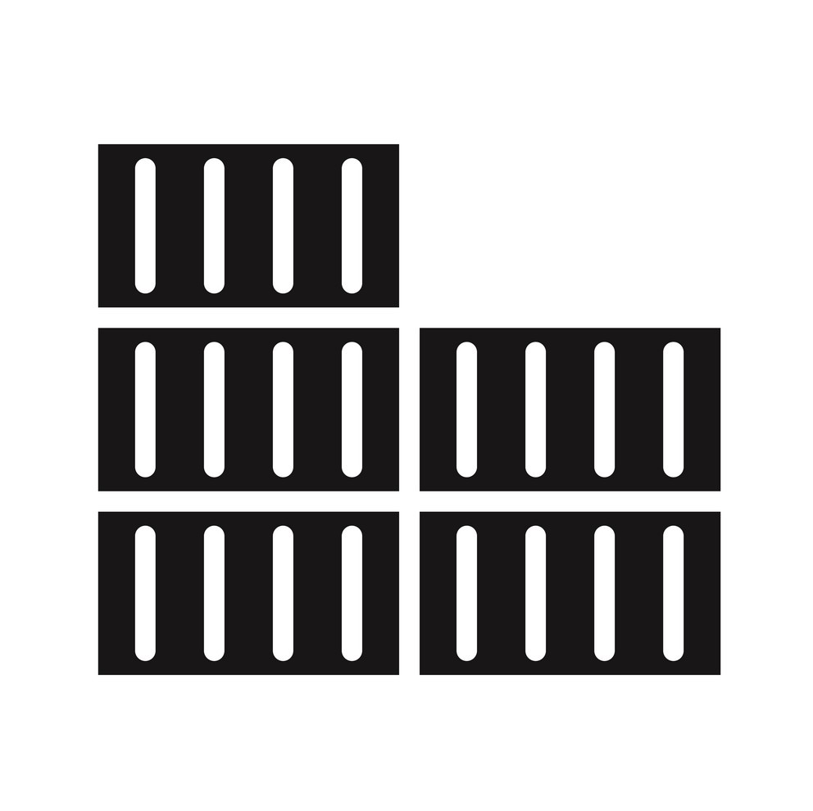
CONTAINERS
An image file.
Includes default values for essential settings.
It makes sure that the services run the same way, no matter where they are run.
Challenges
Communication.
Debugging for issues.
Solution: KUBERNETES

Slide 7
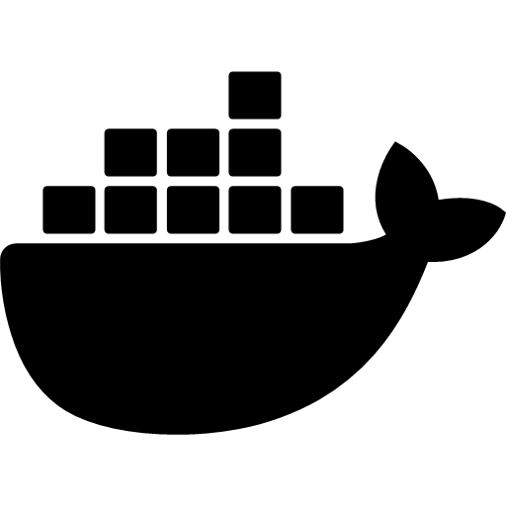
DOCKER
Open-source.
Containerization platform.
Automates configuration.
It is like a VM with the difference being, it does not have a separate OS Kernel and shares the same on which it is run.

Slide 8
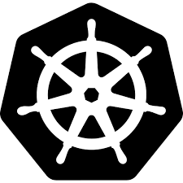
Introduction: what is Kubernetes?
THE WHEEL TO DOCKER
It is a Container Orchestrator.
Validates the Containers.
Monitors the Services.
Manages the Containers as a Cluster of Nodes.
In simple terms, Kubernetes automates most of the repetition and eliminates the inefficiency of doing everything manually. The app developer tells K8s what it wants the Cluster to look like, and Kubernetes makes it happen.

Slide 9
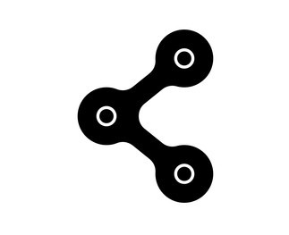
Components
WHAT MAKES UP KUBERNETES
Pods
Services
Ingress
Nodes
Cluster
Control Plane
K8s API
ConfigMap
Secrets
Volumes
Deployment
StatefulSet

Slide 10
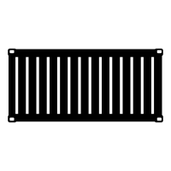
PODS
Pods are the smallest, most basic deployable objects in Kubernetes.
A pod represents a single instance of a running process in a cluster.
An abstraction over container.
Pods contain one or more containers.
Each pod has its own IP.
POD

Slide 11
SERVICES
POD
POD
POD
An abstraction of a logical set of Pods and a policy by which to access them.
Responsible for enabling networking access to a set of pods.
It is a permanent/static IP address with a DNS.
Service
POD
POD
POLICY

Slide 12

INGRESS
It is a service external to the K8s cluster.
Enables users connect to the application through HTTPS/HTTP.
Routes user control to the services internal to K8s cluster.

Slide 13
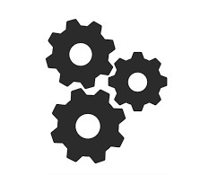
nodes
Container Runtime – A runtime environment for running the Containers/Pods.
Kubelet – for making sure that everything that should run, is.
Kube-proxy – for handling networking.
container runtime
kubelet
kube-proxy
NODE

Slide 14
Cluster
N1: Node 1
N2: Node 2
N3: Node 3
N4: Node 4
set of node machines.
runs containerized applications.
heart of Kubernetes.
N1
N2
N4
N3
CLUSTER

Slide 15

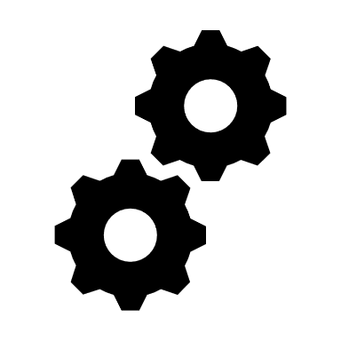


Control plane
API Server
Scheduler
Etcd
Controller Manager (CM)
Cloud Controller Manager (CCM)
The Master Component of Kubernetes.
CCM
CM
API server
Scheduler
etcd
CONTROL PLANE

Slide 16
Kubernetes
API
Kubernetes Control Plane
Manages the cluster of nodes.
Boosts productivity.
Embeds cloud-specific control logic.
Exposes the Kubernetes API.
Pod 4
Pod 1
Pod 2
Pod 3
Pod 5
Pod 6
Node 1
Node 3
Node 2
CLUSTER

Slide 17

KUBERNETES API
REST API
Watches
Rollback
Zero Downtime
Kubectl

Slide 18

configmap
Let’s store configuration for other objects to use.
Its like a properties file.

Slide 19

Secrets
Special type of ConfigMap
Base64 encoded.
Stores data like DB credentials, etc.

Slide 20
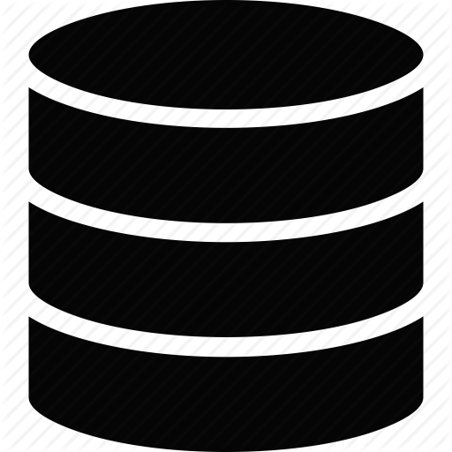
volumes
It facilitates persistence of data.
Data in K8s is non-persistent.
Provides multiple types of storage provision like local and remote.

Slide 21
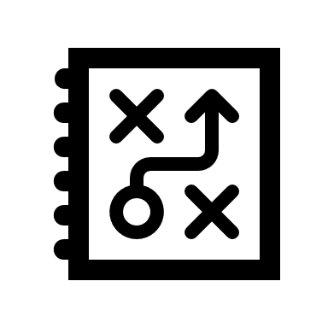
deployment
A blueprint.
An abstraction of pods.
The app developer defines and creates deployment, instead of pods.

Slide 22

Statefulset
Used to replicate databases.
Provisions a mechanism to manage inconsistencies.

Slide 23

ARCHITECTURE
HOW IT WORKS
Master-Worker model.
Master node composed of
etcd cluster
kube-apiserver
kube-controller-manager
cloud-controller-manager
scheduler
Worker model composed of
kube-proxy
kubelet

Slide 24


Cloud Provider API
kubectl
Worker Node 1
Containers
pod
pod
Cloud Provider Network Edge
Masters – 1, 2, …, n
Containers
cloud-controller-manager
kube-apiserver
kube-proxy
kube-controller-manager
Container Runtime
kube-scheduler
kubelet
System Services
Load Balancer
kube-proxy
Additional Services
Containers
End Users
pod
pod
etcd
kube-proxy
Container Runtime
Container Runtime
kubelet
kubelet
Worker Node 2
System Services
Services

Slide 25

THE PRACTICAL
LET’S TRY SOME HANDS-ON

Slide 26
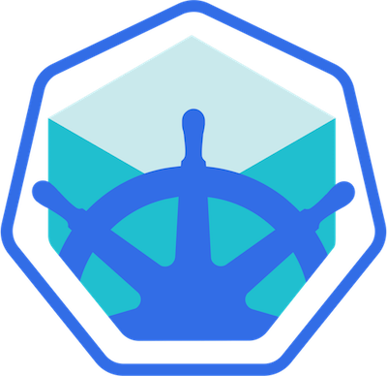
Minikube & kubectl
Kubernetes cluster implementation.
Lightweight.
Kubectl is a command line tool.
Allows to run commands and interact with the K8s cluster.

Slide 27
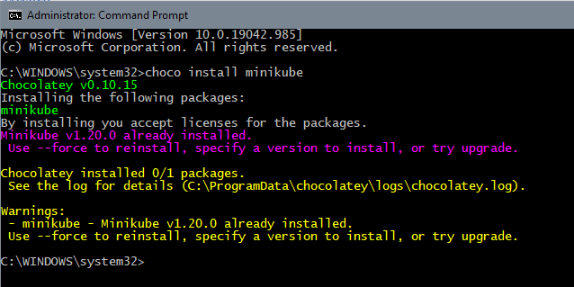
Installing MINIKUBE
Run CMD as administrator.
Use Chocolatey package installer to install Minikube.
Kubectl is installed automatically as a dependency of Minikube.

Slide 28
Installing kubectl
Kubectl is installed automatically as a dependency of Minikube.
We can check the installation is done by running “kubectl” command. It should give the list of available kubectl commands.

Slide 29
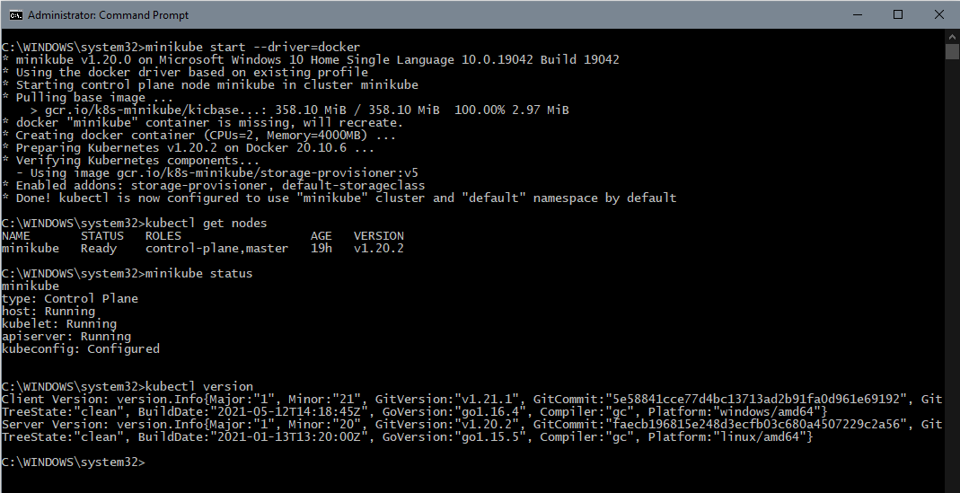
Creating & starting a cluster
Start a cluster using the Docker driver
minikube start --driver=docker
Get status of nodes
kubectl get nodes
Get status of minikube
minikube status
Get kubectl version
kubectl version

Slide 30
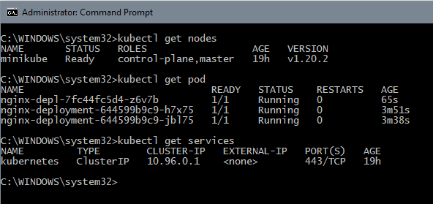
Main kubectl commands
Get status of nodes
kubectl get nodes
Get status of pods
kubectl get pod
Get status of services
kubectl get services

Slide 31
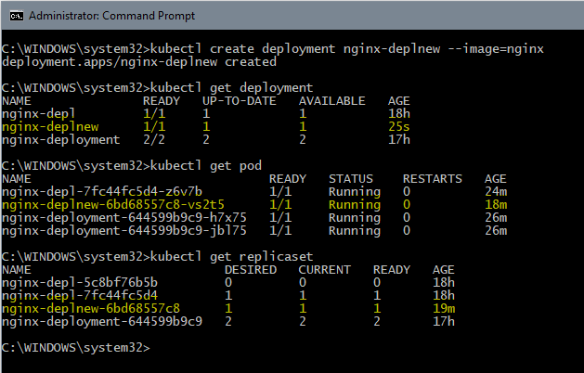
Main kubectl commands
Create deployment
kubectl create deployment nginx-deplnew –image=nginx
Get status of deployments
kubectl get deployment
Get status of pods
kubectl get pod
Get status of replicaset
kubectl get replicaset

Slide 32
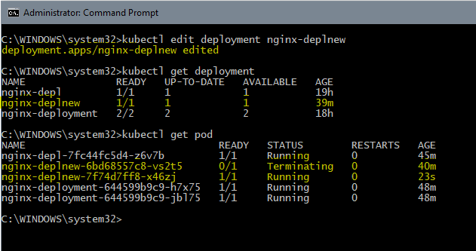
Main kubectl commands
Edit a deployment
kubectl edit deployment nginx-deplnew
Auto-generated configuration file with default values opens.
Make changes
Save and close the file
Result
Old pod terminates.
New pod with different id starts running.

Slide 33
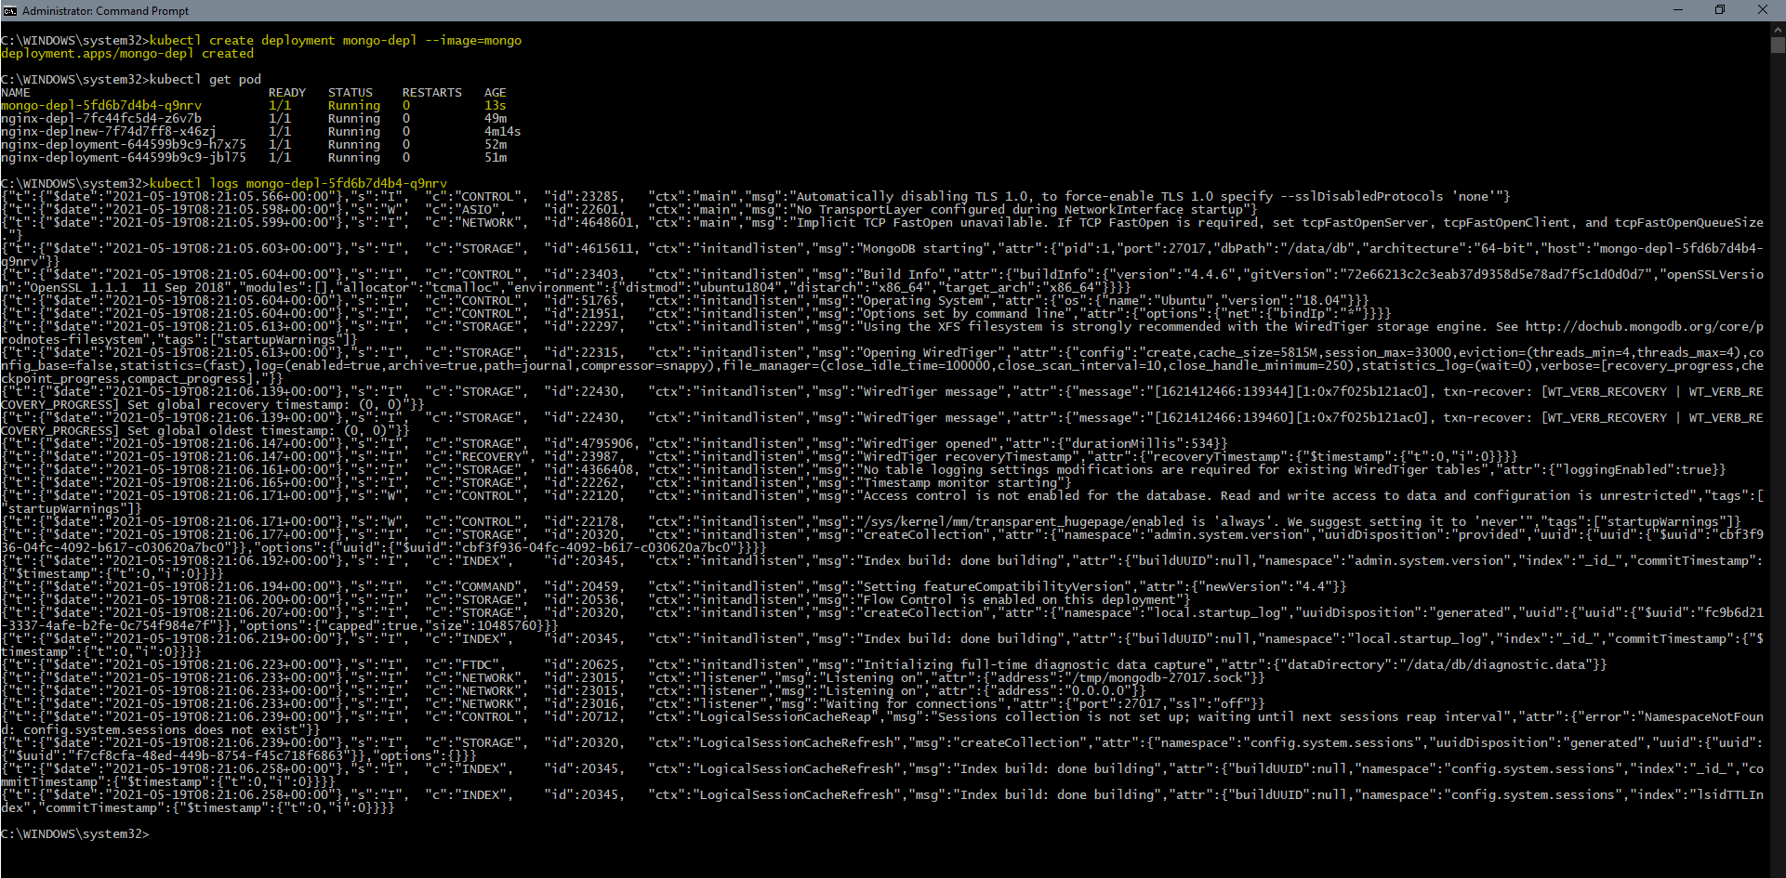
Main kubectl commands
Debug pods by checking logs
kubectl logs mongo-depl-5fd6b7d4b4-q9nrv

Slide 34
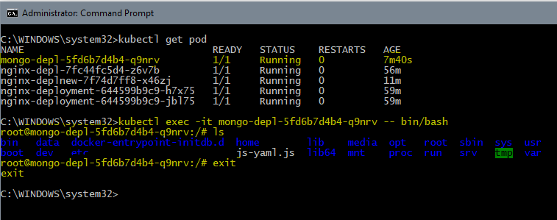
Main kubectl commands
Debug pods by starting interactive guest terminal of the application
kubectl exec –it mongo-depl-5fd6b7d4b4-q9nrv – bin/bash

Slide 35
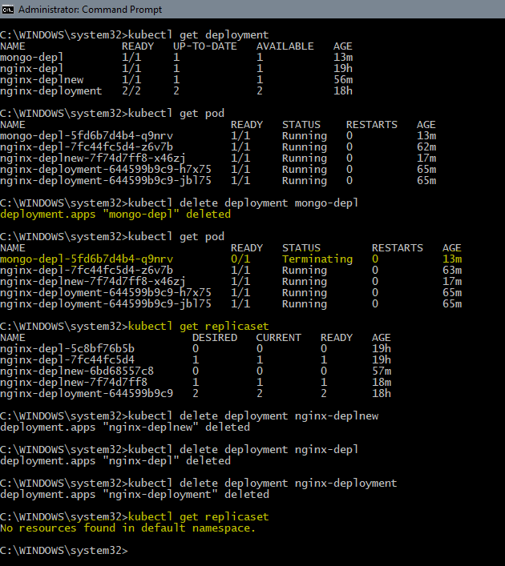
Main kubectl commands
Delete deployment
kubectl delete deployment mongo-depl

Slide 36
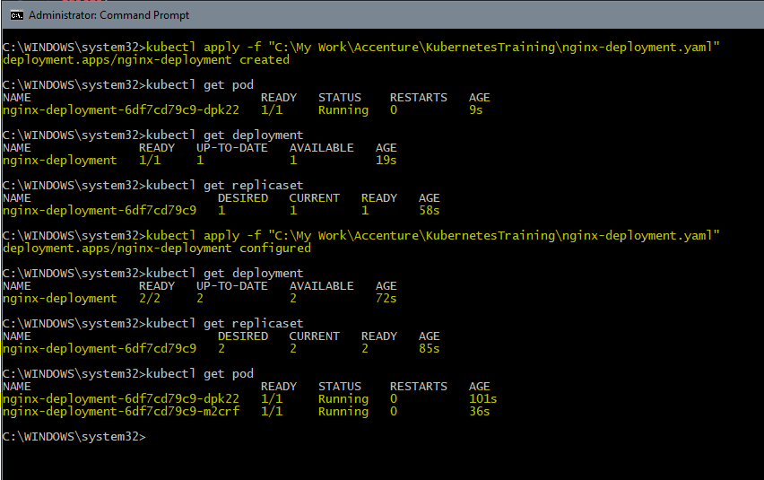
Main kubectl commands
Apply configuration to a deployment using a simple configuration YAML file.
kubectl apply –f "C:\My Work\Accenture\KubernetesTraining\nginx-deployment.yaml"

Slide 37
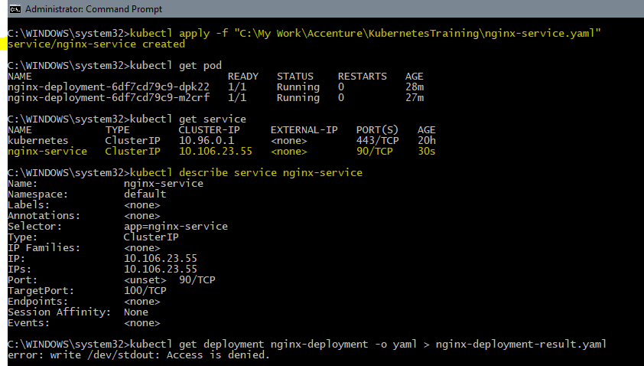
Main kubectl commands
Create a service
kubectl apply -f "C:\My Work\Accenture\KubernetesTraining\nginx-service.yaml“
Describe a service
kubectl describe service nginx-service

Slide 38
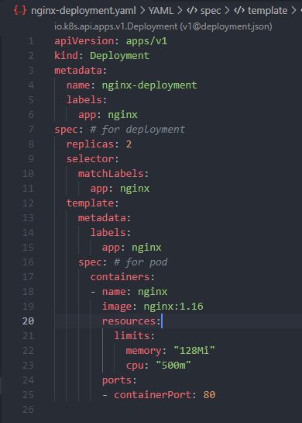
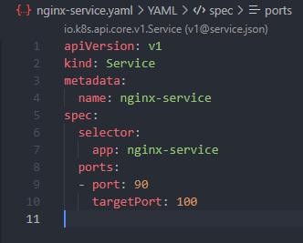
Breakdown of configuration file
Three parts of a configuration file
Metadata
Specification
Attributes of “spec” are specific to the kind.
Status
Automatically generated and added by K8s.
K8s always compares the Desired state and the Actual state from etcd and if they mismatch, K8s makes the actual state equal to the desired state (self-healing feature).

Slide 39
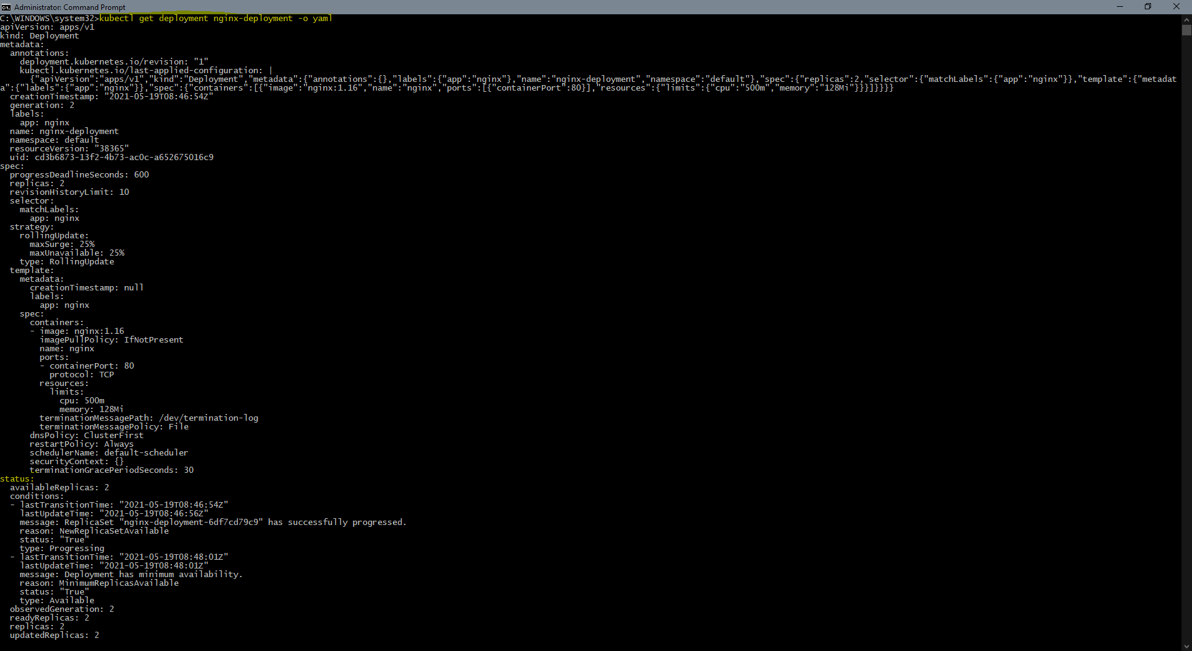
Main kubectl commands
Get the status generated by K8s
kubectl get deployment nginx-deployment -o yaml

Slide 40
Layers of abstraction
Deployment manages a ..
ReplicaSet manages a ..
Pod is an abstraction of ..
Container

Slide 41
summary
Containers help an organization perform updates/maintenance without interrupting services.
Docker helps creating containers.
Kubernetes is a Container Management System.
It automates various processes involved in deployment and scaling (in and out).
Has self-healing capabilities.
Offers environment consistency for development, testing and production.
Infrastructure is loosely couples, so each component can act as a separate unit.
MUCH MORE TO EXPLORE

Slide 42

THE VERDICT
SHOULD EVERYONE SWITCH TO KUBERNETES
Well, not so fast.
Microservices still have their own unique challenges, and sometimes a Monolith can be the right solution, based on what’s right for the application itself.
And Monoliths can still run on Kubernetes, even though they won’t be able to use all the same benefits.
How do we know when we are ready to get started with K8s?
Well, the first step is to start using Containers.

Slide 43



THANK YOU
JITESH SHAW
+91 (824) 087-5834
jitesh.shaw@accenture.com
HAVE A GOOD DAY!

