Slide 1
Shawkat's Charity DApp
A simple and transparent way to support good causes
Notes:
Welcome everyone. Today I will show our charity app, where people can create campaigns and donate directly. The key idea is trust: everyone can see where money goes. I will keep this short and practical in about 10 minutes.

Slide 2
Problem: Donors often cannot clearly see how funds are handled
Vision: Let people donate directly with clear public tracking
Solution: A charity app that records each donation openly and safely
Problem & Vision
Notes:
Many donation platforms are useful, but donors sometimes worry about transparency and fees. Our vision is simple: direct giving with visible records. This project focuses on trust, clarity, and ease of use.

Slide 3
Create Campaigns: Start a fundraiser with a target and deadline
Direct Donations: Send support straight to the selected campaign
Live Progress: See how close each campaign is to its goal
Open Records: Donation history is visible and hard to tamper with
Key Features
Notes:
These are the user-focused features. You can create a campaign, donate quickly, and track progress. The goal is to make the donation experience clear and trustworthy for everyone, including non-technical users.

Slide 4
Website: Built with modern React tools for a smooth user experience
Core Logic: Donation rules are handled by smart contract code
Wallet Login: Users can connect MetaMask or WalletConnect
Testing Setup: Local blockchain used for safe and repeatable demos
Technology Stack
Notes:
I kept this slide light. The main point is that we use a modern web app, blockchain rules for trust, and common wallets for access. We also built a local test setup so the demo is stable.

Slide 5
Smart Contract Design
The contract acts like the app's rulebook:
Start campaigns
Accept donations
Release funds to campaign owners
Allow admin moderation when needed
Built-in checks help keep fund handling safe and traceable
Notes:
Think of the smart contract as a strict set of rules that runs automatically. It decides what actions are allowed and records key events. This reduces manual control and improves accountability.

Slide 6
User Journey
1. Connect wallet
1
2. Browse active campaigns
2
3. Choose a cause and donate
3
4. Track progress and impact
4
Notes:
This is the simple end-to-end journey. In the live demo, I will show exactly these four steps so the flow is easy to follow and easy to remember.

Slide 7
Development & Testing
Tested on a local blockchain before public testing
Added a stable demo mode to avoid wallet switching issues
Checked full flow: create campaign -> donate -> manage funds
Supports both local development and test network usage
Notes:
We faced real issues during development, especially with wallet/network behavior. We resolved them with a deterministic local mode and repeated end-to-end tests. This made the app reliable for presentation.

Slide 8
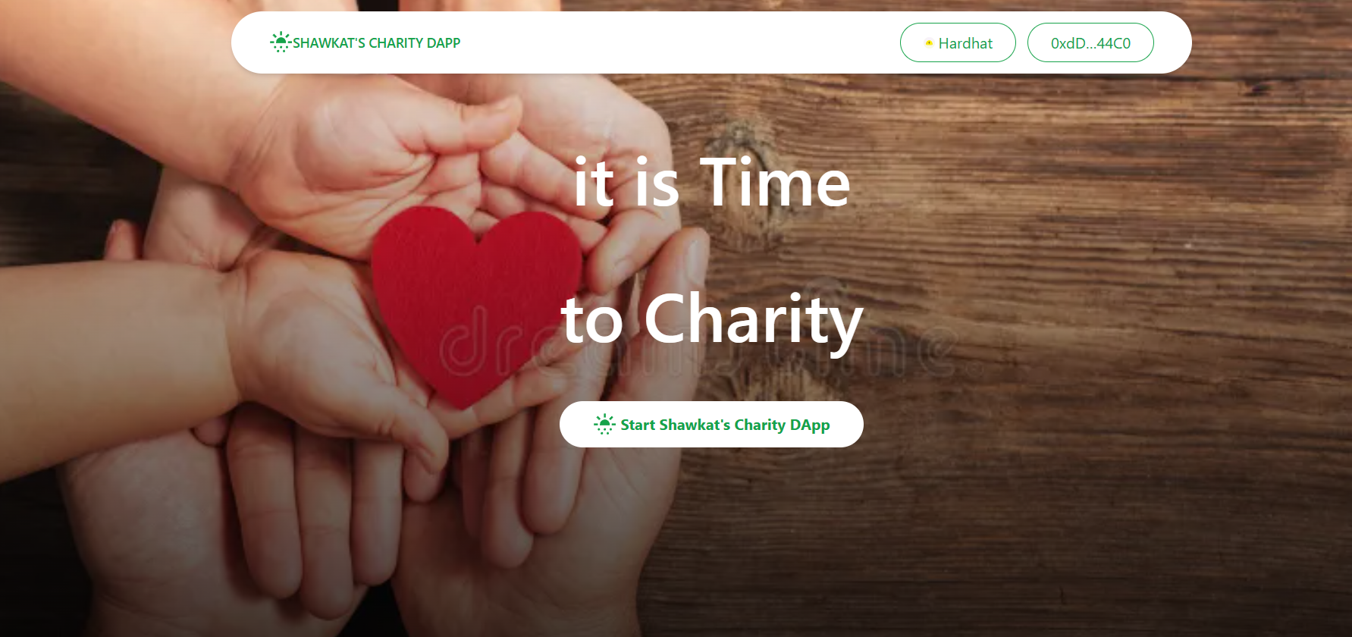
Screenshots: Homepage
Notes:
We faced real issues during development, especially with wallet/network behavior. We resolved them with a deterministic local mode and repeated end-to-end tests. This made the app reliable for presentation.

Slide 9
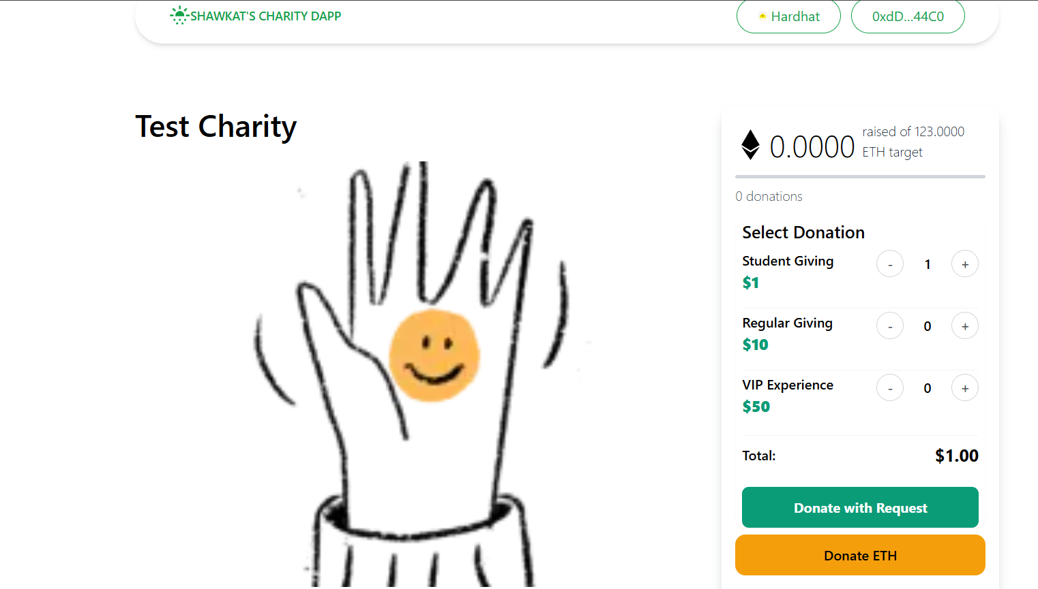
Screenshots: Charity Donation Page
Notes:
We faced real issues during development, especially with wallet/network behavior. We resolved them with a deterministic local mode and repeated end-to-end tests. This made the app reliable for presentation.

Slide 10
Future Roadmap & Conclusion
Future ideas: donor badges, community voting, and more token options
Impact: More trust and lower overhead for digital fundraising
Conclusion: Simple technology choices can make charity more transparent
Next step: pilot with real users and gather feedback
Notes:
To close, this project shows that blockchain can be practical, not just technical. The focus is user trust and clear donation tracking. Next, we can validate with user feedback and continue improving usability.

