Slide 1


Booking Data Analysis
By group-1

Slide 2
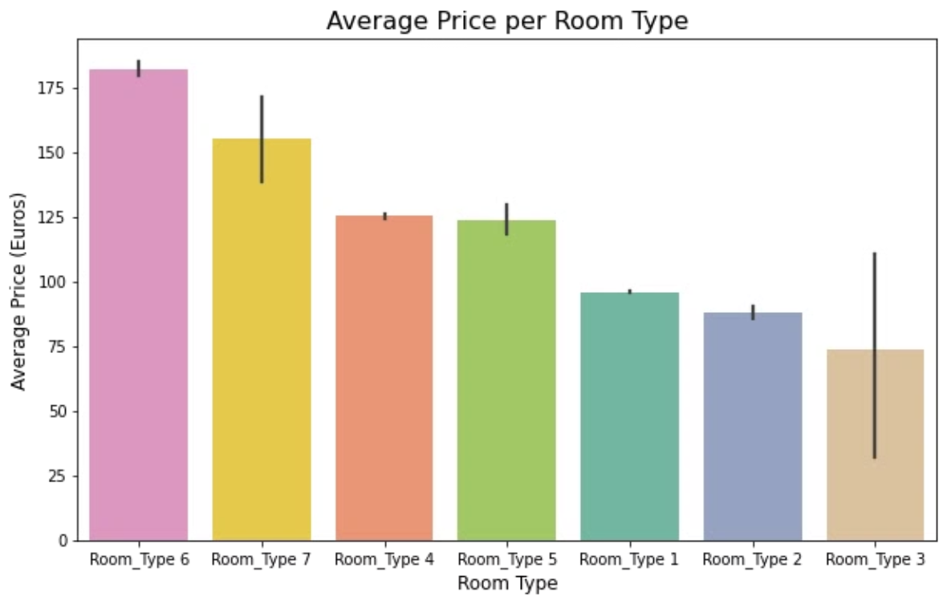
Average price per room type

Slide 3
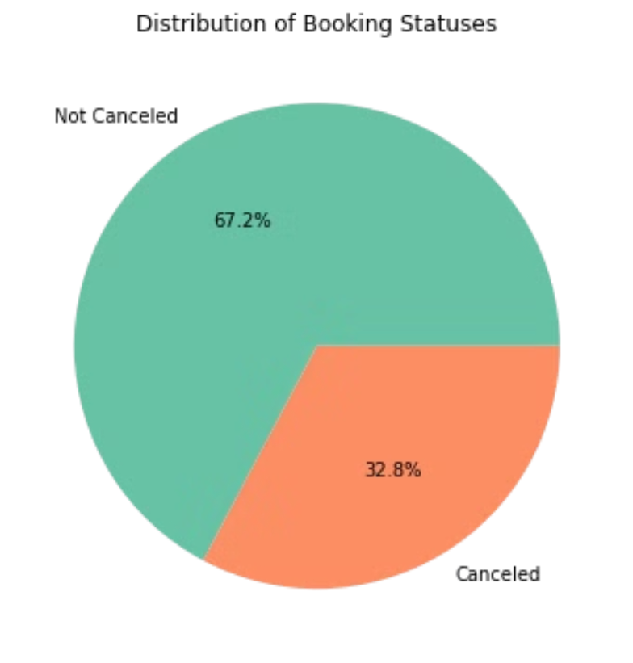
Distribution of booking status

Slide 4
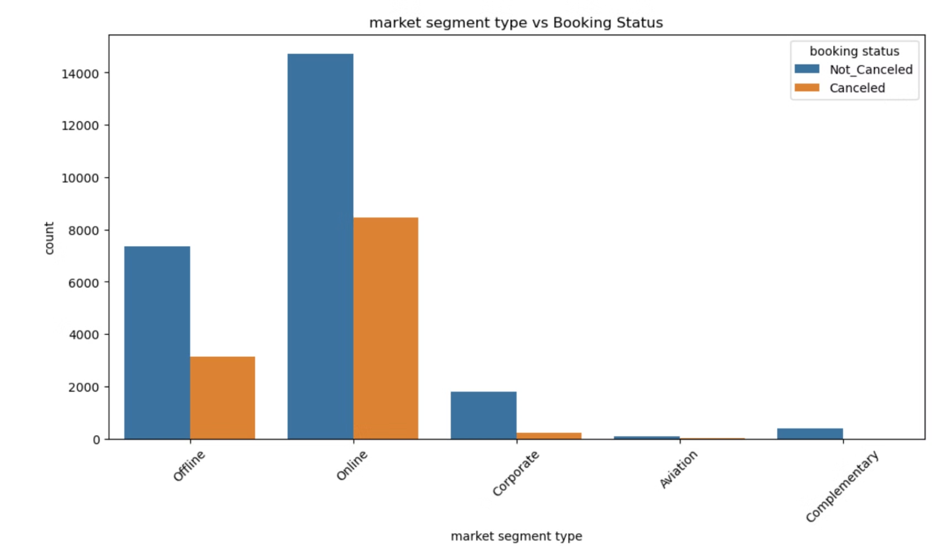
Market segment type Vs Booking status

Slide 5
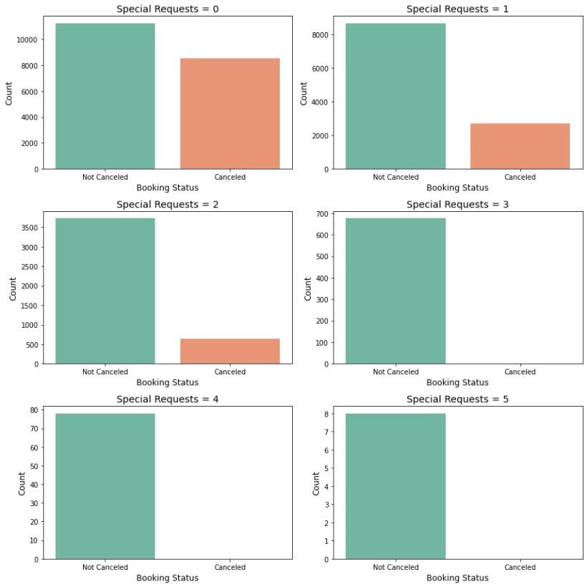
Special requests by booking status

Slide 6
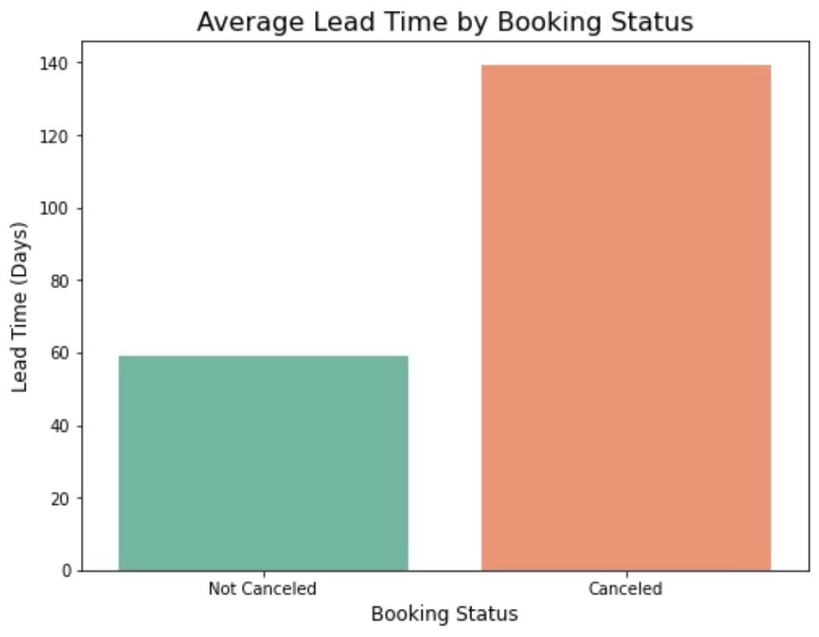
Average lead time by booking status

Slide 7
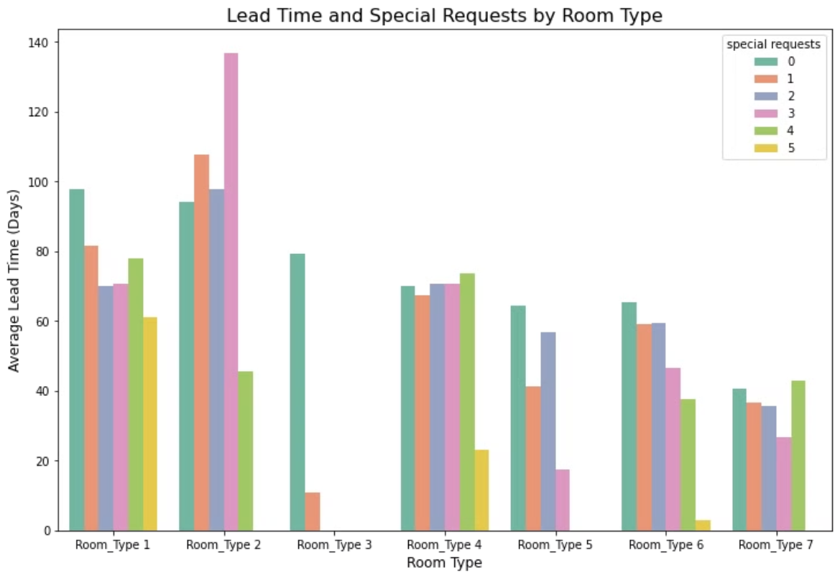
Lead time and special requests by room type

Slide 8
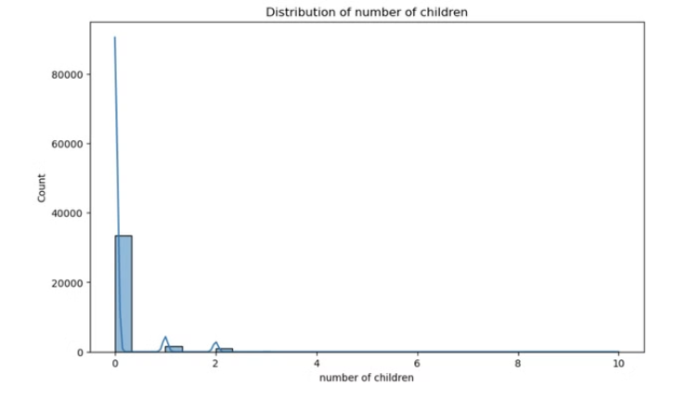
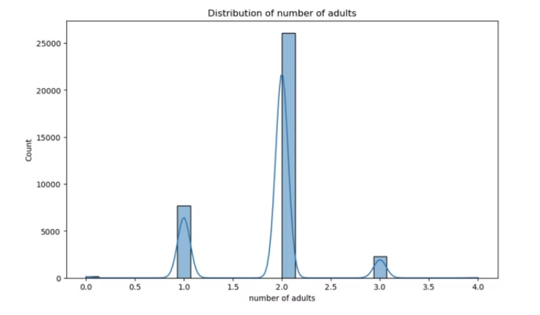
Distribution of adults and children

Slide 9
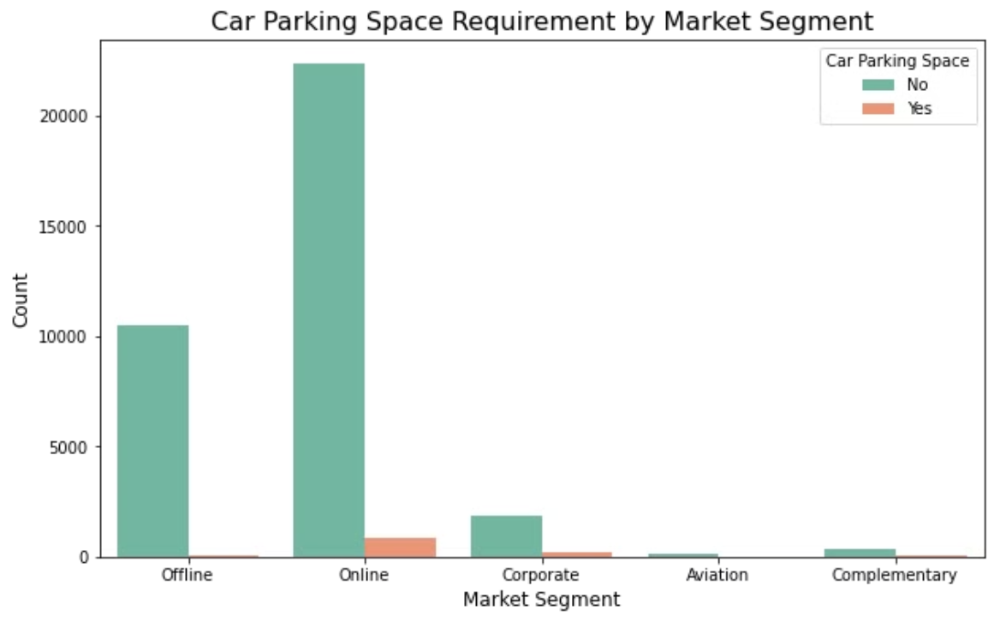
Car parking space requirement by market segment

Slide 10
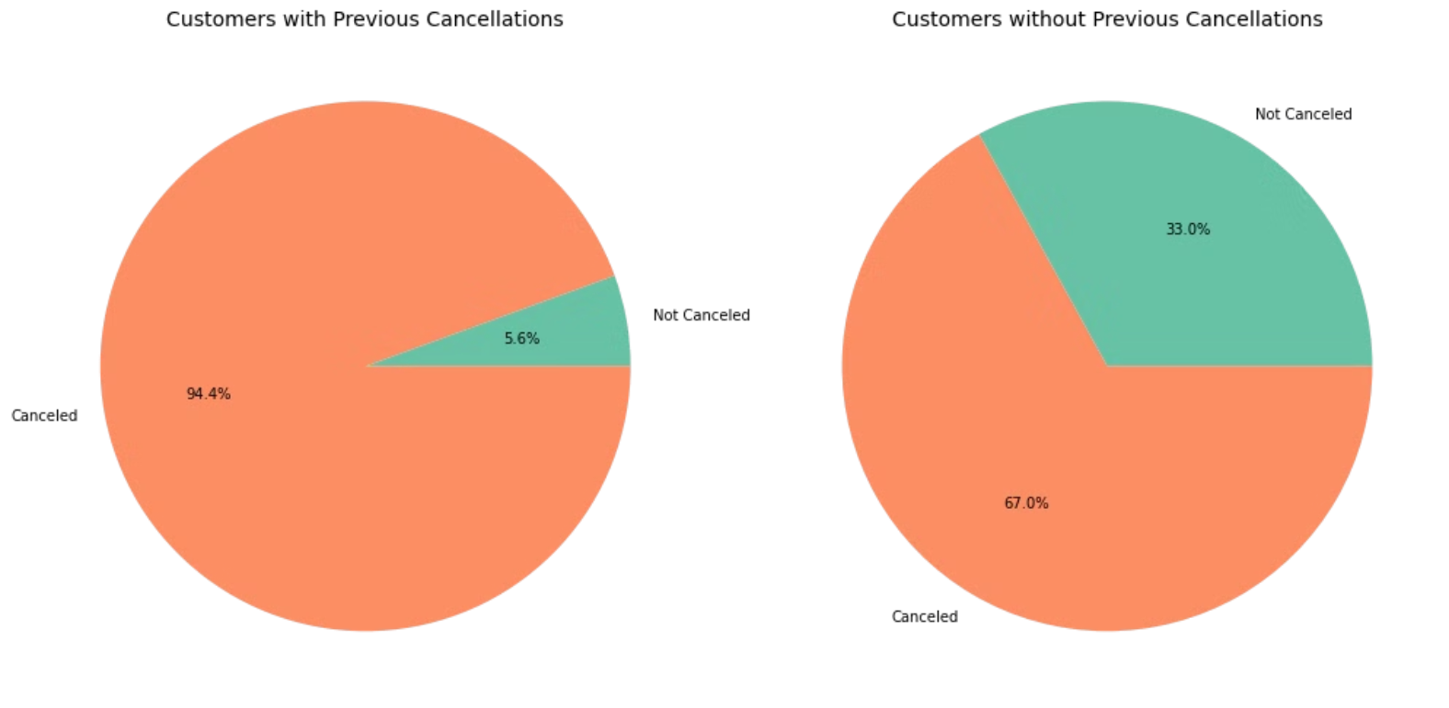
Relation between previous cancellations and current cancellations

Slide 11
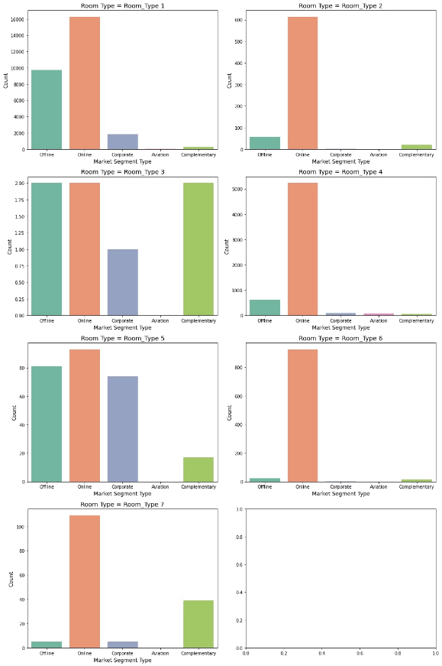
Room type by market segment type

Slide 12
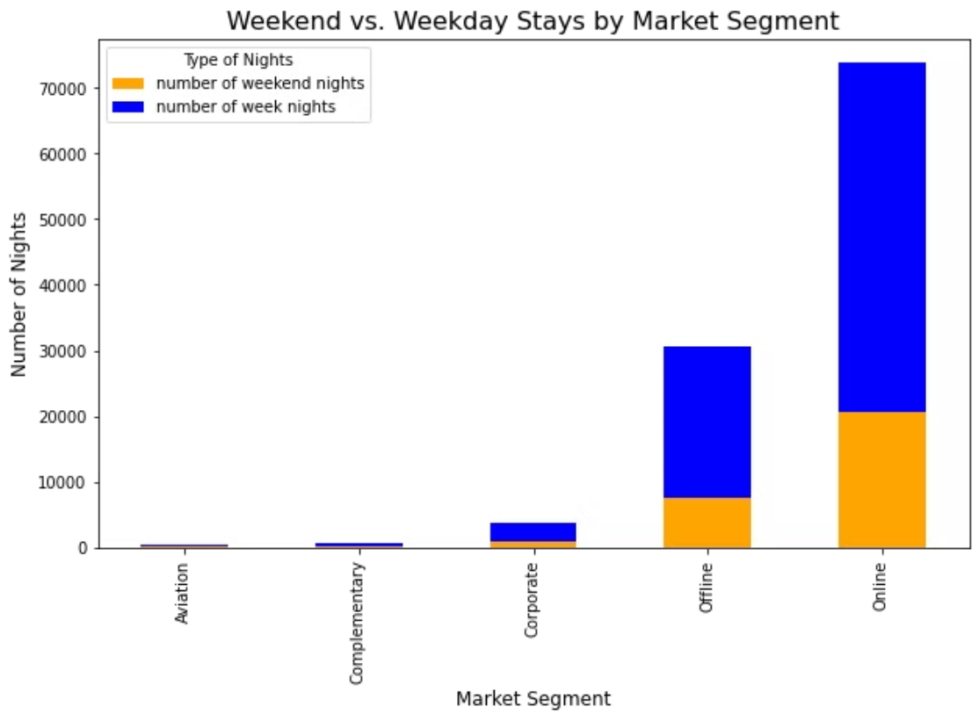
Weekend vs Weekday stays by market segment

