Slide 1
State-of-art statistical analysis of adverse event data to predict clinical outcomes in clinical trial
Hackathon 2023

Slide 2
Background of Adverse Event (AE)
A critical component of clinical trial for safety data to protect patients from unnecessary risk and to develop safety profile of the drug for benefit-risk assessment.
AE definition (by NCI): any unfavorable symptom, sign, or disease (including an abnormal laboratory finding) temporally associated with the use of a medical treatment or procedure that may or may NOT be considered related to the medical treatment or procedure.
AE type: Common Terminology Criteria for Adverse Events (CTCAE) to standardize toxicity characterization.
The CTCAE version 5 lists 26 toxicity categories to cover a total of 837 AE terms.

Slide 3
Potential Clinical Utility
Association with clinical outcomes in various studies:
Hypertension associated with improved survival outcomes
Advanced NSCLC patients treated with bevacizumab in combination with carboplatin and paclitaxel (immunotherapy+ chemotherapy)
Patients with metastatic renal cell carcinoma treated with sunitinib (targeted therapy).
High neutrophil-to-lymphocyte ratio (NLR) correlated with worse survival in multiple immune checkpoint inhibitors (ICI) treated malignancies.
Immune-related adverse event (irAE) associated with improved overall survival
Melanoma patients treated with nivolumab.
NSCLC treated with ICI

Slide 4
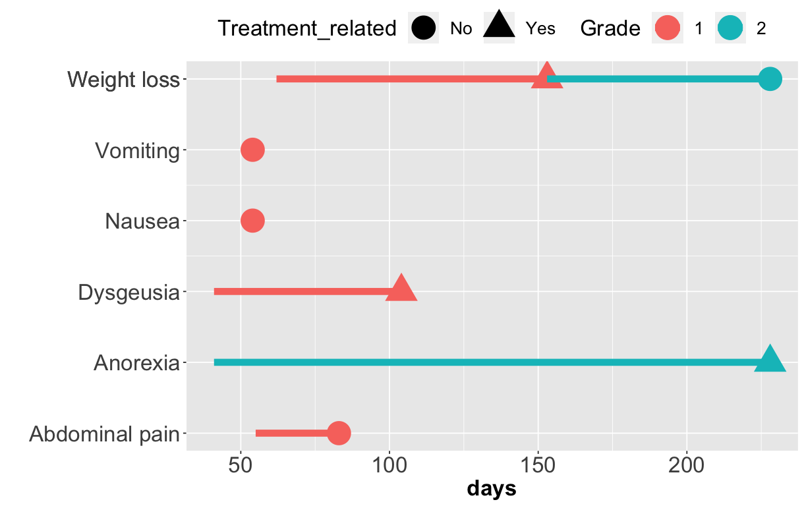
How AE Data Is Recorded? Grade, Treatment relatedness, Occurrence, Recurrence, Duration
Recurrence
Very Very Complicated!
Duration

Slide 5
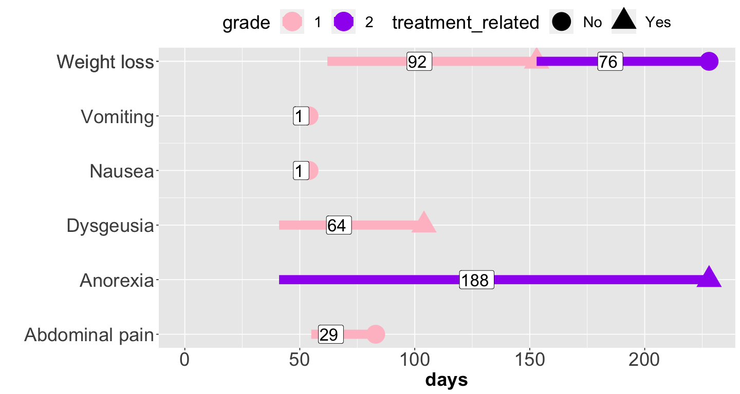
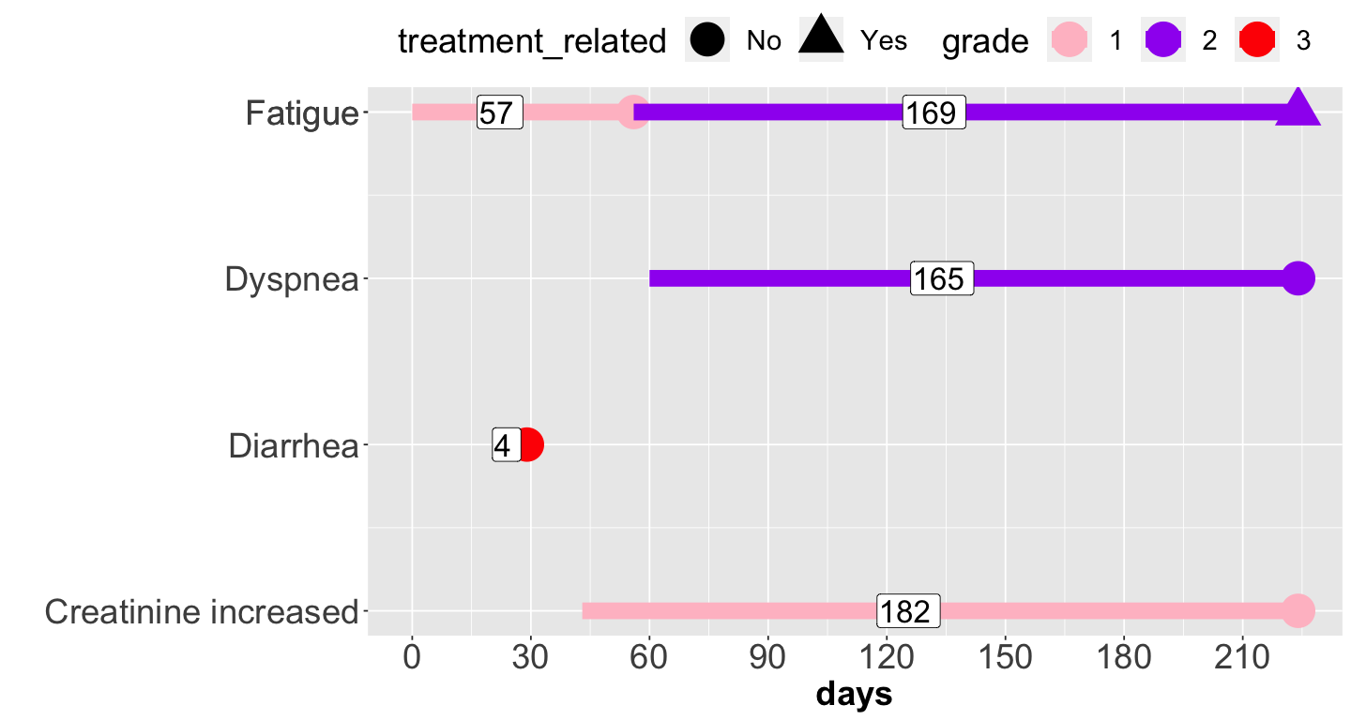
Challenges in AE analysis due to data complexity
Patient A
Patient B
Issues: Duration, Recurrence, Change of grade and treatment relatedness

Slide 6
Existing Approaches
ToxT approach: Incorporate the dimension of time into AE assessment to depict toxic effects.
Limitation: impractical mean of AE grade and fixed time point by drug cycle.
Q-TWiST approach: Analyze quality adjusted time without symptoms or toxicity by decomposing survival time into three health states: time with toxicity (TOX), time without toxicity, relapse, or progression (TWiST), and time after tumor progression or relapse until death (REL), and then uses a weighted average of the three health states to form the Q-TWiST score.
Limitation: dependency of utility weights and inability in individual AE analysis.
Generalized log-rank test: Use mean frequency function to compare recurrent AE events.
Limitation: lack of consideration of AE duration

Slide 7
Potential AE clinical Makers
Any grade AE
Low grade AE (grade 1-2)
High grade AE (grade 3-5)
Any treatment related grade AE
Treatment related low grade AE
Treatment related high grade AE
Frequency of AE
Duration of AE
….

Slide 8
Our Unique Framework of AE Analysis
Utilization of AE parameters to derive AE biomarkers by toxicity severity level (grade), treatment relatedness, AE occurrence, frequency, and duration.
Comprehensive analysis of AE-derived biomarkers from overall AE, toxicity category, down to individual AE.
Landmark analysis at day 30 from initial treatment date for early AE biomarkers.
Informative analysis components including survival plot and boxplot for each AE-derived biomarker, summary plots of effect size and p value for all AE-derived biomarkers in an AE, summary tables for significant AEs.

Slide 9
Integration of AE Parameters AE-Derived Biomarker
AE-derived biomarkers
 |  | Measurement type
 |  | Occurrence | Sum of all unique AEs | Sum of all AEs | Sum of all AE duration
Grade type | Any grade | x | x | x | x
 | Any treatment related grades | x | x | x | x
 | Low-grade (1 or 2) | x | x | x | x
 | Treatment related low-grade | x | x | x | x
 | High-grade (3 or higher) | x | x | x | x
 | Treatment related high-grade | x | x | x | x

Slide 10
Comprehensive Analysis
Vomiting
Gastrointestinal disorders
Diarrhea
…
Entire AE level (overall AE)
Endocrine disorders
…
…
…
…
Toxicity Category
Individual AE

Slide 11
Example 1: Overall AE
AE-derived biomarkers (Patient A for entire AE level)
 |  | Measurement type
 |  | Occurrence | Sum of all unique AEs | Sum of all AEs | Sum of all AE duration (days)
Grade/ Treatment relatedness | Any grade | 1 | 6 | 7 | 451
 | Any treatment related grade | 1 | 3 | 3 | 344
 | Low-grade (1 or 2) | 1 | 6 | 7 | 451
 | Treatment related low-grade | 1 | 3 | 3 | 344
 | High-grade (3 or higher) | 0 | 0 | 0 | 0
 | Treatment related high-grade | 0 | 0 | 0 | 0

Slide 12
Example 2:
Overall AE
AE-derived biomarkers (Patient B for entire AE level)
 |  | Measurement type
 |  | Occurrence | Sum of all unique AEs | Sum of all AEs | Sum of all AE duration (days)
Grade/ Treatment relatedness | Any grade | 1 | 4 | 5 | 572
 | Any treatment related grade | 1 | 1 | 1 | 169
 | Low-grade (1 or 2) | 1 | 3 | 4 | 568
 | Treatment related low-grade | 1 | 1 | 1 | 169
 | High-grade (3 or higher) | 1 | 1 | 1 | 4
 | Treatment related high-grade | 0 | 0 | 0 | 0

Slide 13
Example 3: Toxicity category
Gastrointestinal disorders
AE-derived biomarkers (Patient A for gastrointestinal disorders)
 |  | Measurement type
 |  | Occurrence | Sum of all unique AEs | Sum of all AEs | Sum of all AE duration (days)
Grade/ Treatment relatedness | Any grade | 1 | 3 | 3 | 31
 | Any treatment related grade | 0 | 0 | 0 | 0
 | Low-grade (1 or 2) | 1 | 3 | 3 | 31
 | Treatment related low-grade | 0 | 0 | 0 | 0
 | High-grade (3 or higher) | 0 | 0 | 0 | 0
 | Treatment related high-grade | 0 | 0 | 0 | 0

Slide 14
Example 4: Individual AE
AE-derived biomarkers (Patient A for weight loss)
 |  | Measurement type
 |  | Occurrence | Sum of all unique AEs | Sum of all AEs | Sum of all AE duration (days)
Grade/ Treatment relatedness | Any grade | 1 | 1 | 2 | 168
 | Any treatment related grade | 1 | 1 | 1 | 92
 | Low-grade (1 or 2) | 1 | 1 | 2 | 168
 | Treatment related low-grade | 1 | 1 | 1 | 92
 | High-grade (3 or higher) | 0 | 0 | 0 | 0
 | Treatment related high-grade | 0 | 0 | 0 | 0

Slide 15
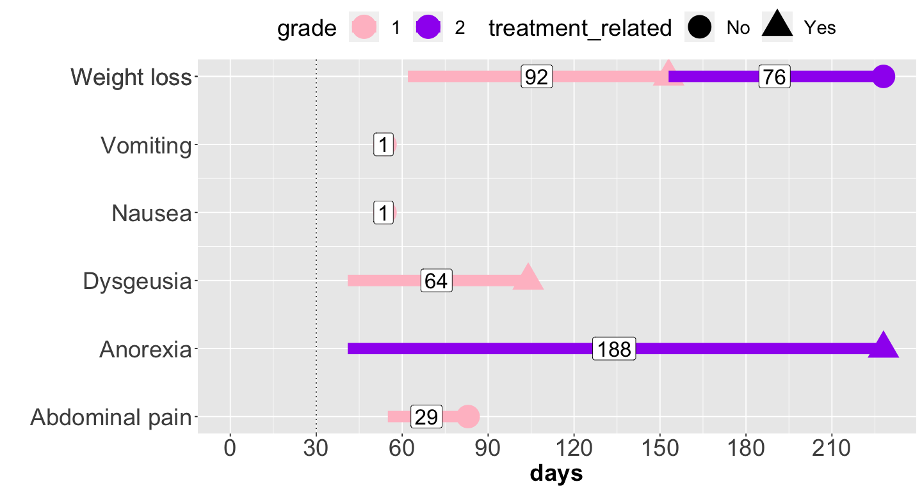
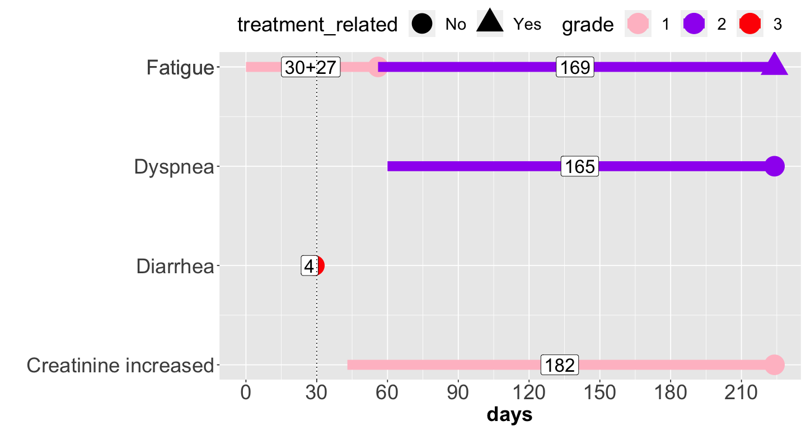
Early AE by Landmark Analysis at Day 30
No Early AE
Early AEs

Slide 16
Example:
Overall Early AE
Early AE-derived biomarkers (Patient B): Overall AE
 |  | Measurement type
 |  | Occurrence | Sum of all unique AEs | Sum of all AEs | Sum of all AE duration (days)
Grade/ Treatment relatedness | Any grade | 1 | 2 | 2 | 34
 | Any treatment related grade | 0 | 0 | 0 | 0
 | Low-grade (1 or 2) | 1 | 1 | 1 | 30
 | Treatment related low-grade | 0 | 0 | 0 | 0
 | High-grade (3 or higher) | 1 | 1 | 1 | 4
 | Treatment related high-grade | 0 | 0 | 0 | 0

Slide 17
Informative Analysis Components
Survival plot and boxplot for each AE-derived biomarker
Summary plots of effect size and p value for all AE-derived biomarkers in an AE
Summary tables for significant AEs

Slide 18
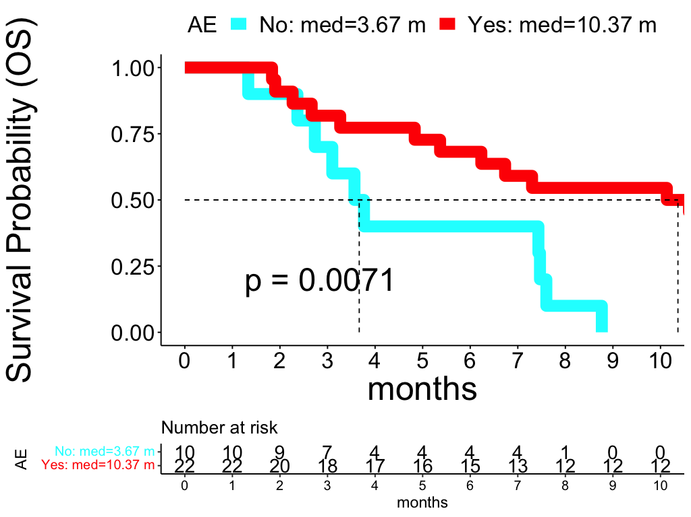
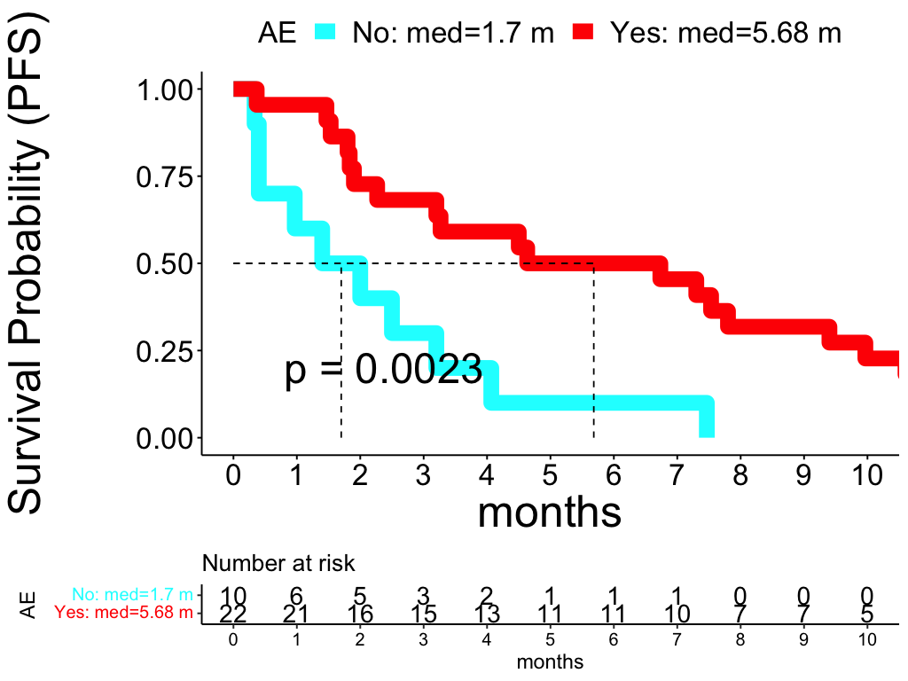
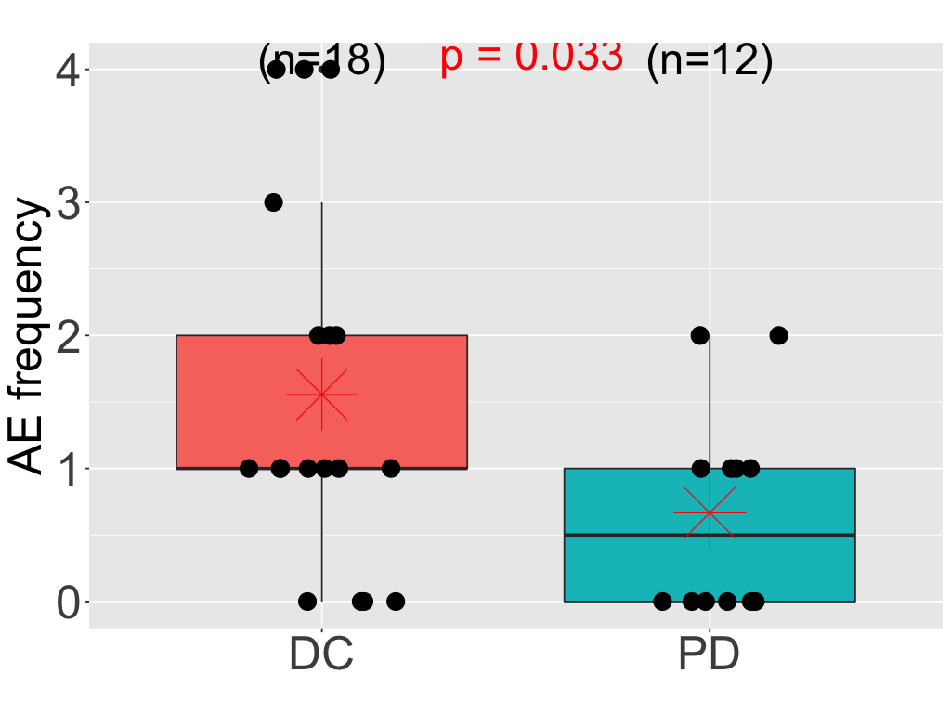
Informative Analysis Components Survival plot and boxplot for each AE-derived biomarker

Slide 19
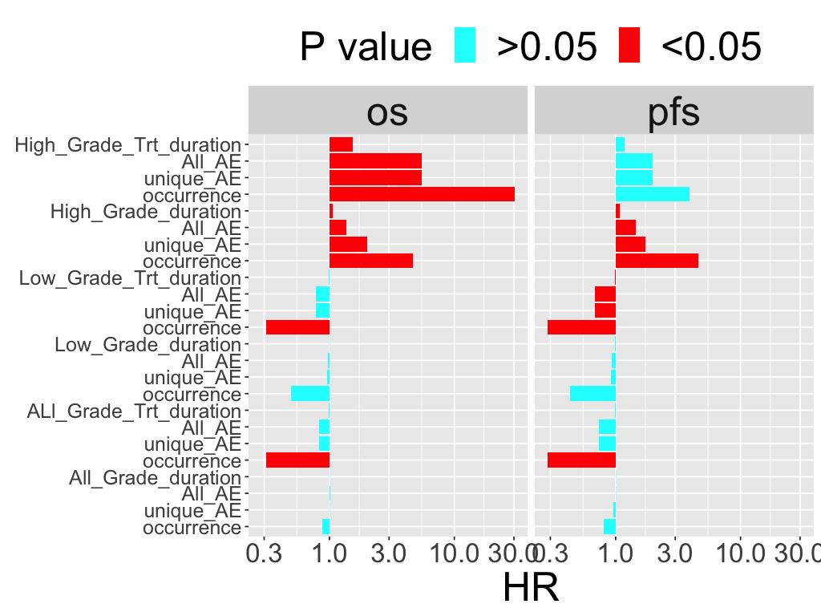
Informative Analysis Components Summary Plot of Effect Size and P Value

Slide 20
Informative Analysis Components Summary Table of Significant AEs
Toxicity category | AE | PD Association | DC Association
Trt: treatment related AE
Overall AE |  | High-Grade | Any grade.Trt Low-Grade Low-Grade.Trt
General disorders and administration site conditions |  |  | Low-Grade
General disorders and administration site conditions | Fatigue |  | Any grade Low-Grade
General disorders and administration site conditions | Pain |  | Low-Grade
Investigations | Platelet count decreased |  | Any grade Any grade.Trt Low-Grade Low-Grade.Trt

Slide 21
Potential Hackathon Tasks
Improvement of Hackathon Shiny app objectives (e.g., enhance AE plot download file, more options for AE measurement output with selection of AE type, display forest plot whole or individual option plot and table for survival outcome, response outcome, and treatment duration outcome, and option to define early AE).
Network analysis of significant AEs (e.g., to offer the potential for insight into AE relationship to inform clinical practice, like pathway analysis in bioinformatics).
Pubmed analysis of significant AEs (e.g., PubMed analysis of significant AEs for clinical relevance and to help verify if a significant AE is a new discovery, a support to published literature through current available R packages, such as RISmed and easyPubMed).
Report of AE data analysis (e.g., key summary text to highlight significant AE).
Sensitivity analysis of early AE event (e.g., evaluate various lengths such as, 2 weeks up to 6 weeks, and measure variation of results for early AE event)

