Slide 1



BA 336
Essentials of Information Technology
October 14, 2026
Notes:
This class was occupied entirely by the game, the project preview, announcements, and mostly Excel.
The in-class Excel vlookup exercise needs to have the instructions revised:
1) Need to give example on question 1, so they know they don’t need to include the sheet reference…. ‘raw data’!A:B …replace with [A2, A:B(raw_data), 2, 0]
2) Question 4 needs to rewritten entirely. You can’t do a logical test on strings.
Probably can move quicker through the overview stuff prior to Excel.

Slide 2

BA 336: Essentials of Information Systems
Attendance
‹#›

Slide 3

BA 336: Essentials of Information Systems
Agenda
Week in Review: homework, grades, etc.
Reminder: Mid-term Exam (Week 5)
Preview of Comparative Analysis
Sheet Happens!
Key Excel Functions (vlookup, IF)
Network effects (this week)
‹#›
Notes:
Today we’re shifting "managerial lens" toward one of the most powerful forces in the modern economy.
Not loving Excel?
Technology isn’t just about spreadsheets and data management.
STRATEGY!
Today: why some companies untouchable giants… other companies disappear….

Slide 4
Comparative Analysis
Canvas Tour of Assignment Guide
Notes:
https://canvas.pdx.edu/courses/104180/pages/week-3-reading?module_item_id=4793793

Slide 5

BA 336: Essentials of Information Systems
Sheet Happens!
‹#›
Notes:
Review Solution for SC2
https://docs.google.com/spreadsheets/d/1UhOtC7QoNS5FrRNK2HlOFNIXmKUtYBMy/edit?gid=944486538#gid=944486538
Martinez

Slide 6
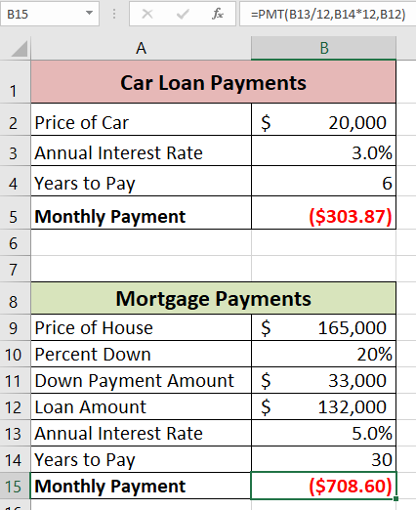
BA 336: Essentials of Information Systems
Sheet Happens!
‹#›
Notes:
CH2
Negative values for payment amount

Slide 7
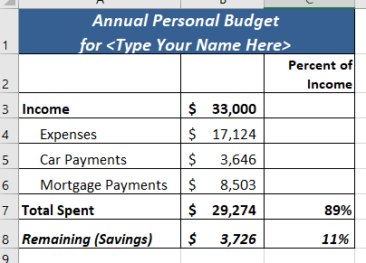
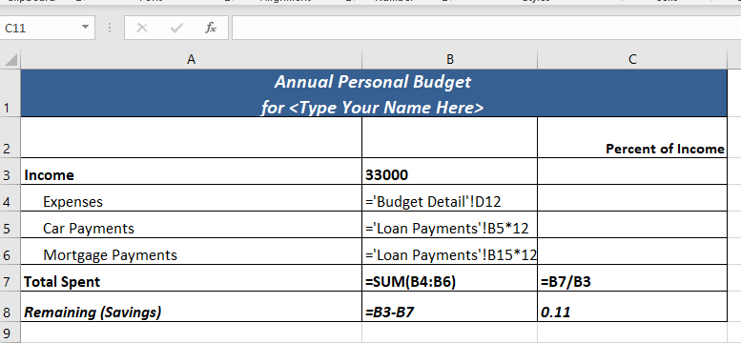
BA 336: Essentials of Information Systems
Sheet Happens!
‹#›
Notes:
CH2
Divide total spent by total income = 89% : Correct
Copy formula down to divide savings/income. Incorrect.
Relative reference instead of absolute

Slide 8
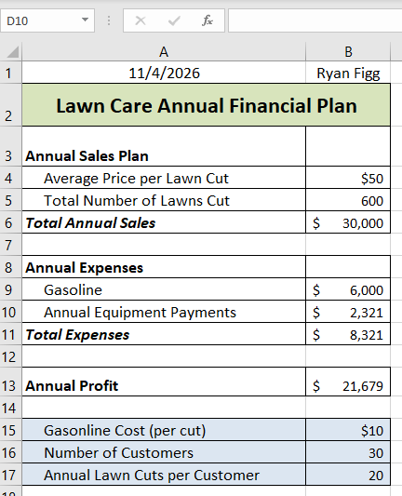
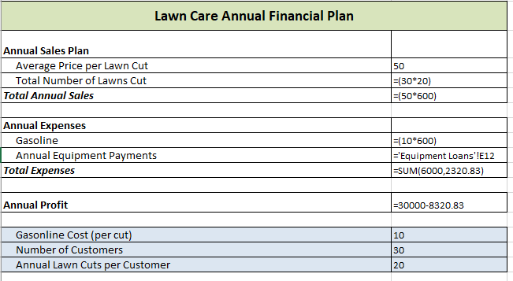
BA 336: Essentials of Information Systems
Sheet Happens!
‹#›
Notes:
PR2
Hardcoding the annual profit instead of using references

Slide 9
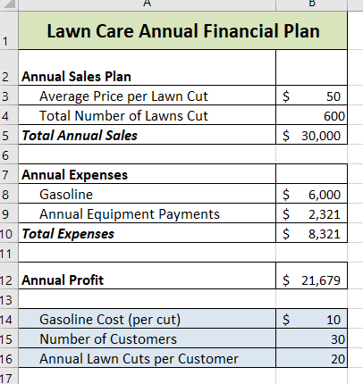
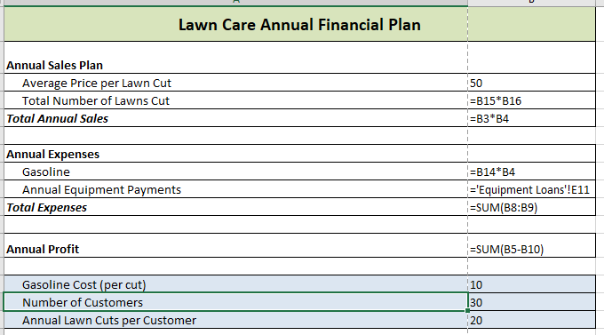
BA 336: Essentials of Information Systems
Sheet Happens!
‹#›
Notes:
PR2
No need for SUM function in Annual Profit. Simplify

Slide 10
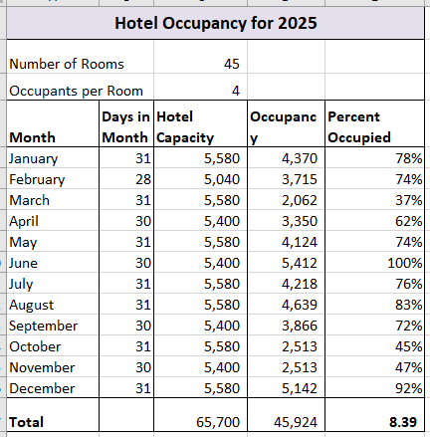
BA 336: Essentials of Information Systems
Sheet Happens!
‹#›
Notes:
No sum for percent occupied

Slide 11
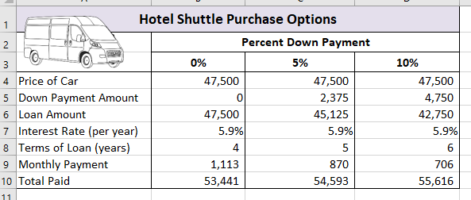
BA 336: Essentials of Information Systems
Sheet Happens!
‹#›

Slide 12
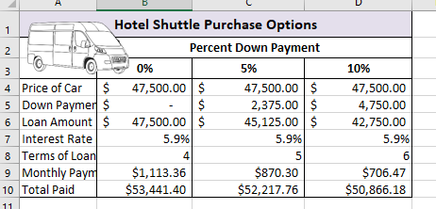
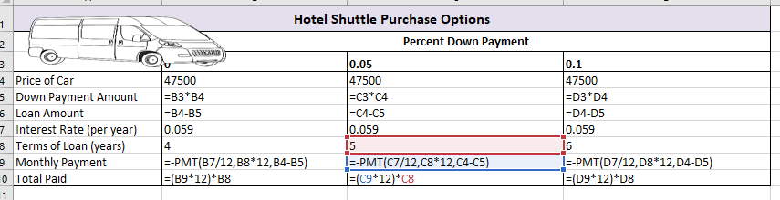
BA 336: Essentials of Information Systems
Sheet Happens!
‹#›
Notes:
Didn’t subtract the downpayment

Slide 13
Excel

Slide 14
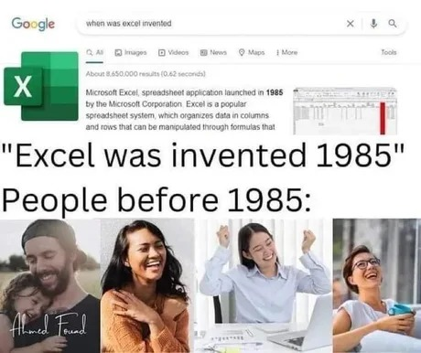
BA 336: Essentials of Information Systems
The Holy Trinity of Intermediate Excel Functions
IF
VLOOKUP
Pivot Tables (Week 5)
‹#›

Slide 15

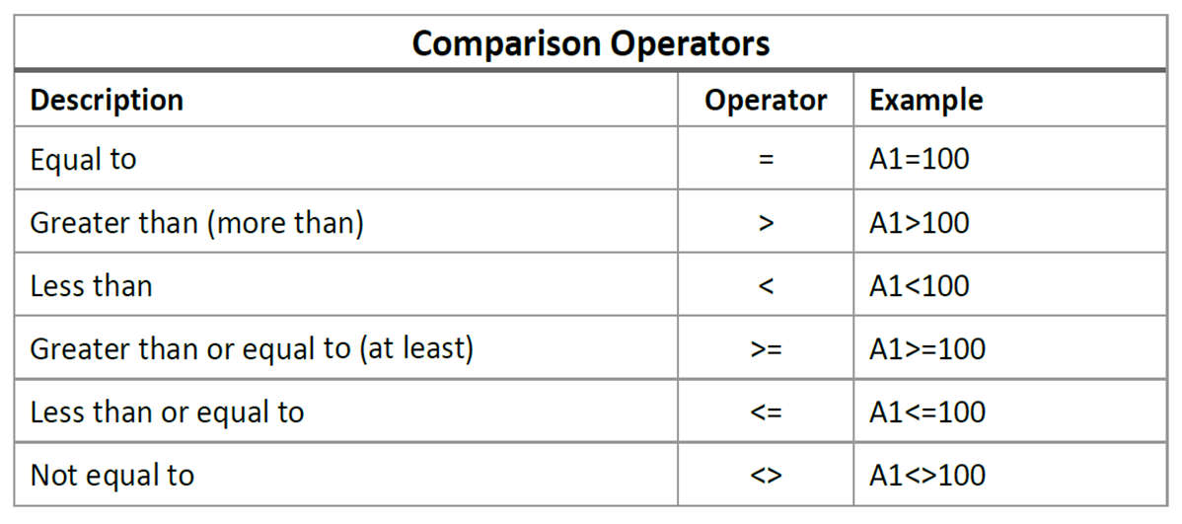
BA 336: Essentials of Information Systems
IF Statements: A Digital Fork in the Road
IF a comparison is true →
  Do this…
Otherwise…
  Do something else
‹#›
Notes:
If A1 = 100 —- Do this – Otherwise…do that…

Slide 16
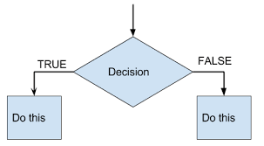
BA 336: Essentials of Information Systems
IF Formula Structure
The Three Arguments
logical_test: math based question
  If a number is > 10
  Do this…otherwise…
value_if_true: output if answer is “yes.”
  Words
  More calculations (e.g. B2*2)
value_if_false: output if the answer is “no.”
  Words, more calculations, or nothing.
‹#›
Notes:
https://docs.google.com/spreadsheets/d/1uc2KSn3kUyhRZa12PuLigMd4-AAXs3jubojp30TeTk4/edit?gid=0#gid=0

Slide 17
IF Statement
Demo
Notes:
Demo 1: set columns in 2nd argument to A:G
Demo 2: manually set the column range in 2nd argument to force relative reference error that needs to be updated to absolute

Slide 18
BA 336: Essentials of Information Systems
IF Statements: Common Mistakes
Issue | Example | Fix
Forgetting quotation marks for text | **=IF(A2>10, Yes, No)** | Add quotes to "Yes" and "No"
Reversing the order | **=IF(A2<10, "Fail", "Pass")** but expecting opposite | Double-check the logic test
Missing parentheses | Causes #NAME? or #VALUE! errors | Always close all parentheses
‹#›

Slide 19
The Taylor Swift Demo
Notes:
Demo 1: set columns in 2nd argument to A:G
Force relative reference error in demo 2

Slide 20
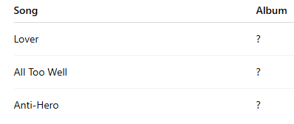
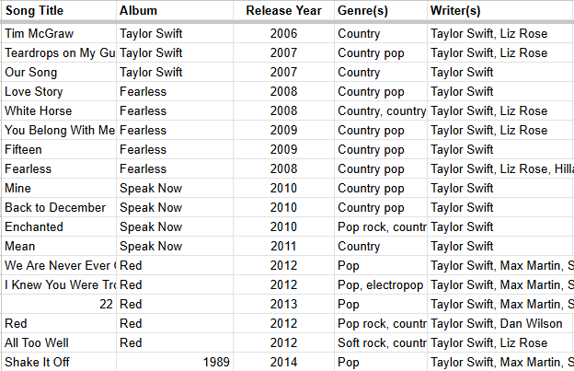
BA 336: Essentials of Information Systems
Vlookup to the Rescue!
Your boss has a list of Taylor Swift songs and wants to know: “What albums are these songs from?”
You looked online and found a spreadsheet of Taylor Swift’s music (title, album, year, duration, etc.)
You can manually scroll through all her songs and hand key the answers or…
Excel can connect the dots!
‹#›

Slide 21
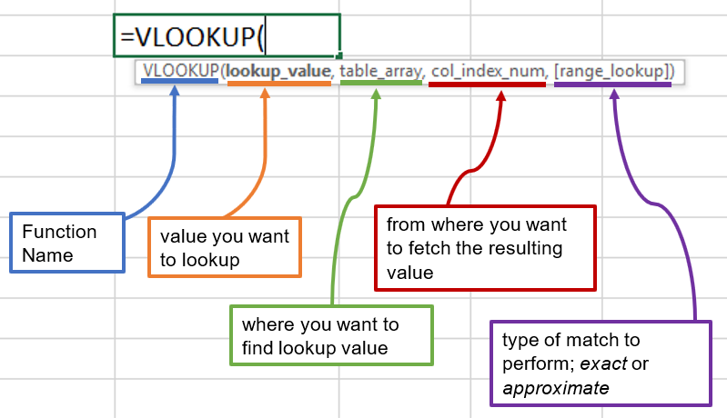
BA 336: Essentials of Information Systems
VLOOKUP Formula
The Four Arguments =VLOOKUP (arguments go inside parenthesis)
lookup_value:
  use what you know to find what you don’t know
table_array:
  “Range” where Excel should look
col_index_number:
  Which column has the answer (columns are numbered, in order)
range_lookup:
  Should Exact look for an exact match or approximate
‹#›

Slide 22
BA 336: Essentials of Information Systems
VLOOKUP Formula
A
B
C
D
E
=VLOOKUP( )
Value to look up
Where to look
Which column to return
Exact match or approximate
‹#›
Notes:
DEMO
https://docs.google.com/spreadsheets/d/1uc2KSn3kUyhRZa12PuLigMd4-AAXs3jubojp30TeTk4/edit?gid=0#gid=0

Slide 23
BA 336: Information Literacy
Platforms, Network Effects, and Winner Take All
Metcalf’s Law

Slide 24

BA 336: Essentials of Information Systems
Learning Outcomes
Define Network Effects
  Products and services that are subject to network effects.
Three primary sources of value for network effects.
One-sided VS. two-sided markets
Competition where network effects are present differ from competition in traditional markets. (most products aren’t subject to network effects)
Parasitic Nature of Dominant Firms (Potentially)
‹#›

Slide 25

Notes:
The Architecture of Connectivity,' isn’t just wires and Wi-Fi.
Strategic blueprint
Weave itself into daily lives of millions.
In tech, the best product doesn't always win.
WHO WINS: Product that connects the most people and creates the most value through those connections DOMINATES
Apple, Microsoft, and Roblox aren't just companies.
Ecosystems.

Slide 26
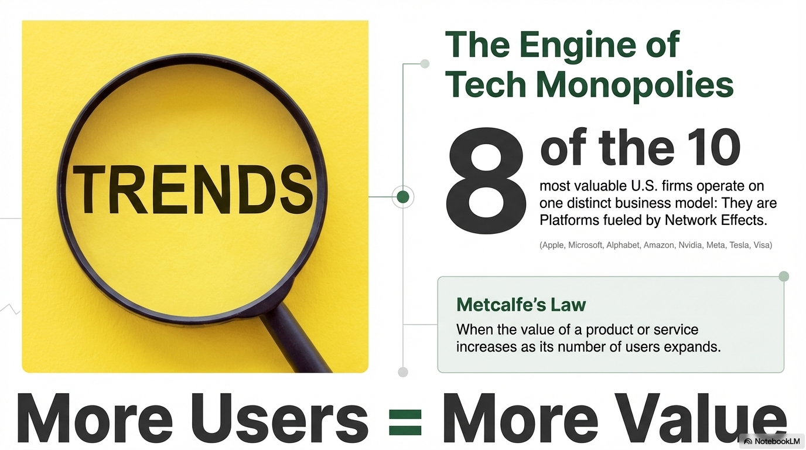
Notes:
At the heart of Network Effects: Metcalfs Law
Alexander Graham Bell invents the phone
Who did he call?
Value of phone?
Each new person that (plugs into network) adds a phone line, increases the value.
Also, behind standards like WIFI, Bluetooth, HTTP
Value Curve: scales exponentially, not linear
Where does value come from?

Slide 27

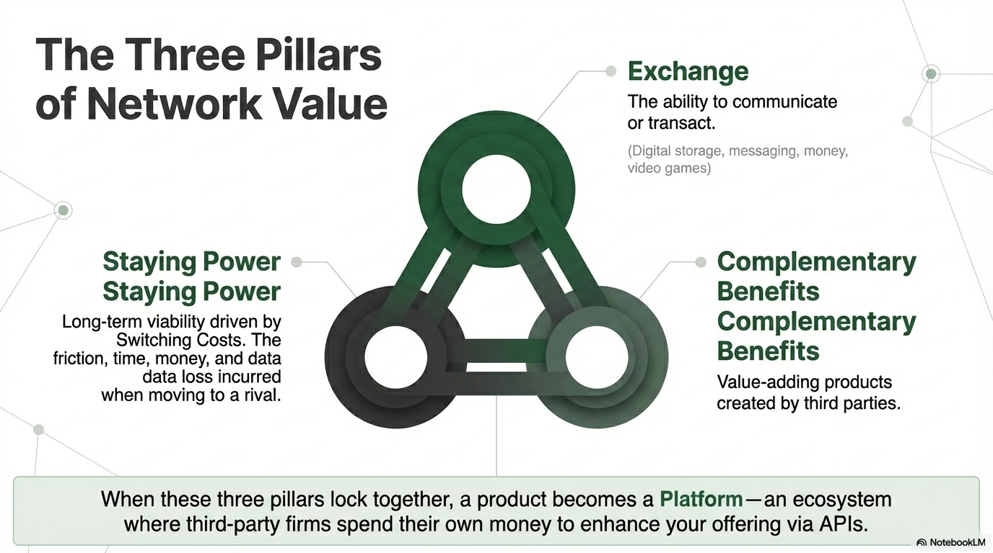
Notes:
Exchange: ability for users to communicate or share with one another
Nintendo gaming console
Apple iOS - mobile operating system
Staying Power = Perceived Longevity.
Related to switching costs
Pain felt switching
Complimentary Benefits
EXTRAS:
Game titles by 3rd party developers
App store + accessories (magsafe charger)
TRANSITION: Use all three = Start becoming PLATFORM
OTHER PEOPLE HELP BUILD YOUR PRODUCT AND REVENUE

Slide 28
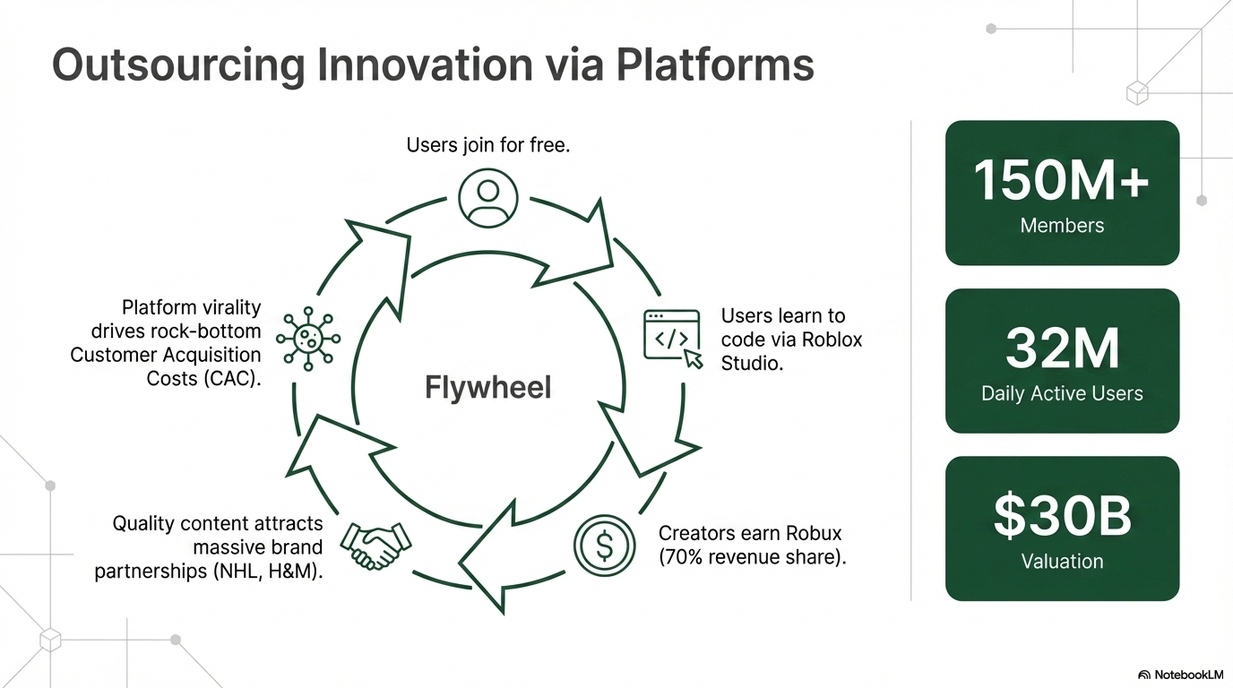
Notes:
Example: Roblox 30 billion valuation.
Not just games.
Platform for others to make games.
Revenue sharing = harnessing creativing of millions.
More games = more players = more games
Virtuous Loop
TRANSITION: Looked at Networks and their users. Different kinds of users. Who is talking to who?

Slide 29
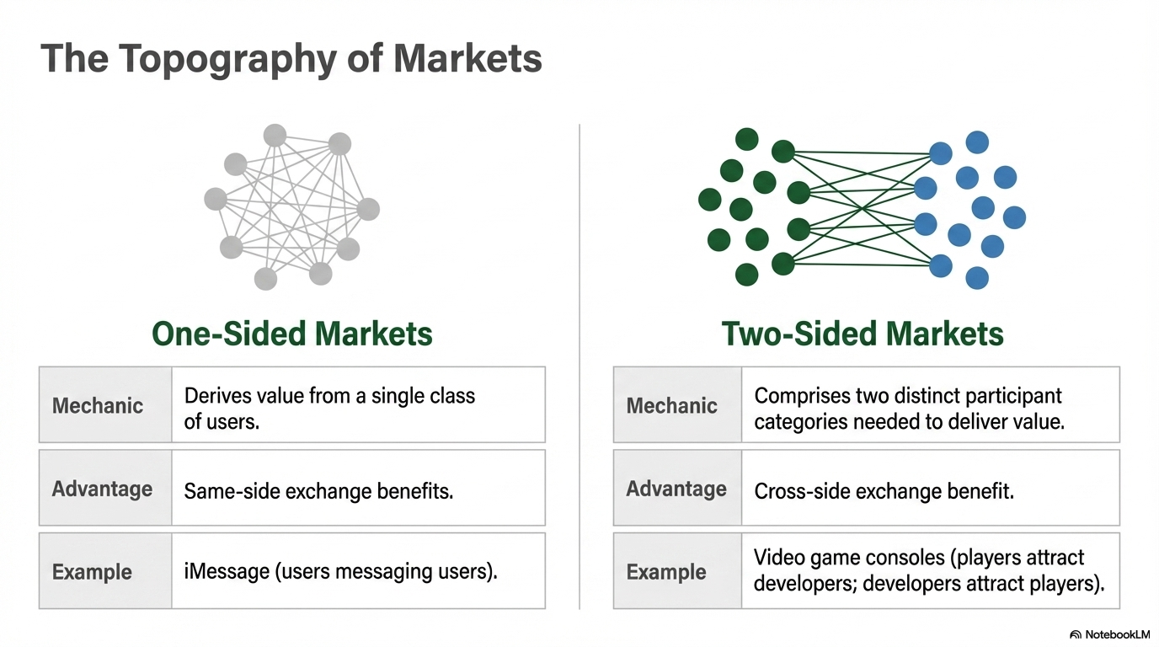
Notes:
One-sided = simple
Two-sided: real complexity: EXAMPLE: Apple Pay, Uber, AirBnb
Consumers
Merchants
Customers only use if merchants accept
Merchants only accept if customer use
Managers job for Two-Sided: solve the chicken and egg problem.
TRANSITION: Solve it and gain the lead. MOAT
Become a GIANT. Can they stay a giant?

Slide 30
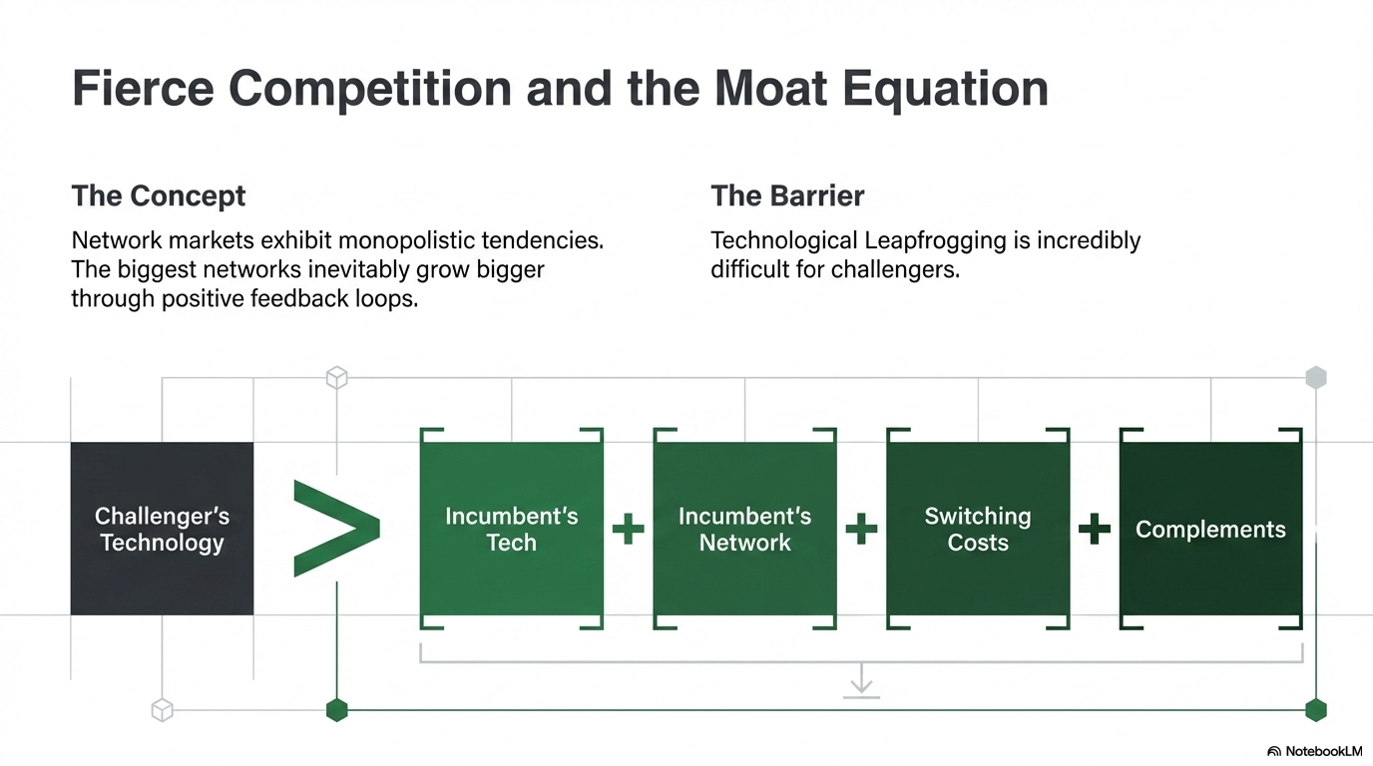
Notes:
Defenders playbook.
Open AI leads AI
Until few months ago
Google Gemini and complimentary benefits
Integrated with Gmail, Web browser.
How can a competitor enter?

Slide 31
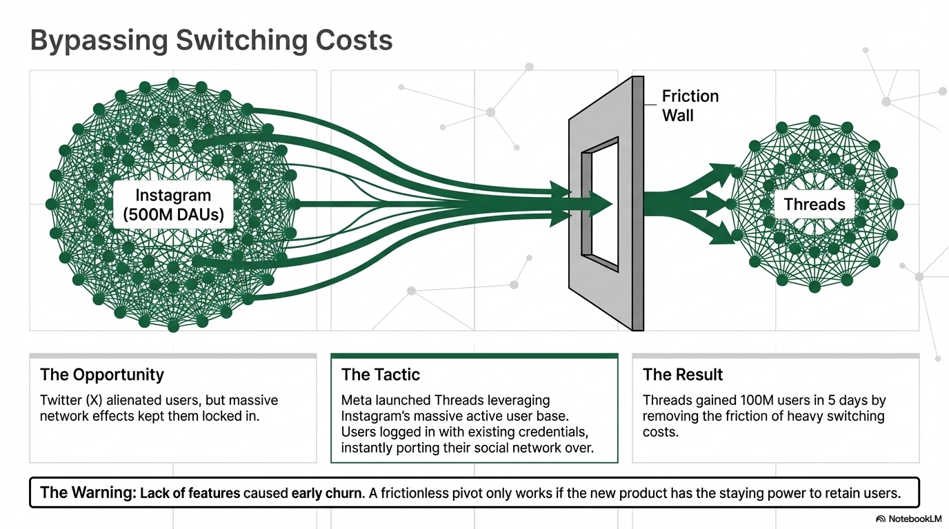
Notes:
Step 1: Eliminate switching costs…
But…
What is the first pillar of Network Effects? Must provide VALUE

Slide 32
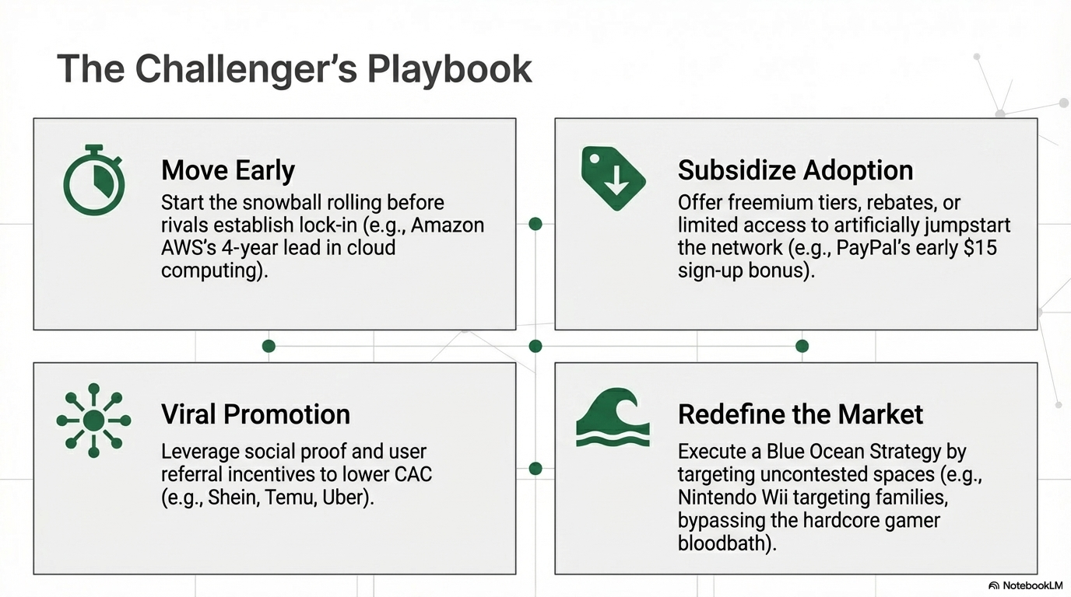
Notes:
Viral: good chance you’re on social media because your friends invited you. Stay because they’re still there.
Trust proxies
Zoom requires someone else. Gmail required invite at first.
Features that publish when a friend is taking action. Facebook + Spotify (“Alex is playing a song on spotify”)
Moving early matters in network markets: establish a lead in users, switching costs, and complementary products, hard to match.
Blue Ocean Strategy
Subsidize
Coinbase
Paypal $15 signup bonus
One more…

Slide 33
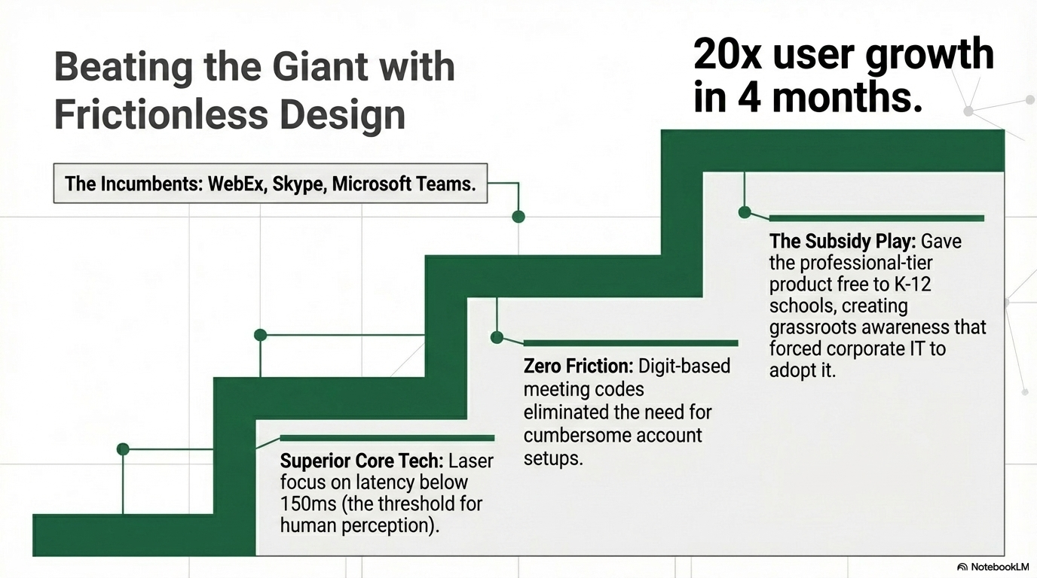
Notes:
Who is this?
Eric Yuan: helped build WebEx and was Cisco’s WebEx VP of engineering, repeatedly heard, firsthand, of customer disappointment in the firm’s product. Yuan’s attempts to refocus Cisco on addressing customer dissatisfaction and growing the market led Yuan to leave Cisco and start Zoom, taking forty engineers with him.
https://www.youtube.com/watch?v=ZWHo3VEw3ow

Slide 34
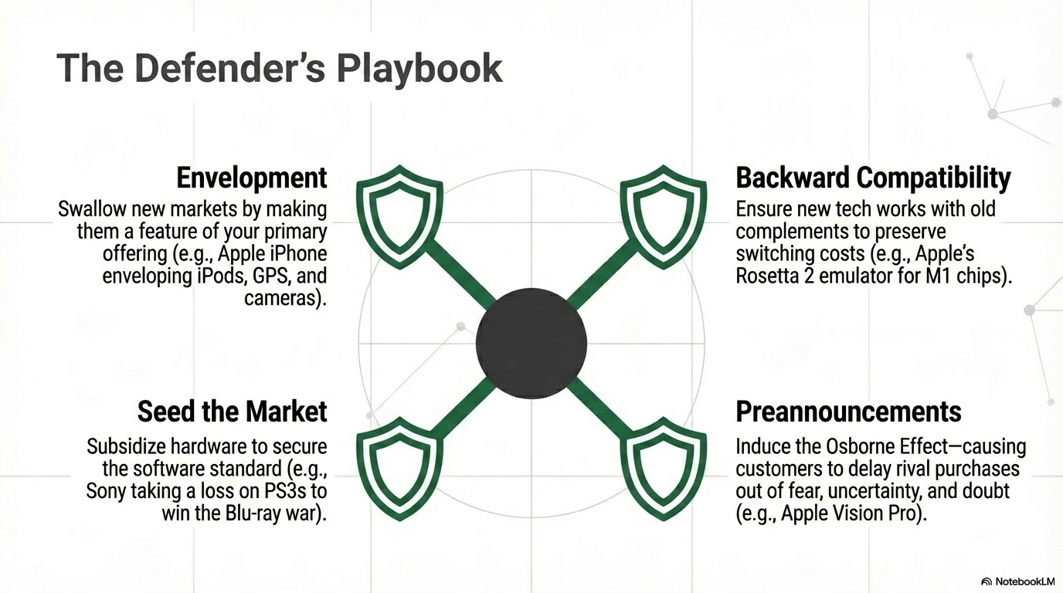
Notes:
Zoom is market leader. They need to defend the lead.
Available tools.

Slide 35
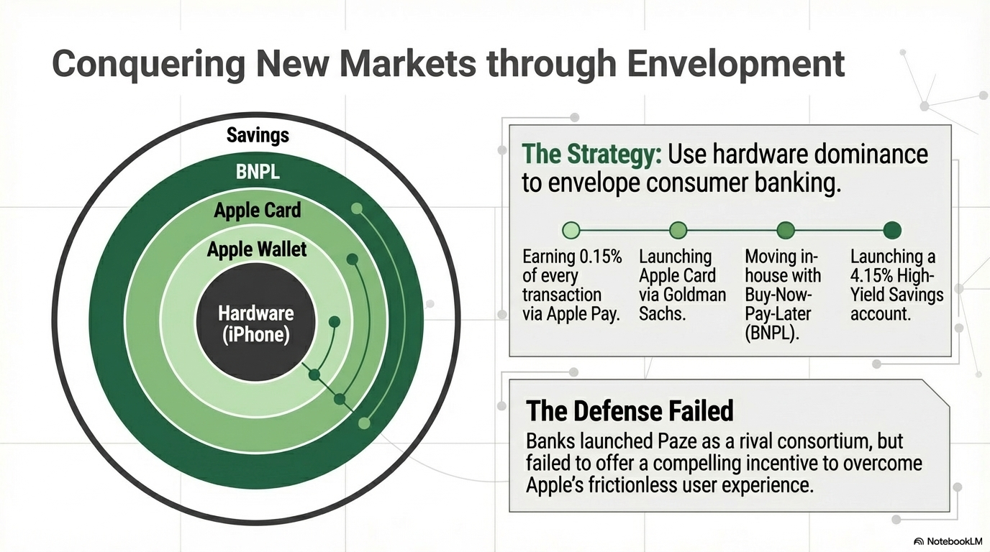
Notes:
Expansion through redefining the market.
Apple and envelopment:
* Start with transaction fees
Transaction fees
Make their own card
Buy now…
High yield savings
Also, see convergence from textbook. When two or more markets, once considered separate, combine.
Apple example: Digital cameras, GPS, gaming devices, telephones, media players

Slide 36
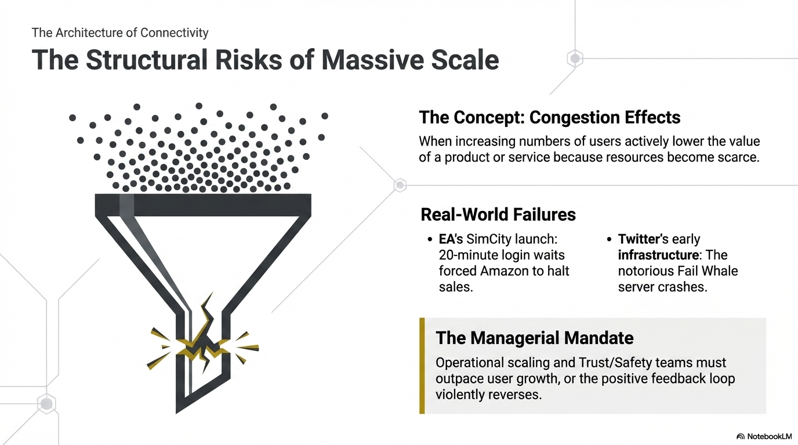

Slide 37
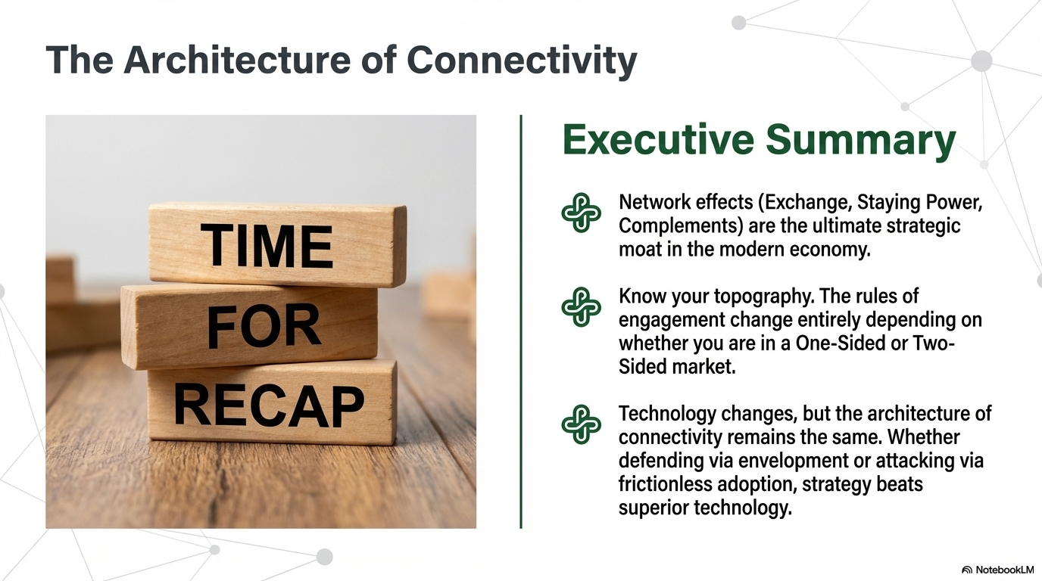
Notes:
Network effects are among the most powerful strategic resources that can be created by technology-based innovation.
Early success isn’t a guarantee of future success

Slide 38
Network Effects and Competition
Fundamental Differences with Conventional, Non-Network Industries

Slide 39

BA 336: Essentials of Information Systems
Defining Network Effects (Metcalf’s Law)
Bob Metcalf (ethernet) publishes V = U²
Occurs when a product or service becomes more valuable as more people use it, a.k.a, Rocket Fuel
  Venmo, Uber
  Instagram, Amazon, Google, eBay, Youtube, Zoom, AppStore
‹#›
Notes:
You want the products you use to be popular.
Why? e.g.
Video games - more developers developing games for your console
Kindle e-books vs. Nook e-readers, iPod vs. Zune music player, iOS and Android vs. Windows phones
8 out of 10 most valuable companies benefit from Network effects

Slide 40
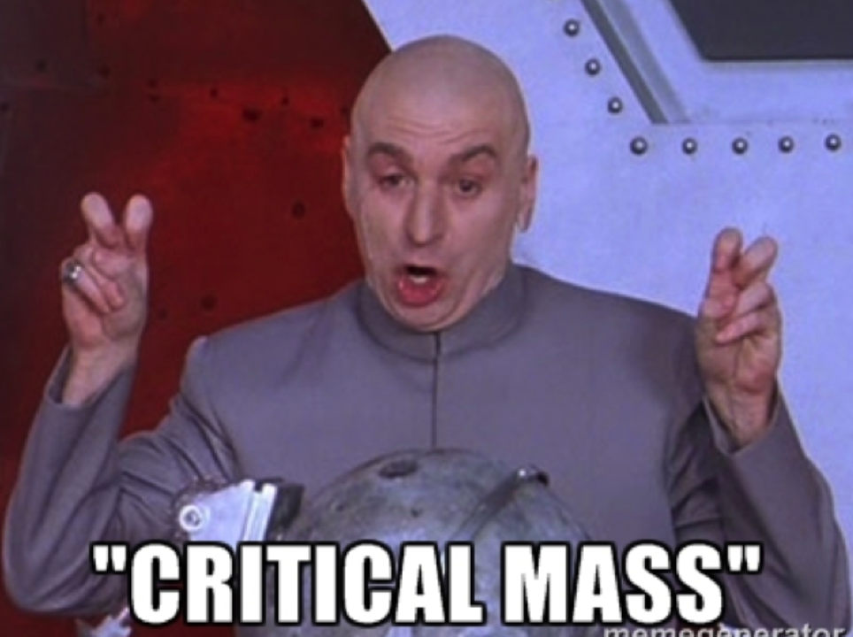
BA 336: Essentials of Information Systems
Sources of VALUE from Network Effects
Exchange
  As Instagram increased user base, potential to communicate increases
  Includes almost anything digital (messaging, movies, money, video games, software)
Staying power - long term viability of a product
  No one would have bought a Zune or Betamax if they knew the tech would die
  Switching costs - higher the investment = sticky
Complimentary benefits add additional value
  Cameras upload to Youtube, Accountants in Excel
‹#›

Slide 41

BA 336: Essentials of Information Systems
Impact of Network Effects
Why does almost everyone use the same social media platforms or messaging apps?
Are they the best tools available?
  iPhone vs. Android
What happens if you don’t use the most popular devices or apps?
‹#›
Notes:
Apple only plays nice with Apple
More hardware choices
Price options
More control to customize

Slide 42

BA 336: Essentials of Information Systems
Platforms and APIs
Platforms is a product or service encouraging other of offer complimentary goods (iOS)
Application Programming Interface
Interface allows two software applications to communicate via a handshake.
Allows third-party devs to build complimentary products
API supercharges the network effects and creates virtuous cycle: more apps, functionality, users, devs
‹#›
Notes:
Two sides: FB posts, clicks, likes and Marketers who need the data, API between the two

Slide 43


BA336: Essentials of Information Technology
One-Sided Marketplace
One-sided marketplace
  Everyone belongs to the same user group
    Social Media and Messaging apps
More people use WhatsApp, the value increases because they can communicate with more people
Effect of more users on the network referred to as same-side exchange benefits
‹#›
Notes:
Understanding key sources of Network value, look at structure of the network.
Some networks derive value from one class of users

Slide 44
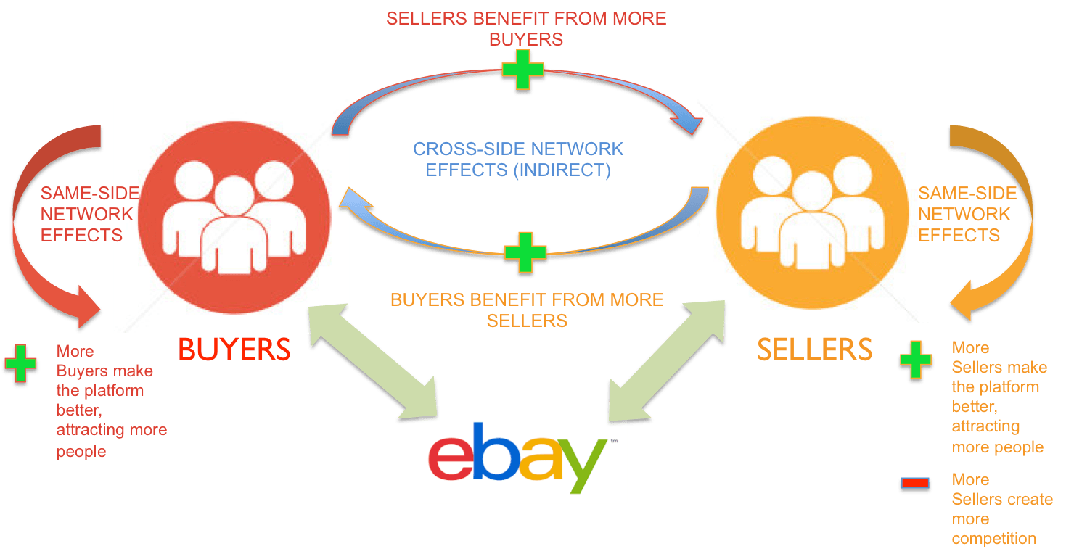
BA336: Essentials of Information Technology
Two-Sided
Two-sided marketplace
  Two distinct user groups
  Value increases as one side grows which makes it more attractive to the other side
Network effects are cross-side
  As one side grows, the plaform becomes more attractive to the other side
  Virtuous loop
Amazon, Uber, Airbnb, App Store, Etsy, Dating Apps, Visa
‹#›
Notes:
Similar to same-side exchange benefits, two-sided market place is referred to as cross-side exchange benefits
What about both?
X-box console is two sided, connecting game developers and game players
Xbox live is a product that sells to players only, one-sided.

Slide 45

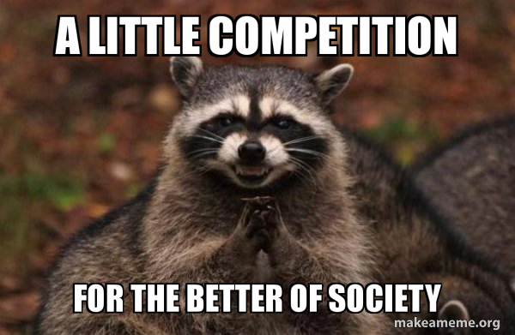
BA336: Information Systems and Technology
Why Late Movers Struggle In Network Effect Markets
Early competition is fierce as companies build marketshare
  Facebook, MySpace, Friendster, Hi5
  Aggressively trying to build the “network”
Once you’ve achieved market share, new users strongly favor the market leader
Switching costs for social media users?
This can lead to monopoly like power and behavior
  Microsoft, Google, Amazon (Amazon Basics), Facebook
‹#›
Notes:
Fierce because companies know the benefits.
Difficulty breaking in
Sticky products
Cost of switching

Slide 46

BA336: Information Systems and Technology
Examples of Monopoly Like Behavior
Amazon
  Accused of using seller data to launch competing products (Amazon Basics)
Facebook
  Acquiring IG and WhatsApp = large share of attention gives ability to control the flow of news.
  Acquiring potential rivals before they are rivals
Google 90% of global search
  Favoring Google products in search results
‹#›

Slide 47

BA 336: Essentials of Information Systems
The Story of Zoom
Example of technological leapfrogging
New entrant in a Network Effect market
WebEx, owned by Cisco, owned the enterprise market (57 billion revenue)
How did Zoom win?
‹#›

Slide 48
BA 336: Essentials of Information Systems
How to Compete in a Network Effects Exist
Move early
Subsidize adoption
Leverage viral promotion
Redefine the market
Build alliances and partnerships
‹#›

Slide 49
In-Class Excel Practice

Slide 50
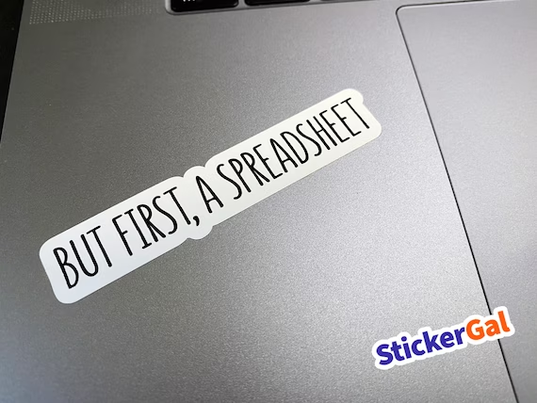
The End…

