Slide 1

URUI
JSP project
201607058 이시헌
ALLPPT.com _ Free PowerPoint Templates, Diagrams and Charts

Slide 2

목차
소개
2. 흐름도
3. DB 설계
4. 기능 소개

Slide 3


Slide 4
흐름

Slide 5
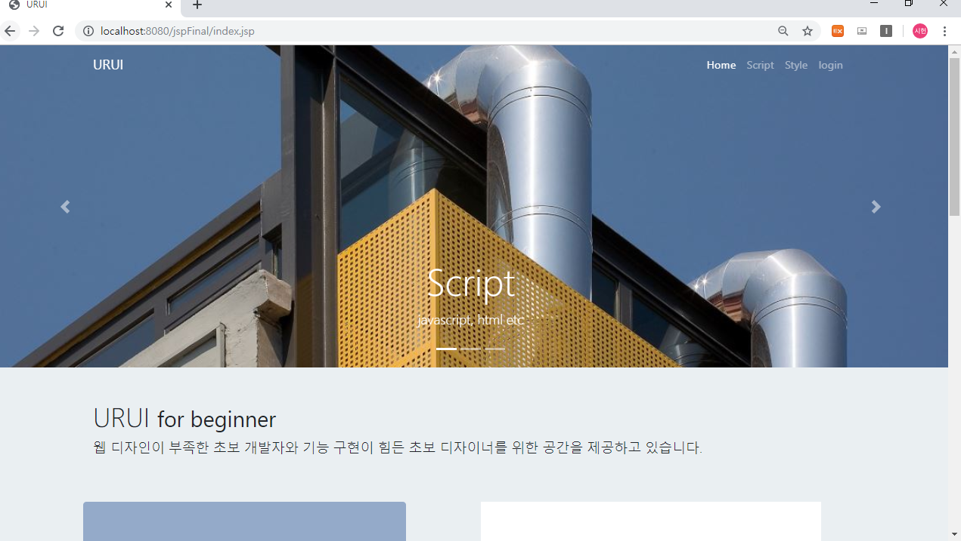
Index.jsp ,index_bottom.jsp

Slide 6
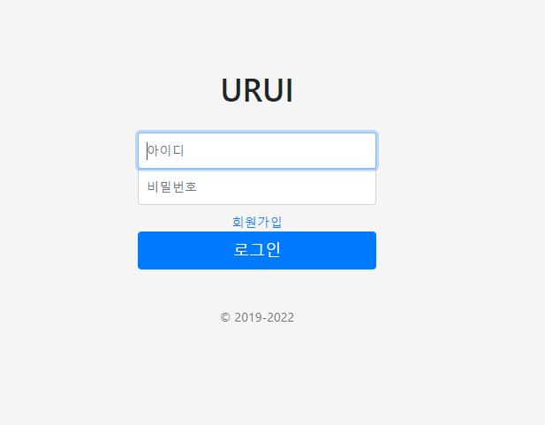
Login.jsp
LoginAction.jsp

Slide 7
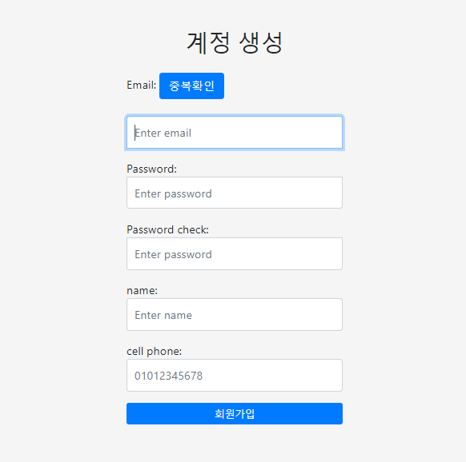
join.jsp
confrim.jsp
confrimAction.jsp
joinAction.jsp

Slide 8



Slide 9
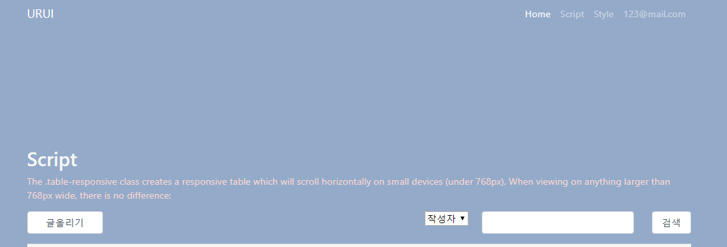
board.jsp
search.jsp

Slide 10
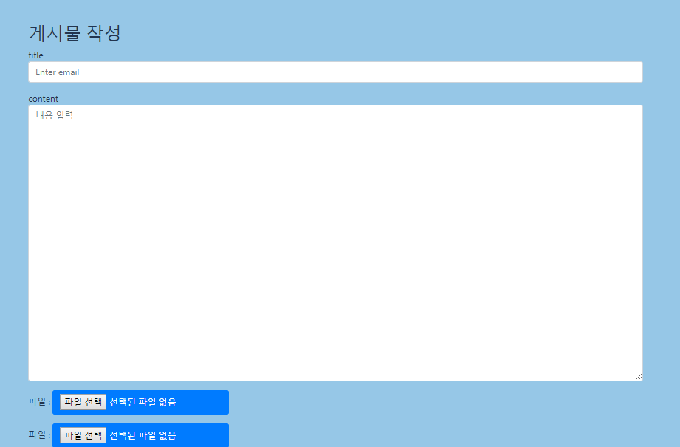
boardForm.jsp
upload.jsp

Slide 11
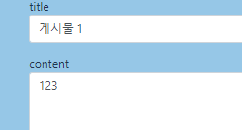
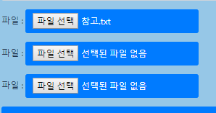

Slide 12
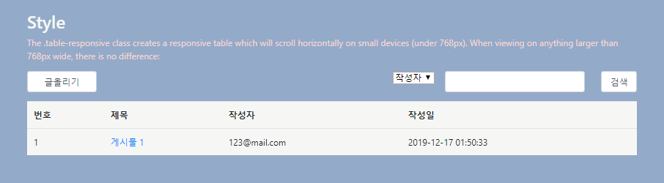

Slide 13
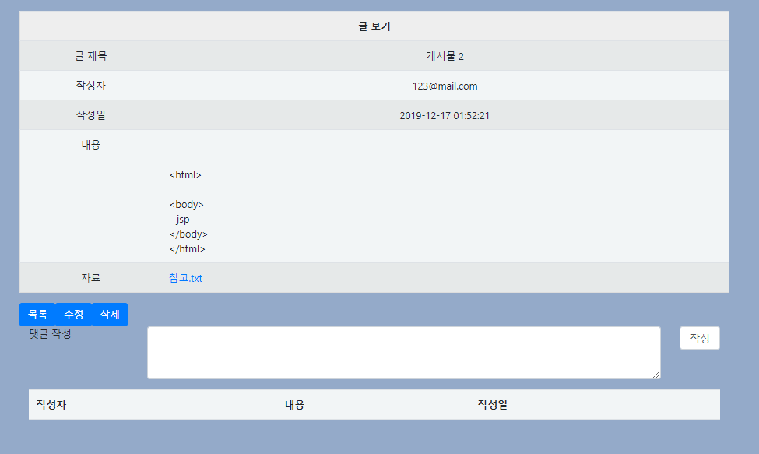
view.jsp
update.jsp
updateAction.jsp
delete.jsp
uploadReply.jsp

Slide 14



Slide 15
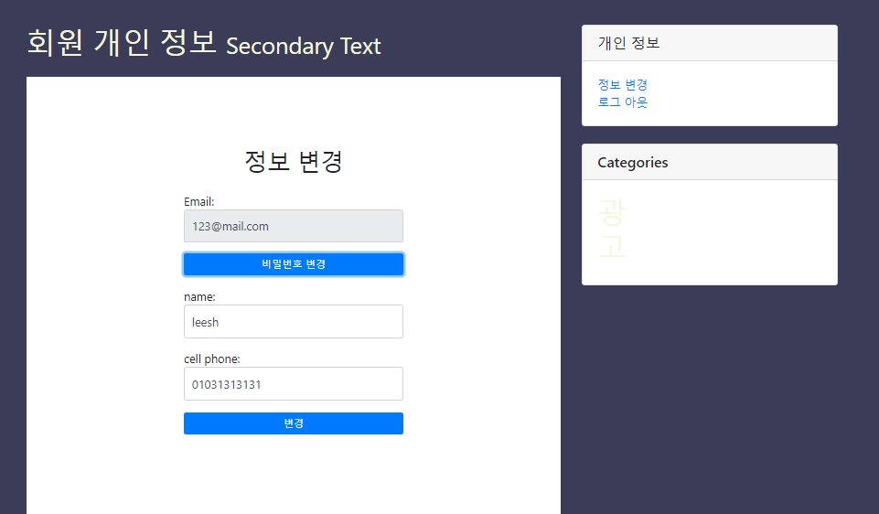
userInfoAction.jsp
userInfo.jsp
logout.jsp

Slide 16
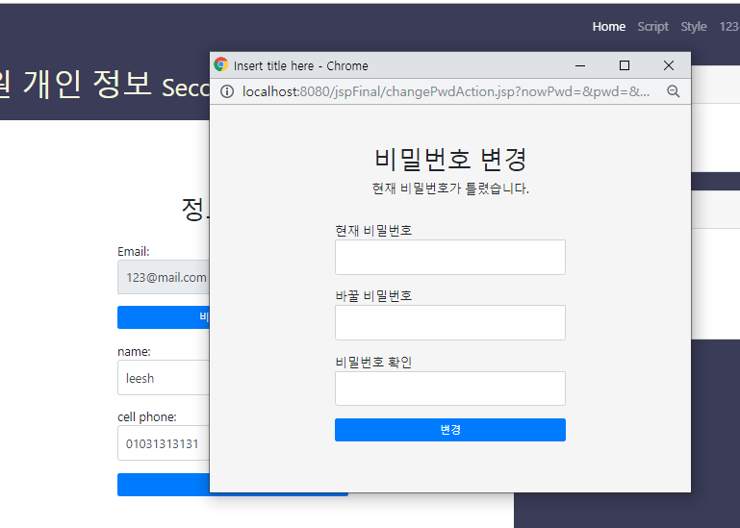
alterForm.jsp
alterFormAction.jsp
checkPwd.jsp

Slide 17
DB 설계

Slide 18
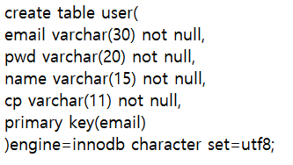

Slide 19
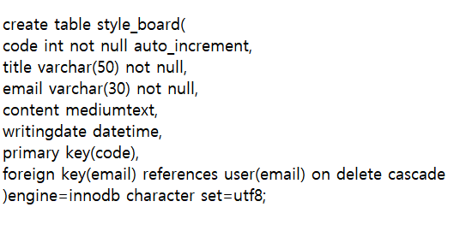

Slide 20
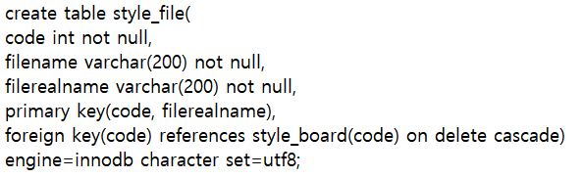

Slide 21
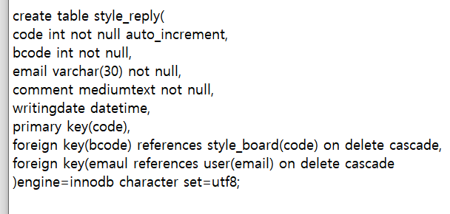

Slide 22
기능 소개

Slide 23
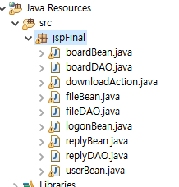

Slide 25
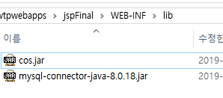

Slide 26



Slide 27

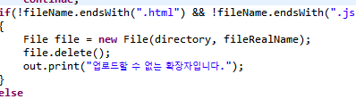

Slide 28
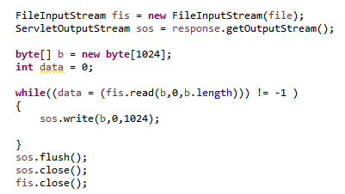


Slide 29


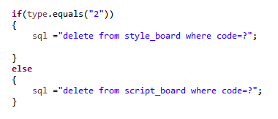

Slide 30
질문

Slide 31
THANK YOU
ALLPPT.com _ Free PowerPoint Templates, Diagrams and Charts

