Slide 1
UnrealCourse.com Section 2 Slides - Bull Cow Game
<< To Section 1 | To Section 3 >>
These are the slides that accompany the Complete Unreal Developer Course.
See me develop the slides as I write the course…
Right click or Insert > Comment to comment, especially if you see a typo
The slides will update immediately as I change things.
Enjoy your stay!
Ben Tristem

Slide 2
Intro, Notes & Assets

Slide 3
In This Video...
Welcome to the first actual coding video.
Why we’re doing this in the IDE only.
What you’ll be building, see resources.
You’ll learn types, loops, routines, classes.
We’ll follow Unreal’s coding style, and re-use.
Notes and resources are attached.
Notes:
http://www.papg.com/word-bullcow.html

Slide 4
Bull Cow Game Overview

Slide 5
In This Video...
You will be getting comfortable with Visual Studio
You write your first C++
We’ll have a simple and fun console game
You’ll be ready to dive into Unreal.
Notes:
http://www.papg.com/word-bullcow.html

Slide 6
Game Design Document (GDD)

Slide 7
In This Video...
How much planning should we do?
Define the emotional problem the game solves*
Choose concept, rules & requirements.
Start to think about the architecture.
Copy as much as possible into the code!
Document now what may change later.
* McConnell, Steve. Code Complete. Microsoft Press 2004. Chapter 3.3

Slide 8
The Problem
I want a mental challenge.
I want to feel smart.
I miss word puzzles.
I want to prove myself.
I want to challenge (feel superior to) someone!
Etc

Slide 9
Concept & Rules
This is a “guess the isogram” game.
An isogram is a word with no repeating letters.
The user has a limited number of guesses.
After each guess the computer outputs…
Bull = right letter in the right place.
Cow = right letter in the wrong place.
You win by guessing the word within max tries.

Slide 10
Write Up The Requirements
What will the inputs be? In what format?
What will the outputs be?
What tasks will the user be asked to do?
Any performance limits worth mentioning?
What assets (art, sound, story text) do we need?

Slide 11
Requirements
Plain text instructions for all interactions.
Code to help the player make a valid guess (e.g. all lowercase, an isogram, right length).
Code to check the number of Bulls and Cows in the guess, compared to the hidden word.
Code to keep track of the number of valid guesses.

Slide 12
Possible Future Ideas (The NO List)
Give feedback on every key press.
Have a large dictionary of hidden words.
User selectable word length, and difficulty.
Checking the user’s guess is a dictionary isogram.
Providing a time limit for the guesses.
A hint system, spend a turn for a hint.

Slide 13
How Solutions & Projects Relate

Slide 14
In This Video...
How projects and solutions relate.
Setting up a new command line project.
An overview of the structure of our solution.
(Adding main.cpp to our project).

Slide 15
How Projects & Solutions Relate
SOLUTION
PROJECT 1
PROJECT 2

Slide 16
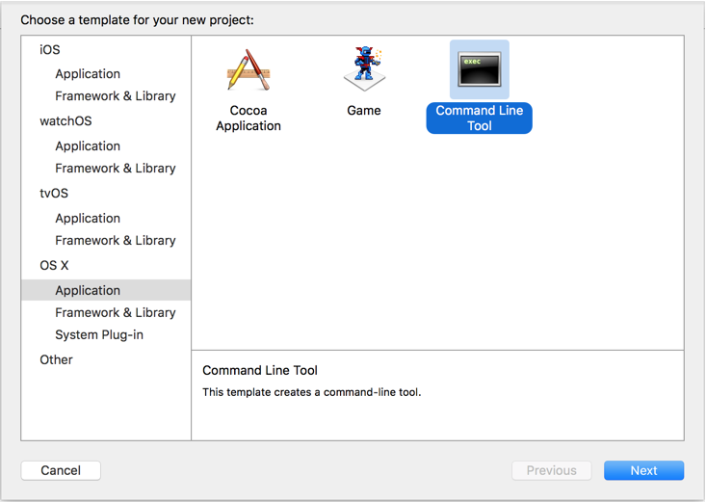
Creating the project in Xcode

Slide 17
Setup Your Project
You want to end up with…
UnrealCourse > Section_02 <= section / solution
Section_02 > BullCowGame <= project folder
BullCowGame > BullCowGame.vcxproj
BullCowGame > main.cpp

Slide 18
C++ Function Syntax

Slide 19
In This Video...
The difference between an engine and a library.
How this relates to this console application.
What is building / compiling code?
How the console knows where to find our code.
The syntax of a function in C++.
Write the minimal C++ program to remove error.
Testing our application runs without error.

Slide 20
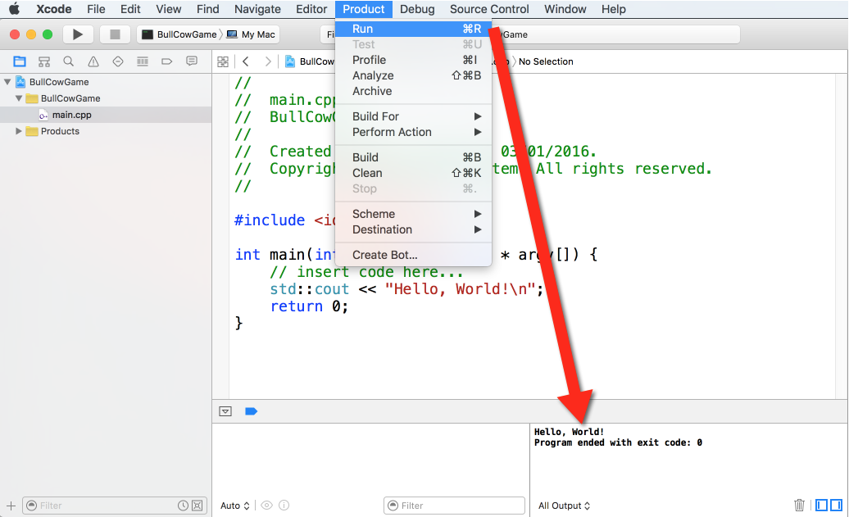
Building (running) in Xcode

Slide 21
The syntax of a function in C++
int DoubleMe(int number)
{
return number*2;
}
<return_type> <name> (<parameters>)
{
<statements>
}

Slide 22
Write the minimal C++ program
Return type is int (short for integer).
Function name is main (lowercase m).
Takes no parameters.
Extra credit: make it return 0.
Test by running and see if the error goes away.

Slide 23
Using, #include and Namespaces

Slide 24
In This Video...
# represents a “preprocessor directive”.
#include copies-and-pastes other code.
The idea of using library code.
Use <> for standard libraries.
Use “ “ for files you have created yourself.
Notice the namespace icon in autocomplete.
Import iostream library and use std namespace.

Slide 25
Using cout vs printf()
There are pros and cons.
You’ll see both in other people’s code.
Read more at the link below.
http://stackoverflow.com/questions/2872543/printf-vs-cout-in-c

Slide 26
Use the std namespace
Make appropriate use of the using statement.
Test by removing std:: prefix from your cout.
Explain the risk in the discussions.

Slide 27
Magic Numbers and Constants

Slide 28
In This Video...
What a “magic number” is.
Why it’s a good idea to avoid them.
constexpr means “evaluated at compile time”.
Introduce coding standards*.
Use a constant for the word length.
*https://docs.unrealengine.com/latest/INT/Programming/Development/CodingStandard/index.html

Slide 29
Include word length in intro
Include the WORD_LENGTH in the intro text.
Make sure it prints with spaces properly.

Slide 30
Variables and cin for Input

Slide 31
In This Video...
The difference between \n and endl
Introducing pseudocode programming
Why we need to #import <string>
Getting input using cin
Discovering woes with our input buffer.

Slide 32
Take and repeat back the guess
Ask the user for their guess.
Use cin to take guess on the same line.
On the next line, repeat back the guess.

Slide 33
Using getline()

Slide 34
In This Video...
Re-cap the problem we have.
Why getline() is useful here.
Where to find C++ documentation.
A word on non-obvious solutions.

Slide 35
Why getline() is useful here
It will read through any spaces by default.
It will discard the input stream once it reaches the new-line character.
Read about it by searching for getline at www.cplusplus.com.
Find out about this sort of thing by

Slide 36
Fix the input problem
Replace both cin lines.
Test that donkey kong is accepted as a guess.

Slide 37
Simplifying With Functions

Slide 38
In This Video...
Programming is all about managing complexity.
We want to think about a few things at a time.
The idea of abstraction and encapsulation.
How functions help us simplify.
Write and call your first functions.
A warning about “side-effects” of functions.
Always use return at the end of your functions.

Slide 39
Abstraction and encapsulation
A major goal in writing software is to manage complexity.
Abstraction is a technique for managing complexity, by considering things at a higher level.
Encapsulation is a way of making sure your abstractions are adhered to.

Slide 40
return in a void functions - pros
Makes you think about where you leave the function.
It's consistent with code Visual Studio creates for you.
You can return earlier than the end (for example an error check fails).

Slide 41
return in a void functions - cons
It's extra code, and less code is generally better.
Somebody may write statements below it later, which never get executed.

Slide 42
Write string GetGuess()
Save your code so you can go back.
Write a function to get the Guess
return it as a string.
Restore your code to its former working glory.

Slide 43
Iterating With For & While Loops

Slide 44
In This Video...
Why we need loops.
When to use for vs while.
The syntax of a for loop.
Think carefully about the first & last loop.
Write a for loop to repeat the game.

Slide 45
When to use for vs while
Pick a standard to keep yourself sane, e.g.
“Know what you’re in for” - you know at compile time how many times it will loop.
“May be looping for a while” - you’re not sure how many times it will loop.

Slide 46
The syntax of a for loop
for (initialization; condition; increase)
statement;
for (int count = 1; count <= limit; count++)
{
<the code you want to repeat>
}
http://www.cplusplus.com/doc/tutorial/control
https://msdn.microsoft.com/en-us/library/b80153d8.aspx

Slide 47
Make the game take 5 guesses
Use what you’ve learnt so far to make the game take 5 guesses in a row.
GetGuess() should appear as a function call only once inside a for loop.
Bonus: remember what I said about magic numbers.

Slide 48
Clarity is Worth Fighting For

Slide 49
In This Video...
More about levels of abstraction.
A word on being clever.
Using Visual Studio’s Extract “Extract Function”
What a header file (.h) is.
What’s refactoring, and why we do it.
Removing side-effects.
Where to find the course code on GitHub.

Slide 50
An aviation quote...
“Truly superior pilots are those who use their superior judgment to avoid those situations where they might have to use their superior skills.”

Slide 51
Remove the side-effect
Rename the GetGuessAndPrintBack().
Move the offending code.
Test it all still works.
Are you very happy with how your code reads?

Slide 52
booleans and comparisons

Slide 53
In This Video...
What a boolean is, and how to use it.
Only use when completely clear what you mean.
Use == for comparison.
Use && for logical AND.
Use || for logical OR.
Use [n] to access a string, starting at n=0.
Use ‘ ‘ for characters, and “ “ for strings.

Slide 54
Write rest of AskToPlayAgain()
Allow for ‘y’ or ‘Y’ as the first letter.
You can ignore the rest of the letters.
Return true for for yes, false for no*
* This is on the limit of what’s “obvious”.

Slide 55
Using do and while in C++

Slide 56
In This Video...
What a do while loop is.
How it executes code one or more times.
Making our game play multiple times.

Slide 57
The syntax of a do while loop
do {
<the code you want to repeat>
}
while (condition);
The code gets executed once before the check.
http://www.cplusplus.com/doc/tutorial/control
https://msdn.microsoft.com/en-us/library/b0kk5few.aspx

Slide 58
Make the game play multiple times
Put a do while loop in main.
Refer to example on previous slide for syntax.
Test you can play as many times as you like.

Slide 59
Introducing Classes

Slide 60
In This Video...
Lookup the Turing machine.
A quick overview of the MVC pattern.
User defined types (classes).
About working at an interface level (black box).
An overview of class FBullCowGame

Slide 61
Read around the topic
Read around these topics…
Model View Controller (MVC) pattern.
Turing machines (e.g. Computerphile on YouTube).

Slide 62
Using Header Files as Contracts

Slide 63
In This Video...
Introducing .h header files in C++.
Why the added complexity is worth it.
Defining the interface to our class.
Writing our first draft of FBullCowGame.h

Slide 64
Write all the methods you can
Write as many simple signatures as you can
Don’t worry about getting it “right”
There is no right anyway, the point is to think
Enjoy working at a higher level.

Slide 65
Including Our Own Header File

Slide 66
In This Video...
NEVER use using namespace in a .h
In fact, why use it at all?
Create your .cpp files and #include
Don’t create chains of includes.

Slide 67
Finish writing blank definitions
Write blank definitions for all methods.
Ensure there are no warnings in the .h file.

Slide 68
Instantiating Your Class

Slide 69
In This Video...
Relax, they’re just user defined types!
string FirstName; creates a string object
FBullCowGame BCGame; works the same way
These instances are initialised by “constructors”
Instantiating means “creating an instance of”
So we’re simply creating a game instance.

Slide 70
Create a BCGame instance
Make it the first line of PlayGame() for now
Declare a new object called BCGame
Make its type FBullCowGame
Don’t worry about “initialising” it yet
Make sure your code still runs.

Slide 71
Writing & Using Getter Methods

Slide 72
In This Video...
What is a getter method
Why we never access variables directly
How to call a method using the dot operator
Pros and cons of initialising in at compile time
Using “Rebuild Project” to make VS behave!

Slide 73
Implement GetCurrentTry()
Initialise the value to 1 in the header file (for now)
Check it works by printing the try from GetGuess()
For example: “Try 1. Enter your guess: “
where 1 is the value of MyCurrentTry.

Slide 74
Introducing the const Keyword

Slide 75
In This Video...
const’s meaning depends on context
Generally means “I promise not to change this”
What this is depends on exactly where it appears
At the end of a member function, for example int GetCurrentTry() const; it prevents the function from modifying any member variables
This is a good safety feature.

Slide 76
Apply const to all your getters
Make all getter methods const
Check it still runs
Are any of the other functions we’ve written so far candidates for the use of const? If so please suggest which (if any) in the discussions.

Slide 77
Constructors For Initialisation

Slide 78
In This Video...
Default constructor called when object created
Initialize in constructor when decided at runtime
Initialize in declaration if known at compile time
Constructor syntax simply: ClassName();
Set the member variables in constructor
Test this has worked.

Slide 79
Write and test Reset()
Initialise all the member variables
Set the max tries to 8
Use the appropriate constant for the magic #
Check that it works by using cout as needed.

Slide 80
Pseudocode Programming

Slide 81
In This Video...
More on Pseudocode Programming Practice (PPP)
Reviewing our code and architecture
Using // TODO as a comment prefix
Introducing Visual Studio’s Task List
Planning our next wave of coding.

Slide 82
Write your own notes and TODOs
Go through your code, make sure it makes sense
Action any existing TODOs that you can
Write any new TODOs for tasks that must be done
Do NOT use code in these comments
Give yourself the gift of working at a higher level.

Slide 83
Using using for Type Aliases

Slide 84
In This Video...
We’re substituting types to be “Unreal ready”
The declaration is using <alias> = <type>;
For example using int32 = int;
Why Unreal uses int32 rather than int
FText is for output, FString is “mutable”
Where to use each type of string
Map FText and FString to std::string

Slide 85
Substitute the integer type
Convert all integers to use the int32 alias
Exclude int main() as this is called by the OS
Explicitly substitute at top of file, not via include
Test your code still runs and reads well.

Slide 86
Using struct for Simple Types

Slide 87
In This Video...
struct is almost identical to class
It’s member variables (data) is public by default
Ideal for simple value types like BullCowCount
Outline BullCowCount SubmitGuess(FString)

Slide 88
Pseudocode the function
Write out the “algorithm” for the function.
Make your best effort.
Avoid the use of any code.
Indent comments inside any loops.

Slide 89
Using if Statements in C++

Slide 90
In This Video...
Why we need conditionals (selection)
Use if when it reads better (e.g. few conditions)
Use switch for multiple, simple conditions
(for loads of statements consider a table lookup)
The syntax of an if statement
Using if to write count bulls and cows.

Slide 91
if syntax
if (condition1) {
statements;
} else if (condition2) {
statements;
} else {
statements;
}
Note this is slightly more compact than Unreal’s coding standards.

Slide 92
Finish SubmitGuess() and test
Finish the function
Test it works as expected
Celebrate your coding ninja skills
Hint: You will need a variable name for Guess
So change to: SubmitGuess(FString Guess)
Hint 2: Second character with Guess[1]

Slide 93
Debugging 101

Slide 94
In This Video...
A very brief intro to Visual Studio’s debugger
Set a break-point by clicking in margin
Watch values by highlighting in debug mode
Use “Continue” to cycle back to breakpoint.

Slide 95
Squash the bug
Fix the bug
That’s it.

Slide 96
A Place for Everything

Slide 97
In This Video...
Centralising the hidden word length
Making this a property of the game class
Writing a getter to access this value
Updating our intro to vary with word length.

Slide 98
A Place for Everything
“A place for everything, everything in it’s place”
Think carefully about what you store
General bandwidth vs. storage
Another example CPU vs. RAM
For example store birthday not age
Until proven otherwise, don’t store results*
http://gameprogrammingpatterns.com/data-locality.html

Slide 99
Replace WORD_LENTGH
Write GetHiddenWordLength() getter
Make it read from the current word length
Do not create another member variable
Replace WORD_LENGTH in PrintIntro()
Test with different hidden word lengths.

Slide 100
Introducing enumerations

Slide 101
In This Video...
An enumerated type consists of named values
Use instead of coded meaning
Makes the code more readable and meaningful
Only defined values can be used - more robust
A benefit of C++ 11’s strongly typed enums
Creating an enum class for error checking.

Slide 102
Finish the error value list
Write at least two more error values
Think about what could break the game
… or try weird input and see what DOES break

Slide 103
Writing Error Checking Code

Slide 104
In This Video...
Use else if for the first time
Outline or CheckGuessValidity() method
Write working code for checking guess length
Use the debugger to test the return values.

Slide 105
Write the word length check
No need to call any “helper methods”
Use != for “not equals”
Call GetHiddenWordLength()
Test the value using the debugger.

Slide 106
Using switch Statements

Slide 107
In This Video...
Use our error values to communicate with user
All our user interaction is via GameManager.cpp
We’ll use FText in this file, as it’s UI text
We can “switch” what we say based on the error
The syntax of a switch statement
Remember your break keywords!

Slide 108
switch statement syntax
switch (expression) // expression is what we switch based on
{
case constant1:
statement(s);
break;
case constant2:
statement(s);
break;
default:
statement(s);
}

Slide 109
Write the rest of the errors
Write a message to the user for each error
Tell them how to get it right next time
Remember your break statements!
Test the console output for wrong word length.

Slide 110
Warm Fuzzy Feelings

Slide 111
In This Video...
Don’t get comfortable with compiler warnings
Refactor GetValidGuess() to remove warning
Rename SubmitGuess() to SubmitValidGuess()
Improve readability of SubmitValidGuess()
Get a warm fuzzy feeling!

Slide 112
Try and remove the warning
Try and remove the warning
Check your code still runs
Watch my suggested method.

Slide 113
Handling Game Win Condition

Slide 114
In This Video...
Change our PlayGame() loop to a while
Implement our IsGameWon() function

Slide 115
Finish IsGameWon()
Define the appropriate getter method
Create a private variable, prefixed with b
Set the private variable in SubmitValidGuess()
Test you can now win the game.

Slide 116
Win or Lose "Screen"

Slide 117
In This Video...
Write a method to print a game summary to the screen once the game is over.

Slide 118
Define PrintGameSummary()
Arrange for a “You won / bad luck” message
Decide where in the program it goes
Write a function for it
Test it works.

Slide 119
Introducing Big O Notation

Slide 120
In This Video...
Algorithm: the recipe for solving a problem
or: 45th US Vice President’s dance style
Introducing the complexity of algorithms
A quick introduction to “Big O” notation
Comparing three ways of checking for isograms.

Slide 121
What order is IsIsogram() at best?
Vote for O(n), O(n log n) or O(n^2)
Share your vote in the discussions
Explain why you think that’s as fast as possible
Carry on watching.

Slide 122
Further reading
http://stackoverflow.com/questions/9107516/sorting-characters-of-a-c-string
http://en.cppreference.com/w/cpp/algorithm/sort
http://www.wolframalpha.com/input/?i=n%5E2+vs+%28n+log+n%29+vs+n%2C+n%3D2+to+17
https://en.wikipedia.org/wiki/Sorting_algorithm
https://en.wikipedia.org/wiki/Big_O_notation
https://en.wikipedia.org/wiki/Isogram

Slide 123
TMap and std::map Data Structure

Slide 124
In This Video...
The importance of knowing your data types
Introducing the std::map data type
#define TMap std::map to keep it ‘Unreal’
How we’ll be using the map
Wiring-up and pseudocoding IsIsogram().

Slide 125
How we’re using a map...
Using the word hApPy as an example...
Key | Value | Note
h | true
a (translated from A) | true
p | true
p (translated from P) | true | return false;

Slide 126
“Wire-up” IsIsogram()
Create a private function
Decide if it should be const or not
Call it from CheckGuessValidity()*
Simply return true for now inside IsIsogram()
Hint: you may need a not ! operator.

Slide 127
Pseudocode IsIsogram()
Only write comments for now
Indent the comments as necessary
Avoid code in the comments, work at a high level
Run through mentally with some examples.

Slide 128
Range-based for Loop

Slide 129
In This Video...
Introducing containers and iterators
Using a range-based for loop in Unreal*
Gently introducing the auto keyword
Finishing our IsIsogram()
*https://www.unrealengine.com/blog/ranged-based-for-loops

Slide 130
std::map syntax
TMap<char, bool> LetterSeen; to declare
Using LetterSeen[Letter] to access
You can assign to the map element
e.g. LetterSeen[Letter] = true;
std::unordered_set or Unreal TSet is a valid alternative. Map is a more versatile.

Slide 131
Finish IsIsogram()
Finish the function
Test it thoroughly
Try entering just \0 as a guess
Try a blank string
Try mixed case e.g. Aa
Share your implementation in the discussions.

Slide 132
Design a Helper Function

Slide 133
In This Video...
Gain confidence with a multi-stage challenge
A word on implicit dependencies.

Slide 134
Get lowercase checking working
Declare and define IsLowercase() helper
Use a range-based for loop
Use the auto keyword
Handle strings of zero length, ‘\0’ and spaces
Hint: a method called islower() may help
Share your solution for discussion
Succeed of F.A.I.L. - pat yourself on the back.

Slide 135
Avoid Implicit dependencies
Implicit: suggested though not directly expressed.
Dependent: reliant on something else.
An implicit dependency is when it’s not completely clear that one thing depends on another. For example the order of checks in CheckGuessValidity().

Slide 136
Playtesting Your Game

Slide 137
In This Video...
Having someone else play test your game is vital
Silently take notes, or record screen if possible
Immediately go away and fix obvious bugs
For improvements consider 2nd or 3rd opinion
Repeat until the bug / issue rate plateaus.

Slide 138
Playtest the game
Find somebody else, Skype if needed
Share the bugs / improvements in Discussions
Make it clear which version you’re commenting on
Also play-test my game, download from…
https://github.com/UnrealCourse/02_BullCowGame/archive/master.zip

Slide 139
My playtesting actions (thanks Lizzie)
Remove new line before bull cow count
Tell user how many guesses they have left
All a bit “left brain”, needs some ASCII art
Spelling error in “Better luck next time!”

Slide 140
Difficulty & Play Tuning

Slide 141
In This Video...
About the flow channel*
map word length to max tries
Play test to determine correct difficulty.
* Read more in Sylvester, T. Designing Games - O’Reilly

Slide 142
Map word length to max tries
Populate your word length : max tries map
Do more play testing to find the “sweet spot”
Do this for at least 4-6 letter words
Optionally: let user select word length.

Slide 143
Polishing & Packaging

Slide 144
In This Video...
First impressions count (think reviews)
Don’t ship a half-baked product, even if digital
Check through your code (polish)
Ship to your customers (package).

Slide 145
Polish your game
Comment with “why”, remove obvious comments
Introduce your classes with block comments
Use #pragma once at the top of each file
Deal with or delete any TODO items
Capture future ideas / improvements.

Slide 146
Ship your game
Zip up source code (not .exe or .app) and share in discussions via DropBox, Drive, YouSendIt etc
Ensure code is in runnable state and archive
Celebrate your success - seriously.

Slide 147
Section Wrap-Up

Slide 148
In This Video...
HUGE congratulations on your progress
Over 6 hours of pure C++ learning
Over 30 challenges you’ve completed
The journey has only just begun
Share your source code for others to play
Here are some suggested improvements
Next we take the game logic into Unreal :-)

Slide 149
Suggested improvements
Easy, medium, hard which changes max tries
Explain what an isogram is in the text*
Define bulls and cows to the user*
Explain the rules of the game more fully*
* consider only doing these on the 1st play

Slide 150
Further Reading

Slide 151
Symbols In Your IDE
Meaning of symbol in autocomplete | VS 2015¹ | Xcode²
Class or Struct
Property or Field
Method or Function
Namespace
Macro e.g. UPROPERTY() or #include
https://msdn.microsoft.com/en-us/library/y47ychfe.aspx
http://stackoverflow.com/questions/6662395/xcode-intellisense-meaning-of-letters-in-colored-boxes-like-f-t-c-m-p-c-k-etc

Slide 152
Streams & Flushing
std::cout << std::endl; // Equivalent to...
std::cout << '\n' << std::flush;
http://www.cprogramming.com/tutorial/c++-iostreams.html
http://www.cprogramming.com/tutorial/c++-iostreams.html

Slide 153
Parameter vs. Argument
They are two sides of the same coin
They often get used interchangeably, but strictly...
You define parameters
You call with argument(s)
http://stackoverflow.com/questions/156767/whats-the-difference-between-an-argument-and-a-parameter

Slide 154
Unreal Coding Standards
We will use a slightly different { } strategy.
This is to save vertical space on the screen.
Otherwise we’ll generally stick to these*
*https://docs.unrealengine.com/latest/INT/Programming/Development/CodingStandard/index.html

Slide 155
Unreal’s TSet & std::unordered_set
“Unordered sets are containers that store unique elements in no particular order, and which allow for fast retrieval of individual elements based on their value.”
This is ideal alternative for our SeenLetters container. Thanks to Daniel for bringing this up.

Slide 156
Braced Initializers
int32 AgeInYears {24}; initialisation syntax
Prevents “narrowing conversions” e.g.
int32 AgeInYears {24.3}; ⇐ error
int32 AgeInYears = 24.3; ⇐ narrows to 24
Defaults to the right empty value
e.g. char PreviousChar {}
Compatible with lists and other containers.

