Slide 1
Section 4 Slides - Battle Tank
<< Back To Section 3 | To Section 5 >>
These are the slides that accompany the Complete Unreal Developer Course.
See me develop the slides as I write the course…
Right click or Insert > Comment to comment, especially if you see a typo
The slides will update immediately as I change things.
Enjoy your stay!
Ben Tristem

Slide 2
Intro, Notes & Assets

Slide 3
In This Video…
Battle Tank is an open world tank fight
This will be a head to head battle
Other players can be human or simple AI
Heavy focus on control systems
Also learning terrains, UI, terrain sculpting & more
Dive right in and enjoy yourself!

Slide 4
Research Tank Games
Watch at least 1 YouTube video of a tank moving
Watch at least 1 YouTube video of a tank game
Play World of Tanks (free, multi-platform)
Take notes on controls, features & challenges
Share your notes with us.

Slide 5
Battle Tank Overview

Slide 6
In This Video…
An overview of the finished Battle Tank project.

Slide 7
Game Design Document (GDD)

Slide 8
In This Video…
The Concept, Rules and (initial) requirements
We’ll iterate around a loop while making this game
Constantly asking “what’s least fun”
Remember we’re not AAA studios
Let’s find the essence of fun of this game.

Slide 9
Concept
Tank battle is an open-world head-to-head tank combat game.
The terrain will be used for tactical advantage.
The focus will be on flow and feel.

Slide 10
Rules
You can move anywhere in the terrain, which is surrounded by mountains
Both players start with finite health and ammo
​Each direct hit takes away health
The last player standing wins.

Slide 11
Requirements
SFX: Gun firing, explosion, barrel moving, turret moving, engine sound.
Static mesh: Simple tank comprising tracks, body, turret and barrel.
Textures: Later-on we’ll want to add for visual flare.
Music:​ Background music to create tension.

Slide 12
Our Iterative Cycle
World
UI
Tank
Player 2
Controls

Slide 13
Write & Share Your GDD
Write your understanding of the Concept
Write out the Rules you can think of
List the asset Requirements (graphic, sound, etc)
Share your work with us.

Slide 14
Setting Up a GitHub “Repo”

Slide 15
In This Video…
Creating an online repository for your project
GitHub provides public hosting for free
We will use their default UnrealEngine .gitignore
We’ll then “clone” this repository to our machine
How to use a readme.md with markdown*
https://daringfireball.net/projects/markdown/basics

Slide 16
Setup Your Remote Repo
Setup a repo on GitHub (or BitBucket)
Write your first readme.md
Why not include your GDD in there?
Share the repo link with us.

Slide 17
Creating & Deleting Landscapes

Slide 18
In This Video…
Creating an Unreal project in an existing “repo”
What’s good about Landscapes in Unreal Engine
How to add a Landscape in Unreal
How to delete a Landscape in Unreal.

Slide 19
What’s Good About Landscapes
⅙ or less of storage of Static Mesh
Supports Level Of Detail (LOD) & streaming
Up to 8196x8196 heightmaps for import*
Good built-in tools for sculpting
Work well with mini-maps
* For example Terragen or World Machine

Slide 20
Our Iterative Cycle
World
UI
Tank
Player 2
Controls

Slide 21
Try and Add a Landscape
See if you can find where to add it
Start without using a web search or docs
Use any settings, we’ll delete and re-add
Share how long it took you to find.

Slide 22
Landscape Setup & Scaling

Slide 23
In This Video…
You can change position & rotation later
Scale will impact terrain size, so set on creation
How to choose your “Section Size”
The effect of the “Number of Components”
Creating a landscape of a specific scale.

Slide 24
Create Your Landscape
Make it about 1000m square
Make each quad 0.5m in size
Use 8x8=64 components (like a chess board)

Slide 25
A Landscaping Process

Slide 26
In This Video…
Sculpt: hills, valleys & flat areas
Smooth, flatten & ramp: create useful features
Erosion & noise: make it more organic
Paint: use layered materials
Details: add details (foliage, trees, etc)

Slide 27
Create your Version 1 Landscape
Remember you’ll iterate again later
Keep it simple but believable looking
Have a 500x500m flat area in the middle for now
This will allow simple movement & raycast testing.

Slide 28
Upgrading Engine Version

Slide 29
In This Video…
Epic games launcher helps manage versions
Remember to commit your project first
You can then “Convert in-place”
Check your project runs OK in new version
Close everything and re-commit
How to tag a commit in GitHub.

Slide 30
What’s New in Unreal 4.11
Relevant to us at the moment…
Faster lighting build times
Runtime performance enhancements
For a full list of improvements...
https://www.unrealengine.com/blog/unreal-engine-4-11-released

Slide 31
Upgrade Your Project
Go through the upgrade process
Ensure the new project runs ok
Commit the changes
Optionally: tag the specific commit with “v.4.11”

Slide 32
Using Landscape Layers

Slide 33
Paint Your Landscape
Create a material for your landscape
Set Usage > Used with Landscape
LandscapeLayerBlend node & Vector Parameters
Add at least two layers & create LayerInfo
Paint the landscape from the Modes tab
Screenshot and share with us.

Slide 34
Flat Shading Low Poly Landscapes

Slide 35
In This Video…
Unreal’s tools are setup for photoreal landscapes
Once you set the bar high, the rest must match
An alternative is to opt for a low-poly look...
...then you can focus on gameplay, story, sound
Can be a good choice for smaller teams
How to make low-poly, flat-shaded landscapes.

Slide 36
Choose Your Final Landscape Style
Decide which route you want to pursue
If high-poly, use this time to tweak
If low-poly, then create your initial landscape
Remember to leave a flat area in the middle.

Slide 37
More Landscaping Tools

Slide 38
In This Video…
How to make flat shading optional
Importing and exporting landscape heightmaps
Reducing the resolution of a landscape
Using a texture in a landscape material.

Slide 39
Try Adding a Texture
Add a texture to your high (or low) poly landscape
Paint & share

Slide 40
Tank Control System

Slide 41
In This Video…
Support keyboard, mouse & gamepad controller
Mapping player intentions to control inputs
Mapping control inputs to actor actuators
Introducing the concept of “fly by wire”.

Slide 42
Our Iterative Cycle
World
UI
Tank
Player 2
Controls

Slide 43
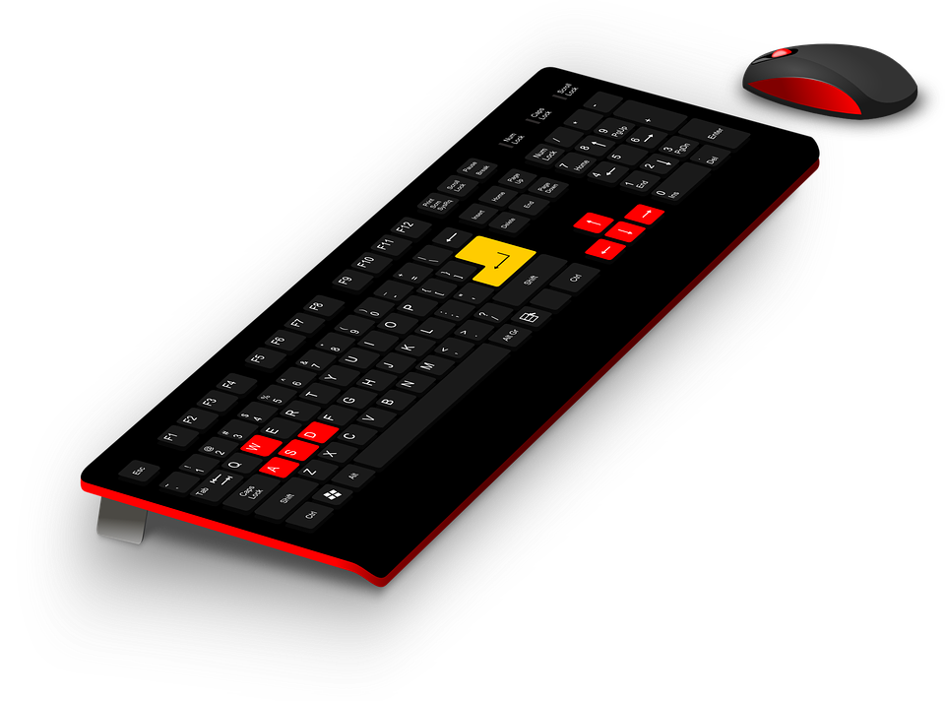
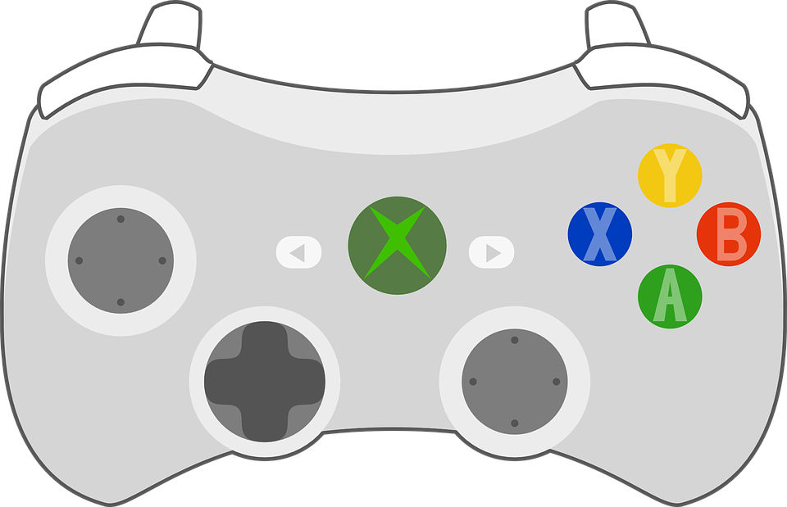
Control Inputs

Slide 44
Major Tank Components

Slide 45
Virtual Control & “Fly-by-wire”
Intention | Manual Control | Fly-by-Wire Control | Actuator(s)
Forward | Symmetric Triggers | Left Stick Forward or W Key | Both Tracks Forward - Same Speed
Backwards / Braking | Symmetric Bumpers | Left Stick Backward or S Key | Both Tracks Backwards - Same Speed

Slide 46
Complete the Control Table
Finish this control intention table
There is no right or wrong here
The idea is to think through the consequences
Fly-by-wire controls only on KB / mouse
Manual control only with controller.

Slide 47
Virtual Control & “Fly-by-wire”
Intention | Manual Control | Fly-by-Wire Control | Actuator(s)
Forward | Symmetric Triggers | Left Stick Forward or W Key | Both Tracks Forward - Same Speed
Backwards / Braking | Symmetric Bumpers | Left Stick Backward or S Key | Both Tracks Backwards - Same Speed
Strafe | N/A | N/A | N/A “You Can’t Strafe a Tank Fool”
Rotate Body | A-Sym Triggers / Bumpers | Left Stick Left / Right or A/D Keys | Tracks - Different Speeds
Rotate Turret | N/A | Look & Aim with Right Stick or Mouse | Turret Rotator
Elevate Barrel | N/A | Look & Aim with Right Stick or Mouse | Barrel Elevator

Slide 48
Actors from Multiple Meshes

Slide 49
In This Video…
Import the tank in 4 static mesh parts
Assemble the parts using sockets
Create our Tank_BP and test.

Slide 50
Import the Barrel
Import the .fbx file
Create a socket on the turret (eyeball position)
Create a child of turret in Tank_BP
Link to the barrel mesh and set socket
Check it all looks and rotates ok.

Slide 51
Configuring a Tank

Slide 52
In This Video…
Add mass to the tank
Fine-tune track position
Replace root component in Tank_BP
Enable physics and assign a mass
Set the tank as the Default Pawn
Setup PlayerStart and debug start collisions.

Slide 53
Set Tank_BP as Default Pawn
Create a BattleTankGameMode_BP
Assign the tank as the Default Pawn
Check the correct tank spawns on play.

Slide 54
3rd Person Camera Control

Slide 55
In This Video…
Horizontal Coordinate System*
Setup a Camera Spring Arm
Why the Spring Arm alone isn’t enough
How rotations don’t “commute”
Binding mouse and gamepad to camera control.
*https://en.wikipedia.org/wiki/Horizontal_coordinate_system

Slide 56
Bind AimElevation in Blueprint
Use the AimAzimuth as a template
Setup corresponding binding for elevation
Test it works

Slide 57
Fixing 3rd Person Camera Rotation

Slide 58
Setup Your Camera
Use a Scene Root as azimuth gimbal
Use the Spring Arm for elevation control
Adjust the Spring Arm length
Set the camera rotation to 0 (down the arm)
Decide if you want the camera to roll or not.

Slide 59
User Interface (UI) in Unreal

Slide 60
In This Video…
Create a Widget Blueprint for the aim point
Decide the Player Controller with create the UI
Create widget and add to viewport in Blueprint
Override the Player Controller in the game mode.

Slide 61
Set the Player Controller
Find the game mode blueprint for this level
Set the Player Controller to be our new BP class
Test the aiming dot shows up.

Slide 62
Main Menu Screens

Slide 63
In This Video…
Create a dedicated Scene for the Main Menu
Use the Level Blueprint to configure UI
Add a background image to get started.

Slide 64
Add Widget from Level Blueprint
Open the MainMenu Level Blueprint
Create Blueprint to add widget to screen
Test this works with a button, image or something
Extra credit: get the mouse cursor showing.

Slide 65
UI Scale Box, Buttons & Mouse

Slide 66
In This Video…
Show mouse cursor in Unreal UI
Use a Scale Box for background image scaling
Add a Start button
Customise fonts inside our UI Widget
Set anchors so UI scales to different aspect ratios.

Slide 67
Lay Out Your Main Menu
Choose a font for your title text
Consider adding a sub-title
Add and style a Start button
Check the scaling works well.

Slide 68
Controller Ready Navigation

Slide 69
In This Video…
Bind Start button event to Blueprint
Create custom WidgetReady event
Make Start menu button focused on play
Ensure we can quit from the game
Aim towards Steam “Full Controller Support”.

Slide 70
Make Quit Button Work
Ensure you have a Quit action bound
Make it call the Quit event in BP.

Slide 71
Trial Packaging Your Game

Slide 72
In This Video…
Creating a stand-alone game
Setting the first level that loads
Making sure the input mode works
Setting-up for “Full Controller Support”.

Slide 73
Package for your OS
Set the Editor and Game start maps
Build for your platform
Test it runs, try rescaling, try gamepad only.

Slide 74
Delegating to Components

Slide 75
In This Video…
How delegation can hide information
Creating a custom Player Controller class
Re-parenting Blueprint classes onto our C++

Slide 76
Our Iterative Cycle
World
UI
Tank
Player 2
Controls

Slide 77
Aiming Architecture
Tank AI Controller
Tank Player Controller
AimAt(Player)
AimAt(Crosshair)
Tank
Blueprint Event Handles Rotations
Delegates To
Tank Aiming Component

Slide 78
Create TankPlayerController
Create a C++ class TankPlayerController
Re-parent the TankPlayerController_BP onto this
Good luck!

Slide 79
Using virtual and override

Slide 80
In This Video…
A virtual method can be overridden by children
The override keyword is a sanity check
Use Super:: to include parents’ functionality
Use this to add BeginPlay() to PlayerController.

Slide 81
Aiming Architecture
Tank Player Controller
Tank

Slide 82
Overriding in a Nutshell
Children inherit their parents’ methods
To check you’re actually overriding use override
If the method was declared virtual, it can be overridden by any descendant in the future.
Specifying virtual on an already virtual method has no effect.

Slide 83
How to Override a Virtual Method
Find the signature in the API reference*
Copy the signature, postfix override in the .h
Define in the .cpp without virtual or override
Usually call Super:: in the first line of code.
*https://docs.unrealengine.com/latest/INT/API/Runtime/Engine/GameFramework/APlayerController/index.html

Slide 84
Log Out Possessed Tank
Remember your UE_LOG macro
Consider an intermediate variable
Remember to use * (contents at) for strings

Slide 85
Overloading and Polymorphism

Slide 86
In This Video…
What is polymorphism?
How to overload functions.
Using run-time polymorphism.

Slide 87
Polymorphism
Ad-hoc - A different implementation per signature.
Subtype - Parent pointers pointing at children instances.
Parametric - One implementation, multiple signatures.

Slide 88
Polymorphism and C++
Polymorphism | Also known as... | Language Features
Ad-hoc |  | Overloading
Subtype | runtime polymorphism | Sub-classes and Virtual functions
Parametric | compile-time polymorphism | Templates

Slide 89
Make the Animals Behave
Each call should call the right behaviour.
What would happen if this wasn’t a pointer?

Slide 90
Virtual Functions and Vtables

Slide 91
In This Video…
How methods are called.
Why we need the virtual method.
How Vtables implement this.
See how the assembly changes.

Slide 92
Vtables
Animal
Cat Vtable
Cat::MakeNoise()
Animal*
Animal
Dog Vtable
Dog::MakeNoise()
Animal

Slide 93
Creating an AI Controller Class

Slide 94
In This Video…
How to create a AIController based C++ class
Assigning an AI Controller to a Pawn
Verifying which pawns are possessed
Logging possession to the console.

Slide 95
Aiming Architecture
Tank AI Controller
Tank Player Controller
Tank

Slide 96
Log the Possessed Tank
Use similar code to our PlayerController
Try placing some more tanks in the level
You should see one log entry for each tank.

Slide 97
Get the Player Controller with C++

Slide 98
In This Video…
Getting the AI to find the player position
We won’t implement line-of-sight for simplicity
UGameplayStatics::GetPlayerController()
Or GetWorld()->GetFirstPlayerController()

Slide 99
Aiming Architecture
Tank AI Controller
Tank Player Controller
AimAt(Player)
Tank

Slide 100
Finding the Player Controller
World /
Level
Game Mode
PC C++ Class
PC BP Class
Actor
PC Instance
PC = Player Controller

Slide 101
Get the Player Tank
GetWorld()->GetFirstPlayerController()
Protect your pointer
Cast to a Tank
Log on BeginPlay() to check it worked.

Slide 102
Add Tick() to PlayerController

Slide 103
In This Video…
Revise adding engine methods into new classes
Pseudocode our initial aiming logic
Learn about Visual Assist for Visual Studio.

Slide 104
Aiming Architecture
Tank AI Controller
Tank Player Controller
AimAt(Player)
AimAt(Crosshair)
Tank

Slide 105
Make the Player Controller Tick
Declare and define the Tick() method
Check it works with a log message.

Slide 106
Creating an Out Parameter Method

Slide 107
In This Video…
Out parameters smell a little but are used a lot
Allows you to return a bool and a FVector
Alternative architecture would be a struct or class
We’ll do it this way to get you more comfortable with creating your own methods using out parameters.

Slide 108
Write GetSightRayHitLocation()
Return a bool, and make the method const
Return FVector HitLocation as out parameter
Remember you will need &, and think why
Bonus: pseudocode actual functionality
Super bonus: code working functionality!

Slide 109
Finding Screen Pixel Coordinates

Slide 110
In This Video…
Use FVector2D() to store pixel coordinates
This is two floats, pixels can be non-integer
Revising UPROPERTY(EditAnywhere) and more.

Slide 111
Find ScreenLocation
Create CrossHairXLocation and set to 0.5
Create CrossHairYLocation and set to 0.33333
Make both of these EditAnywhere for BP
Calculate an FVector2D ScreenLocation
This will be a pair of floats specifying the pixel coordinates that we’ll want to de-project later.

Slide 112
Using DeprojectScreenToWorld

Slide 113
In This Video…
How to find the camera look direction
What the WorldLocation parameter does
WorldDirection returned is a unit vector.

Slide 114
Do the “De-Projection”
DeprojectScreenPositionToWorld docs
Lookup the method signature online
Log the WorldDirection it returns
Ignore the WorldLocation it returns, it’s the camera’s World Location but isn’t needed.

Slide 115
Using LineTraceSingleByChannel()

Slide 116
In This Video…
We want world position of anything visible
GetWorld()->LineTraceSingleByChannel()
Use the ECC_Visibility channel for what’s seen
Remember HitResult is a rich object
Use HitResult.Location for Location member.

Slide 117
Write GetLookVectorHitLocation()
Make a LineTraceRange parameter = 10km
Line-trace out to this distance in LookDirection
Trace by ECC_Visibility channel (if you can see it)
Return true if hits, and HitLocation as OUT
Return false if nothing is hit
Log-out to see what you’re hitting.

Slide 118
Unify Player & AI Aiming

Slide 119
In This Video…
AI and Player possessed tanks aim the same way
Later the tank will delegate aiming
But the AI/Player controllers don’t care
This provides nice abstraction
We also hide implementation details
… and make the game more fair.

Slide 120
Aiming Architecture
Tank AI Controller
Tank Player Controller
AimAt(Player)
AimAt(Crosshair)
Tank

Slide 121
Get AI Tank Reporting Aim
Add Tick() into TankAIController class
Call Tank->AimAt() every frame
You should get 3 logs per frame now.

Slide 122
Create Default Sub Objects in C++

Slide 123
In This Video…
You can add required components in C++
Our Tank Aiming Component is a good candidate
We will delegate all AimAt() requests…
… regardless of their source (AI or player).

Slide 124
Aiming Architecture
Tank AI Controller
Tank Player Controller
AimAt(Player)
AimAt(Crosshair)
Tank
Delegates To
Tank Aiming Component

Slide 125
Move Aim Logs to Component
Move the aim logging to the new component
Test that the message gets through
Ensure you’re comfortable with what’s happening.

Slide 126
BlueprintCallable()

Slide 127
In This Video…
Why StaticMeshComponet is prefixed with U
Creating a setter for the barrel reference
How to name parameters in setters
Using BlueprintCallable() to call C++ from BP
Finding the start position of or projectile.

Slide 128
Our Projectile Flight
Barrel
HitPoint

Slide 129
SuggestProjectileVelocity()

Slide 130
In This Video…
How speed and velocity relate
The high and low projectile arc
Setting a launch speed on the tank
Introducing SuggestProjectileVelocity()

Slide 131
Projectile Speed & Velocity
LaunchVelocity
Length = 5
LaunchSpeed = 5
LaunchDirection
Length = 1

Slide 132
Two Projectile Arcs
Same Launch Speed
https://en.wikipedia.org/wiki/Trajectory_of_a_projectile

Slide 133
Research SuggestProjectileVelocity()
Research the method
Recap this video
Make sure it all makes sense.

Slide 134
Predict Projectile Landing Point

Slide 135
In This Video…
Use SuggestProjectileVelocity() in Unreal
Work out where a projectile will land.

Slide 136
Get Launch Direction
Use SuggestProjectileVelocity()
Use OutLaunchVelocity.GetSafeNormal()
Log out the required aim direction.

Slide 137
Using FRotators in Unreal

Slide 138
In This Video…
A FRotaor is a struct
It contains Roll, Pitch and Yaw as floats
Convert using .Rotation() method
Report aim direction as a rotator
Log result to the console in Unreal.

Slide 139
Pseudocode MoveBarrel()
Abstract at higher level than actual code
Use plain English
Have fun, it’s just an exercise.

Slide 140
The C++ Compilation Process

Slide 141
In This Video…
More about the Unreal Header Tool (UHT)
Pre-processing happens first, e.g. on macros
Then compilation produces .obj files
These .obj files are linked by the linker
How to #include strategically.

Slide 142
The Compilation Process
Controller.h
Tank.h
TankBarrel.h
Pre-Processor(s)
Controller.cpp
Tank.cpp
TankBarrel.cpp
Compiler
Controller.obj
Tank.obj
TankBarrel.obj
Linker
Executable
(eg .exe)

Slide 143
The Compilation Process
Controller.h
Contents of .h files
Class ATank;
Controller.cpp
ATank* Tank;
Controller.cpp
Compile
Pass
Controller.obj

Slide 144
Try This For Yourself
Open TankPlayerController.h
Move #include “Tank.h” to the .cpp file
Try it both above and below the following line…
#include “TankPlayerController.h”
Put your code back to original state for now.

Slide 145
Using Forward Declarations

Slide 146
In This Video…
Usually only include classes in .h when inheriting*
But you will need referenced types to compile
You could #include other in the .cpp above
We don’t want order dependence
So forward declarations are the way to go.
* or when not a pointer, or a few other cases.

Slide 147
BlueprintSpawnableComponent

Slide 148
In This Video…
In actor blueprints you have custom components
Static mesh components don’t appear by default
Use BlueprintSpawnableComponent annotation
Using hidecategories = ("CategoryName")

Slide 149
Add Remaining Properties
Add a max and min elevation in degrees
Give sensible defaults in C++
Prevent self-collision.

Slide 150
Review Our Execution Flow

Slide 151
In This Video…
How to disable or enable tick on various classes
GetWorld()->GetTimeSeconds() for logging
Documenting your execution flow for clarity
Change parameter names for clarity.

Slide 152
How The Barrel Elevates
ticks
Player / AI Controller
AimAt(HitLocation)
Tank
LaunchSpeed
AimAt(HitLocation, LaunchSpeed)
tick?
Tank Aiming Component
Elevate(RelativeSpeed)
MaxDegreesPerSecond
Barrel
MaxElevationDegrees
MinElevationDegrees

Slide 153
How to Report Bugs

Slide 154
In This Video…
If something’s weird break it down
Use logs or the debugger to follow each step
SuggestProjectileVelocity() has a bug*
… it MUST have an optional parameter!?
Moving to forward declarations.
https://answers.unrealengine.com/spaces/11/bugs-and-crashes.html

Slide 155
Move to Forward Declarations
Report that bug to Epic if you want
Re-cap the Forward Declarations video if required
Move to forward declarations in all .h files
Test your game still runs.

Slide 156
Using Clamp() to Limit Values

Slide 157
In This Video…
FMath::Clamp<type>(Input, Min, Max);
Very useful for restricting value ranges
Clamp our Barrel’s elevation
Wire it to the aiming component
Test barrel elevation works.

Slide 158
Clamp The Elevation
Use FMath::Clamp()
Test this does indeed restrict elevation.

Slide 159
CHALLENGE - Turret Rotation

Slide 160
In This Video…
This mid-section challenge will help you integrate your knowledge and really cement what you’ve done in the past few lectures. It will also give you a great foundation of practical understanding on which to build. Please give it a good shot before watching my solution.

Slide 161
Get the Turret Rotating!
Revise the last few lectures if required
At least take a look at your commits*
Work through the Blueprints and C++ code
See if you can get the turret rotating
Don’t worry how that barrel moves.
*You have been committing to source control right ;-)

Slide 162
CHALLENGE - Turret Rotation Pt.2

Slide 163
In This Video…
This is the 2nd part of the solution to this section’s longer challenge. We’ll be finishing off the turret rotation, giving us complete barrel aiming control by the end :-)

Slide 164
Setting Up Projectiles

Slide 165
In This Video…
Create a public Fire() method on our tank
Bind input via Blueprint
Call this new C++ method to test
Create a Projectile class, and Blueprint it.

Slide 166
Our Iterative Cycle
World
UI
Tank
Player 2
Controls

Slide 167
Setup the Firing Code
Create a Fire() method on the tank
Make it BlueprintCallable
Bind input, and wire-up in Blueprint
Test by logging to console from C++.

Slide 168
Upgrading to Unreal 4.12

Slide 169
In This Video…
Multiple versions of the engine take up GB
Upgrade Building Escape and Battle Tank
Learn more about using source control
Using Stash in source control
Fixing issue with overlapping collision volumes.

Slide 170
Upgrade Both Projects to 4.12
Upgrade Building Escape, test & commit
Upgrade BattleTank, test & commit
Remove previous version(s) of Unreal
Consider deleting other Vault local content.

Slide 171
Working Round Awkward Bugs
4.12

Slide 172
In This Video…
About AutoWeld compound objects
Working through self-collision issues
Disabling gravity on subobjects
A reminder Unreal is designed for humanoids.

Slide 173
Find the Remaining Problem
What other meshes could be responsible?
Go through a similar process
See if you can solve the bug.

Slide 174
Using SpawnActor<>() to Spawn
4.12

Slide 175
In This Video…
Using TSubclassOf<Type>
More about forward declarations
How to use GetWorld()->SpawnActor()
How to spawn projectiles from a weapon.

Slide 176
Spawn the Projectile
Fill-in the SpawnActor() parameters
Test that it works.

Slide 177
Lecture Resources
Community Discussions (for intros, shares, discussions, tips etc)
https://docs.unrealengine.com/latest/INT/Programming/UnrealArchitecture/TSubclassOf

Slide 178
Projectile Movement Components
4.12

Slide 179
In This Video…
Recap use of CreateDefaultSubobject()
Use a ProjectileMovementComponent
Get our tank delegating launch to projectile.

Slide 180
Add a Default Sub Object
Add the projectile movement component in C++
Set it’s bAutoActivate property to false
Test that your tank now comes with one
Also ensure you can’t edit properties.

Slide 181
Lecture Resources
Community Discussions (for intros, shares, discussions, tips etc)
https://github.com/UnrealCourse/04_BattleTank/commits/master

Slide 182
Making AI Tanks Fire
4.12

Slide 183
In This Video…
Inline some code for readability
Inlining can also be called “defactoring”
Less lines of code is often better*
* everything else being equal
FPlatformTime::Seconds() is an accurate timer
Make AI tanks fire on every frame.

Slide 184
Our Iterative Cycle
World
Tank
Player 2
Controls

Slide 185
Inline the Two Private Getters
Remove the two methods
This is called in-lining, or “de-factoring”
Put the code in the Tick() method
You can remove code in BeginPlay().

Slide 186
EditAnywhere vs EditDefaultsOnly
4.12

Slide 187
In This Video…
EditAnywhere allows all instances to be edited
For example each AI tank could be different
EditDefaultsOnly allows “architype” editing
In other words, all tanks must be the same
Think which you want in future.

Slide 188
Question every EditAnywhere
Search the project
For each instance decide what you want
Make the changes and test.

Slide 189
Adding a Quit Button
4.12

Slide 190
In This Video…
Using primitive colliders in Unreal
Adding a quit button to our main menu.

Slide 191
Our Iterative Cycle
World
UI
Tank
Player 2
Controls

Slide 192
Add a Quit Button
Add a Quit Button to the main menu
Call application quit from Blueprint
Test it stops play.

Slide 193
Setup Track Throttles
4.12

Slide 194
In This Video…
Base Tank Tracks on UStaticMeshComponent
Create a BlueprintCallable throttle method
Bind input to track throttles
Discuss what Input Axis Scale does.

Slide 195
Our Iterative Cycle
World
UI
Tank
Player 2
Controls

Slide 196
Base Tracks on C++ Class
Create a TankTrack class
Inherit from UStaticMeshComponent
BlueprintSpawnableComponent as barrel / turret
Replace tracks on Tank blueprint
Test the game still works.

Slide 197
ApplyForceAtLocation() in Action
4.12.4

Slide 198
In This Video…
GetComponentLocation() does what it says!
Find root: GetOwner()->GetRootComponent());
Cast to UPrimitiveComponent so you can…
AddForceAtLocation();
Estimate sensible defaults for driving forces.

Slide 199
Suggest a Sensible Default
Remember Force = mass * acceleration
Be clear on what units we’re using
Guess an initial force assuming no friction
Getting within a factor of 10 of my guess is OK!

Slide 200
Guessing Required Force
Tank mass is 40,000 kg
Force = mass x acceleration
Imagine 10ms⁻² (1g) acceleration*
Force is therefore around 400,000 Newtons
* a real tank would be more like 2-3ms⁻² but it’s a game.

Slide 201
Lecture Resources
Community Discussions (for intros, shares, discussions, tips etc)
0-60 in 10s on Wolfram Alpha

Slide 202
Physics Materials & Friction
4.12.4

Slide 203
In This Video…
You can assign a physics material under collision
Friction is combined between two surfaces
The coefficient is the proportion of the contact force that can be exerted sideways before slip.
Adjust friction and driving forces to get movement.

Slide 204
Tweak Your Physics Settings
Set your track max driving force
I’m using 40,000,000 Newtons
Set your track physics material friction value
I’m using 0.2 for this
This means the friction is 0.2 x the contact force.

Slide 205
Fly-by-Wire Control System
4.12.4

Slide 206
In This Video…
Fly-by-wire means translating control intention
How control intention maps to track throttles
Creating a TankMovementComponent C++ class
Why inherit from UNavMovementComponent

Slide 207
Our Fly-by-Wire Architecture
Human or AI Intention
Clockwise
-1 to +1
Forward
-1 to +1
Fly By Wire Layer
(TankMovementComponent)
-1 to +1
Left Track
Right Track

Slide 208
Using BlueprintReadOnly
4.12.4

Slide 209
In This Video…
Bind some input for forward and backward
Make the method BlueprintCallable
Make TankMovementComponent a default on tank
Make a protected tank variable to store pointer
Make this pointer BlueprintReadOnly pointer
Test that you get a log of +/-1.

Slide 210
Wire-up IntendMoveForward()
Bind some input for forward and backward
Make the method BlueprintCallable
Make TankMovementComponent a default on tank
Make a protected tank variable to store pointer
Make this pointer BlueprintReadOnly pointer
Test that you get a log of +/-1.

Slide 211
Lecture Resources
Community Discussions (for intros, shares, discussions, tips etc)
Creating C++ Variables For Use In BP
BlueprintCallable docs

Slide 212
A Better Component Architecture
4.12.4

Slide 213
In This Video…
Actor components require instance references
We were passing these references from the tank
But we could equally keep them locally
Move to composing our actor in Blueprint
Create an initialise method for aiming
Test it works and hail the simpler code.

Slide 214
Our Component Architecture
Tank
Pass References
Call Methods
Aiming
Movement
Component X
Barrel
Turret
Left Track
Right Track
Other Things!

Slide 215
Finish The Movement
Finish IntendMoveForward()
Make sure the tank moves
Make sure the speed is variable.

Slide 216
Completing Manual Tank Movement
4.12.4

Slide 217
In This Video…
Add IntendTurnRight() method
Bind firing input to the “A button”
Test we can move manually with fly-by-wire.

Slide 218
Introducing AI Pathfinding
4.12.4

Slide 219
In This Video…
Pathfinding is finding the shortest possible path
This requires some (artificial) intelligence
All pathfinding must happen on a navmesh
Adding Nav Mesh Bounds to the level
An overview of how MoveToActor() and RequestDirectMove() work.

Slide 220
Place Your Nav Mesh Bounds Volume
Place a 100 x 100m bounds volume in the world
Make sure you have obstruction(s) e.g. hills
See the effect of raising and lowering the volume
Leave Player Start and at least 1 AI tank are inside.

Slide 221
How We’re Using Pathfinding
Navmesh
Tank AI Controller
Tank Movement Component
AI Controller
Nav Movement Component
MoveToActor()
Pathfinding Logic
RequestDirectMove()

Slide 222
Lecture Resources
Community Discussions (for intros, shares, discussions, tips etc)
Unreal’s Volumes Documentation
A* Pathfinding on Wikipedia

Slide 223
Dissecting RequestDirectMove()
4.12.4

Slide 224
In This Video…
We have access to Unreal’s source code
Let’s look into the UNavMovementComponent.h
We’re looking for RequestDirectMove()
We’ll override it without calling Super
We can then get the golden MoveVelocity vector
AI tanks can now use our fly-by-wire controls!

Slide 225
How We’re Using Pathfinding
Navmesh
Tank AI Controller
Tank Movement Component
AI Controller
Nav Movement Component
MoveToActor()
Pathfinding Logic
RequestDirectMove()

Slide 226
Get RequestDirectMove() Signature
Find the NavMovementComponent.h file*
Copy the signature of RequestDirectMove()
Override it in your TankMovementComponent.h
No need to call Super this time, we’re replacing
Log the tank name and value of MoveVelocity.
*Engine > UE4 > Source > Runtime > Engine > Classes > GameFrameWork

Slide 227
DotProduct() Vector Operator
4.12.4

Slide 228
In This Video…
Focusing on controlling forward speed of AI
If target in front, move forward full speed
If target to side, don’t move forward
Vary smoothly in-between
This sounds like a cosine function to me!
Using FVector::DotProduct()

Slide 229
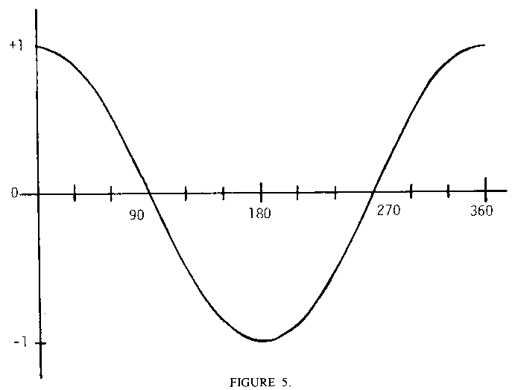
The Cosine Function
X-axis: Angle between AIForwardIntention & TankForward
Y-axis: Throw for IntendMoveForward()

Slide 230
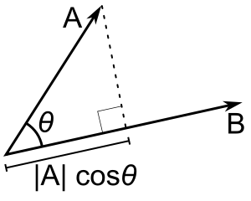
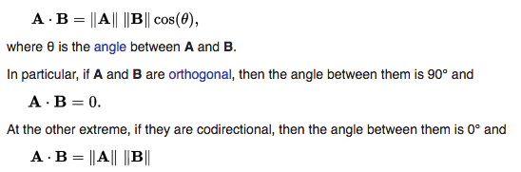
The Vector Dot Product
Type | Input | Output | Interpretation & Notes | Diagram
Dot | 2 x FVector | Float | Projection of one vector onto the other, “parellness” Maximum when vectors are parallel, and zero when they are perpendicular. Cos 𝞱

Slide 231
Use FVector::DotProduct()
Dot AIForwardIntention & TankForward
Feed the result into IntendMoveForward()
Share the resulting movement with the community.

Slide 232
Lecture Resources
Community Discussions (for intros, shares, discussions, tips etc)
Dot Product Scalar Projection on Wikipedia

Slide 233
CrossProduct() Vector Operator
4.12.4

Slide 234
In This Video…
Focusing on controlling turning of AI
If target in front or behind* don’t rotate
If target to side rotate at full speed
This is the behaviour of a sin function
Using FVector::CrossProduct()
* If behind once any rotation starts it will continue.

Slide 235
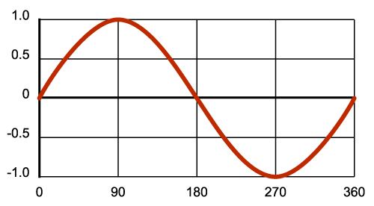
The Sine Function
X-axis: Angle between AIForwardIntention & TankForward
Y-axis: Throw for IntendTurnRight()

Slide 236
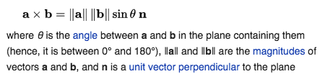
The Vector Cross Product
Type | Input | Output | Interpretation & Notes | Diagram
Cross | 2 x FVector Order matters. | FVector | “perpendicularity” Maximum when vectors are perpendicular, zero when they are parallel. Always orthogonal to both. Sin 𝞱

Slide 237
Cross & Dot Products Compared
Type | Input | Output | Interpretation & Notes | Diagram
Dot | 2 x FVector | Float | Projection of one vector onto the other, “parellness” Maximum when vectors are parallel, and zero when they are perpendicular. Cos 𝞱
Cross | 2 x FVector Order matters. | FVector | “perpendicularity” Maximum when vectors are perpendicular, zero when they are parallel. Always orthogonal to both. Sin 𝞱

Slide 238
Use FVector::CrossProduct()
Cross AIForwardIntention & TankForward
Find the Z component of the resulting vector
Feed the result into IntendTurnRight()
Share the resulting movement with the community.

Slide 239
Lecture Resources
Community Discussions (for intros, shares, discussions, tips etc)
Cross Product Animation on Wikipedia

Slide 240
Finalising Your Class Code
4.12.4

Slide 241
In This Video…
Private, protected or public? Use the safest
UPROPERY / UFUNCTION needed? Use “”
#include and forward declarations required?

Slide 242
How to Use Blueprint Variables
4.12.5

Slide 243
In This Video…
Remember “what’s the least fun thing about this?”
One thing is not knowing if you can fire
How to change crosshair colour in blueprint…
… according to the aiming component state
States: Locked, Aiming, Reloading
Referencing actor component from player UI.

Slide 244
Our Iterative Cycle
World
UI
Tank
Player 2
Controls

Slide 245
How Our Crosshair Gets Its Colour
Player Controller
Creates
Player UI
Widget
BP Variable
Controls
Tank
Aiming Component

Slide 246
Wire Up Get Aim Point Color...
Wire the rest of this Blueprint
Test that it works by changing the index and observing the crosshair colour change.

Slide 247
Using Enum(erations) in UE4
4.12.5

Slide 248
In This Video…
We met enum class around lecture 35
In Unreal we must annotate with UENUM()
We must specify the storage type (uint8)
See Unreal’s coding standards in Resources
Remember we use enums to encode meaning.

Slide 249
Create EFiringStatus
Use the following pattern...
UENUM()
enum class EThing : uint8 { Thing1, Thing2 };
Specify Locked, Aiming and Reloading
Create a private member & initialise to Reloading.

Slide 250
Refactoring our Aiming Component
4.12.5

Slide 251
In This Video…
Move away from CreateDefaultSubObject()
Make aiming a BlueprintSpawanableComponent
Get our code re-compiling as soon as possible
Experience hard crash and add pointer protection
Possibly get exasperated that we can’t find the suspected null-pointer causing the crash.

Slide 252
Refactor the Aiming Component
Try and move the aiming component to the same architecture as the movement component, that is added in blueprint
Don’t worry if you can’t get it working, but see if you can at least get it compiling and then commit.

Slide 253
Our Component Architecture
Tank
Call Methods
Aiming
Movement
Component X
Barrel
Turret
Left Track
Right Track
Other Things!

Slide 254
Attaching a Debugger to Unreal
4.12.5

Slide 255
In This Video…
Hard crashes can be difficult to diagnose
Attach your IDE’s debugger to the Unreal editor
Use it to discover the source (often null pointer)
We can also probe using Print in blueprint.

Slide 256
Add the Pointer Protection
Protect the null pointer we have found
Ensure the game still runs
Don’t worry about setting the pointer yet

Slide 257
Constructor & Begin Play Timing
4.12.5

Slide 258
In This Video…
Adding log entries to C++ and BP helps you to uncover the timing over events in the engine
We’re doing this to discover exactly when Construct and Begin Play gets called in both C++ and Blueprint
Note dropped actors are constructed in editor.

Slide 259
Convince Yourself with Logs
Log Construct and Begin Play for the tank
Do this both in C++ and Blueprint
Use a unique prefix to filter logs
See what order things happen in
Also see the order from the Start Menu.

Slide 260
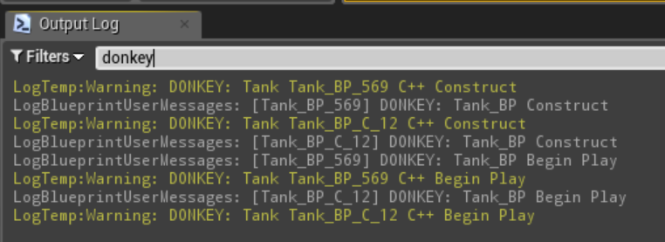
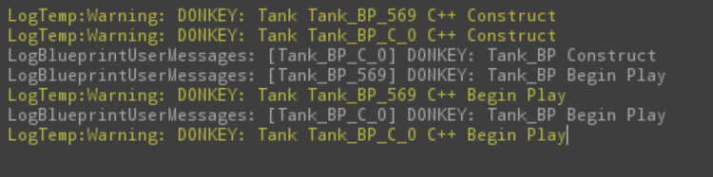
What Runs When...
Run from Main Menu
Tank 569 is the AI tank
Run from BattleGround

Slide 261
Decoupling Your Architecture
4.12.5

Slide 262
In This Video…
We don’t have a Aiming Component reference
It is hard to find a sensible time to set it
Also we don’t need the reference on the tank
We can Get Components by Class in Blueprint
Mock-up our C++ code in Blueprint.

Slide 263
C++
C++
BP
BP
Constructors
Begin Play

Slide 264
Key Object Timing
2
Tank
Aiming Comp.
Tank
Aiming Comp.
?
?
?
1
UI Widget
Player Controller
UI Widget
Player Controller
Constructors
Begin Play

Slide 265
BlueprintImplementableEvent
4.12.5

Slide 266
In This Video…
We want to expose a C++ function to Blueprint
We also want to pass a parameter (aiming ref.)
Multicast delegates only work like this for actors
We’re using a component so we use…
UFUNCTION(BlueprintImplementableEvent)
You don’t need to define the function!

Slide 267
Create UI Widget from Event
Go to the TankPlayerController_BP
Use the event to trigger UI creation
Also use the passed reference to set the variable
Test that the crosshair color now tracks the enum state set in the declaration.

Slide 268
Using the ensure Assertion
4.12.5

Slide 269
In This Video…
We use pointer protection to prevent hard crashes
If we still get a crash we can attach the debugger
The way we protect leads to things not working
We may not notice this, which is dangerous
So we use the ensure assertion macro.

Slide 270
Ben’s Game Error Handling Criteria
Execution should continue if possible
We get a helpful warning with line #
We can compile out the checks for production
if (!(LeftTrack && RightTrack)){ return; };
becomes...
if (!ensure(LeftTrack && RightTrack)){ return; };

Slide 271
Use ensure Everywhere
Add ensure to all your pointer protection
Find the null pointer that’s stopping aiming
Celebrate!

Slide 272
Dependency Mapping
4.12.5

Slide 273
In This Video…
Code architecture can be hard to see
Dependency mapping shakes-out the structure
Go through your .cpp files and look at includes
Map these as dependencies on a diagram
If it looks like spaghetti, you need to refactor!

Slide 274
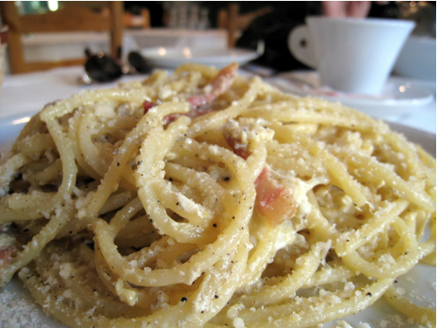
Our Current Aiming Architecture
AI Controller
Player Controller
Tank
Aiming Component
Spaghetti!
Projectile
Barrel
Turret
TankTrack and TankMovementComponent omitted for clarity

Slide 275
Our Desired Aiming Architecture
AI Controller
Player Controller
Aiming Component
Projectile
Barrel
Turret
TankTrack and TankMovementComponent omitted for clarity

Slide 276
Our Desired Movement Architecture
Input
AI Controller
Via Pathfinding
Movement Component
Tracks
TankTrack and TankMovementComponent omitted for clarity

Slide 277
Real World Skills
4.12.5

Slide 278
In This Video…
Congratulations on getting this far
We’re not teaching sterile solutions here
We’re showing you how to recognise real issues
… and how to tackle them sensibly
It’s not the easy path, but it is the valuable one.

Slide 279
Starting From Green
4.12.5

Slide 280
In This Video…
You should probably only refactor working code
Red means your code’s not working
Green means it is, even if the code is messy
We commit at green, then start refactoring.

Slide 281
What’s Changing - Class Level
AI Controller
Player Controller
Tank
Aiming Component
Projectile
Barrel
Turret
TankTrack and TankMovementComponent omitted for clarity

Slide 282
Aiming Methods in Tank Now...
AimAt
Fire
Aiming Component*
LaunchSpeed
ReloadTime
Barrel
LastFireTime
Projectile_BP
TankTrack and TankMovementComponent omitted for clarity

Slide 283
Red -> Green -> Refactor
Red
Functionality in question isn’t working.
Green
Functionality is working, even if code is messy.
Refactor
Tidy the code, without changing functionality
TankTrack and TankMovementComponent omitted for clarity

Slide 284
Get Aiming Working
If your aiming doesn’t work, get it working
I introduced a bug in the aiming component
It can be hard to track, use logs
Follow the execution through.

Slide 285
Aiming Without the Tank
4.12.5

Slide 286
What’s Changing - Class Level
AI Controller
Player Controller
Tank
Aiming Component
Projectile
Barrel
Turret
TankTrack and TankMovementComponent omitted for clarity

Slide 287
In This Video…
There is no need to cast the Pawn to a Tank
Doing so creates a dependency we don’t want
Remember a Tank is a Pawn
We simplify our architecture here.

Slide 288
Aim Without the Tank!
Move just the aiming code from tank
Move forward declarations and includes
Check all tanks now aim.

Slide 289
Finishing our Refactoring
4.12.5

Slide 290
In This Video…
Removing our final dependencies
If you override BeginPlay() in an actor you should call Super::BeginPlay()
If you don’t override it at all, there’s no need to, your Blueprint Begin Play will still run.

Slide 291
What Needs To Change
AI Controller
Player Controller
Tank
Aiming Component
Projectile
Barrel
Turret
TankTrack and TankMovementComponent omitted for clarity

Slide 292
Fire Without the Tank
Move all remaining firing code out of tank
The tank will end-up with no code useful code!
Re-specify projectile in blueprint
Re-bind the firing in blueprint
Good luck!

Slide 293
Adding TickComponent() Back
4.12.5

Slide 294
In This Video…
Actor Components use TickComponent not Tick
You can find the signature in docs online
Or by copying from the engine code
Remember to use override at to check
Remember to set the boolean in the constructor
GetWorld()->GetTimeSeconds() alternative.

Slide 295
Are Two Floats Equal?
4.12.5

Slide 296
In This Video…
FVectors are just structs containing floats
You must “define equal” when comparing floats
The FVector::Equals() method allows this
Specify a tolerance, see docs in resources.

Slide 297
Write bool IsBarrelMoving()
Compare the barrel’s current forward vector...
… to the AimDirection used in AimAt()
Use the FVector::Equals() static method
Test it works by seeing if it changes colour.
Hint coming up next…
Promote AimDirection to a member variable.

Slide 298
Programmatic Sideways Friction
4.12.5

Slide 299
In This Video…
We can apply a sideways correction force
Remember Force = Mass * Acceleration
… and Acceleration = Speed / Time
So we calculate the force using the slippage speed,the frame time, and the tank mass
A way to calculate is FVector::DotProduct()

Slide 300
Calculate SlippageSpeed
The component of speed in the tank right direction
If no slippage should be zero
If sliding entirely sideways, should be speed
In general use cos of the angle between velocity
… and the sideways (right) vector
Use FVector::DotProduct()

Slide 301
OnComponentHit Event in 4.12
4.12.5

Slide 302
In This Video…
We could use OnComponentHit in Blueprint
But we’re grown-ups so we’re going to use C++
Signature of OnHit(...) has changed in 4.12
Remember you need to make it a UFUNCTION
Details on next slide.

Slide 303
How to Register for OnHit() Events
Register delegate at begin play like this
OnComponentHit.AddDynamic(this, &UTankTrack::OnHit);
Use this signature for the delegate
OnHit(UPrimitiveComponent* HitComponent, AActor* OtherActor, UPrimitiveComponent* OtherComponent, FVector NormalImpulse, const FHitResult& Hit)
Make OnHit(...) a private UFUNCTION.

Slide 304
Register for OnHit()
Use the instructions on the previous slide
Ensure both tracks have the following set in BP…
Collision > Simulation Generates Hit Events
Test it works with a log entry
Celebrate being one of the first since 4.12!

Slide 305
Avoiding Boolean Flags
4.12.5

Slide 306
In This Video…
Boolean flags usually make answers old
Try and think of a way of avoiding them
Revise the use of FMath::Clamp()

Slide 307
Improving Tank Aiming
4.12.5

Slide 308
In This Video…
Use a literal glass ceiling to help with testing!
Sometimes the barrel takes the long route
A simple if() statement can help here
Find and fix another bug in the code
You can use %i formatter to log booleans.

Slide 309
Make Turret Take Short Route
Use a simple if() statement
Rotate so that you always take the short route
Test with player and AI tanks.

Slide 310
Tweaking Tank AI
4.12.5

Slide 311
In This Video…
Expose the Acceptance Radius to blueprint
Tweak that value as EditAnywhere
Change back to EditDefaultsOnly once found
Prevent AI tanks firing until aiming is locked.

Slide 312
Our Iterative Cycle
World
UI
Tank
Player 2
Controls

Slide 313
Choose Your Acceptance Radius
Make a blueprint of the TankAIController class
Expose AcceptanceRadius as EditAnywhere
… at least for now to help you tweak the values
Code your default Acceptance Radius
Place your AI tanks in the world
Hint: Remember to refresh navmesh if required.

Slide 314
Making an Ammo Display
4.12.5

Slide 315
In This Video…
Add a 4th enum state for out of ammo
Work around bug of blueprint select nodes not updating when we add new enum values in C++
Add a display for rounds remaining
Bind the UI to a GetRounds() method.

Slide 316
Our Iterative Cycle
World
UI
Tank
Player 2
Controls

Slide 317
Make an Ammo Display
Get an ammo display working
Should count down each time you fire
Bonus: make crosshair grey when out of ammo
Tip: restart editor after adding new enum state.

Slide 318
Making an AutoMortar
4.12.5

Slide 319
In This Video…
The tank components were built for the tank
It turns-out we can re-use movement and aiming
This is the benefit of re-usable components
We’ll create a self-aiming mortar tower.

Slide 320
Assemble the AutoMortar
Look at how the Tank_BP is constructed
Put the mortar together in a similar way
Use the Tank Aiming Component
Associate with the Tank AI Controller
We’ll rename these classes once it’s working
Bonus: get the AutoMortar actually working.

Slide 321
Using the Reference Viewer
4.12.5

Slide 322
In This Video…
Currently we .gitignore the Starter Content
Therefore we can’t track changes
We want a consistent starting point for particles
So we’re going to delete Starter Content
Lots depends on it so we use a special tool
That special tool is the reference viewer.

Slide 323
Remove your Starter Content
Backup the folder as a .zip outside project
Try deleting Starter Content in Content Browser
Move all referenced assets out or delete objects
Delete the Starter Content folder
Re-open the editor and test everything works
Share you tidy folder structure in the discussions.

Slide 324
Preparing for Particles
4.12.5

Slide 325
In This Video…
We will compose our projectile in C++
Use SetRootComponent()
Use AttachTo(RootComponent)
You can set default properties in C++
Use UPROPERTY(VisibleAnywhere)

Slide 326
Setup the Projectile Components
Create default sub-objects in C++ for…
UStaticMeshComponent called CollisionMesh
UParticleSystemComponent called LaunchBlast
Make them UPROPERTY(VisibleAnywhere)
Check they appear on the Blueprint.

Slide 327
Introducing Particle Systems
4.12.5

Slide 328
In This Video…
Setup a Starter Content project
Use it to migrate assets to Battle Tank
Explore particle systems
Use world space for smoke trails
Create and share your smoke trail.

Slide 329
Setup & Share Your Smoke
Tweak the parameters to your taste
Get creative with color, size, etc
Don’t worry about it disappearing from side view
Share with the community (link in Resources).

Slide 330
Particle Bounding Boxes
4.12.5

Slide 331
In This Video…
Our smoke disappeared when viewed from side
This is due to the fixed particle bounding boxes
We can fix it by making the boxes dynamic
BUT we need to remove GPU rendered particles
… and test the performance hit is acceptable.

Slide 332
Test Your Performance Impact
Measure your FPS with 20 smoke trails visible
Turn on dynamic bounding boxes
Measure again, see if there’s a change
Share your results with the community.

Slide 333
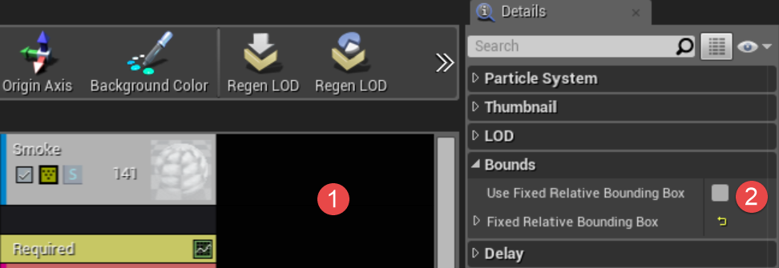
How to Set Dynamic Bounding Boxes

Slide 334
Using FAttachmentTransformRules
4.12.5

Slide 335
In This Video…
Use Message Log to see warnings
AttachTo() has become AttachToComponent()
Now must provide FAttachmentTransformRules
We’ll use KeepRelativeTransform for now
Write code to de-active launch blast and
Activate impact blast on impact.

Slide 336
Code Projectile Impact
Register a component OnHit() event delegate
Use LaunchBlast->Deactivate() to turn off
Add an ImpactBlast particle effect to projectile
Activate this on impact
Share your explosion.

Slide 337
Radial Forces & Caching
4.12.5

Slide 338
In This Video…
If you don’t AttachToComponent() then…
It will look like you’re attached but…
The transform may be broken and…
You’ll get really weird effects and…
Unreal may cache the issue
So, always AttachToComponent() :-)

Slide 339
Find the Bug
Why is this behaviour happening?
Try inspecting the projectile at run time
Look carefully at the Explosion Force component
Write a line of code to solve the problem
Share your solution in the discussions.

Slide 340
Using GetTimerManager()
4.12.5

Slide 341
In This Video…
Currently we don’t destroy our projectiles
This will cause slow-down and memory leakage
You won’t pass console testing with a leak
Tidy up after ourselves
Discuss projectile schemes
Destroy our projectiles with a timer.

Slide 342
Projectile Destruction Schemes
Sheme | Pros | Cons
Projectile destroy timer | Simple. Projectile self-responsible. | Not very performant with 100s of projectiles.
Spawn explosion effect | More physical, projectile gone, explosion remains. | More complex. Can cause slow-down just when you don’t want it.
Projectile pool | Probably most performant when there’s a natural limit to number of projectiles. | Most complex, consider a “ring buffer” or similar.

Slide 343
Make Projectiles Self-Destroy
GetWorld()->GetTimerManager().SetTimer()
Set a Blueprint editable DestroyDelay
Write a simple delegate method
Use Destroy() to destroy the projectile
Test it works, and comment on approach.

Slide 344
Using TakeDamage() on Actors
4.12.5

Slide 345
In This Video…
Unreal has an actor damage system
We’ll apply radial damage from the projectile
Then the AActor::TakeDamage() method will be called on the tank (and all other actors in radius)
We’ll then finish our damage system off
Solve the int or float damage question.

Slide 346
Implement a Damage System
Override the Tank’s virtual TakeDamage method
Clamp DamageToApply to CurrentHealth
Log DamageAmount and DamageToApply
Carry on watching the video, or finish the system.

Slide 347
BlueprintPure & Health Bars
4.12.5

Slide 348
In This Video…
Add a UI Widget component to our tank
Make a very simple health progress bar
Wire the bar to the tank.

Slide 349
Set the Tank BP Variable
Make a Blueprint Variable on the Health Bar
Set this from the Tank Event Graph

Slide 350
The Observer Pattern
4.12.5

Slide 351
In This Video…
We want the tank to broadcast it’s death
Tank doesn’t need to know who is listening
Player and AI controllers listen, and de-possess
Other systems (e.g. audio or scoring) could listen
DECLARE_DYNAMIC_MULTICAST_DELEGATE
Binding and broadcasting with delegates.

Slide 352
How Our Delegates Work
TankPlayerController
Tank
OnDeath.Broadcast();
Unreal Engine
TankAIController

Slide 353
Steps for Setting-Up DMCDs
Create type: DECLARE_DYNAMIC_MULTICAST_DELEGATE(FSubjectName);
Declare: FSubjectName OnSomethingHappened;
Broadcast: OnSomethingHappened.Broadcast();
Declare delegate on listener(s): UFUNCTION() // Must be a UFUNCTION to get called void DelegateMethod(); // e.g. void OnTankDeath();
To register: BroadcastingInstance-> OnSomethingHappened. AddUniqueDynamic(this, &AListenerClass::DelegateMethod);

Slide 354
Setup Delegate System
Use the crib-sheet on the previous slide
Register the TankPlayerController and the
TankAIController to receive OnDeath
From their possessed tank
Log to prove they’re getting the message.

Slide 355
Finishing Off - Part 1
4.12.5

Slide 356
In This Video…
We’re nearing the end of the section
You have several challenges over to try
These include various fixes and improvements...
Use StartSpectatingOnly() in Player Controller
DetachFromControllerPendingDestroy() in AI
Fixing a bug with our starting health.

Slide 357
Pick & Mix Challenge
Call StartSpectatingOnly() in Player Controller
DetachFromControllerPendingDestroy() in AI
Fix the starting health bug
Use the noise landscape function to undulate
Make the AutoMortars damageable
Check code against Unreal’s coding standards.
Notes:
6. Only down to and including comments section. bIsBarrelMoving. All functions that return a bool should ask a true/false question, such as IsVisible() or ShouldClearBuffer().

Slide 358
Finishing Off - Part 2
4.12.5

Slide 359
In This Video…
You can use the noise function on landscapes
Gameobjects are automatically destroyed when they travel a long way from the play area
Reviewing Unreal’s coding standards.

Slide 360
Pick & Mix Challenge
Call StartSpectatingOnly() in Player Controller
DetachFromControllerPendingDestroy() in AI
Fix the starting health bug
Use the noise landscape function to undulate
Make the AutoMortars damageable
Check code against Unreal’s coding standards.
Notes:
6. Only down to and including comments section. bIsBarrelMoving. All functions that return a bool should ask a true/false question, such as IsVisible() or ShouldClearBuffer().

Slide 361
Section Wrap-Up
4.12.5

Slide 362
In This Video…
In this section we learnt a tonne including…
Basic terrain landscaping
Using and modifying the AI pathfinding system
A deep-dive into control systems
User Interface for the first time
A whole tonne of C++ and architecture.

Slide 363
Improve Building Escape
Put the project under version control
Add a start menu
Create at least one new puzzle
Add some landscape around the room(s)
Consider a projectile-based puzzle
Improve the overall architecture.

Slide 364
Bonus - Switching Cameras
4.12.5

Slide 365
In This Video…
Our player controller line traces to aim
This can hit the UI in some circumstances
Change our line trace channel to ECC::Camera
Add a 1st person camera
Use the Toggle Visibility Blueprint node
Bind input and enjoy simple camera swapping.

Slide 366
Write the Blueprint
Search for a “toggle” node
See if you can make it work.

Slide 367
Fixing The Tank Suspension
4.12.5

Slide 368
Upgrade to 4.19 And Bug Fixes
4.19.2

Slide 369
Real-world Vehicle Physics
4.19.2

Slide 370
Why The Tank Pops

Slide 371
Why The Tank Pops

Slide 372
Why The Tank Pops

Slide 373
Why don’t real vehicles do this?
What does a vehicle have?
What is essential?
Can you boil this down to a physics model?

Slide 374
The Sprung Vehicle

Slide 375
The Sprung Vehicle

Slide 376
The Wheeled Vehicle

Slide 377
The Wheeled Vehicle

Slide 378
The Sprung-Wheeled Vehicle

Slide 379
The Sprung-Wheeled Vehicle

Slide 380
Creating Physics Constraints
4.19.2

Slide 381
Play with the constraints
Can you get them fixed?
Can you get them rotating like a wheel?
Can you get it moving in one dimension?

Slide 382
Making Springs
4.19.2

Slide 383
Make A Suspension
Mass attached to Wheel
Both should simulate physics
Tweak the strength of the spring
What happens with different masses?

Slide 384
Converting The Spring To C++
4.19.2

Slide 385
Create a base class
All components be DefaultSubObjects
Setup the same root
Setup the same attachment
Recreate the same spring.

Slide 386
Attachment, Actors & Components
4.19.2

Slide 387
Actors vs Component Attachment
Tank Root
⤷ LeftTrack
⤷ RightTrack
⤷ Wheel1Root
⤷ Wheel Spring
⤷ Wheel
Tank
⤷ Wheel1

Slide 388
Create A Spawning Component
Position the component in the tank BP
Specify the class to spawn
Attach the actor to the component
What is the value of GetAttachParentActor()?

Slide 389
SpawnActorDeferred and BeginPlay
4.19.2

Slide 390
Fix The Attach Parent
Use SpawnActorDeferred.
What do you get?
What transform will you pass?

Slide 391
Attaching Constraints In C++
4.19.2

Slide 392
Suspend The Tank
Constraint the wheel to the tank.
Add as many wheels as you like.
What should the wheel mass be?
What should the spring strength be?

Slide 393
Chaining Physics Constraints
4.19.2

Slide 394
Creating A Sprung Wheel
Tank
Spring Constraint
Axle
Axle - Wheel Constraint
Wheel

Slide 395
Setup The Sprung Wheel
Your setup needs be sprung like before
And free wheeling only forward and backwards.
HINTS:
All constrained items will need to simulate physics
Items simulating physics require colliders
USphereComponents might be the right shape
You don’t want the axle colliding with anything.

Slide 396
Applying Wheel Driving Force
4.19.2

Slide 397
Implement GetWheels()
SpawnPoint should have a getter
Wheels spawned by this track should be returned.

Slide 398
Solution: Implement GetWheels()
4.19.2

Slide 399
Tick Groups And Physics
4.19.2

Slide 400
Detecting No Collision
AddDrivingForce()
Add to force
OnHit()
Apply the force
After hit
Cancel force

Slide 401
Apply Force On Collision
Move force handling to OnHit
Cancel the force before the next frame
Test!

Slide 402
Tweaking Linear & Angular Damping
4.19.2

Slide 403
Finish Tweaking The Tank
Add more wheels
Does the tank sit well?
What about angular damping?

Slide 404
BONUS: Fixing Collider Issues
4.19.2

Slide 405
INTENTIONALLY BLANK
… but now it isn’t - weird.
This is just to help mark the current end of the slides.
I’m adding content most weekdays

