Slide 1
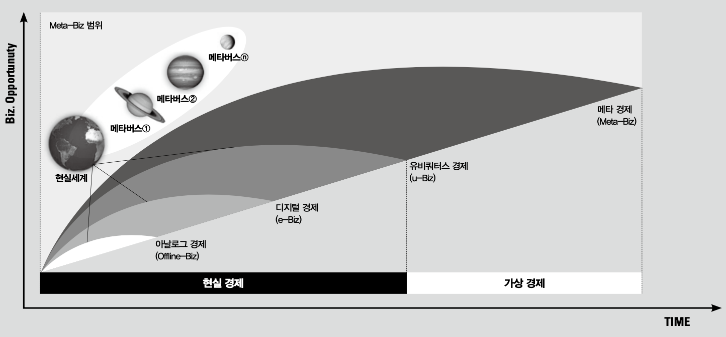


Meta-Biz Area
Metaverse - n
Metaverse - 2
Metaverse - 1
Meta-Biz
Real World
u-Biz
e-Biz
Offline-Biz
Real World Economy
Mixed/Virtual World Economy

Slide 2
Meta-Biz Area
Metaverse - n
Metaverse - 2
Metaverse - 1
Real World
Real World Economy
Mixed/Virtual World Economy

