Slide 1


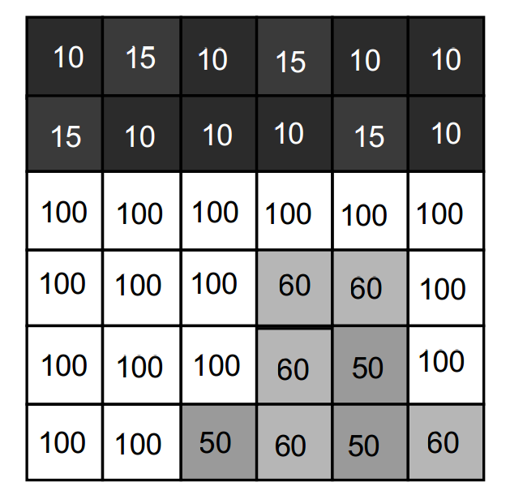
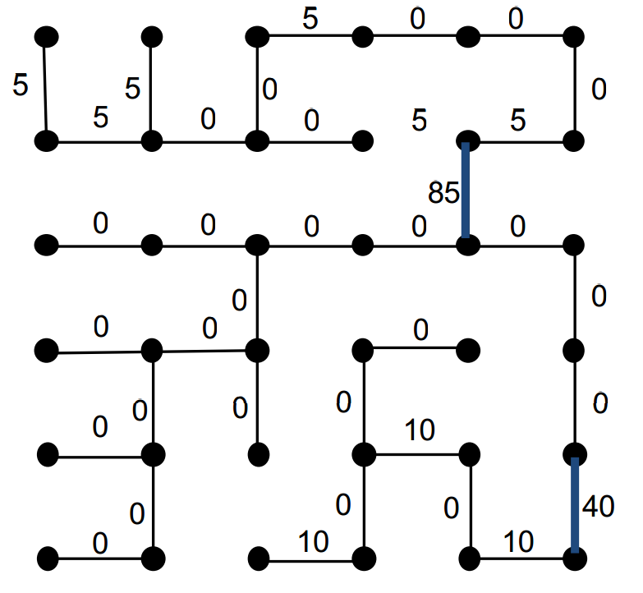
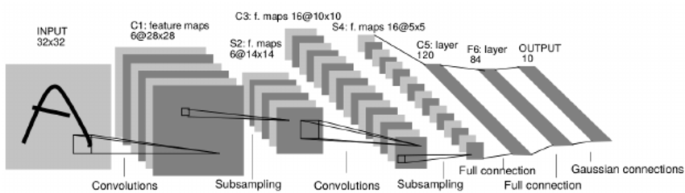
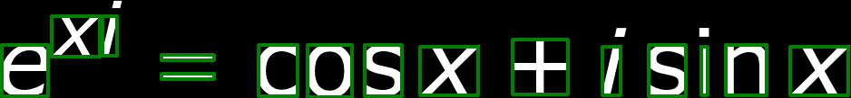
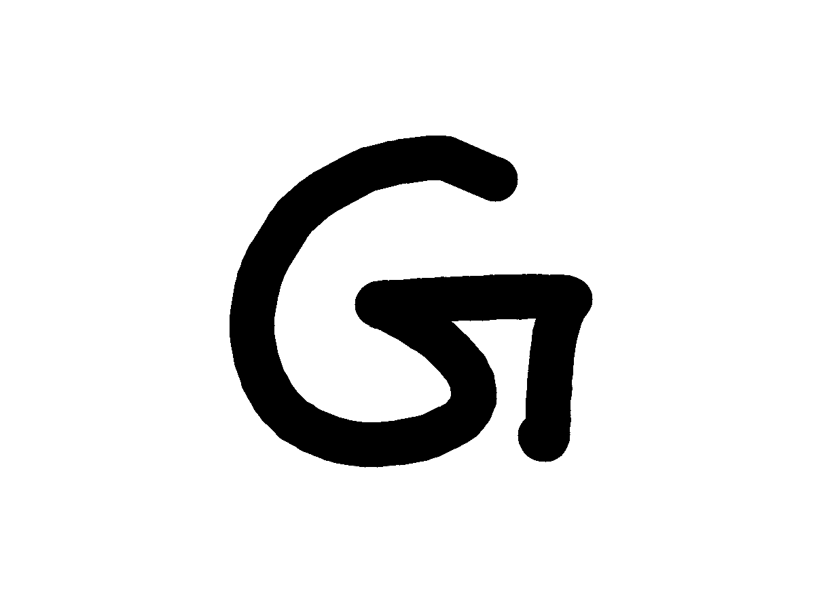
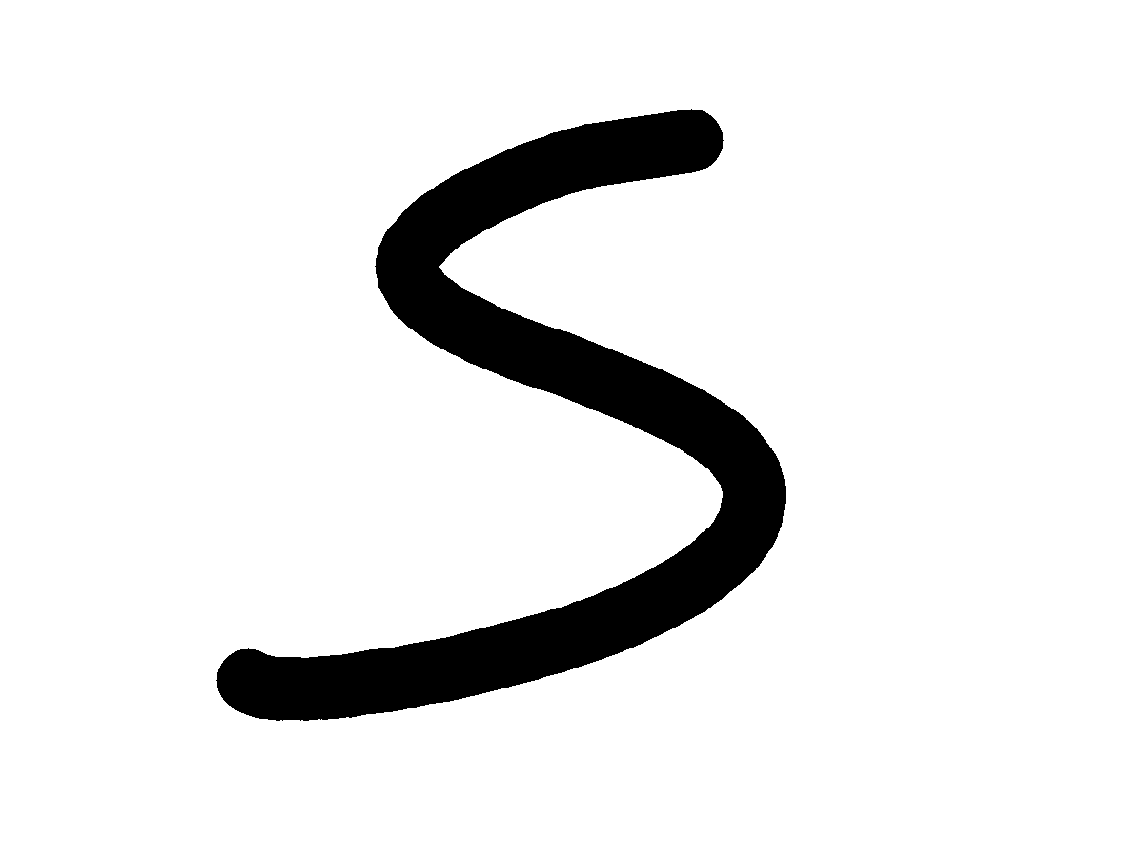
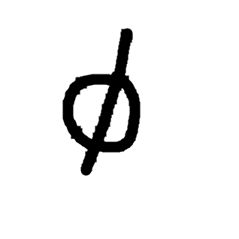
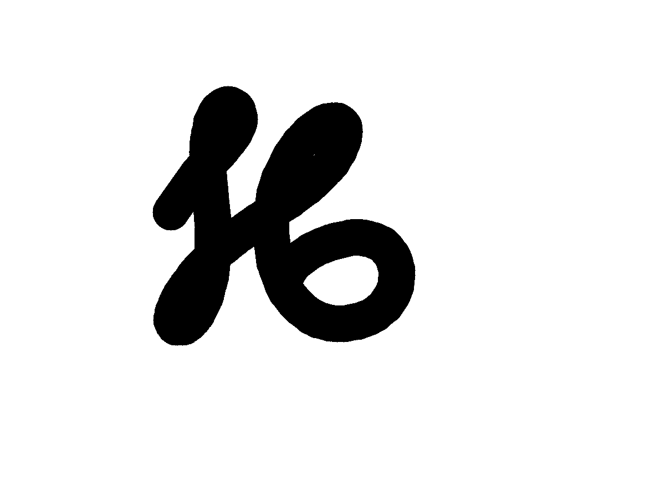
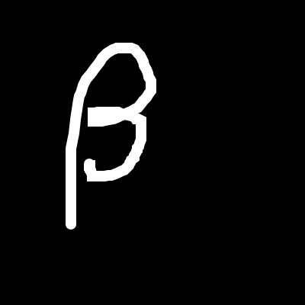
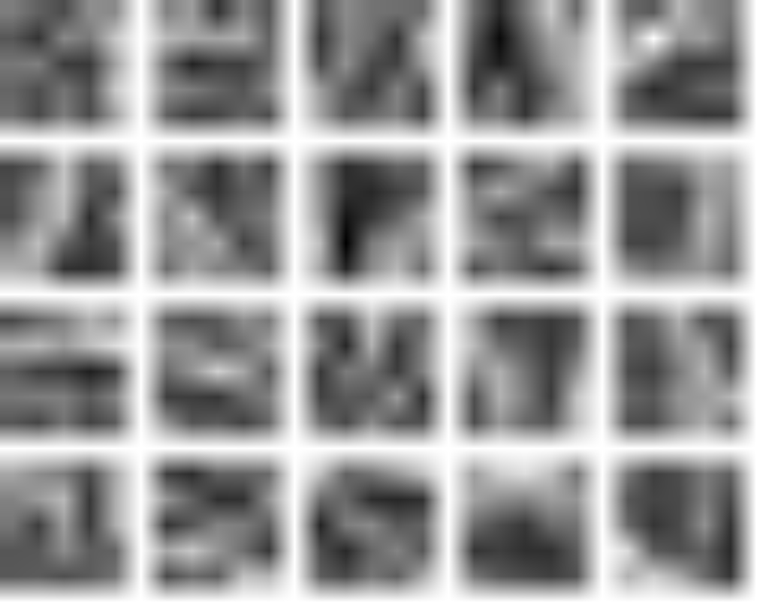
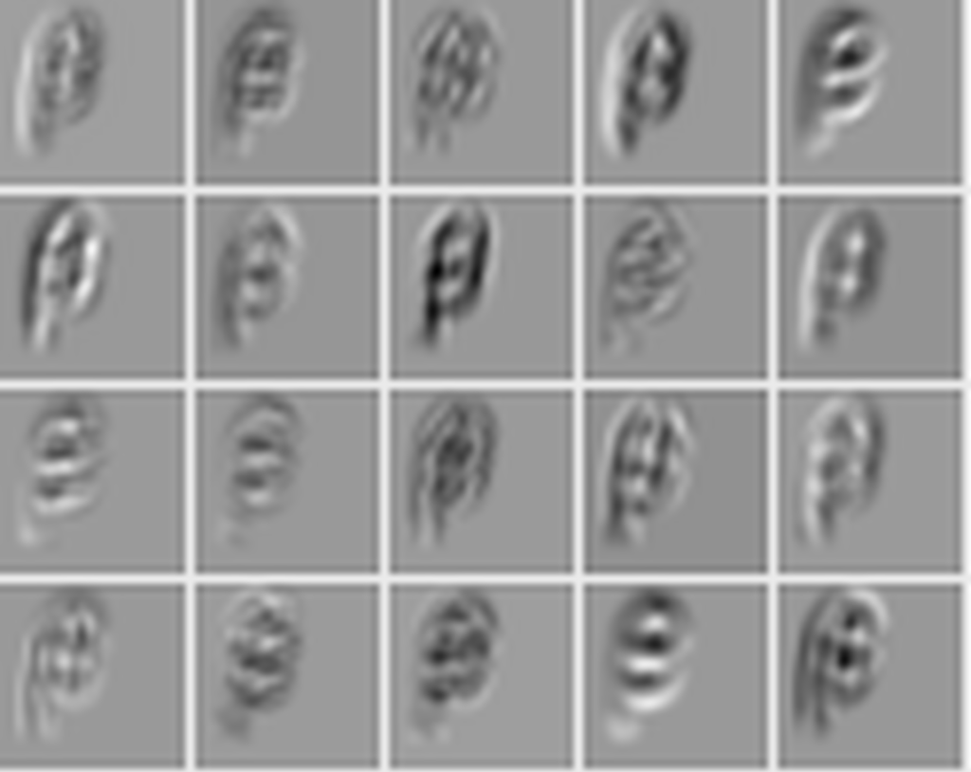
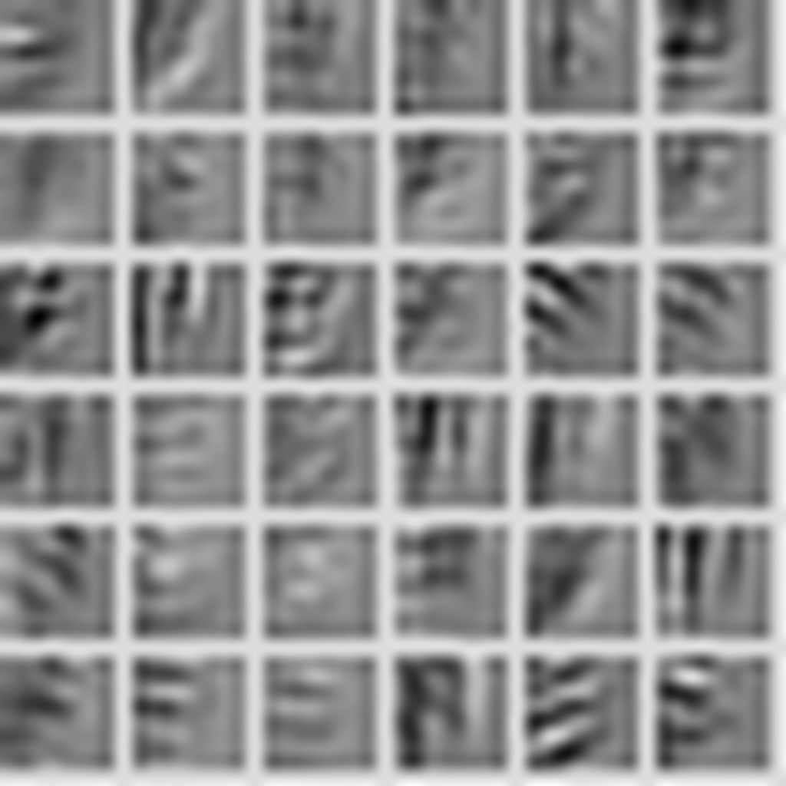
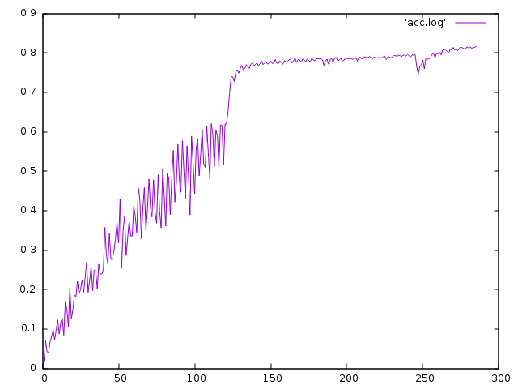





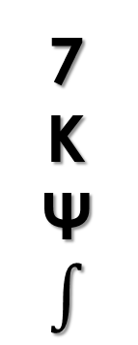
Offline Mathematical Expression Recognizer
Shawn Peng: yisupeng@iu.edu 2016 Spring B657 Computer Vision
Yang Zhang: zhang505@Indiana.edu Prof. David Crandall
System Architecture
Segmentation
Formula image
Segmentation
Classification
Parser
Latex code
Architecture of LeNet-5
From: http://eblearn.sourceforge
.net/beginner_tutorial2_train.html
From: Proj. Crandall’s B657 course ppt
We use the spanning tree algorithm, which treat the image as a graph, and assign edge to every two adjacent pixels, according to their difference in color. After we construct the graph, we find the minimum spanning tree for this graph, and cut some edges with weights over a threshold to get a forest.
Data Set
7
K
Ψ
$$∫$$
Digits MNIST English Chars74K, Write-Math Greek Detexify Math Symbols Write-Math
Convolutional Neural Network
Convolution1
5x5/1, 20
Pooling1
Max, 2x2/2
Convolution2
5x5/1, 20
Pooling2
Max, 2x2/2
Flatten
FullyConnected
500
Activation
Tanh
FullyConnected
101
SoftmaxOutput
Data
Activation
ReLu
28x28x1
Since we use different data sources, and they use different image formats, we need to preprocess those data. Some of them is preprocessed, like mnist and Chars74K dataset, but Chars74k, Detexify and write-math dataset use whte background.
Weights
output
Preprocessing
CouchDB
nodejs
SVG
imagemagick
PNG
output
LMDB
convert
image_set
PNG
crop & padding
PNG
We use nodejs to convert the couchdb dat to svg and make the stroke border.
We use imagemagick to negate, resize the image and convert it to png
We use python to crop the image and add our image
We balance the training and testing data set by resampling
The last step is to use caffe tool conver_image_set to convert the image to lmdb
Conclusion & Discussion
First, we found it is very useful to have the character to be properly bold before we send it to the convolutional neural network. For svg image this can be done very easily, for images one thing we can use is the dilution.
Second, in the training of our convolutional neural network (we use LeNet), we find it is very useful to perform the trim operation on images.
On the other hand, the problem is that we do not have enough data to train neural network. We have enough digit number and geek letter data, but for English letter we only get 50 samples. We believes that is the problem that we only get 81.5% accuracy.
We have not begin to do grammar parse because of the poor performance of classifications.
We thank Prof. David Crandall for really helpful comments and discussions.
We also thank Dr. Daniel Kirsch and Martin Thoma to provide us the permission to the handwrite data.
Accuracy
reset leaning rate
increase batch size &
reset learning rate
Tech we used

