Slide 1

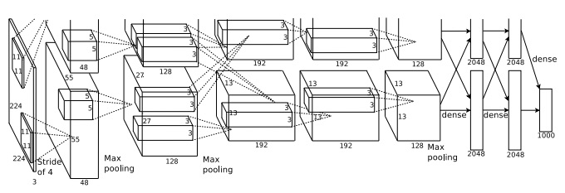





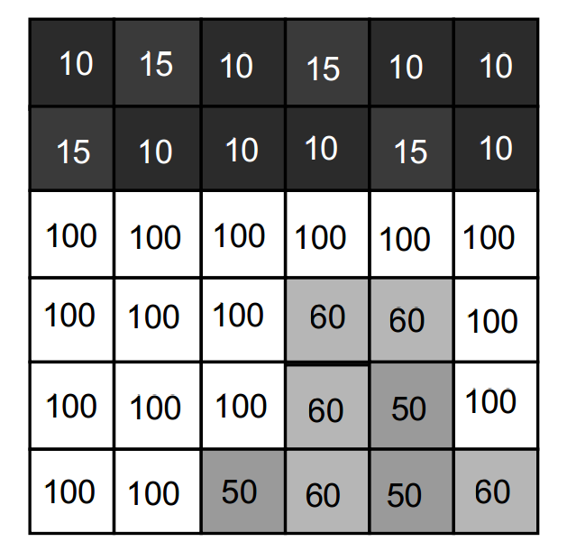
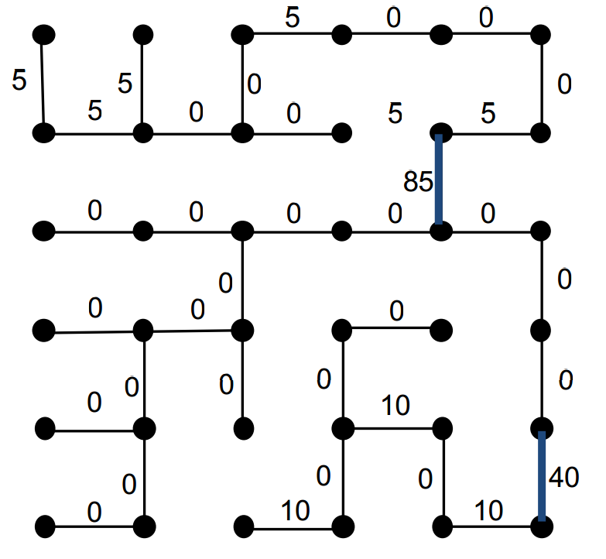


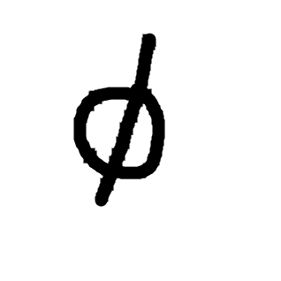


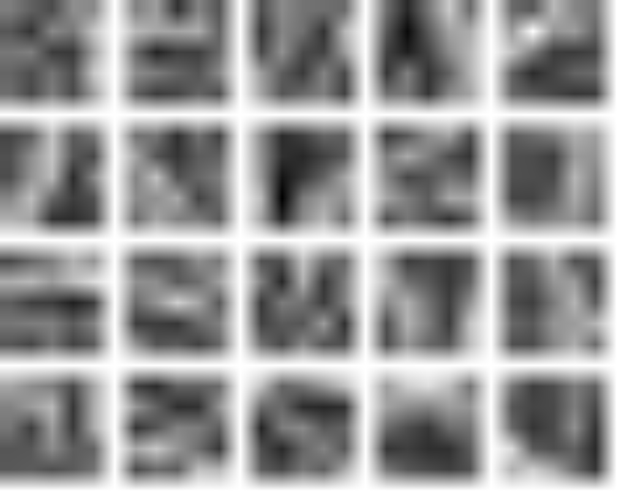
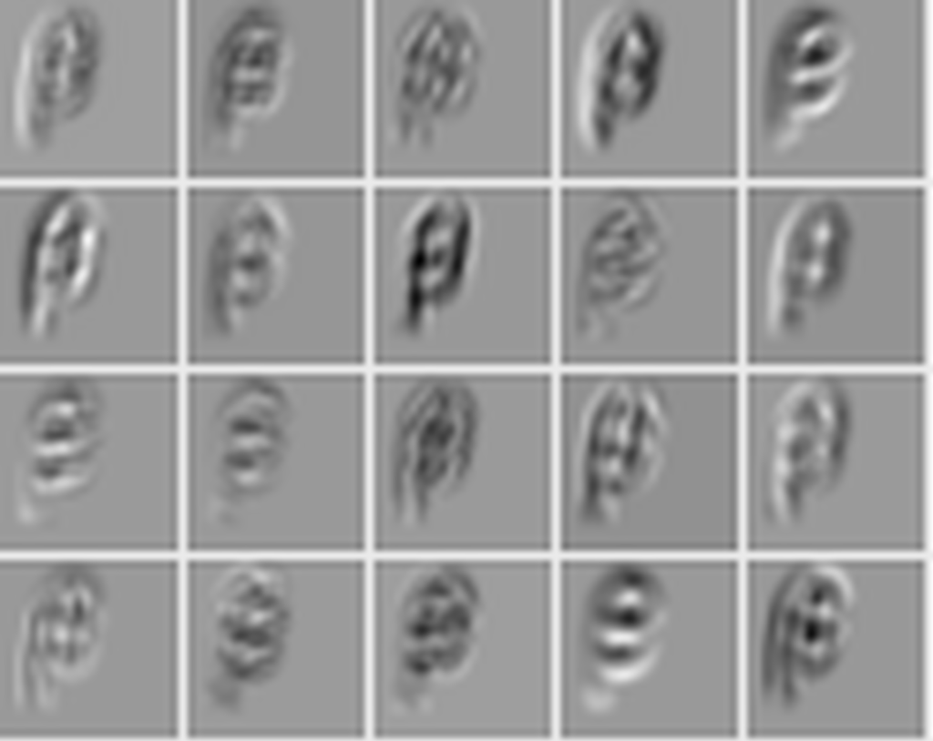
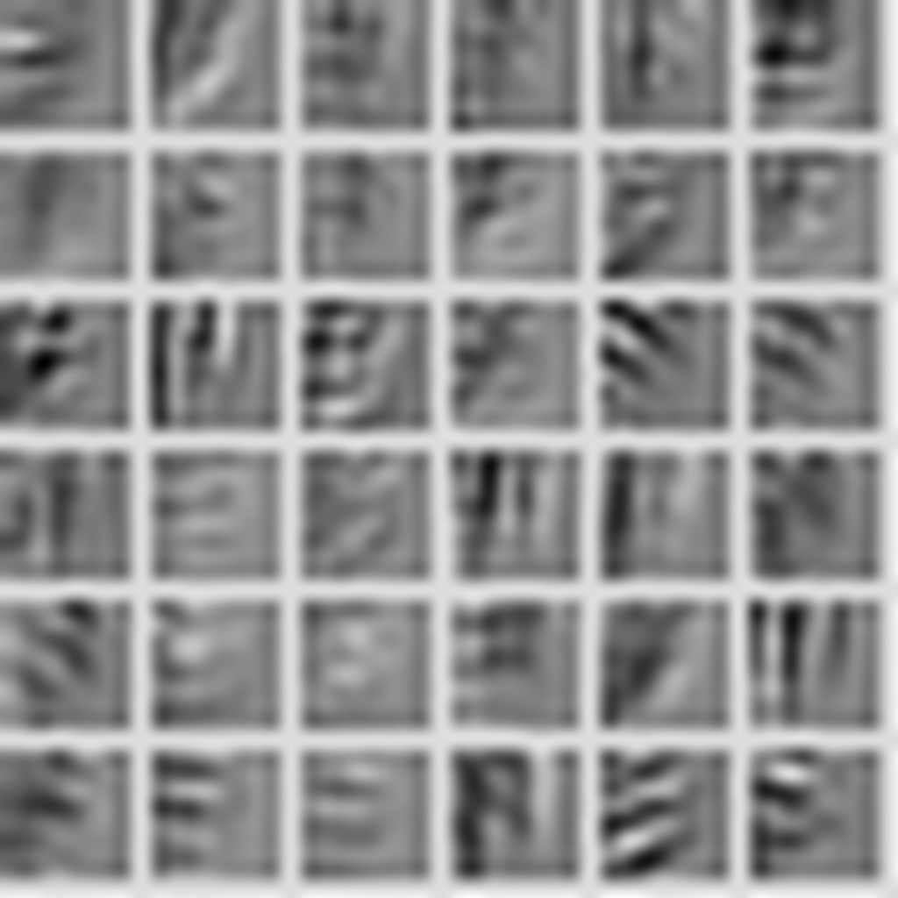
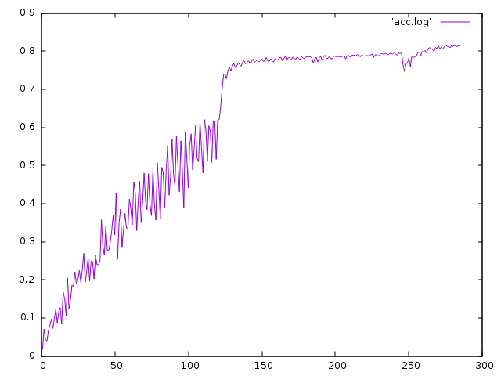
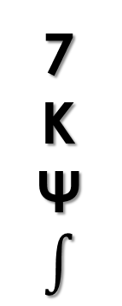
Offline Mathematical Expression Recognizer
Shawn Peng: yisupeng@iu.edu 2016 Spring B657 Computer Vision
Yang Zhang: zhang505@Indiana.edu Prof. David Crandall
CNN Diagram
Tech we used
Segmentation
Expression recognition effect
Data Set
We use the spanning tree algorithm, which treat the image as a graph, and assign edge to every two adjacent pixels, according to their difference in color.
7
K
Ψ
$$∫$$
Digits MNIST English Chars74K, Write-Math Greek Detexify Math Symbols Write-Math
Convolutional Neural Network
Convolution1
5x5/1, 20
Pooling1
Max, 2x2/2
Convolution2
5x5/1, 20
Pooling2
Max, 2x2/2
Flatten
FullyConnected
500
Activation
Tanh
FullyConnected
101
SoftmaxOutput
Data
Activation
ReLu
28x28x1
Since we use different data sources,
we need to preprocess those data
Weights
output
Preprocessing
CouchDB
nodejs
SVG
imagemagick
PNG
output
LMDB
convert
image_set
PNG
crop & padding
PNG
We use nodejs to convert the couchdb dat to svg and make the stroke border.
We use imagemagick to negate, resize the image and convert it to png
We use python to crop the image and add our image
We balance the training and testing data set by resampling
The last step is to use caffe tool conver_image_set to convert the image to lmdb
Discusstion
reset leaning rate
We thank Prof. David Crandall for helpful comments and discussions.
We also thank Dr. Daniel Kirsch and Martin Thoma to provide us the permission to the handwrite data.
increase batch size &
reset learning rate

