Slide 1






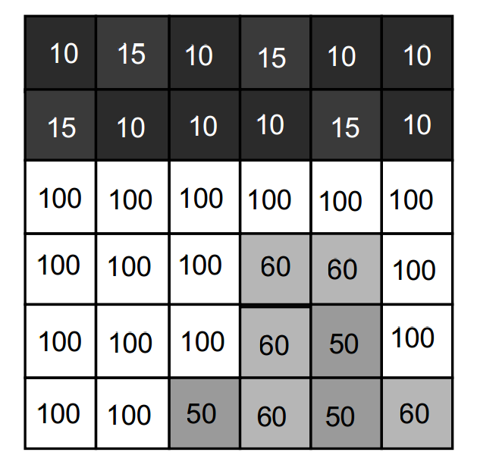
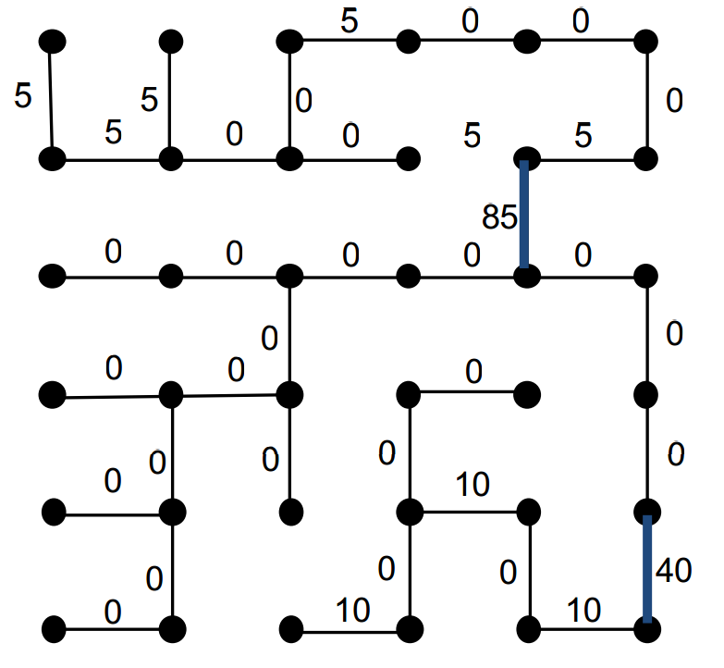

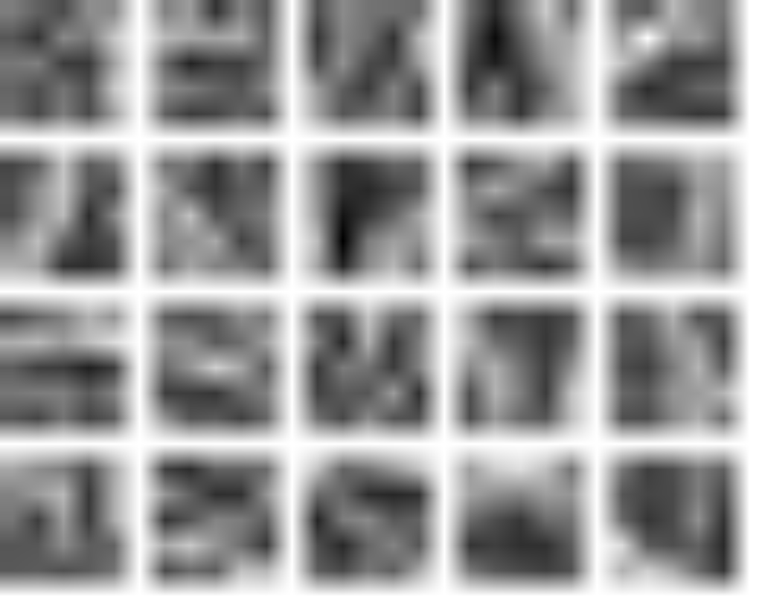
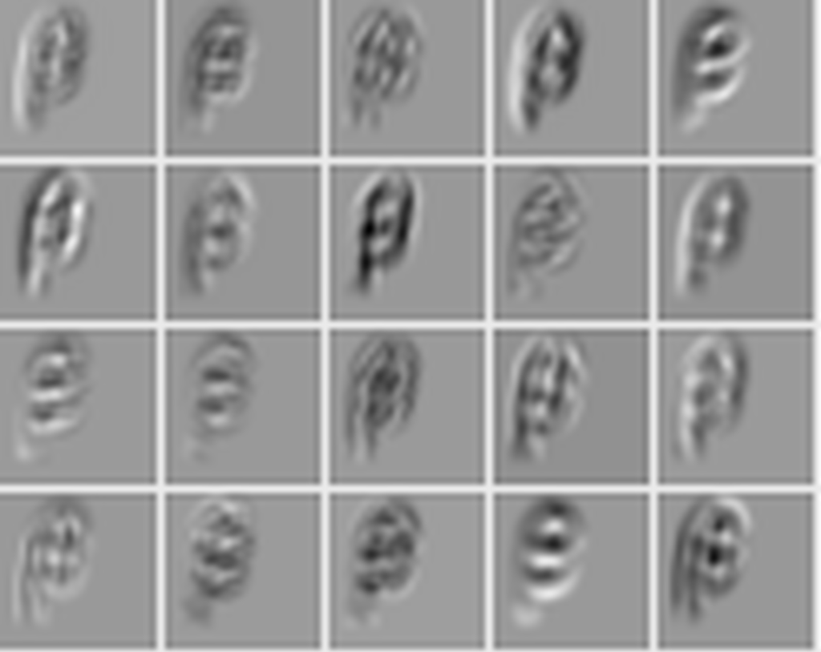
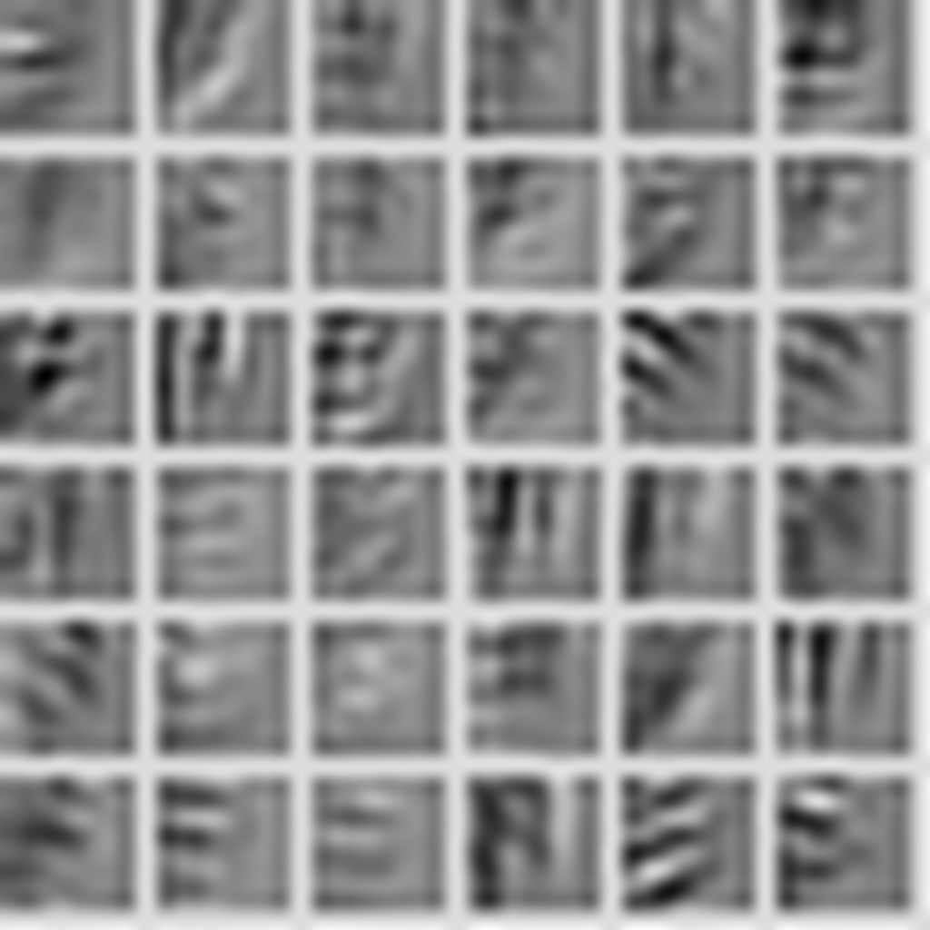

Offline Mathematical Expression Recognizer
Shawn Peng: yisupeng@iu.edu 2016 Spring B657 Computer Vision
Yang Zhang: zhang505@Indiana.edu Prof. David Crandall
CNN Diagram
Segmentation
Expression recognition effect
Data Set
We use the spanning tree algorithm, which treat the image as a graph, and assign edge to every two adjacent pixels, according to their difference in color.
7
K
Ψ
$$∫$$
Digits MNIST English Chars74K, Write-Math Greek Detexify Math Symbols Write-Math
Convolutional Neural Network
Convolution1
5x5/1, 20
Pooling1
Max, 2x2/2
Convolution2
5x5/1, 20
Pooling2
Max, 2x2/2
Flatten
FullyConnected
500
Activation
Tanh
FullyConnected
101
SoftmaxOutput
Data
Activation
ReLu
28x28x1
Preprocessing
LMDB
Reference

