Slide 1
Modeling S&P 500 Stock Dynamics Using Non-Parametric Methods: The Case for Amazon (AMZN)
DS 5030 - Understanding Uncertainty
BY: Shawn Ding, Arnav Jain, Aeon Levy

Slide 2
Project Objectives
Analyzing distributional shape; volatility dynamics and tails risk
Focus on empirical patterns and no so much classic predictive modeling
Our Goal : To effectively model and predict the risk of individual stock
1
2

Slide 3
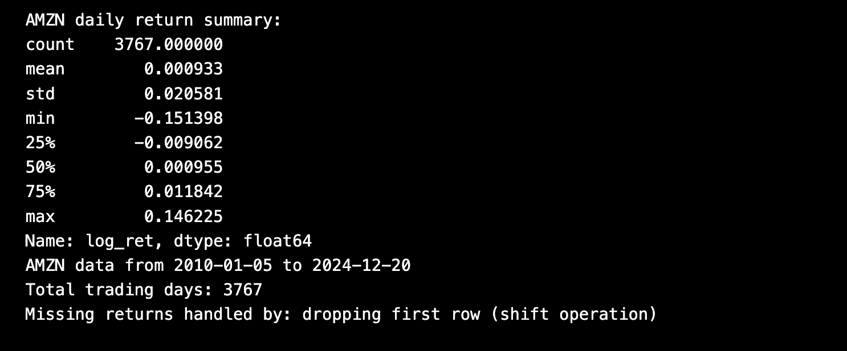
Data Background
Source: Kaggle.
The S&P 500 Data Originally Scraped by an Andrew MVD
Date Range : 2010-01-04 —> 2024-12-20
Variables : Date, Symbol, Open High, Low, Close, Volume
Our focus was on AMZN (complete daily time-series)
Missing data was handled per-symbol and removed after return computation

Slide 4
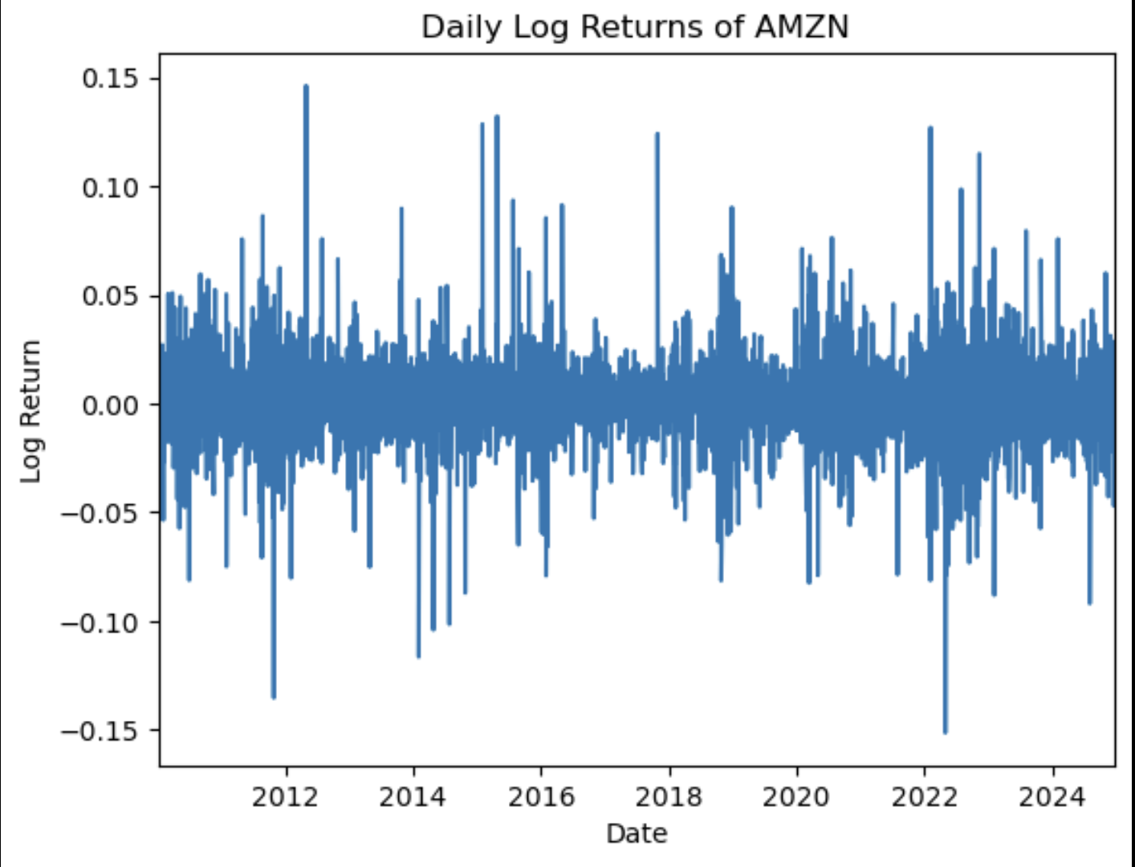
Behavior of Financial Returns
Volatility Clustering
Heavy Tails (Leptokurtosis)
Slight Skewness
Non-Stationarity Across Regimes 4
Key properties of AMZN returns:
These reflect standard “stylized facts” in empirical finance

Slide 5
Modeling Approach
Kernel Density Estimation(KDE):
  Estimate empirical distribution of returns
Local-Constant Regression:
  Smooth 21-day rolling variance (volatility proxy)
Non-parametric methods used to avoid strong distributional assumptions
Any Bandwidth selection validated using cross-validation

Slide 6
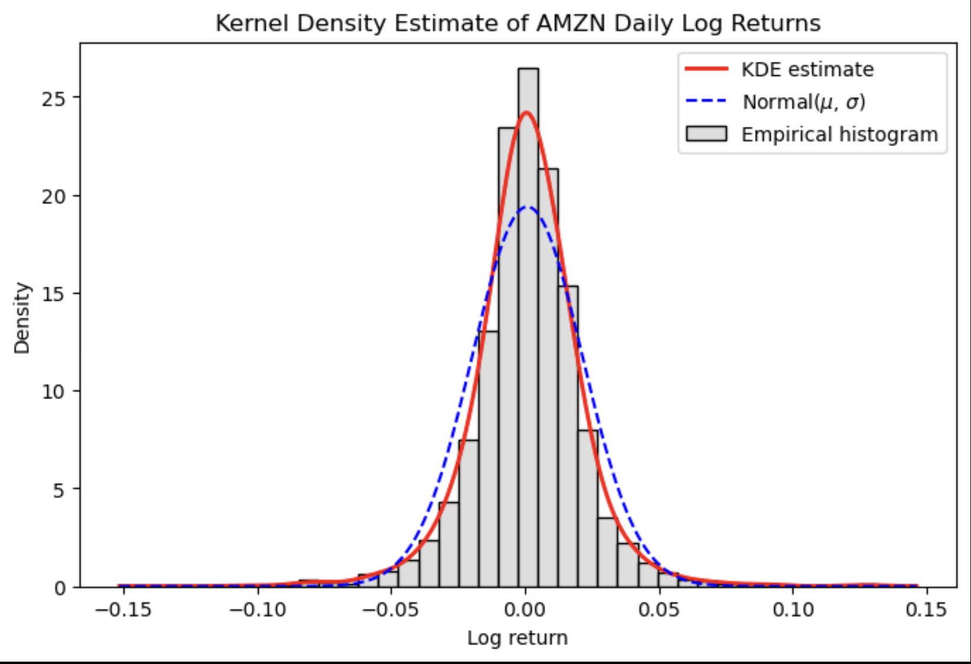
Kernel Density Estimation
Gaussian KDE fitted to AMZN log returns
KDE (the red) aligns with empirical histogram
Deviates from normal (blue dashed)
  Sharper peak, Heavier tails
Indicates leptokurtosis and frequent extreme returns

Slide 7
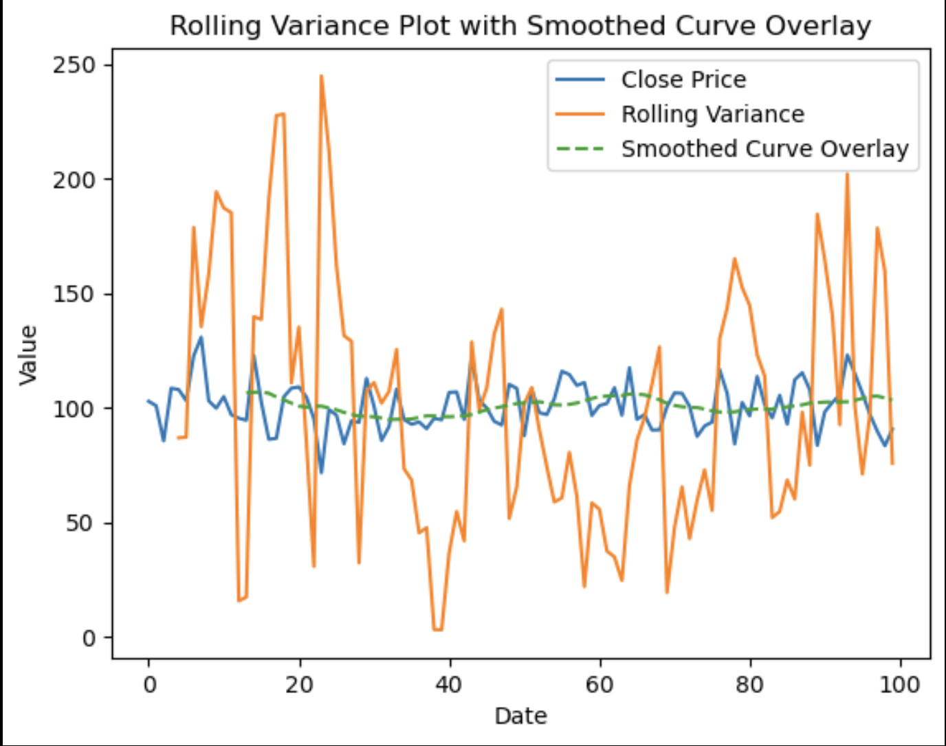
Local-Constant Regression
Nadaraya–Watson regression to create 21-day rolling variance smoothed
This captures volatility clustering
  High/low-variance regimes
Confirms time-dependent risk in AMZN returns

Slide 8
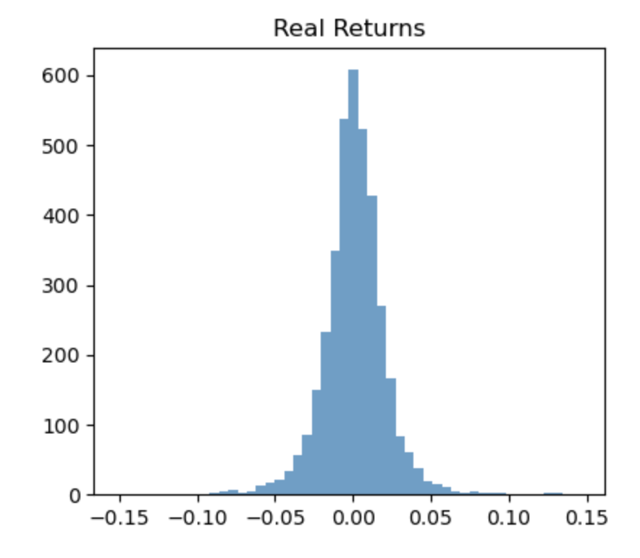
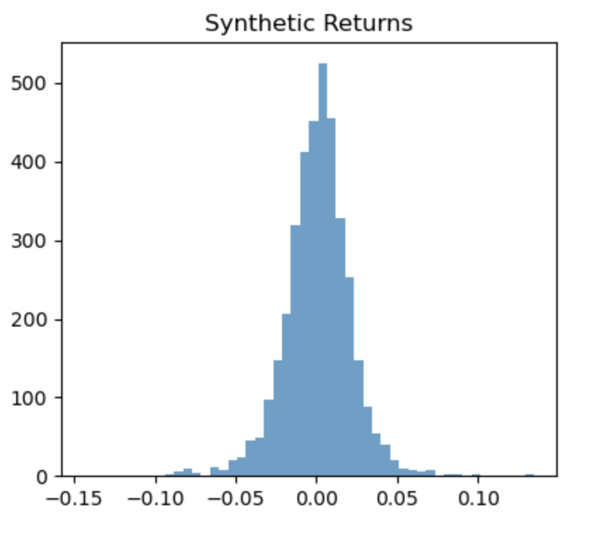
Synthetic Returns and Bootstrapped Risk
Generated synthetic returns via KDE resampling
Bootstrapped 5,000 replications to estimate risk metrics
95% Confidence Intervals:
VaR: −3.25% to −2.86%
ES: −5.08% to −4.36%

Slide 9
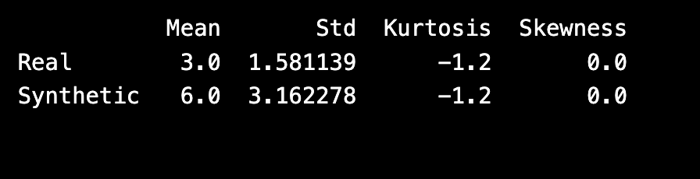
Evaluation of Results
Strengths
Limitations
Preserves mean and standard deviation
Captures empirical distribution shape
Simple, transparent, and data-driven
KDE underestimates tail risk (lower kurtosis)
Loses volatility clustering (IID sampling)
Bandwidth sensitivity affects smoothness
comparing metrics: Mean, Std, Kurtosis, Skew (Real vs Synthetic)

Slide 10
Conclusion and Next Steps
Key Takeaways
Non-parametric models capture true distribution shape and volatility structure=
KDE + Kernel Regression effectively describe the uncertainty
Limitations : These include IID assumption and over smoothing tails
Future Work
Multivariate KDE across multiple stocks
Conditional KDE or rolling-window estimation
Integrate GARCH/EVT for improved tail modeling

Slide 11
Resources
https://www.kaggle.com/datasets/andrewmvd/sp-500-stocks/data?select=sp500_stocks.csv

