Slide 1
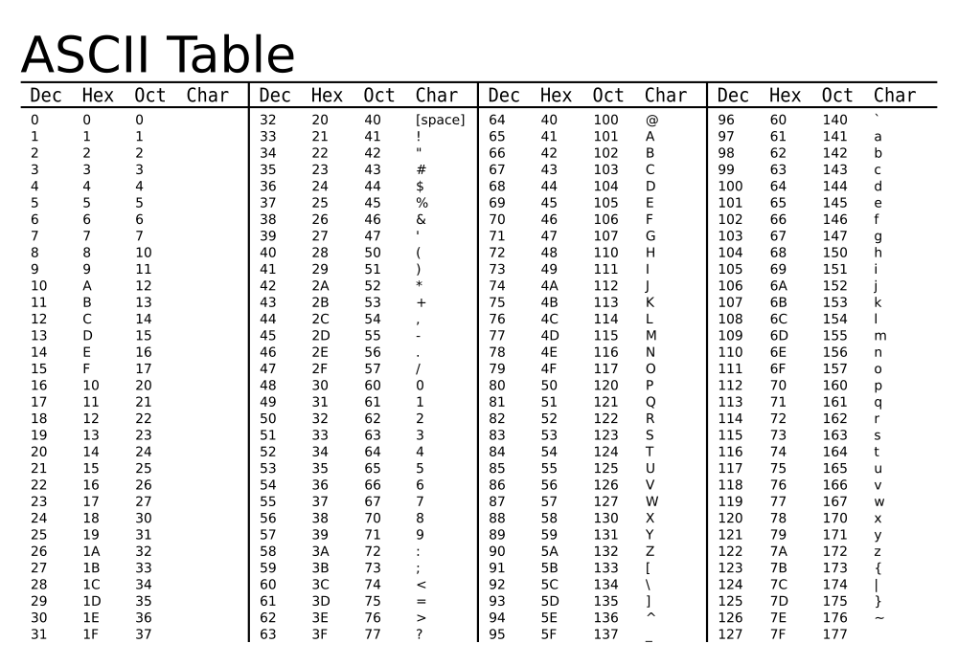
ASCII code
Source: http://durofy.com/ascii-values-table-generator-in-c

Slide 2
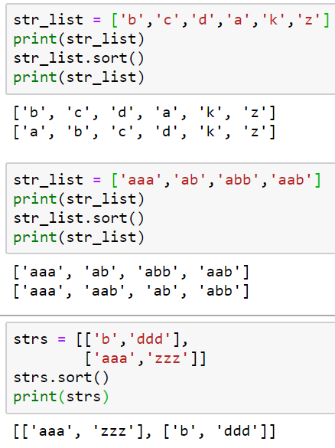
Sorting string

Slide 3
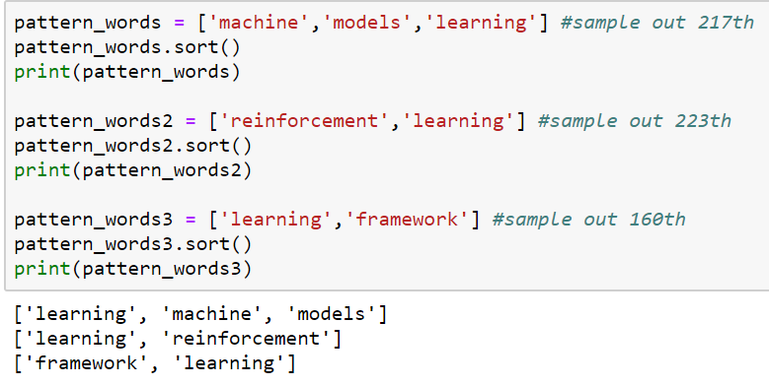
In our homework

Slide 4
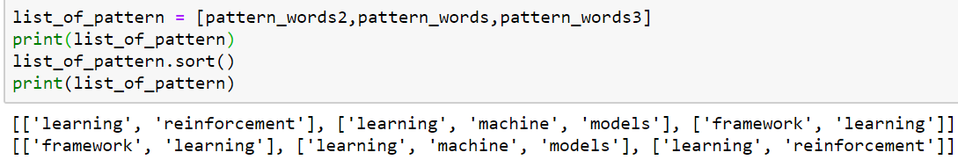
In our homework
一言以蔽之: 先sort裡面, 再sort外面

Slide 5
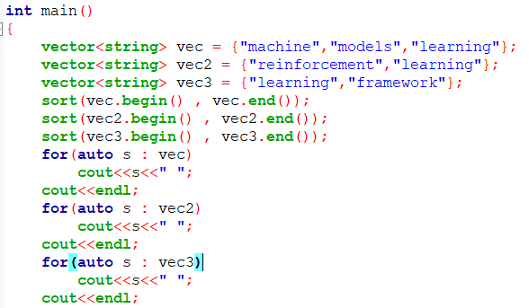

C++

Slide 6
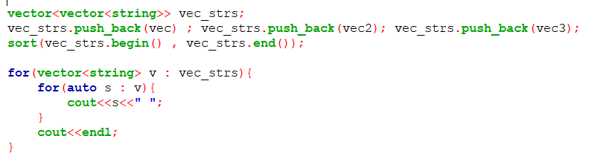

C++

Slide 7
Q & A
Q: About ‘\n’
A: replace ‘\n’ in to ‘ ‘ (space)
Q: about ‘-’
A: If only ‘-’ in frequent pattern, don’t output it

