Slide 1
Data science HW4
Department of Computer Science
National Tsing Hua University (NTHU)
Hsinchu, Taiwan
Date: May 7th, 2019

Slide 2
HW4
We still use kaggle this time
Link to competition
https://www.kaggle.com/c/ds2019hw4/overview
Deadline: 5/21 23:59

Slide 3
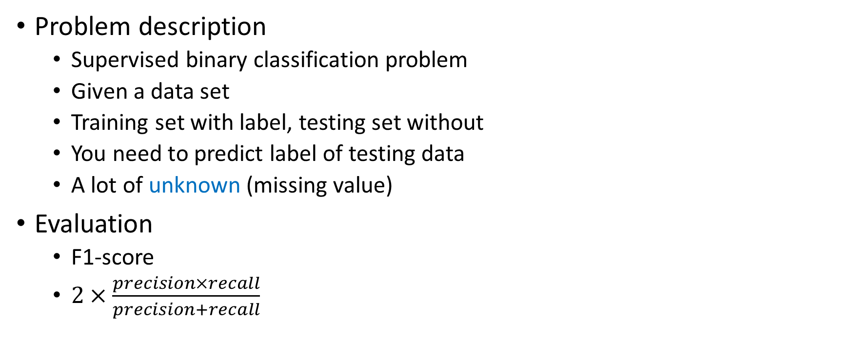
HW4
Problem description
Supervised binary classification problem
Given a data set
Training set with label, testing set without
You need to predict label of testing data
A lot of unknown (missing value)
Evaluation
F1-score
$2×\frac{precision×recall}{precision+recall}$

Slide 4
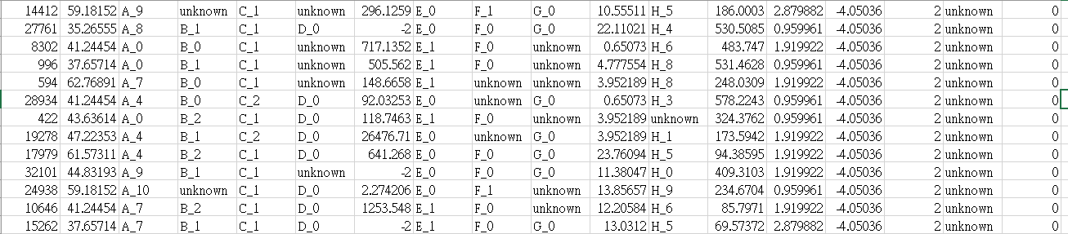
Dataset preview – training data
First column: unique index for each data instance
Last column: label (only in training set)

Slide 5
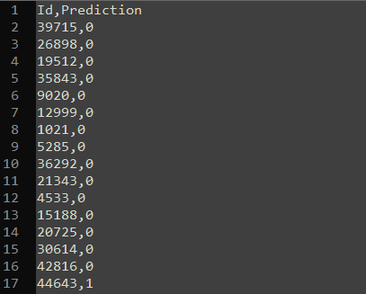
Output format
For each testing instance, there is a unique id
You need to submit you answer to kaggle with following format
Id,Prediction
Id1,predition1
Id2,predition2
…

Slide 6
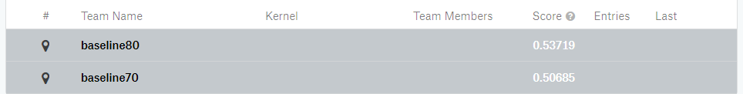
Evaluation
There are two leaderboards in kaggle
Public: can be seen during competition, for reference
Private: used to evaluate, can be seen after competition

Slide 7
Evaluation
You will get 75 points, if your private F1-score is between baseline 70 and baseline 80
For those have scores better than baseline 80
TOP 10% (<=10%): 100
10% ~ 30% (<=30%): 92
30% ~ 60% (<=60%): 86
60% ~ 80% (<=80%): 83
Other: 80
0 point, if your private F1-score is worse than baseline 70

Slide 8
Baseline public/private score
 | Public | Private
Baseline 80 | 0.53719 | 0.53286
Baseline 70 | 0.50685 | 0.50962
Sample output | 0.47664 | 0.49032

Slide 9
Hints
Missing value can be imputed in many way
Drop the column with missing value (Performance would be bad)
Mean/mode value
Mean/mode of same class
Treat missing value problem as classification/regression problem
Special algorithm
https://arxiv.org/pdf/1603.02754.pdf
Don’t forget over/undersampling
Hints in hw3 still working

Slide 10
Hints
Library for missing value imputation in python
https://datawig.readthedocs.io/en/latest/
https://github.com/eltonlaw/impyute
https://scikit-learn.org/stable/modules/impute.html
Other reference
https://towardsdatascience.com/6-different-ways-to-compensate-for-missing-values-data-imputation-with-examples-6022d9ca0779
https://www.bu.edu/sph/files/2014/05/Marina-tech-report.pdf
http://www.stat.columbia.edu/~gelman/arm/missing.pdf

