Slide 1
Data science HW3
Department of Computer Science
National Tsing Hua University (NTHU)
Hsinchu, Taiwan
Date: April 16th, 2019

Slide 2

Kaggle
A platform of
Machine learning competition
Sharing dataset
https://zh.wikipedia.org/wiki/Kaggle
HW3 will be held on kaggle
https://www.kaggle.com/c/nthuds2019hw3/overview
Deadline: 2019/5/7

Slide 3
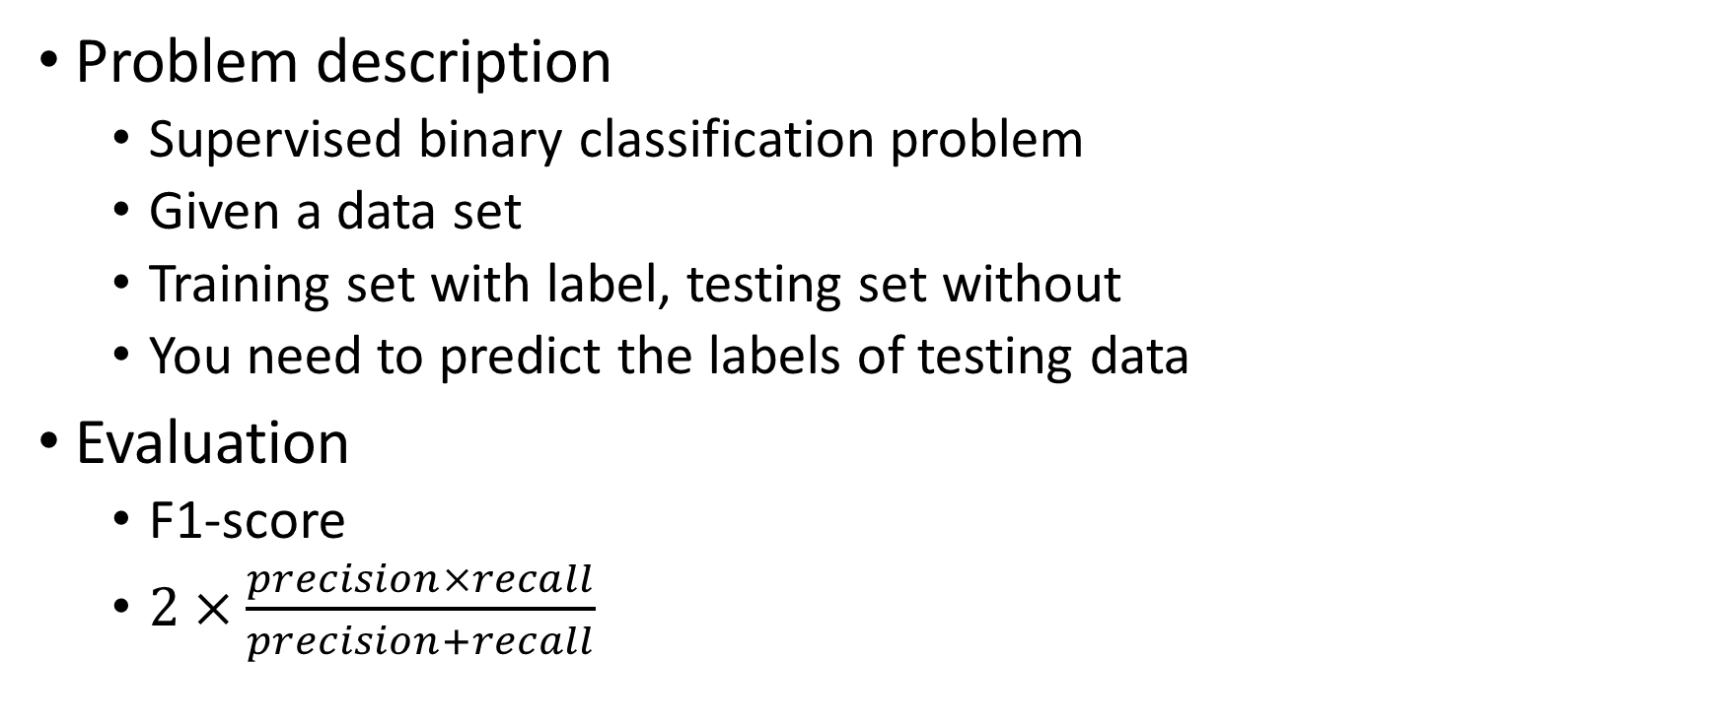
HW3
Problem description
Supervised binary classification problem
Given a data set
Training set with label, testing set without
You need to predict the labels of testing data
Evaluation
F1-score
$2×\frac{precision×recall}{precision+recall}$

Slide 4
Dataset description
The dataset we use is “transformed” from some real dataset
Nominal features are anonymized
Numeric feature are linear transformed
14 numeric features, 13 nominal features
Label imbalance: about 12% positive label

Slide 5
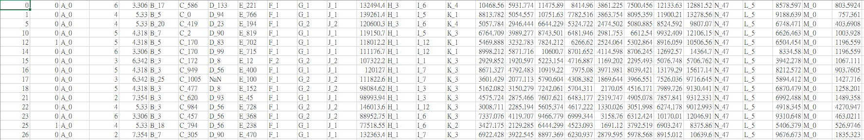
Dataset snapshot – training set
Label
Feature
Unique id for each data object

Slide 6
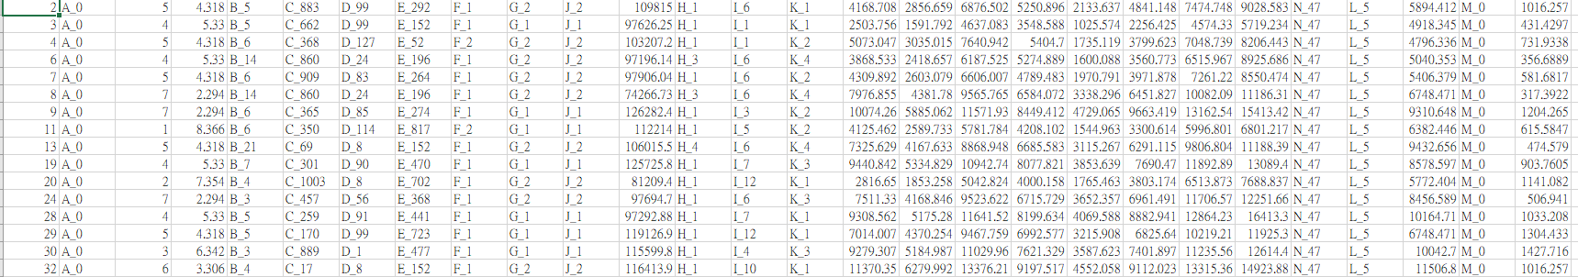
Dataset snapshot – testing set
Feature
Unique id for each data object

Slide 7
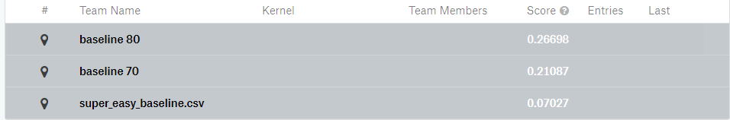
Baseline method
We provide a simple baseline method for your reference
The steps in baseline are as below
Read training/testing data
Fill missing value with mode/mean
One-hot encode nominal features
Train a random forest classifier
Output prediction

Slide 8
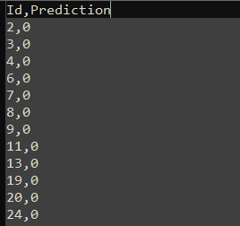
Output format
For each testing instance, there is a unique id
You need to submit you answer to kaggle with the following format 第一行請記得也要output
Id,Prediction
Id1,predition1
Id2,predition2
…

Slide 9
Evaluation
There are two leaderboards in kaggle
Public: can be seen during competition, for reference
Private: used to evaluate, can be seen after competition
0 point, if your private F1-score is worse than baseline 70
One week before deadline (4/30), you will be informed if your private score is worse than baseline 70

Slide 10
Evaluation
You will get 75 points, if your private F1-score is between baseline 70 and baseline 80
For those have scores better than baseline 80
TOP 10% (<=10%): 100
10% ~ 30% (<=30%): 92
30% ~ 60% (<=60%): 86
60% ~ 80% (<=80%): 83
Other: 80

Slide 11
Baseline score in public and private
 | Public | Private
Baseline 80 | 0.26698 | 0.26939
Baseline 70 | 0.21087 | 0.20617
Super easy | 0.07027 | 0.06475

Slide 12
Hints
You can try more techniques for better performance
Feature selection
Dimension reduction (PCA, TSNE)
Try different models
Data augmentation
…
We use private leaderboard as the final score
Use public score to choose your model is dangerous
It’s better to perform validation

Slide 13
Packages you may use
Scikit-learn
https://scikit-learn.org/stable/index.html
Pandas
https://pandas.pydata.org/pandas-docs/stable/
Imbalance learn (for over sampling and down sampling)
https://imbalanced-learn.readthedocs.io/en/stable/

Slide 14
Other rules
You can submit 15 times per day
You can choose 4 predictions for final scoring

