Slide 1
HW5 & HW6
Department of Computer Science
National Tsing Hua University (NTHU)
Hsinchu, Taiwan

Slide 2
HW5
In our example, we use Q-learning, which is a value-based algorithm
In homework 5, you are asked to implement REINFORCE algorithm, which is a policy-based algorithm

Slide 3
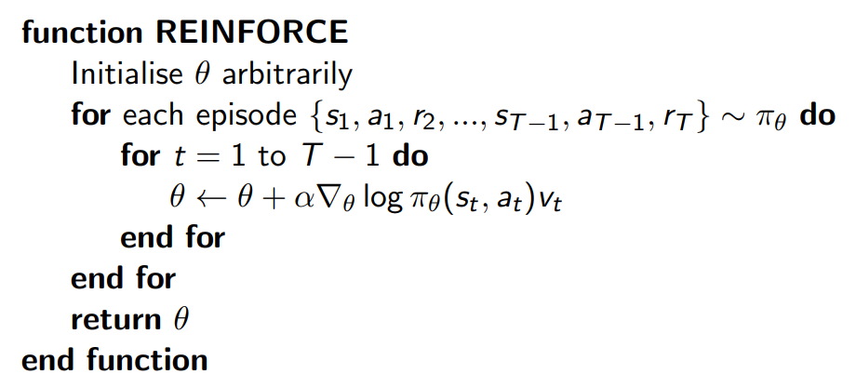
REINFORCE

Slide 4
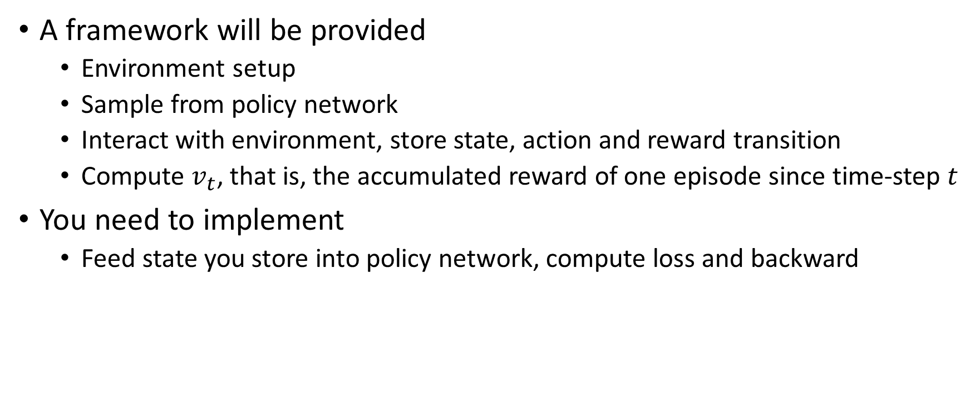
Implementation detail
A framework will be provided
Environment setup
Sample from policy network
Interact with environment, store state, action and reward transition
Compute $v_{t}$, that is, the accumulated reward of one episode since time-step $t$
You need to implement
Feed state you store into policy network, compute loss and backward

Slide 5
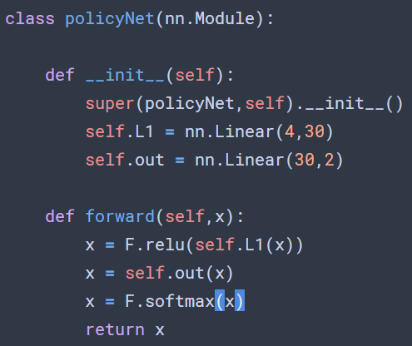
Policy network
Use softmax as activation function
of output layer, map output into probability
distribution

Slide 6
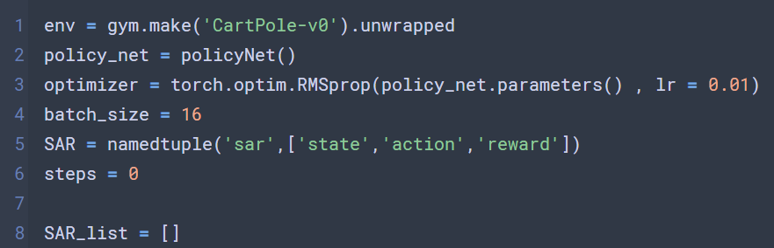
Environment setup
Store state, action, reward transition

Slide 7
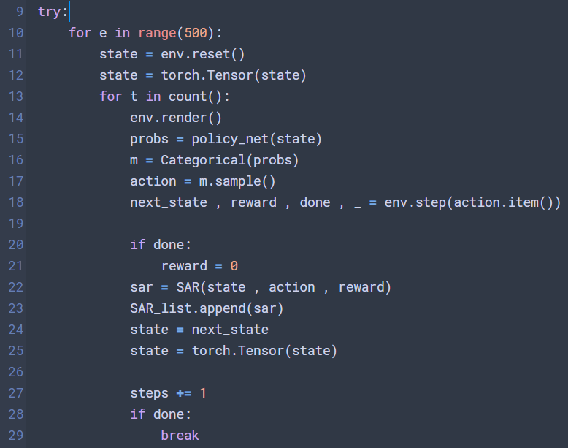
Interact with environment
Sample action
Store transition

Slide 8
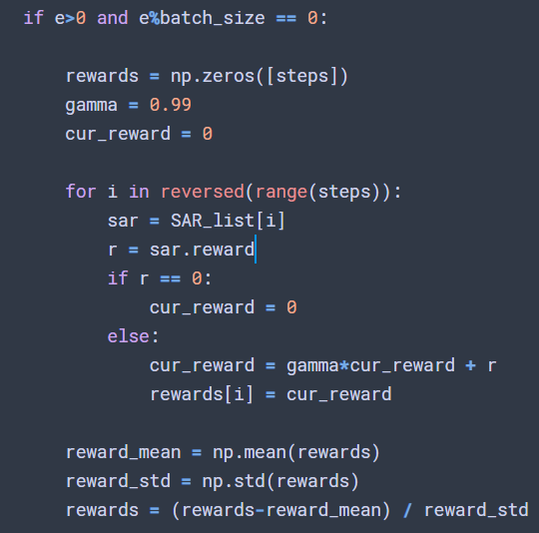

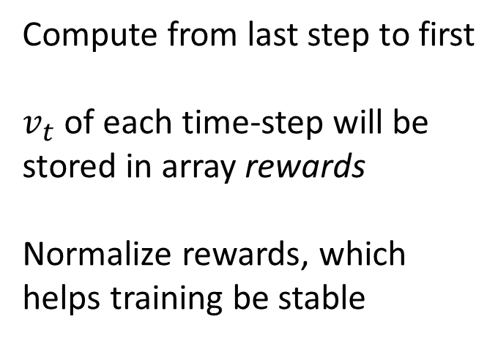
Compute $v_{t}$
Compute from last step to first
$v_{t}$ of each time-step will be stored in array rewards
Normalize rewards, which helps training be stable

Slide 9
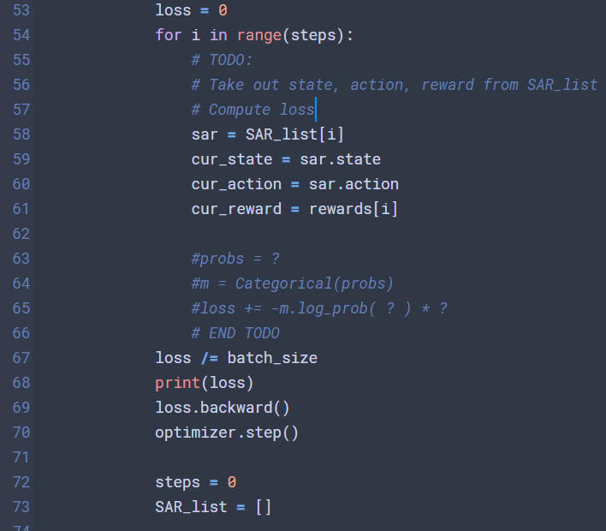
TODO
Update the model based
on REINFORCE algorithm

Slide 10
Trick
將所有episode的transition存在一個List,並讓每個episode結束時的reward為0
這樣更新model時, 會比較方便算出每個action的expected reward

Slide 11
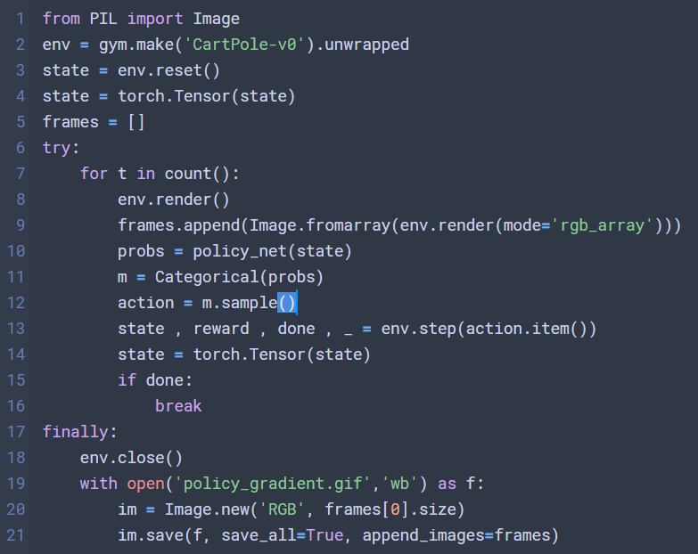
Submission
Code for recording gif
Submit the following files
Your code, can be .py or .ipynb
A gif file, record the result of your agent
A report, can be PDF or docx

Slide 12
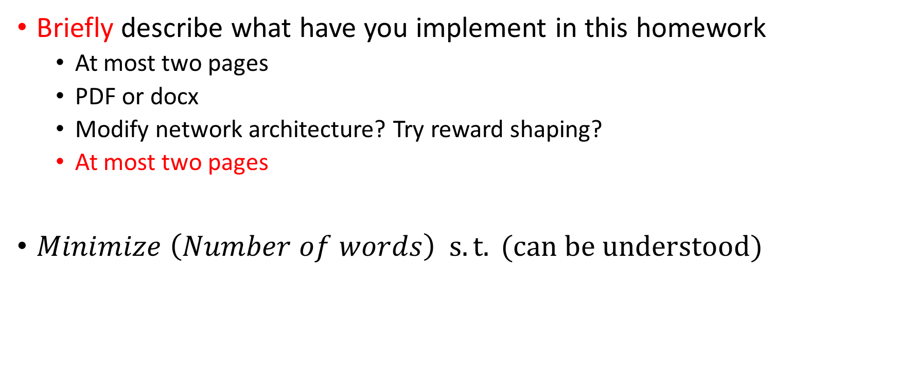
Report
Briefly describe what have you implement in this homework
At most two pages
PDF or docx
Modify network architecture? Try reward shaping?
At most two pages
$Minimize \left(Number of words\right) s.t. (can be understood)$

Slide 13
HW6
In hw6, you need to choose other environment and implement your algorithm (Cartpole can’t be chosen)
You can choose one the following tasks as your homework
Try at least two different kind of reward-shaping (85)
Implement Actor-Critic (95)
Implement Advantage Actor-Critic (A2C) (100)
Implement improved RL algorithm that been proposed in recent years (110)

Slide 14
RL improvement
Improvements to DQN
https://arxiv.org/pdf/1710.02298.pdf
You can choose one of mentioned method in the paper
Improvements to policy gradient
Natural policy gradient/ TRPO / PPO
http://rll.berkeley.edu/deeprlcourse/f17docs/lecture_13_advanced_pg.pdf
Or other methods in papers (2015 after)

Slide 15
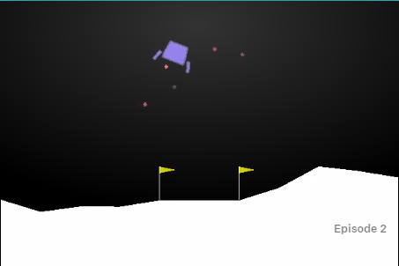
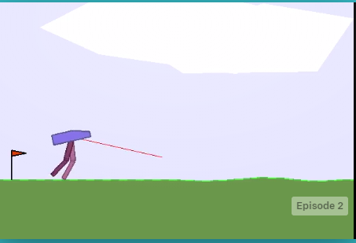
Environment
You can choose one environment from GYM except cartpole
https://github.com/openai/gym/wiki/Table-of-environments

Slide 16
Submission
Submit following files
Your code, can be .py or .ipynb
A gif file, record the result of your agent
A report, can be PDF or docx

Slide 17
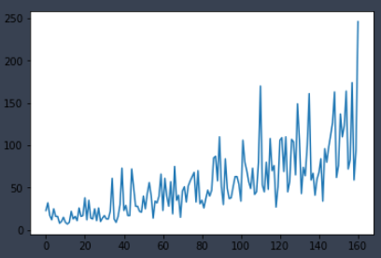
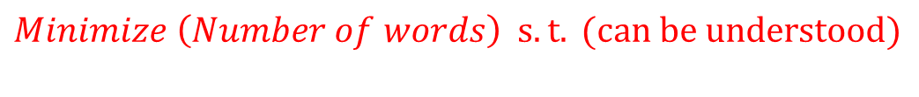
Report
$$Minimize \left(Number of words\right) s.t. (can be understood)$$
You have to describe following things in your report
Which environment you choose
What algorithm have you implemented
How do you implement the algorithm
The different between original algorithm and improved version
For example, you can record reward you get along with training episodes, and show that the improved version is able to
learn faster
Or you can compare the difference between
actor-critic and policy gradient

Slide 18
Report
In order to prove that you have improved the algorithm, you can provide one of following
Compare of original algorithm and improved version with respect to training episode and reward get (plot the figure)
Compare of original algorithm and improved version with respect to final performance (Two GIF file, and discussion the improvement)
Anything else help us know your work

Slide 19
我們會用以下設備測試你們的程式
OS: Ubuntu 16.04
GPU: RTX 2080ti
CPU: Intel-core i9
RAM: 64GB

