Slide 1
HW6 baseline
Department of Computer Science
National Tsing Hua University (NTHU)
Hsinchu, Taiwan

Slide 2
Baseline
Reward shaping on MountainCar-v0
We will provide framework. If
you finish this, you will get 75 score

Slide 3
MountainCar-v0
Observation
Action
Num | Observation | Min | Max
0 | position | -1.2 | 0.6
1 | velocity | -0.07 | 0.07
0 | push left
1 | no push
2 | push right

Slide 4
Reward
-1 for every time step
0.5, if goal position is reach
Goal position is 0.5 (first dimension of observation)
The reward is very sparse

Slide 5
Reward shaping
We have speed and position in the observation
We observe that
Speed is important, the faster, the better
Position is important, we should close to final position. But in order to accelerate, we have to go left side first

Slide 6
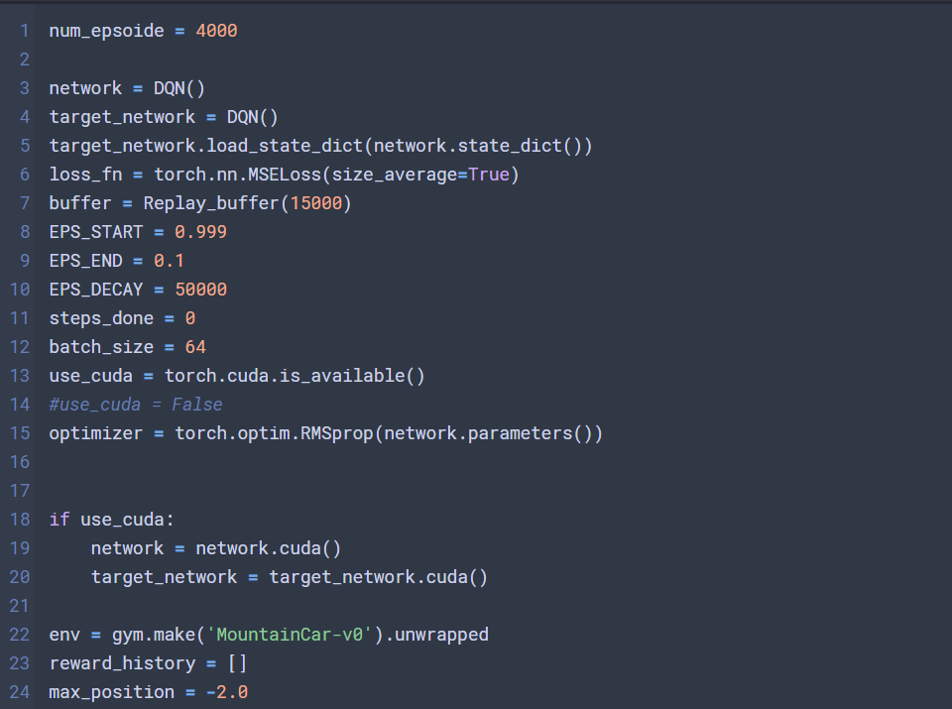
Environment setting
We need to explore more, set EPS_DECAY with a large value

Slide 7
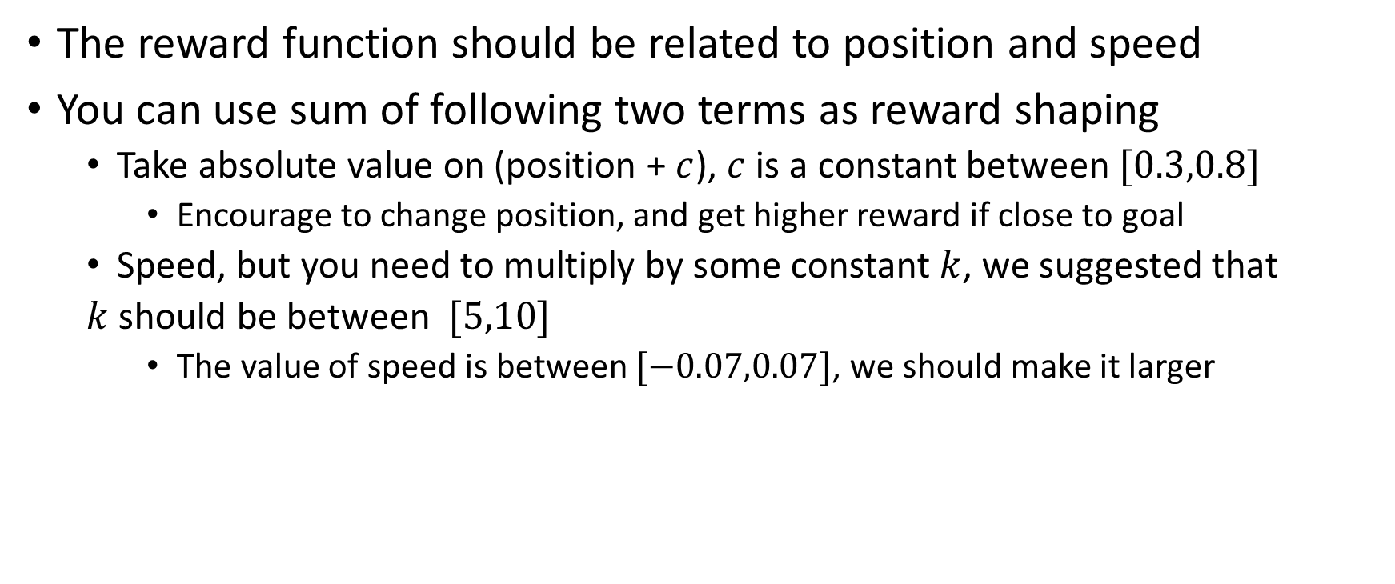
Reward shaping
The reward function should be related to position and speed
You can use sum of following two terms as reward shaping
Take absolute value on (position + $c$), $c$ is a constant between $[0.3,0.8]$
Encourage to change position, and get higher reward if close to goal
Speed, but you need to multiply by some constant $k$, we suggested that
$k$ should be between $[5,10]$
The value of speed is between $[−0.07,0.07]$, we should make it larger

Slide 8
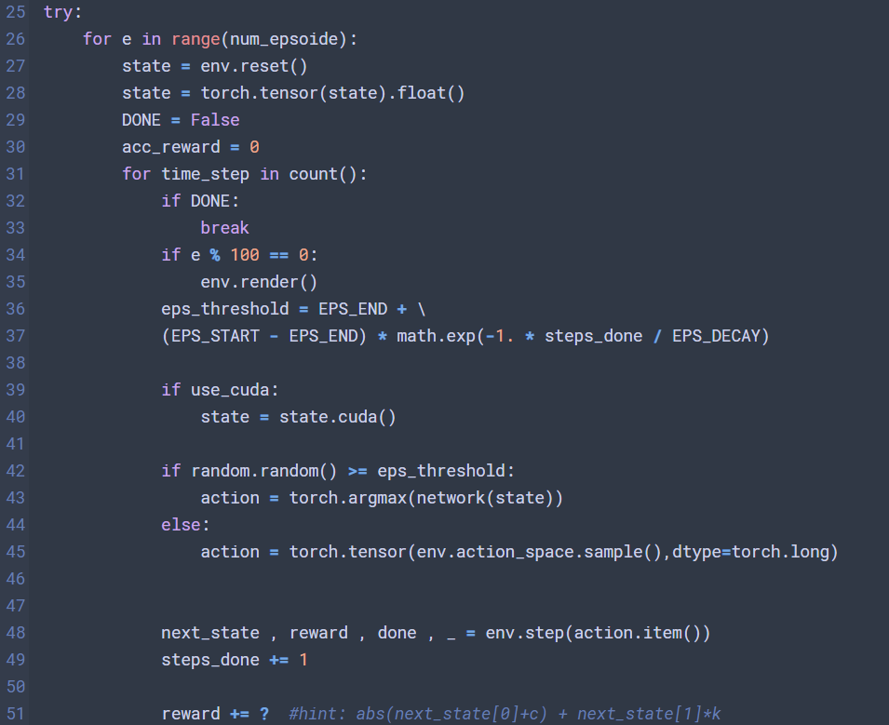
Reward shaping

Slide 9
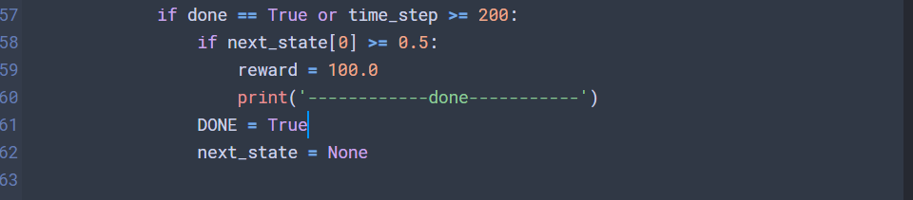
Terminate
If the car reach the goal, the reward should be larger
next_state[0] >= 0.5 means reach the goal

Slide 10
Training result
Training time: about 600 episode

