Slide 1
Predicting Energy Usage in California
-UCI Capstone 2023
Frank Dong, Yang Weng, Nima Hendi, Sean Lee

Slide 2
Agenda
01 UC Irvine Relationship
02 Introduction
03 Data
04 Analysis
05 Prediction & Validation — Visualization
06 Report
07 Additional Support

Slide 3
01 UC Irvine Relationship
Notes:
Meeting 1

Slide 4
Team
UC Irvine:
Accenture:
Frank Dong
Nima Hendi
Yang Weng
Sean Lee
Shawna Tuli
Vishrut Chokshi
Jeff Lu
Ella Liang

Slide 5
02 Introduction
In this project, we want to develop a system to forecast energy usage per sector (residential, commercial, industrial) and per source for California.
Notes:
Meeting 1

Slide 6

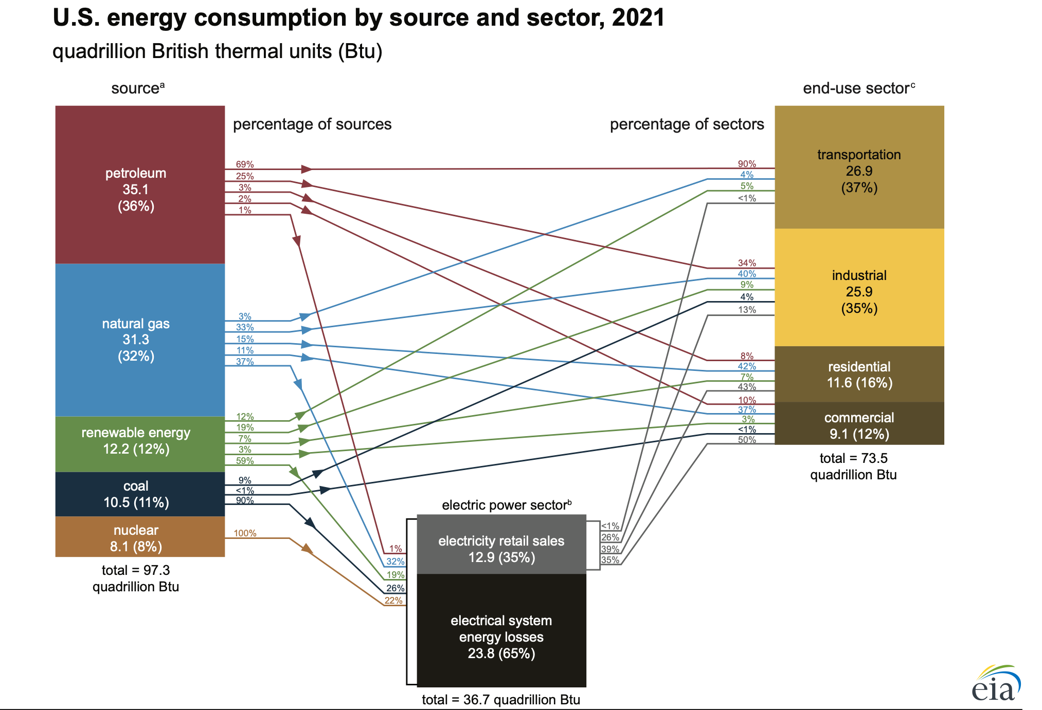
OBJECTIVE
Predicting energy consumption in California based on various price data using machine learning models:
Time Series models such as ARIMA, SARIMAX, Linear, Dense, Multi-Step Dense, and LSTM models
Predictions were made for:
2 years, 5 years, and 10 years into the future
Taking into account factors such as: trends and seasonality, price data, policy changes, and technological advancements.
Source: Energy Information Administration. https://www.eia.gov/energyexplained/us-energy-facts/images/consumption-by-source-and-sector.pdf

Slide 7


SOURCES
Website:
https://www.eia.gov/totalenergy/
Website:
https://www.ca.gov/

Slide 8
Project Process
Scrap and wrangle the data from U.S. Energy Information Administration and California Energy Commission website.
Preprocess the data and store it in SQL database
Build statistical and machine learning models to forecast energy usage per sector and per source
Validate and communicate the results using appropriate visualizations

Slide 9
03 Data
In this project, we will be using data from U.S. Energy Information Administration (https://www.eia.gov/totalenergy/data) and California Energy Commission website (https://www.energy.ca.gov/data-reports). We will be working on datasets that provide yearly energy usage, prices and different needs of resources for different sectors. The data sets will be in CSV and EXCEL formats.
Predicting energy uses:
https://docs.google.com/presentation/d/1zvVwxJ04zf214ujSyKs-WahalehKll8IFVgxumDou5M/edit?usp=sharing
SQL database Github Repository
Notes:
Meeting 2

Slide 10

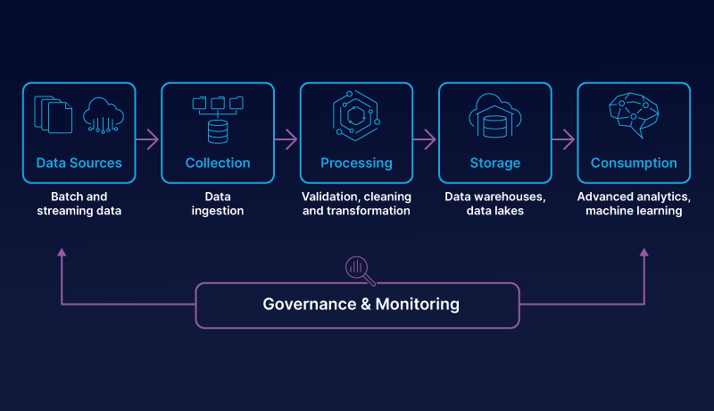
Database (PostgreSql)
Data Pipeline
DATABASE AND PIPELINES
Concatenate data from different sources
Transform the data base to be list of features
Convert the data to machine readable formate
Manual inspection to NA data
Data Normalization
Database store more than three hundred different features, combined from different category of energy uses, and price.
Data are linked together by MSN index, MSN translation included in data file.
Independent variable: price and consumption table named (Price_CA, Use_energy_source)
Target variable: 5 energy source table and 5 energy sector table.

Slide 11
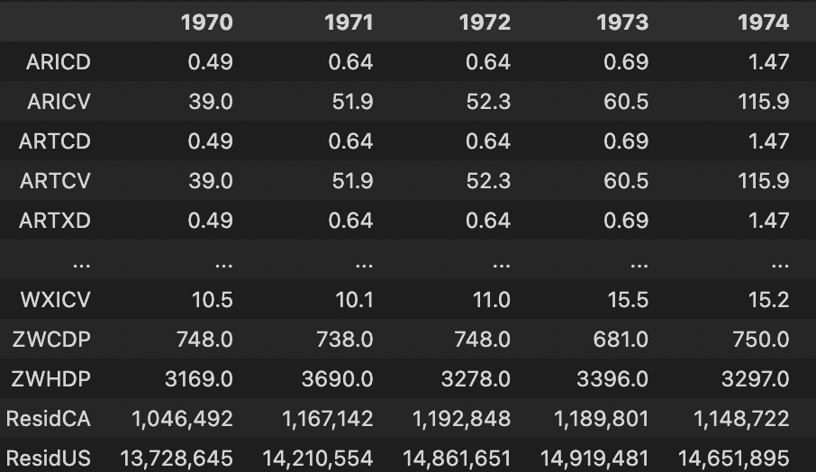
Sample:
Residential Energy Consumption Prediction vs price features (named in MSB index):
Predict next year(or specified year) energy consumption based on other given prices.

Slide 12
Sample (unnormalized):
Residential Energy Consumption Prediction vs price features (named in MSB index):
Predict next year(or specified year) energy consumption based on other given prices.
Years | ARICD | … | ZWCDP | Residential CA
1970 | 0.49 | … | 3169 | 1192848
… | … | … | … | …
2020 | 12.56 | … | 2539 | 1507721

Slide 13

Feature Explanation
"DFSCB":"Distillate fuel oil total consumption adjusted for process fuel."
"ESSCB":"Electricity total consumption adjusted for process fuel."
"NGRCV":"Natural gas expenditures in the residential sector"
"OPISB":"Other petroleum products consumed by the industrial sector excluding refinery fuel and intermediate products."
"TEPFB":"Total energy used as process fuel and other consumption that has no direct fuel costs"
"TNSCB":"Total net energy consumption"
"WWIXB" : "Wood and waste consumed by the industrial sector, at no cost."

Slide 14
04 Analysis
Notes:
Meeting 3

Slide 15
Data Preprocessing
Split training and test data (45 years training, 5 years validation)
Eliminate features that are similar. Pick high confident features, by linear regression.
Removed features that were the same except in different units.

Slide 16
Performance Metric Definitions
Mean Squared Error (MSE) is a popular statistical metric used to evaluate the accuracy and precision of models in various fields. It measures the average of the squared differences between predicted and actual values in a dataset.
MAPE (Mean Absolute Percentage Error) is a commonly used metric in forecasting and time series analysis to measure the accuracy of a model's predictions as a percentage of the actual values.

Slide 17
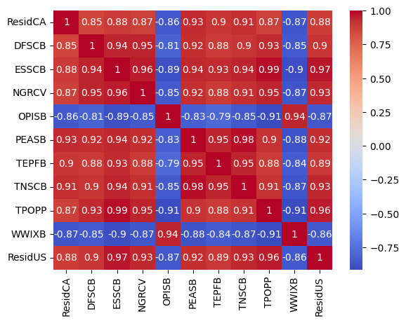
Correlation analysis
Two year Residential Sector Prediction Sample
Select features with high correlation with target (>0.85)
Eliminate duplicate features:
# TNASB & PEASB
# OPSCB & OPISB
Manual cluster

Slide 18
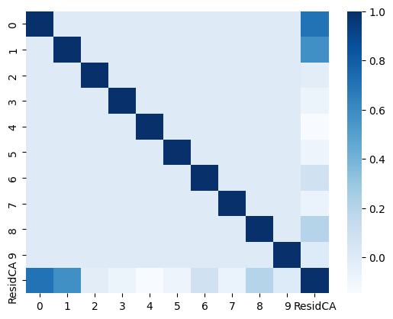
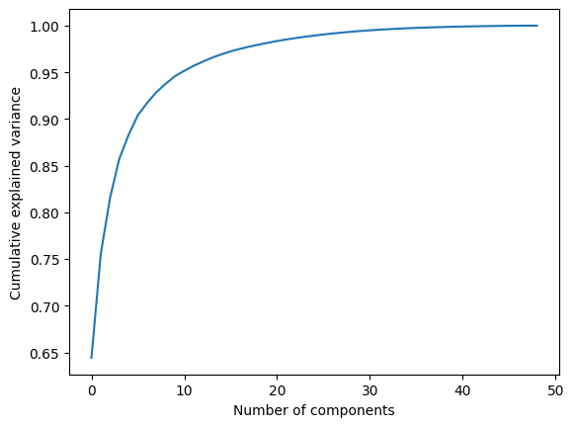
PCA analysis
Select 10 as hyperparameter for pca analysis

Slide 19
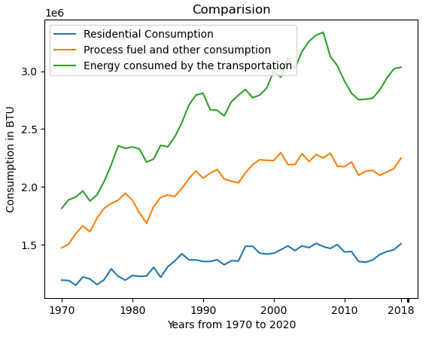
Sample Relation
Residential Consumption in CA
Residential consumption Compare with main features

Slide 20
05 Prediction & Validation
— Visualization
# still working

Slide 21

SARIMAX
SARIMAX, short for Seasonal Autoregressive Integrated Moving Average with Exogenous Variables, is a time series forecasting model that extends the traditional ARIMA model to incorporate seasonality and exogenous variables. It is a powerful tool for analyzing and forecasting time series data that exhibits seasonal patterns and is influenced by external factors.
SARIMAX is generally preferred when the data exhibits clear seasonal patterns and there are known external factors that influence the time series.
It relies on the assumption that future values depend on past values and can capture linear relationships.

Slide 22
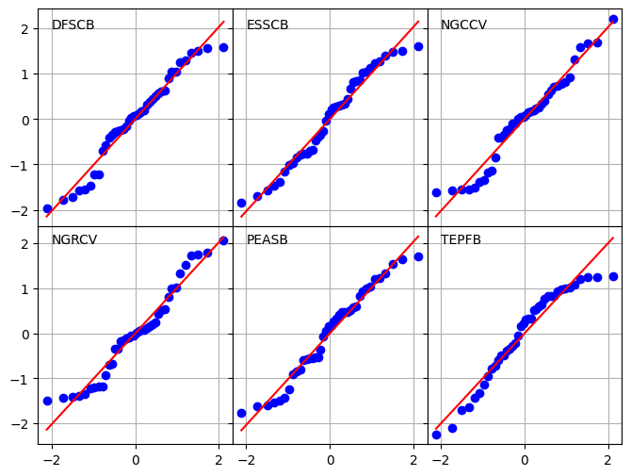
SARIMAX Assumption

Slide 23
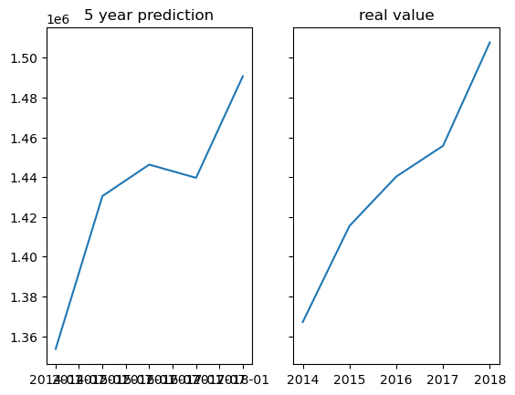
SARIMAX Prediction & Validation
5 year prediction based on pca data

Slide 24
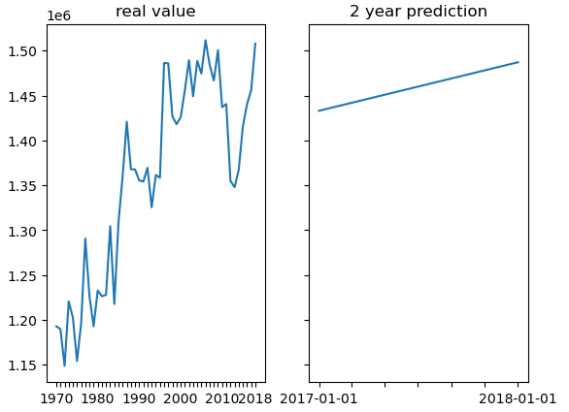
SARIMAX Prediction
2 year prediction based on top feature data

Slide 25
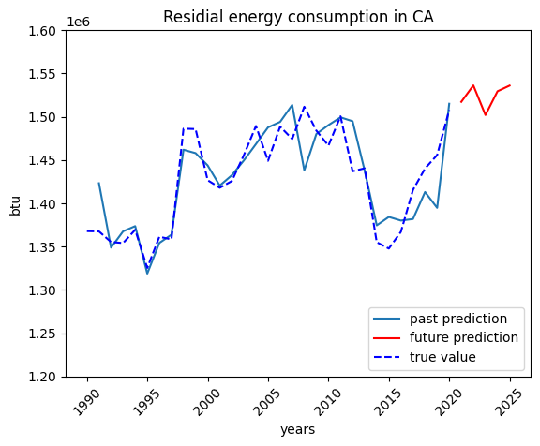
SARIMAX Prediction
5 year prediction based on top feature data

Slide 26
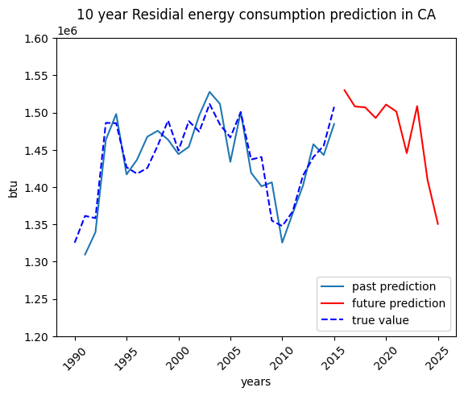
SARIMAX Prediction
10 year prediction based on top feature data

Slide 27
06 Report

Slide 28
Key Outcomes
This analysis identified an accurate model for yearly data prediction with seasonal pattern and identified top factors

Slide 29
The most accurate model for yearly prediction
SARIMAX perform the best over other stats models and machine learning models
Able to apply this model on other Energy Source and Sector, even other states. (Data trained based on the US.)
Residential energy consumption will keep in high level for 5 years, and will have a sharp decrease in 10 years.

Slide 30
Top features for Residential Energy Consumption
Resident population
Electric total consumption
Natural Gas expenditures
Total net energy consumption
Natural Gas expenditures in residential sector
Natural Gas expenditures in commercial sector
Natural Gas is still the most important energy source for CA residents’ daily lives.

Slide 31
07 Additional Support
LSTM
Decision Tree
Linear Regression

Slide 32
LSTM
LSTM, short for Long Short-Term Memory, is a type of recurrent neural network (RNN) architecture that has gained significant popularity in the field of deep learning, particularly for modeling sequential data. It is designed to address the vanishing gradient problem of traditional RNNs, allowing it to capture long-term dependencies in time series or sequential data.
LSTM, on the other hand, is a type of recurrent neural network (RNN) that can model complex nonlinear relationships in time series data. It can capture long-term dependencies and has the ability to learn and extract features from raw data without manual feature engineering.
Do not fit for small seasonal data, causes underfitting due to yearly data.

Slide 33
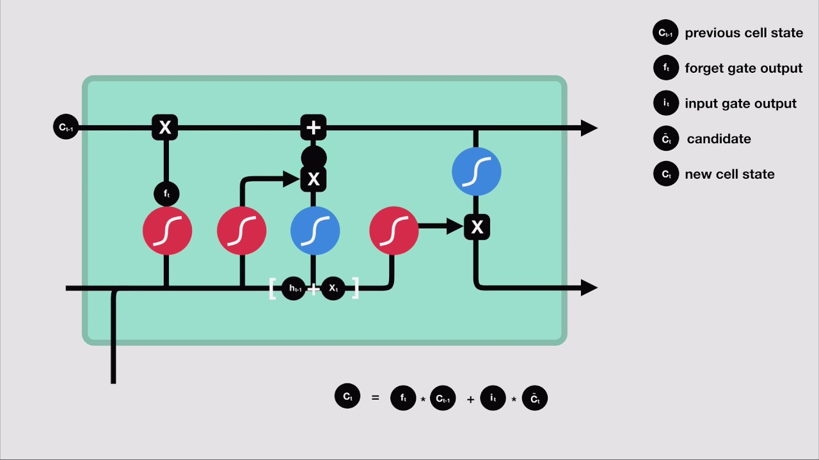
LSTM

Slide 34
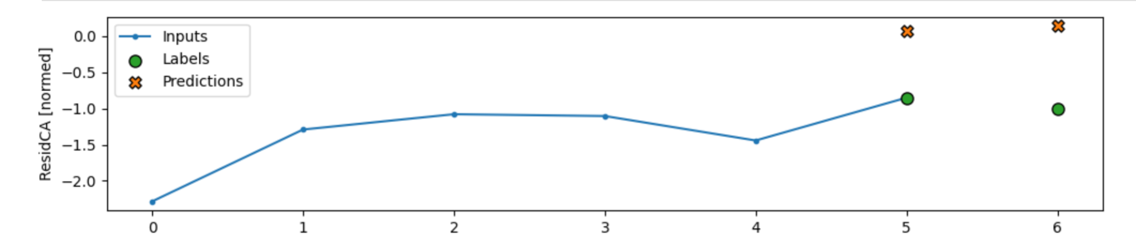
LSTM Prediction & Validation
2 year prediction

Slide 35
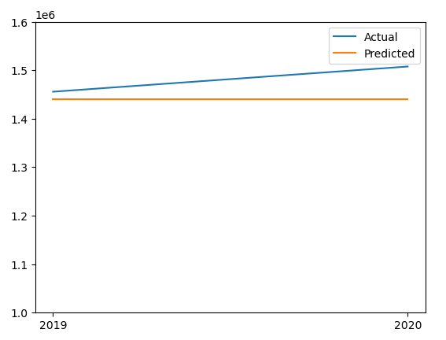

Decision Tree Prediction & Validation
2 year prediction
MAPE: 0.027555422500944136

Slide 36
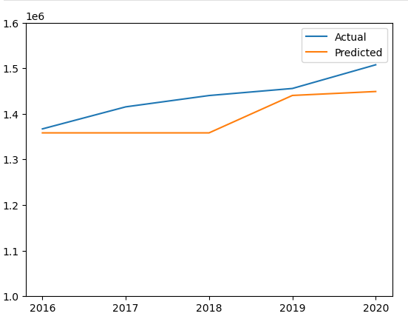
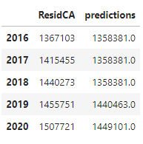
Decision Tree Prediction & Validation
5 year prediction
MAPE: 0.03058845284341623

Slide 37
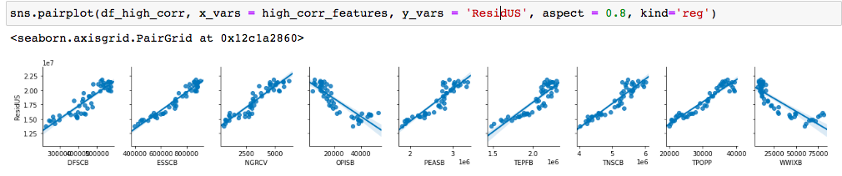
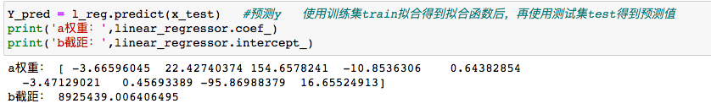
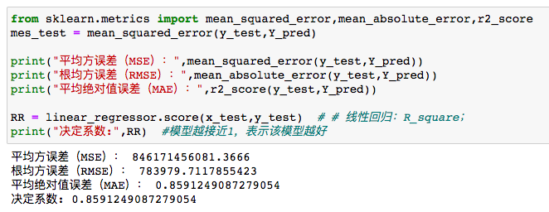
LinearRegression
Prediction
Nine variables were selected and explored for their relationship with ResidUS, positive or negative correlation. The regression model derived using LinearRegression with scikit-learn was then used. The weights and constant term values of each variable were obtained and tested by each coefficient.

Slide 38
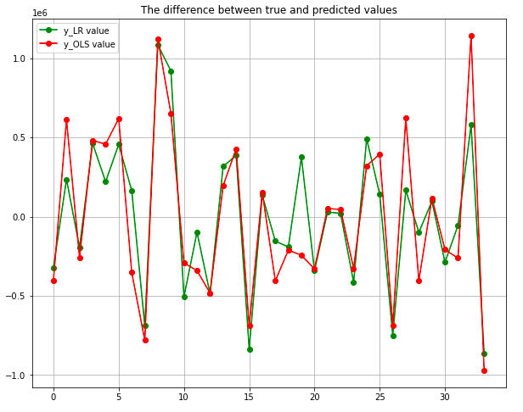
LinearRegression
Prediction
The regression was built using the OLS model that is statsmodel and compared with LinearRegression.
By comparing the difference between the predicted and true values of the two models and drawing line graphs of the values
The difference between the predicted and true values of LinearRegression model is smaller and the model is more accurate.

