Slide 1
Massage
Shawna tuli
(shawna.tuli@avanade.com)
Northern california wellness

Slide 2
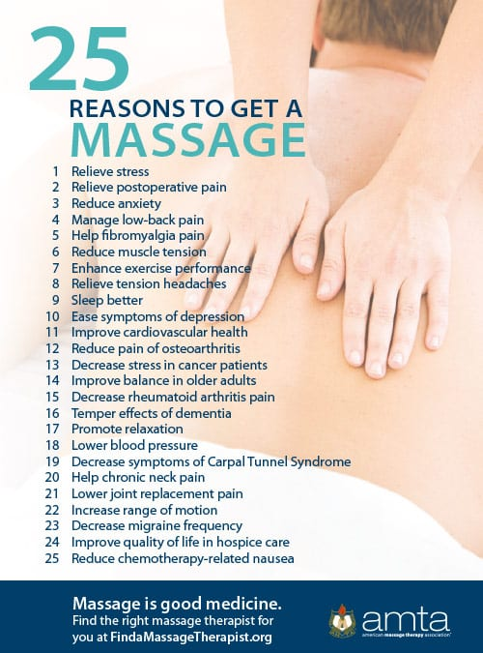

Slide 3
