Slide 1
Node JS
Shawn Aten, Sohail Baig, Sofian Baig,
Ruben Garcia, Jason Wang

Slide 2
What is Node JS
Node.js is an open-source, cross-platform runtime environment for developing server-side web applications. Node.js applications are written in JavaScript and have many advantages.
Web development in a dynamic language (JavaScript) on a VM that is incredibly fast (V8). It is much faster than Ruby, Python, or Perl.
Ability to handle thousands of concurrent connections with minimal overhead on a single process.
JavaScript is perfect for event loops with first class function objects and closures. People already know how to use it this way having used it in the browser to respond to user initiated events.
A lot of people already know JavaScript, even people who do not claim to be programmers. It is arguably the most popular programming language.
Using JavaScript on a web server as well as the browser reduces the impedance mismatch between the two programming environments which can communicate data structures via JSON that work the same on both sides of the equation. Duplicate form validation code can be shared between server and client, etc.

Slide 3
NoSQL(MangoDB)
Schema less : MongoDB is document database in which one collection holds different documents. Number of fields, content and size of the document can be differ from one document to another.
While SQL will have multiple tables MongoDB schema design will have one collection post.

Slide 4
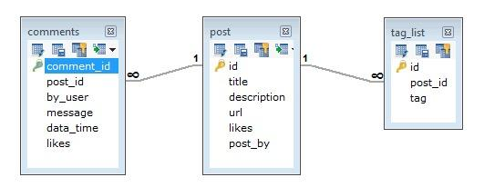
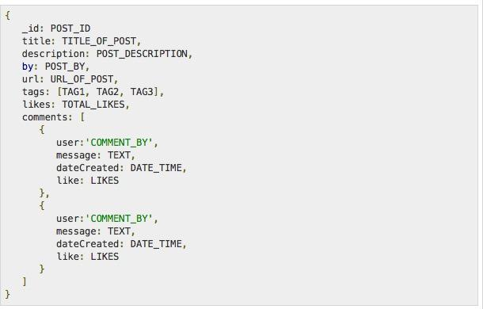
SQL vs NoSQL(MangoDB)

Slide 5
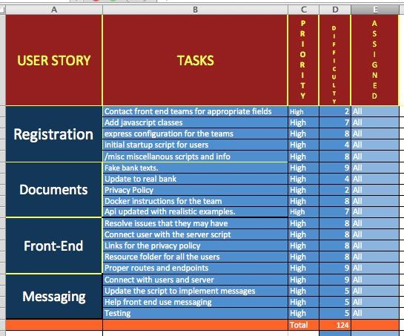
Backlog

Slide 6
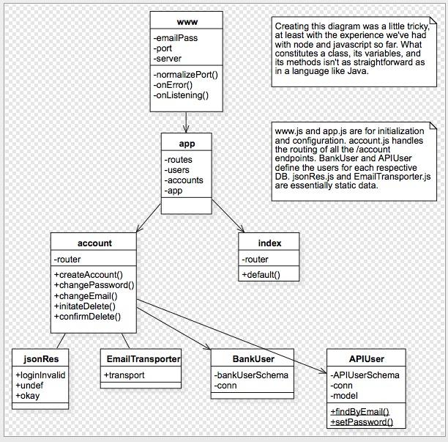
Class Diagrams

Slide 7
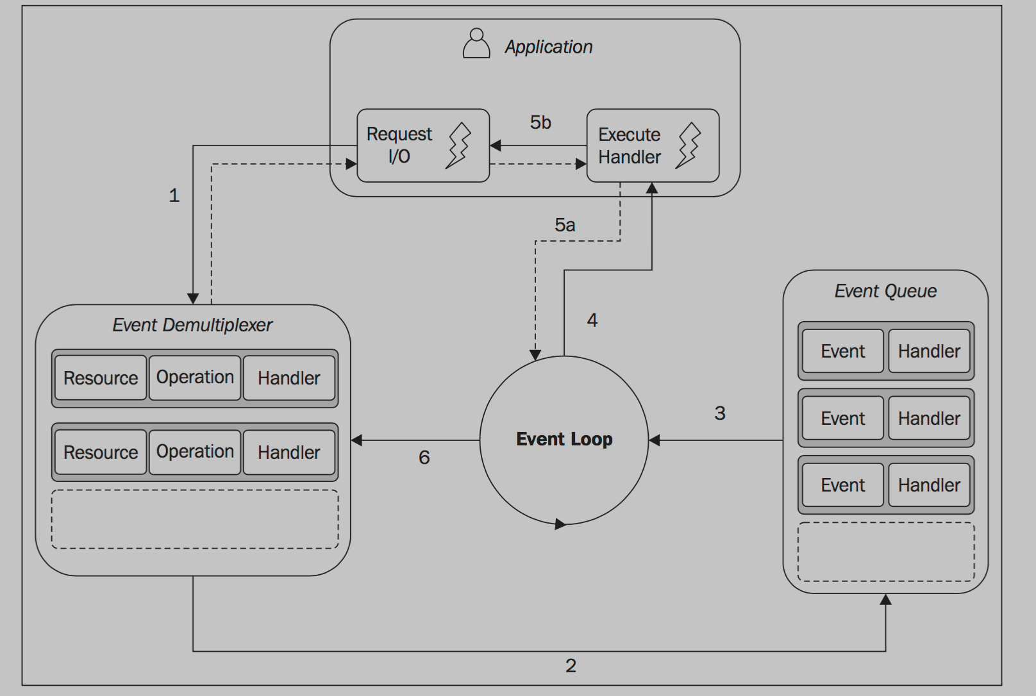
Reactor Pattern
Main Concepts - Single Threaded Architecture and Non-Blocking IO
BusyWaiting is not an efficient technique for processing non-blocking resources, thus a Synchronous Event Demultiplexer is used which allows us to collect and queues I/O events that come from a set of watched resources, and block until new events are available to process
The main idea is to have a Handler which is the NodeJS associated with each IO operation which will be invoked as soon as the event is produced and processed by the event loop
Asynchronous behavior : the application expresses the interest to access a resource at one point in time (without blocking) and provides a handler, which will then be invoked at another point in time when the operation completes.

Slide 8
Reactor Pattern: what happens
The application generates a new I/O operation by submitting a request to the Event Demultiplexer. The application also specifies a handler, which will be invoked when the operation completes.
(Submitting a new request to the Event Demultiplexer is a non-blocking call and it immediately returns the control back to the application)
When a set of I/O operations completes, the Event Demultiplexer pushes the new events into the Event Queue.
At this point, the Event Loop iterates over the items of the Event Queue.
For each event, the associated handler is invoked.
The handler, which is part of the application code, will give back the control to the Event Loop when its execution completes (5a). (However, new asynchronous operations might be requested during the execution of the handler (5b), causing new operations to be inserted in the Event Demultiplexer (1), before the control is given back to the Event Loop).
When all the items in the Event Queue are processed, the loop will block again on the Event Demultiplexer which will then trigger another cycle.

Slide 9
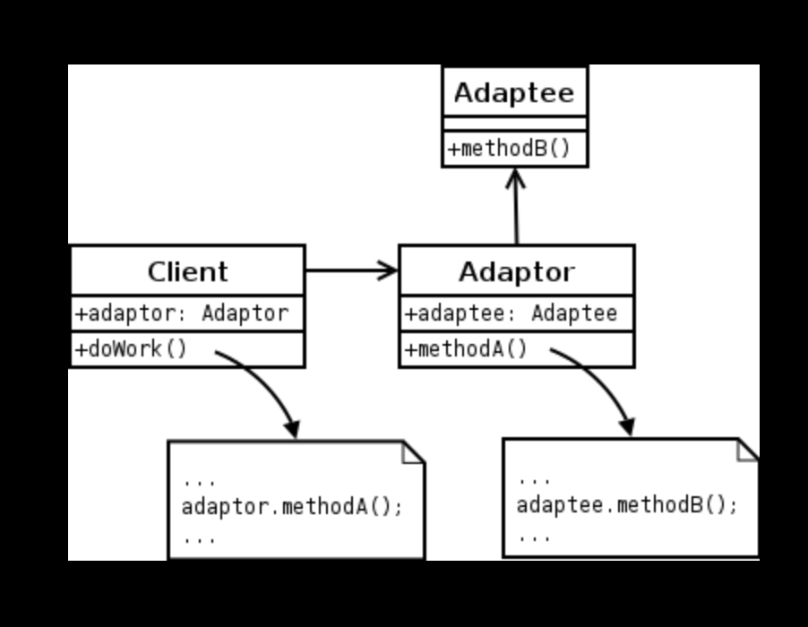
Adapter Pattern
Pattern was implemented for Chat Function
Simply to allow the interface of an existing class to be used from another interface. This way we can have existing classes work with others without modifying their source code.

Slide 10
Project API specs
Account Endpoints
Create account
Change Password
Change Email
Initiate and confirm account deletion

Slide 11
Registration
Server takes: Bank ID, Social, Name and E-Mail
Possible Error Messages:
"user not found"
"account exists"
Notes: If the temp password is not changed within 10 minutes the username is freed and you must start over.

Slide 12
Change Password or E-Mail
To change password (Enter Old Password, New Password, Confirm New Password)
Possible Error Causes:
"login invalid"
Notes: This applies to both changing your temporary password or a previously set password.
To Change E-Mail (Enter Old E-Mail Password and New E-Mail)
Possible Error Causes:
"login invalid"
"new-email invalid"

Slide 13
Real Time Chat ?
SocketIO: using a client side ‘emit’ method and ‘broadcast’ method on the server side

Slide 14
Everything is on GitHub
https://github.com/shawnaten/utsa-cs-4733-restful-node/blob/master/docs/api_spec.md
GitHub
shawnaten/utsa-cs-4733-restful-node
utsa-cs-4733-restful-node - RESTful node API for UTSA CS 4773 group project.
Android App with initial login setup:
Android App Repo

