Slide 1
CprE 381: Computer Organization and Assembly Level Programming
Lab Week 3 VHDL
Henry Duwe
Electrical and Computer Engineering
Iowa State University
Notes:
Learning Objectives:
Students should know that VHDL is a specific HDL for _describing_ hardware.
Students should be able to described three different ways to model hardware in VHDL – structural, dataflow, and behavioral.
Students should be able to develop a VHDL testbench.

Slide 2
Model Truth Table Part I
Use with select… when statement (FreeRange VHDL Listing 4.13 for full file)
entity my_4t1_mux is
port (D3,D2,D1,D0 : in std_logic;
SEL : in std_logic_vector(1 downto 0);
MX_OUT : out std_logic);
end my_4t1_mux;
architecture mux4t1 of my_4t1_mux is
begin
with SEL select
MX_OUT <= D3 when “11”,
D2 when “10”,
D1 when “01”,
D0 when “00”,
‘0’ when others;
end mux4t1;

Slide 3
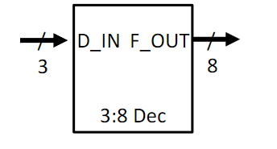
Model Truth Table Part II
Use with select … when statement
(FreeRange VHDL Listing 13.10 for more information)
with D_IN select
F_OUT <= “00000001” when “000”,
“00000010” when “001”,
“00000100” when “010”,
“00001000” when “011”,
“00010000” when “100”,
“00100000” when “101”,
“01000000” when “110”,
“10000000” when “111”,
“00000000” when others;

Slide 4
Others
Use with others assignment (FreeRange VHDL 10.2 for more information)
with SEL select
s_mux_result <= D0 when ‘0’,
D1 when ‘1’,
(others => ‘0’) when others
The model for the 2:1 MUX uses the terminology (others => '0'). This is a short-hand terminology for assigning all of the outputs to '0'.
The neat part about this instruction is that you do not need to know how many 0's you need to write. If the width of the associated bundle were to change, this particular line of code would not need to be modified.

Slide 5
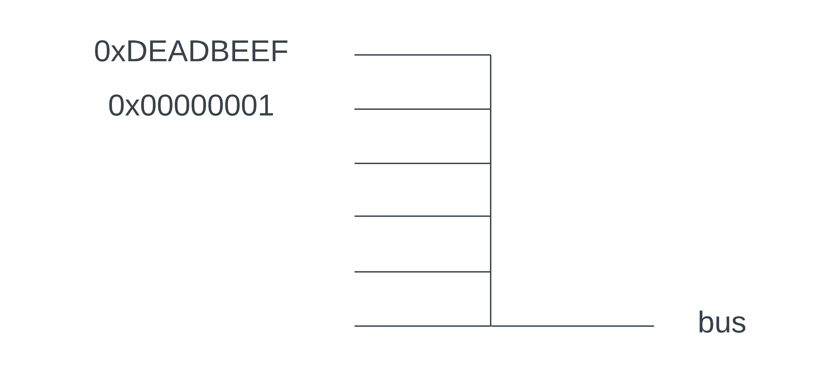
User-Defined Types
Use Custom types for simplification and organization (FreeRange VHDL 11.6 for more information)
type bus_t is array(3 downto 0) of std_logic_vector(31 downto 0);
Signal mux_bus : bus_t;
mux_bux(0) <= x”DEADBEEF”;
Mux_bus(1) <= x”00000001”;
This syntax is handy for large groups of signals and can reduce clutter within your code. Can be especially powerful when paired with generate loops to individually connect multiple components.

Slide 6
Packages Part I
my_package.vhd
package my_package is
constant four_bit_zero : std_logic_vector := "0000";
type t_bus_2x32 is array (0 to 1) of std_logic_vector(31 downto 0);
end package my_package;
Similar to header file in C, you can define custom data types, set constants, or even define functions
This file will need to be referenced in your subsequent component files to be useful and it always needs to be compiled before the dependent files.

Slide 7
User-Defined Types
Mux32b2t1.vhd
use work.my_package.all;
use IEEE.numeric.std. all;
entity big_mux is
port( data : in t_bus_2x32;
sel : in std_logic_vector(0 downto 0);
out : out std_logic_vector(31 downto 0));
end big_mux;
architecture dataflow of big_mux is
begin
out <=data(to_integer(unsigned(sel)));
end dataflow
*Notice we had to import our package
use the syntax "use work.my_package.all;".

