Slide 1
CprE 381: Computer Organization and Assembly Level Programming
Lab Week 4 VHDL
Henry Duwe
Electrical and Computer Engineering
Iowa State University
Notes:
Learning Objectives:
Students should know how the memory module provided in lab operates
Students should be able to described the differences between word and byte addressable memory
Students should be able to understand the model hierarchy during questa-sim simulation
Students should be able to initialize and set memory values during simulation

Slide 2
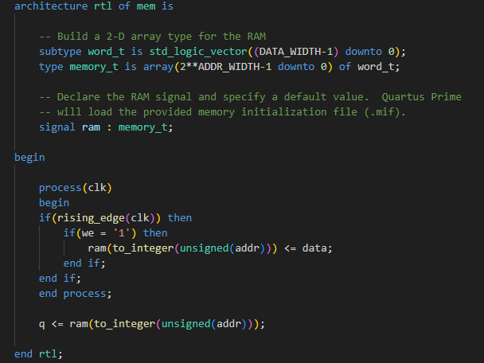
Modeling Memory in VHDL
Notes:
Brief overview of the provided memory unit, might want to point out some keywords, but a better breakdown will come in the next few slides

Slide 3
Modeling Memory in VHDL
Defining data type
Instantiation
Notes:
First, tie back the components of this module to what was learned in the previous weeks.
Firstly, we are defining two custom data types, we use the keyword subtype here, but we easily could just replace “of word_t” with “of std_logic_vector(DATA_WIDTH-1 downto 0)” like we did last week
Second, we initialize the memory, it should generate physical components. We can access the different elements of this component as shown within the process statement

Slide 4
Modeling Memory in VHDL
Synchronous write
Asynchronous read
Notes:
*Highlight when things change within this memory module
* Notice that we have both synchronous and asynchronous pieces in this module, we can perform our reads without waiting for the clock!

Slide 5
Word Vs. Byte Addressable memory
Word Addressable
- This is the format provided in lab
- Must read/write 4 bytes at a time
- Only 4 addresses (0x00-0x03)
-Big Endian format
Byte Addressable
- This is the format RISC-V uses
- Can read/write to individual bits
- 16 addresses
(0x00-0x0F)
00 | 0x14120900
01 | 0x44220215
10 | 0xFFFFFFFF
11 | 0x00000000
 | 00 | 01 | 10 | 11
00 | 0x00 | 0x09 | 0x12 | 0x14
01 | 0x15 | 0x02 | 0x22 | 0x44
10 | 0xFF | 0xFF | 0xFF | 0xFF
11 | 0x00 | 0x00 | 0x00 | 0x00
Notes:
Both tables correspond to the exact same memory
The word addressable size is stored in big endian format similar to MARS, but this can be up to the designer.
Notice the memory size is the same, but the number of valid addresses is different
How would you go about making word addressable memory operate the same as byte addressable memory, is it possible?

Slide 6

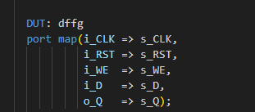
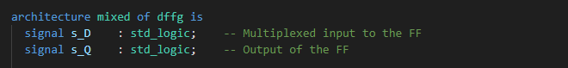
Simulation Hierarchy
Simulated Entity
Notes:
The purpose of this slide is to highlight key parts of the VHDL and to use in conjunction with the next slide in order to draw the parallel between the names given in the code, vs. what they see in questasim

Slide 7
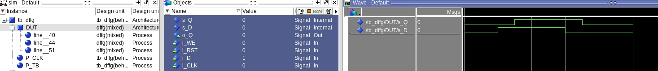
Simulation Hierarchy
Simulated Entity

Slide 8
Simulation Hierarchy
Simulated Entity
Component Instantiation
Notes:
The purpose of this slide is to highlight key parts of the VHDL and to use in conjunction with the next slide in order to draw the parallel between the names given in the code, vs. what they see in questasim

Slide 9
Simulation Hierarchy
Component Instantiation
Simulated Entity

Slide 10
Simulation Hierarchy
Simulated Entity
Component Instantiation
Internal Signals
Notes:
The purpose of this slide is to highlight key parts of the VHDL and to use in conjunction with the next slide in order to draw the parallel between the names given in the code, vs. what they see in questasim

Slide 11
Simulation Hierarchy
Internal Signals
Component Instantiation
Internal Ports
Simulated Entity
You can find the address of a component by following this hierarchy
Ex, the address of the internal signal s_Q is “/tb_dffg/DUT/s_Q”

Slide 12
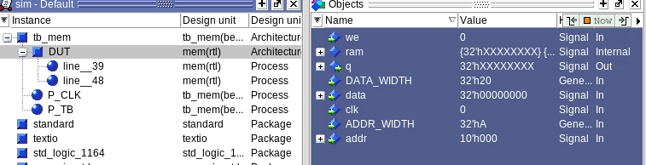
Initializing memory
mem load –infile {path to memory file} – format hex {path in simulated hierarchy}
Our goal in this case is to initialize the RAM signal, so we should use the address
/tb_mem/DUT/RAM
Notes:
This slide draws from the previous slide, it is just easier to read, and shows our specific goal for this lab.

